Slide 1
Policy Context Wales : Well Being of Future Generations (Wales) Act 2015
SJEQ7004
Sustainable Communities: Equality in Action

Slide 2
Well Being of Future Generations (Wales) Act 2015
The act came into force on 1st April 2016 and is about improving the social, economic, environmental and cultural wellbeing of Wales.
It will make the public bodies listed in the Act think more about the long-term, work better with people and communities and each other, look to prevent problems and take a more joined-up approach.

Slide 3
Well Being of Future Generations (Wales) Act 2015
The Well-being of Future Generations (Wales) Act is viewed as one of the most holistic pieces of sustainable legislation to be passed worldwide, with the aim of securing future-justice, for the well-being of current and future generations.
The Act identifies goals and objectives to improve the well-being of people in Wales.
The Act introduces national indicators that measure the difference being made to well-being with the aim to move beyond GDP.
The Act establishes a statutory Future Generations Commissioner for Wales, whose role is to act as a guardian for the interests of future generations in Wales, and to support the public bodies listed in the Act to work towards achieving well-being goals.
The Act outlines local service boards and well-being plans, as well as simplifying requirements for integrated community planning.

Slide 4
Well Being of Future Generations (Wales) Act 2015
http://thewaleswewant.co.uk/about/well-being-future-generations-wales-act-2015

Slide 5
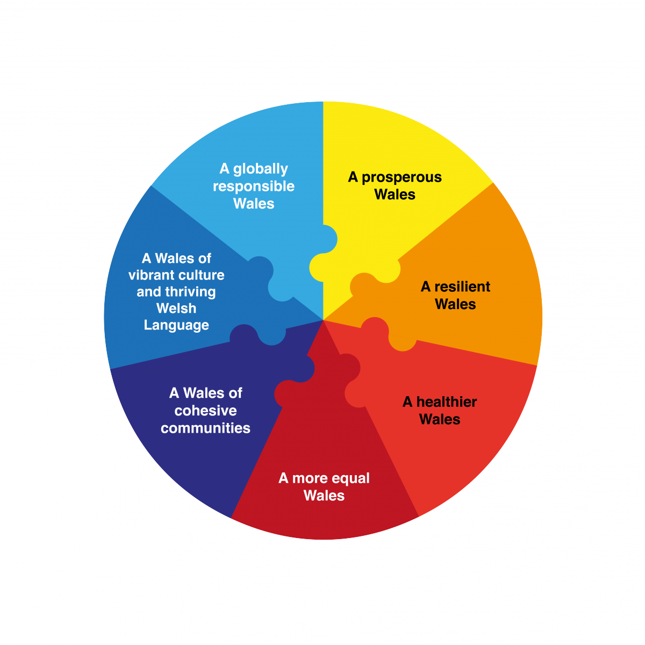
Well Being of Future Generations (Wales) Act 2015
“Wales faces a number of challenges now and in the future, such as climate change, poverty, health inequalities and jobs and growth”. (Welsh Government 2016)
Split in to small groups: choose one or two of the well being goals and discuss
The implication of the goal in relation to the promotion “sustainable communities”
What the challenges might be in implementing and measuring the goal/s
What are the implications in relation to promoting a more equal and just society?

Slide 6
Issues to consider…?
The Act would appear to place increasing responsibility for communities to influence adaptation options in their own areas in the face of climate, social, economic and cultural issues; to what extent is this a positive or negative thing?
Welsh Government have outlined in the act that community participation and transparency is important? Do you think this is achievable? What might be the challenges?
Will the act help to increase the adaptive capacity (e.g. climate change, social and economic issues) of all our communities in Wales through its policy and strategies.
Does the Act address fully sustainability issues?

