Slide 1
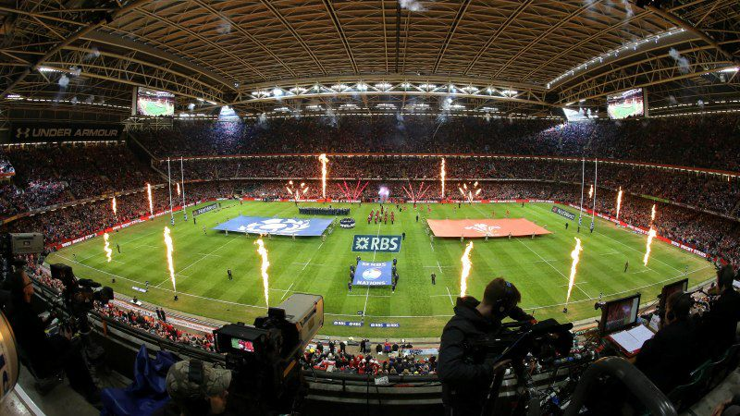
The Events Industry
Week Four
Event Market Segmentation

Slide 2
Last week
Attendee motivations for participating in events
Buyer behaviour and decision-making
Event satisfaction, how can it be measured
Start of event checklists

Slide 3
The consumer experience - reminder
Consider the event you are to attend/have attended
Design a checklist which will aid your observation of the event as an event manager/researcher
Make sure you consider elements of consumer experience, motivation and marketing effectiveness
A useful tool here is www.eventimpacts.com

Slide 4
Session Outcomes
Re-cap from last week
  Demand and Motivation for events
  The Event Experience
Assignment Focus
Event Marketing planning
Market selection and segmentation
Event research

Slide 5
Assignment Focus
Students are required to attend an event/choose an event they have previously attended (support for this will be provided in class) and produce a review of the event which could be presented to the management team. To carry out this task, students will need to produce a checklist for event consumer evaluation which may be used for observational research.
The review should include but not be limited to the following:
Definition and description of the event – event type, scale, industry context
Identification of the ‘typical’ event consumer
Event satisfaction checklist which enables a review of the organisation and delivery of the event
Discussion relating to the key elements which influence consumer satisfaction and experience
Written and presented to accepted academic standards

Slide 6
The Marketing Concept
Marketing, as defined by the CIM (2000):
‘the management process responsible for identifying, anticipating and satisfying customer requirements profitably.’
In an events context (Hall, 1997, p 136):
‘Marketing is that function of event management that keeps in touch with the event’s participants and visitors, reads their needs and motivations, develops products that meet these needs, and builds a communication program which expresses the event’s purpose and objectives.’
Notes:
Buying experiences, not purchasing products

Slide 7
Marketing Planning Process
Organizational/event goals
Internal and external analysis
  Screening methods
  SWOT analysis
Marketing goals
Market selection
  Identification of potential markets
  Selection of target market (segmentation)
Notes:
An identification of the event consumers/market segments the event is designed to appeal to.
An event marketing plan (how, when and where the marketing and communication of the event will occur)

Slide 8
Marketing Planning (Cont.)
Marketing mix
  Development of marketing strategy
Organization/implementation
  Scheduling execution of marketing plan
Control
  Controls and performance indicators
    Correction and comparison with objectives
(Adapted from Masterman, 2009)
Notes:
An identification of the event consumers/market segments the event is designed to appeal to.
An event marketing plan (how, when and where the marketing and communication of the event will occur)

Slide 9
Market Selection
Questions to be asked:
  What is the existing and potential demand for the event?
  How many people are expected?
  What types of people are most likely to be interested/attracted?
  What are their needs/motives?
  What are the expected spending patterns? (packages, admission, merchandise)
  Predict how many will attend and at what time they are likely to attend
  Consider profile of customers and what they might be willing to pay

Slide 10
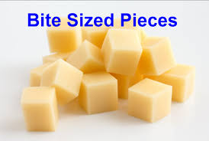

Segmentation
Market segmentation is the process of identifying your target market. Some factors to consider:
Geographic - location
Demographic – population and population trends
Psychographic – life style, values, opinions personality characteristics, interests
Behavioural - brand loyalty, volume usage and price sensitivity

Slide 11
Task
Consider specific ways in which events consumers could be segmented
If you could ask attendees, what would you ask?

Slide 12
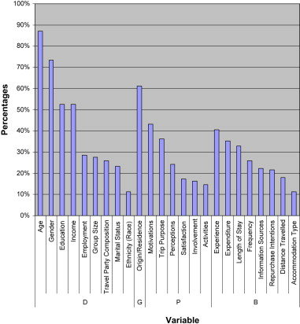
Event segmentation: A review and research agenda
http://www.sciencedirect.com.ezproxy.uwtsd.ac.uk/science/article/pii/S0261517710000579

Slide 13
Seminar
Read The Discussion section of the Research paper provided
1. What is the author aiming to do?
2. How can you use this information to provide segmentation criteria for your own events
3. Conduct further research to identify one other useful piece of research to support
4. Identify other means of supporting segment details
5. How would you reference this article in your report?

