Slide 1
ECGE4003PC
Cyfeirnodi a TURNITIN
ECGE4003P
Referencing and TURNITIN

Slide 2
Cynnwys Content
Beth yw cyfeirnodi?
Llên-ladrad
TURNITIN
Llawlyfr cyfeirnodi
Fformatio rhestr o gyfeiriadau
What is referencing?
Plagiarism
TURNITIN
Referencing handbook
Formatting a reference list

Slide 3
Adnoddau
Resources
Cyflwyniad PP
Rhestrau cyfeirnodi
TURNITIN
Gweithgareddau ymarferol
PP Presentation
Reference lists
TURNITIN
Practical activities

Slide 4
Beth yw cyfeirnodi?
What is referencing?
Cydnabod ffynonellau
Dyfyniadau
Aralleirio
Rhestr gyfeiriadau
Acknowledge sources
Quotations
Paraphrasing
Reference list

Slide 5
Pam? Why?
Cydnabod ffynonellau
Dod o hyd i’r wybodaeth eto
Helpu osgoi llên-ladrata
Acknowledge sources
Find information again
Help avoid plagiarism

Slide 6

A ydych erioed wedi cael unrhyw beth wedi'i ddwyn?
Have you ever had anything stolen?
Mobile phone
Money
Identity
Authorship
‘refers to the production and ownership of ideas and
intellectual material, such as books, articles, images, etc‘
(University of Essex, n.d., p. 4)
http://crime-security.org/71-thief/001-thief.html
Ffôn symudol
Arian
Hunaniaeth
Awduriaeth
‘cyfeirio at gynhyrchu a pherchnogi syniadau a deunydd deallusol, megis llyfrau, erthyglau, delweddau, ag ati.’
Image 1

Slide 7
Felly beth yn union yw llên-ladrad?
So what exactly is plagiarism?
‘Using or copying the work of others (whether written, printed or in any other form) without proper acknowledgement in any coursework’ (UWTSD, n.d.)

Slide 8
‘Respecting authorship through good academic practice is one of the key values of higher education in the UK.’ (University of Essex, n.d.)
Llên-ladrad
term a ddefnyddir i ddisgrifio camddefnydd awduraeth
yn drosedd academaidd ddifrifol ac yn cael ei thrin felly gan Brifysgol Cymru Drindod Dewi Sant
Plagiarism
term used to describe the misuse of authorship
a serious academic offence and is treated as such by the University of Wales Trinity Saint David

Slide 9
Ymwybyddiaeth o’r rhesymau dros lên-ladrad
Awareness of the reasons for plagiarism
Yn aneglur ynghylch llen-ladrad
Sgiliau rheoli amser gwael
Dull aneffeithiol o gymryd nodiadau – e.e. diffyg cofnodi o ble daeth y wybodaeth
Teimlo dan bwysau eithafol i basio neu lwyddo
Gwahanol werthoedd diwylliannol/ymarfer gwahanol gonfensiynau academaidd
Credu na fydd yn cael ei ganfod
Gwybod bod y cynnwys wedi aros yr un fath bob blwyddyn – e.e. cael cyrchiad at waith myfyrwyr blaenorol
Diffyg hyder academaidd
Cael ei cyflyru o addysg uwchradd
Being unclear about what plagiarism is
Poor time management skills
Ineffective method of note-taking – e.g. not always recording the source of information
Feeling under extreme pressure to pass or succeed
Different cultural values/practising different academic conventions
Believing that it will not be detected
Knowing that the syllabus has stayed the same each year – e.g. having access to work from previous students
Lack of academic confidence
Being conditioned from secondary schooling

Slide 10
Turnitin
Adnodd ar-lein sy'n helpu staff i ganfod llên-ladrad posib
Cymharu gwaith myfyrwyr yn erbyn cronfa ddata fawr iawn
Yn helpu myfyrwyr i leihau canran tebygrwydd
Online resource which helps staff detect potential plagiarism
Compares students’ work against very large database
Helps students reduce percentage of similarity

Slide 11
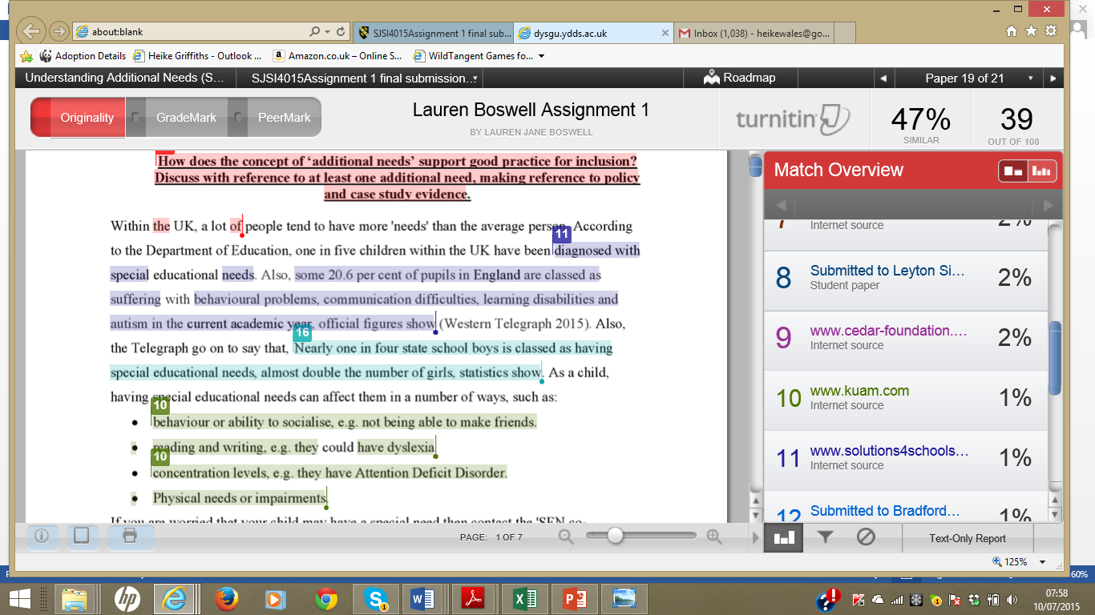
Canfod Llên-ladrad
Detecting Plagiarism
(Turnitin, 2015)

Slide 12
Turnitin
https://moodle.uwtsd.ac.uk/course/view.php?id=3441

Slide 13
Turnitin – Aseiniadau/Assignments
Llwythwch aseiniad ar ddolen DRAFFT
Edrychwch ar yr adroddiad tebygrwydd (MEWN LLIW)
Hyd yn oed os yw canran isel, rhaid i chi wirio pob darn lliwgar
Upload assignment onto DRAFT link
Check similarity report (IN COLOUR)
Even if low percentage, you must check every coloured segment

Slide 14
Turnitin
EWCH AMDANI ...
A oes llawer o liw?
Efallai bod angen fwy o aralleirio?
Efallai bod angen lleihau’r nifer o dyfyniadau uniongyrchol?
HAVE A GO...
Is there a lot of colour?
Perhaps more paraphrasing is required?
Perhaps amount of direct quotations need to be reduced?

Slide 15
Cyfeirnodi uniongyrchol
Direct referencing
Awgryma Knight (2011) fod chwarae yn yr awyr agored yn rhoi sgiliau cymdeithasol pwysig i blant.
Mae chwarae yn yr awyr agored yn darparu nifer o sgiliau cymdeithasol pwysig. Cefnogir y farn hon gan Knight (2011).
Knight (2011) suggests that outdoor play provides children with important social skills.
Outdoor play provides several important social skills. This view is supported by Knight (2011).

Slide 16
Yn y rhestr o gyfeiriadau...
In the reference list...
Knight, S. (2011) Risk and Adventure in Early Years Outdoor Play: Learning from Forest Schools. London: SAGE Publications Ltd.

Slide 17
Cofiwch!
Remember!
Manylion y ffynhonnell yn y drefn gywir.
Defnydd cywir o atalnodi.
Dylai manylion y ffynhonnell gyfateb yn union gyda’r rhestr o gyfeiriadau.
Trefn yr wyddor.
Correct order of the sources’ details.
Correct use of punctuation.
Details should correspond exactly with reference list.
Alphabetical order.

Slide 18
HARVARD
Cofiwch gyfeirio at y llawlyfr cyfeirnodi sydd ar gael ar Moodle hefyd.
Remember to refer to the referencing handbook also available on Moodle.
https://uwtsd.ac.uk/media/uwtsd-website/content-assets/documents/library-and-learning-resources/infoskills/Harvard-eng_v.1.2.pdf

Slide 19
Tasg
Task
Gyda’r llyfrau a ddarperir, dilynwch y cyfarwyddiadau (o’r ddarlith a’r llawlyfr cyfeirnodi) a fformatiwch rhestr o gyfeiriadau o 10 ffynhonnell
With the books provided, follow the guidance (from the lecture and referencing handbook) and format a reference list of 10 sources

