Slide 1
Bronfenbrenner's ecologist model of human development
Romeenah akhar
Sam westwood
Lamaiya smith
Grace benewaa

Slide 2
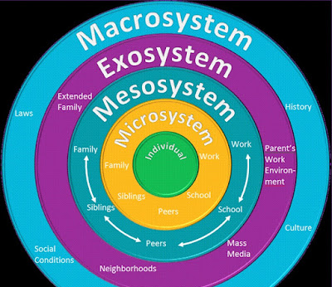
What is the theory about?
Developed by Urie Bronfenbrenner
Explains how different environments influence a person's development.
Shows how family, community, and society affect growth and wellbeing.
People develop through interactions with the world around them.
Development is influenced by different environmental systems.
These systems include family, friends, school, community, and society.
All systems work together to shape behaviour and wellbeing
This Photo by Unknown Author is licensed under CC BY-NC-ND

Slide 3
Why is it Important in Health and Social Care?
Helps professionals understand the whole person.
Recognises that health is affected by social and environmental factors.
Supports a holistic and person-centred approach.
Helps identify factors that may affect wellbeing.

Slide 4
How is it Used in Health and Social Care?
Used to assess a person's needs and circumstances.
Helps professionals work with families and other services.
Supports care planning and decision-making.
Encourages multi-agency working.

Slide 5
Example and Conclusion
Older Adult
Family support affects wellbeing.
Community services can reduce loneliness.
Life events such as bereavement may affect mental health.
Conclusion
Bronfenbrenner's theory helps us understand that a person's development and wellbeing are influenced by the people and environments around them. In health and social care, it encourages professionals to look at the whole person and provide support that meets their individual needs.

