Slide 1
Developing Innovation and
Creativity for Business Advantage
Week 7 (Part 1)
Digital Revolution

Slide 2
Recap
Week 1 (Introduction to DIB)
Week 2 (Creativity, Innovation, and Entrepreneurship".
Week 3: Part 1: Concepts & techniques of innovation & creativity & Part 2: New-Product Development and Product Life-Cycle Strategies
Week 4: Part 1: Concepts & techniques of innovation & creativity & Part 2: New-Product Development and Product Life-Cycle Strategies
Week 5: Part 1: Innovation, Growth & Competition & Part 2: Open and Closed Innovation
Week 6: Part 1: Disruptive Innovations & Part 2: Innovation Impulses
This week we will look at:
Part 1: Digital Revolution
Part 2: Innovative eBusines
Part 3: Digital Marketing

Slide 3
Recap
Week 1 (Introduction to DIB)
Week 2 (Creativity, Innovation, and Entrepreneurship".
Week 3: Part 1: Concepts & techniques of innovation & creativity & Part 2: New-Product Development and Product Life-Cycle Strategies
Week 4: Part 1: Concepts & techniques of innovation & creativity & Part 2: New-Product Development and Product Life-Cycle Strategies
Week 5: Part 1: Innovation, Growth & Competition & Part 2: Open and Closed Innovation
This week we will look at:
Part 1: Disruptive Innovations
Part 2: Innovation Impulses

Slide 4
What do we know are the main factors of the Digital Revolution?

Slide 5
What did we say are the main factors of the Digital Revolution?
Information & Connectivity

Slide 6

The network – a paradigm for the digital age

Slide 7
Harnessing the Power of Networks
The digital age is all about networks – connecting information, people, businesses, or goods, across boundaries and borders – making the world interconnected.
For businesses to thrive in the digital age, they must harness the power of networks, utilize digital networks to reinvent their business models, change their internal processes, and adapt the way they reach out to customers.
Adapting successfully to networks in all these fields is called Digital Transformation.

Slide 8
Let’s have a look at this flock of birds (a self-organised network)
https://www.youtube.com/watch?v=DmO4Ellgmd0

Slide 9
How do you think the birds organised themselves? Do they have a ‘kingpin bird’ who decides where everybody goes next?

Slide 10
Network Effects
Networks are inherently creative.
Networks are flexible and adaptive.
Networks have no central command control (they are self-organised).

Slide 11
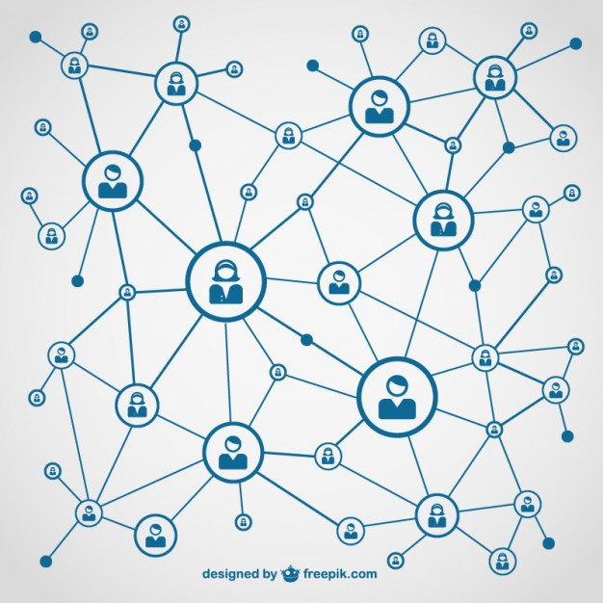
Would you be on a social network if no one else was on it?
Network effects only kick in when the network has a high enough number of nodes (critical threshold or critical mass).
This is important when thinking of adoption for new networks or network-based offers.

Slide 12

4 Key Concepts in the Digital Age Mindset
- Ecosystems
- Co-Opetition
- Co-Creation
- New Work Culture

Slide 13

Key CONCEPTS: Ecosystem

Slide 14

Ecosystems
Concept: The concept of business ecosystems has been gaining currency lately and is now widely used to describe a business’s or organization’s wider network (everybody that effects the business somehow, including customers, suppliers, partners, service providers, competitors, governmental and non-governmental actors, the public, the media, etc.)
The idea behind ecosystems strategy is that in the interconnected digital age, companies no longer vie only for industry leadership or product superiority – what matters more now is system leadership.

Slide 15
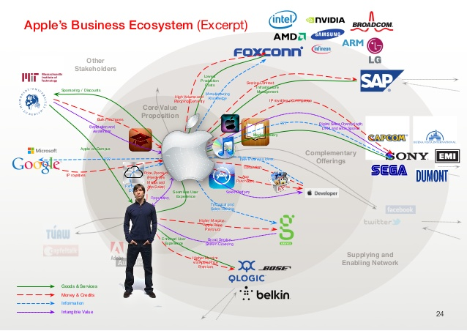

Slide 16
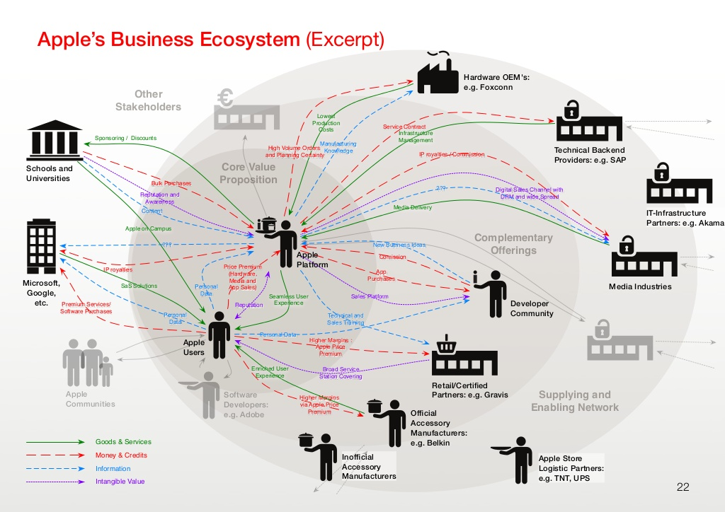

Slide 17
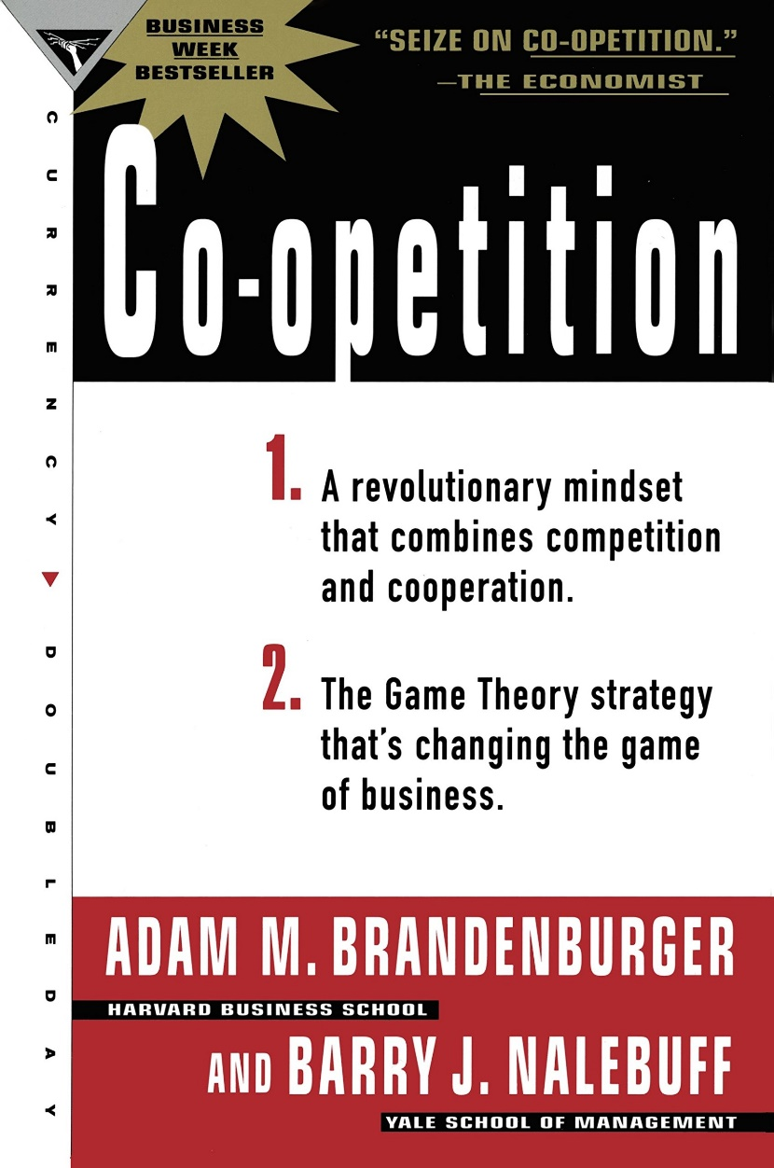
Co-Opetition
Concept: In a networked ecosystem, value creation is no longer a zero-sum game. Companies create value together with competitors who are at the same time collaborators in other regards.
Companies should see other players in their ecosystem as co-opetition because their own success also partly depends on the flourishing of the entire ecosystem. If you outcompete everybody, you might just kill the ecosystem.
See Brandenburger & Nabelbuff (2013)

Slide 18
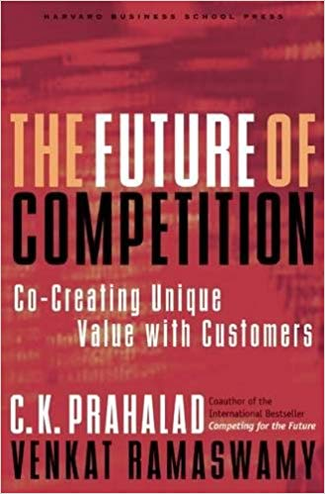
Co-Creation
Concept: In business ecosystems, value is co-created instead of being created within a firm only and then received and passively consumed by customers.
Companies should open the design of their products and services and their innovation process to other stakeholders (mainly customers) in their ecosystem to create more value for everyone involved.
See Prahalad & Ramaswamy (2013)

Slide 19

Co-Creation Examples
58% of businesses are now fielding co-creation initiatives (Hitachi Europe Report)
See 10 Examples of Co-Creation here:
https://www.braineet.com/blog/co-creation-examples/
Is UWTSD also co-creating its offerings and services?

Slide 20
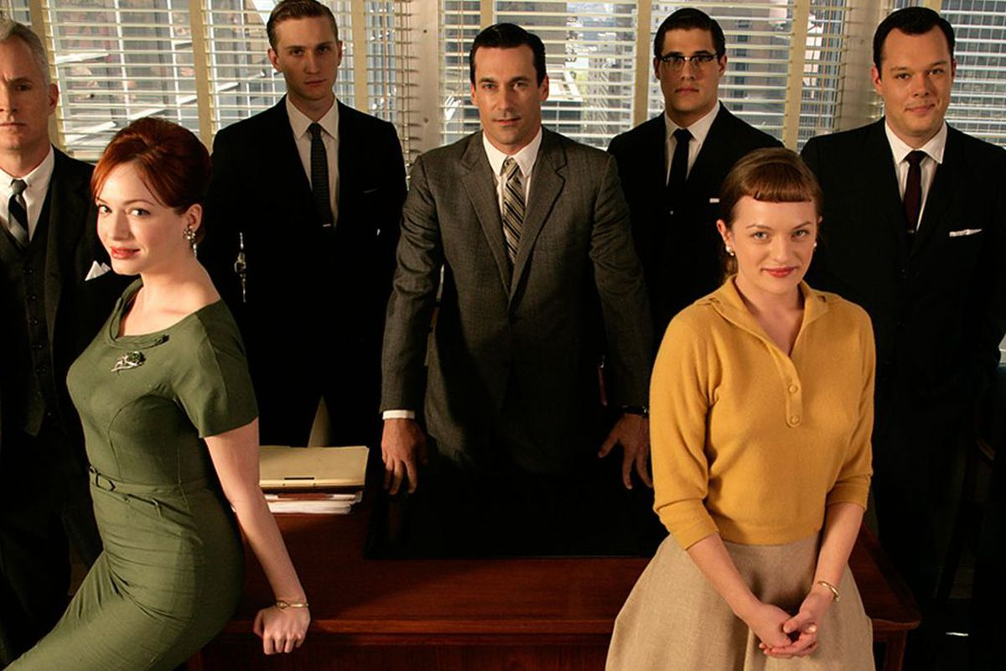

Traditional vs new work culture

Slide 21
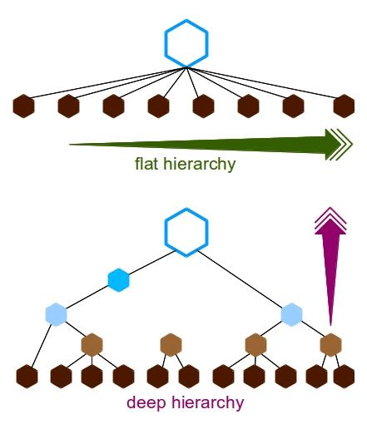
New Work Culture
Work cultures are changing rapidly in all industries. This has to do with changing cultural attitudes, but also with network effects and evolved mindsets of digital native generations (Millennials, Gen Z).
New work cultures are generally agile, flexible, and collaborative, and deploy flat hierarchies as opposed to traditional work cultures which are top-down and silo based (departments don’t talk to each other, employees do what they are told, creativity is not expected or rewarded).

Slide 22
Agile Work Culture Principles
Actual human input from collaborators is more important than official/established work processes
Documentation does not have to be extensive when processes are showing desired results
Collaboration is more important than contractual or hierarchical relations between parties
Genuine desire to find innovative responses and effective solutions is more important than following a plan or prescriptive work process

Slide 23
5 Spheres of Digital Transformation
Business Models
Cultures & Processes
Brand & Customer Experience
Data Management
Innovation

Slide 24
Class Exercise
Choose an organization you are familiar with and then identify the 5 Spheres of Digital Transformation

Slide 25
5 Spheres of Digital Transformation
Business Models
Cultures & Processes
Brand & Customer Experience
Data Management
Innovation

Slide 26
1) Business Models
How do businesses create value? How do they produce and sell their goods or services?
Traditional | Digital

Slide 27
2) Brand & Customer Experience
How do businesses present themselves to the public (what type of advertising and messaging) and how do they involve the customer or make the customer feel when dealing with them?
Traditional | Digital

Slide 28
3) Culture & Process
What is the company culture and how do businesses handle work processes (such as collaboration, customer management, etc.)? How do they involve customers and other stakeholders?
Traditional | Digital

Slide 29
4) Data Management
How do businesses treat customer data? What uses do they make of it?
Traditional | Digital

Slide 30
5) Innovation
How do businesses innovate? Which new technologies do they use to upgrade existing services and products?
Traditional | Digital

