Slide 1

BID Pitch by Steffan Treharne

Slide 2
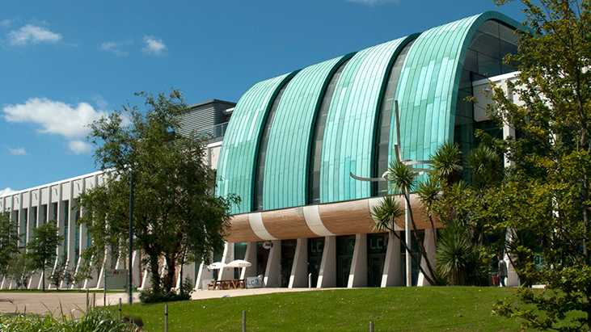
Introduction
Opened 2008
£32 million investment
Attracting roughly 900,000 visitors
Formerly council run
Taken over by Freedom Leisure
£600,000 reinvested into new gym facilities

Slide 3
Aims & Objectives
To produce a balanced food menu to a balanced lifestyle.
Creating a new want in life not only what is needed.
Work with the LC by creating a healthier body & mind performing menu.
Linking the menu to what the LC is all about.

Slide 4
Reasons for the project
Create a menu that’s like no other.
Opening newer & healthier options at affordable prices.
Previous customer feedback about what is on offer.
Promoting healthy lifestyle.
One step ahead of the competition.
Availability on secondary spend is not meeting food and beverage targets.

Slide 5
Ideas
healthy options
Vegetarian
Vegan
Dairy free
allergy related
Dietary needs
Body & Mind progression

Slide 6
Why me?
Culinary background in Michelin star.
First-hand experience on what LC consumers need.
Already with the company.
Experience in food beverage trends
Out of the box ideas

Slide 7
Research
Primary and secondary research
Required information for ideas
Look at the market
See what can be brought to the table
Put forward ideas to business and consumers

Slide 8
Project plan
Create a gant chart to guide when i need to hit a deadline and carry me through the project.

Slide 10
Possible constraints, problems, issues
Company running into difficulty
Communication from both sides
Feedback
Lack of consumer interaction
Research does not support your idea

Slide 11
Any Questions?

