Slide 1
New Step for Our Primary School
Assessment For Learning

Slide 2
“The term ‘assessment’ refers to all those activities undertaken by teachers, and by their students in assessing themselves, which provide information to be used as feedback to modify the teaching and learning activities in which they are engaged. Such assessment becomes ‘formative assessment’ when the evidence is actually used to adapt the teaching work to meet the needs. ”
–Black and William, 2003, pg.2

Slide 3
How does it work?
Exploring learning evidence
Analysing / interpreting the evidence
Used by students/teachers
Further improvement

Slide 4

Formative vs. summative assessments
AOL evaluates the outcomes of learning at the end of the learning process by calculating the level of knowledge, it assesses student achievement by assigning grades or levels to each student
AFL does not involve student achievement evaluations
AFL allows the students and the teacher to determine how they can achieve student’s learning goals

Slide 5
AOL is:
backward looking, only assesses your final outcome, not your journey of improvement
compares students,
created and measured by people who aren’t involved at the school (irrelevant)
Affects students’ self esteem by highlighting what students aren’t good at based on grades, instead of embracing progress and what students are good at or showing them a way to develop and grow!
Judgemental
Current AOL can be harmful to students ( high stakes at risk, you cannot always resit an exam, grades seem to be the only measurement of how intelligent or educated a person is)
Only caters to small group of students who are considered to be the ‘academic’ type

Slide 6
AFL is:
Forward looking, helps you outline your next steps to better yourself
Students understand how to improve
Teacher guides and supports
Relevant because created by teachers themselves
Shows students how to improve ( not focusing on a poor grade without future improvement)
Recognises all educational achievement

Slide 7
Why is formative assessment the way forward?
understanding what knowledge and skills they need to learn makes them more aware as learners an therefore allows them to take a more active approach in their learning
Students learn to self assess which helps them monitor their own progress, it also makes them better at offering peer assessment
Understanding how they are being assessed means they can observe their progress themselves to see if they reached the learning objective outcome or not quite
Students understand what successful work looks like for each activity they do
Students become independent learners

Slide 8
Introduce as a whole school approach
It takes time and consistency for results to visibly expand
It prevents children from regurgitating knowledge
Makes feedback more relevant than digit numbers or generic comments
Provides a clear link for students between an activity and the learning intention
Once children are used to this approach if they were to move class or change years, and if their new teacher wouldn’t employ the AFL approach, it would have a negative impact on child’s education
Knowing what they will learn provides them with additional confidence and security because they know what to expect
Keeping the LO in mind adds to their awareness while doing activities

Slide 9
Main learning strategies which I will implement in the classroom:
Student self assessment
Peer assessment/ feedback
Feedback
Questioning
Setting goals/targets
Using summative assessment in a formative way
Using:
Portfolios
Hands on activities
Reflective activities
Work samples
Recordings
Authentic and performance based assessments (focus on the process rather than product)
Observations
Discussion conferences/ meetings

Slide 10

How is it different to summation assessments?
Essays in controlled and uncontrolled conditions
Coursework
Portfolios
Teacher assessments
Exams and tests (snapshots of students abilities, taken out of context)
Image from:http://www.youngparents.com.sg/education/academic-stress-singapore-are-parents-blame/2/

Slide 11
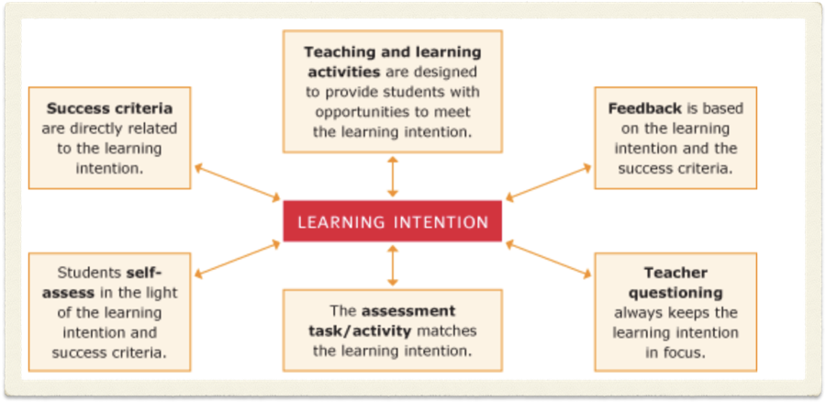
Learning Objectives
Image from: http://www.assessmentforlearning.edu.au/professional_learning/modules/learning_intentions/learning_research_background.html

Slide 12
The Black Box
Black and William (1998) refer to a classroom as a black box in which learning takes place. They suggest that teaching and learning have to be interactive. Formative assessment is at ‘the heart of effective teaching’.
As a teacher you have to be aware of your students’ progress and their difficulties to provide appropriate activities and to adapt the learning activeties to each learner’s needs.

Slide 13
References:
Assessment for Learning, (no date), ‘Background', http://www.assessmentforlearning.edu.au/professional_learning/modules/learning_intentions/learning_research_background.html (accessed: 11/02/2018)
Association for Achievement and Improvement Through Assessment, (2017), ‘Assessment Reform Group', https://www.aaia.org.uk/blog/2010/06/16/assessment-reform-group/ (accessed: 11/02/2018)
Assessment Reform Group, ‘Assessment For Learning: 10 Principles’, (2002), https://www.aaia.org.uk/content/uploads/2010/06/Assessment-for-Learning-10-principles.pdf
Azim S., Khan M., (2012), ‘Authentic assessment: An instructional tool to enhance students learning’ , The Aga Khan University, https://ecommons.aku.edu/cgi/viewcontent.cgi?referer=https://www.google.co.uk/&httpsredir=1&article=1008&context=pakistan_ied_pdcc (accessed: 12/02/18)
Black, P., Harrisson C., Lee C., Marshall B., and William D., (2003), ‘Assessment For Learning: Putting it into practice’, Berkshire: The Open University Press
Black, P., William, D., (1998), ’Inside the black Box’, King’s College London School of Education, http://weaeducation.typepad.co.uk/files/blackbox-1.pdf
Blanhard, J., (2009), ‘Teaching, Learning and Assessment’, Maidenhead: Open University Press
Florez M. T. And Sammons P., for Oxford University Dept. Of Education, (2013), ‘Assessment For Learning: Effects and Impact’, CfBT Education Trust, https://www.educationdevelopmenttrust.com/~/media/EDT/Reports/Research/2013/r-assessment-for-learning-2013.pdf ( accessed: 12/02/18)

