Slide 1

Applying Search Engine Technologies for Internet Marketing
Dr. Ben Choi
Computer Science
Louisiana Tech University, U.S.A.
ben@benchio.com
Dr. Huichuan Liu
Information & Communication
Tamkang University, R.O.C.
hliu@mail.tku.edu.tw

Slide 2
Our Research on Building New Search Engine
Providing new ways for people to use the Internet
Allowing Web users to have more interaction and control of their Internet
Providing new ways to organize and classify Web pages found on the Internet
Providing new ways to capture the preferences of the Internet communities
® Patented Technology
Treating Web pages and files on the Internet like files on our own disk directory
Allowing browse, organize, search, and even edit Internet files

Slide 3
New Search Engine System

Slide 4
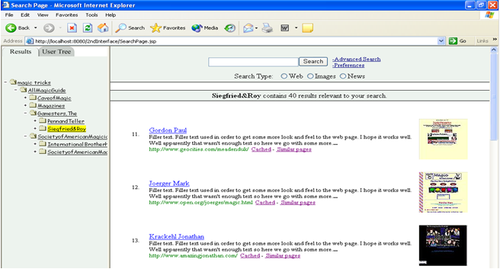
Search Result User Interface (Prototype)

Slide 5
Applying Search Engine Technologies for Internet Marketing & for Everyone
Based on current research in search engine technologies
to provide pointers that are useful to marketers and anyone creating their own web pages
How search engines
find web pages
steps needed for search engines to find our web pages
How search engines
rank search results
getting our web pages to the top of the lists
wanting them to be visible on the vast Internet
direct customers to online stores or your web pages
How search engines
classify web pages
Outlines current developments
putting our web pages into the right categories
keeping up with the advanced web technologies

Slide 6
For Search Engines to
Find Our Web Pages
Search engines constantly try to find new web pages
by visiting and revisiting known web links (URLs)
Our current research project addresses
how often a webpage should be visited, and
For search engines to find our web pages
need to put the URLs of our web pages in some other web pages that had already been crawled (can be checked by eg., “site:cnn.com” in Google)
by retrieving new links from those web pages
by following those new links and trying to find more web pages
submit our URLs to search engine
in what order web pages should be visited

Slide 7
Getting Our Web Pages to the Top of Resulting Lists
Search engine helping web users to find the information that they need
Google uses over 100 factors in their methods to rank the search results, e.g.,
by ordering the search results (sequentially), and
by presenting to the users the most relevant pages first
locations of the keywords (in the title or in the body)
number of times the keywords appear
number of links referring to the web page
Our current research on Ranking
popularity of the webpage, if a large number of users like the webpage then it might be more relevant

Slide 8
Getting Our Web Pages to the Top of the Lists
No easy way to guarantee top ranking,
but a few good practices:
When designing a webpage, we should keep in mind what keywords should be associated with the webpage
The title of the webpage is very important, which should contain some of the keywords
The URL of the webpage is also important, which should be descriptive and also contain some of the keywords
The content of the webpage should contain informative descriptions, which should also contain some of the keywords
To have many other web pages linked to our webpage

Slide 9
Search Engines are Beginning to
Arrange Web Pages Into Categories
Finding ways to organize the massive number of web pages on the Internet
Our current researches on automatically organizing web pages into categories
Webpage categorized by analyzing words on the page
Representing a webpage by a vector of words

Slide 10
Putting Our Web Pages Into the Right Categories
need to make sure there are sufficient text contents in our webpages to be processed by the automatic classifiers
provide additional text contents in the meta tags of HTML codes that are not displayed on the browsers
<meta name="description" content="Provide additional information here."/>
<meta name="keywords" content="Provide list of keywords here."/>
For marketers selling products, it is important for their web pages to be classified and put into Google product search
They should make sure their web pages containing detailed product name, description, photo, condition, tax, shipping charges and base price.

Slide 11
Keeping Up with the Advanced Web Technologies
New search engines are being developed and new web technologies are being deployed
Our research on developing a new search engine
allowing users to have more interactions and controls of their Internet (claiming it’s “My Internet”)
presenting the search results in a hierarchical structure much like a directory tree structure
not only allowing users to click on links, but also authorizing them to move a link from one directory to another
Our changes to our Internet directory and others’ changes to their Internet directories are gathered and analyzed to produce the next generation of Internet directory

Slide 12
The Future of Information Technologies is Moving toward Semantic Web
Aims at automatically extracting useful and meaningful information from the web (not just keywords)
Web designers now need to assign meaningful HTML tags to strings
e.g., a string of digits may be assigned as “base price” and
another as “shipping charge”
Our research on Semantic Web
Understanding web contents will help organizing webpages into categories, and
help creating better summary of webpages

Slide 13
Conclusion and
Future Research
Conclusion
(1) Highlighting our decade long research on search engine technologies
Future
(1) Finding more innovative way to use the Web!
(2) Providing pointers that may be useful to marketers and anyone creating their own web pages and wanting them to be visible on the vast Internet
(2) The future of Information Technologies is moving toward Semantic Web

Slide 14





Questions?
???
???
???
???
???

Slide 15


For more information Visit Website: BenChoi.info
E-mail: hliu@mail.tku.edu.tw
http://www.ic.tku.edu.tw

