Slide 1
The development of contemporary diagnosis methods
By Declan Hodson

Slide 2


Introduction to DSM-5
DSM5 (Diagnostic and statistical manual of mental disorders) is the American diagnosis method developed by the APA in 1952 (Fried, 2015) . The fifth iteration of the DSM5 was put into practice on 18 may 2013.
A more recent version named the “DSM5 T-R” has been in development since 2019. This more recent version attempts to update the current DSM5 with newer problems society has faced over the last nine years.
Similarly to the ICD11, it attempts to provide an accurate diagnosis by grouping together symptoms and choosing and appropriate ailment for that individual.
The original DSM was developed in 1952 to get a better understanding of mental condition of individuals after WW2. At the same time, WHO released the sixth version of the ICD, this version being the first to incorporate psychopathologies (APA).
Declan Hodson

Slide 3
Development of DSM
The third version of the DSM added what is known as the “Multi-axial system”. These five axis were added to allow clinicians to better categorise mental health problems. Based on the patients diagnosis, they would be put into the axis that correlated the most with their condition. The five Axis were;
Clinical disorders
Personality disorders
Medical or physical conditions
Environmental or psychosocial factors
Global assessment of functioning
(Schimelpfening, 2022)
Upon the release of the fifth version of the DSM, the multi axis system was discarded. It was decided that too many artificial distinctions were being found in diagnosis with the APA noting “the multiaxial system in DSM-4 was not required to make a mental disorder diagnosis”. (Pedeault, 2020).
Declan Hodson

Slide 4
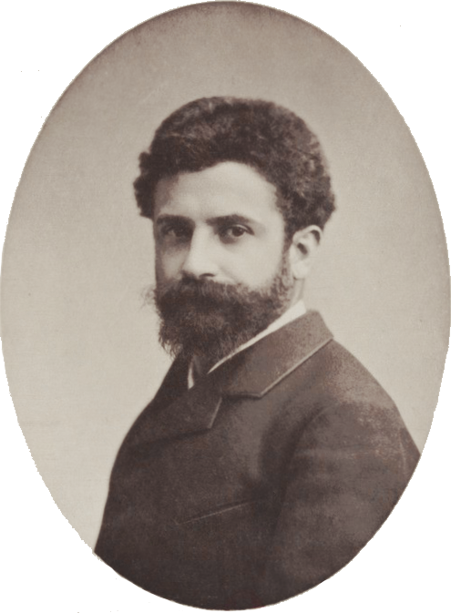

Introduction to the ICD-11 – Declan HODSON
ICD11 (International Classification of diseases, 11TH version as of Jan 1 2022) – European method of diagnosis. The 11th iteration was put into practice on January 1st of 2022. The 10th version was in practice from Jan 1993 – 2022 (WHO, 2022).
It is the European method used for diagnosis. The first iteration was published in 1893 by French statistician Jacques Bertillon. It was based on Bertillon’s own work on the “Classification of causes of death” (Britannica, 2022).
The ICD11 attempts to give a diagnosis by grouping symptoms together, then choosing a diagnosis based on the grouped systems.
The ICD system was eventually adopted and published worldwide by WHO (World health organisation) in 1948. At the time, the ICD was in its 5th version. WHO became responsible for updating and gathering data for the ICD.
The current version of ICD was reviewed and verified by 194 countries before its publishing this year.

Slide 5
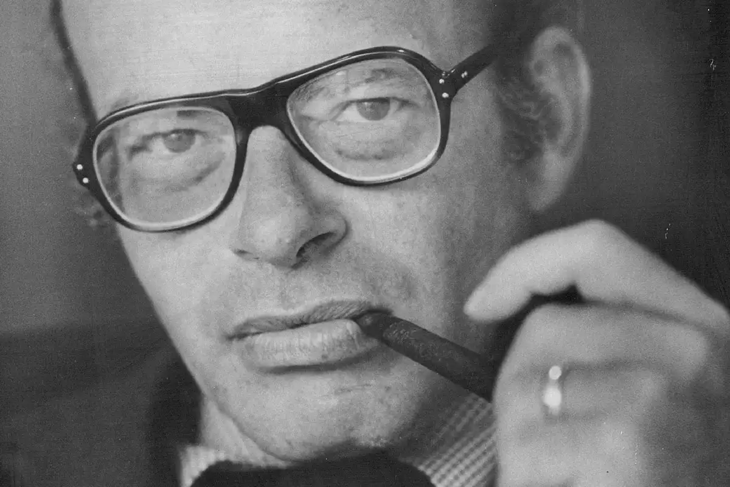
The Rosenhan experiment
One reason why methods like the ICD11 and the DSM5 exist are because of people like David Rosenhan who wanted to prove that older methods of diagnosis were wrong.
He advocated for better treatment of those diagnosed by the old biomedical model. For example, at the beginning of the 19th century, inhumane acts such as trepanning were in business. “The third method was cutting a circular groove and then lifting the disc of bone” (Gross, 2021).
Rosenhan argued that if these older diagnosis methods were indeed correct, doctors and physicians should have no problem distinguishing between a sane person and someone suffering.
“Between 1969 and 1972, Prof David Rosenhan sent eight pseudo patients to twelve psychiatric hospitals without revealing this to the staff. None of the pseudo patients had any symptoms or history of mental disorders. In all twelve instances, pseudo patients were diagnosed with a mental condition and
Hospitalised” (Mcleod, 2021). Declan Hodson

Slide 6
Reference slide
W. (2022, January 1). International Statistical Classification of Diseases and Related Health Problems (ICD). Retrieved October 27, 2022, from https://www.who.int/standards/classifications/classification-of-diseases
T. (2022, September 22). Jacques Bertillon, French Statistician. Retrieved October 27, 2022, from https://www.britannica.com/science/statistics/Experimental-design
Goldberg, D. (2014, June 27). Psychopathology and classification in psychiatry. Psychopathology and Classification in Psychiatry, 2-5. doi:https://web-p-ebscohost-com.ezproxy.uwtsd.ac.uk/ehost/pdfviewer/pdfviewer?vid=0&sid=dc5c453d-0753-4d90-a3f9-036f81d3a78f%40redis
Fried, E. L. (2015, March 23). Problematic assumptions have slowed down depression research: Why symptoms, not syndromes are the way forward. Problematic Assumptions Have Slowed down Depression Research: Why Symptoms, Not Syndromes Are the Way Forward. doi:https://www.ncbi.nlm.nih.gov/pmc/articles/PMC4369644/
Bartolome, J. M. (1994, September). Classification of mental diseases. From Bertillon to CID-10: A century of international collaboration. Classification of Mental Diseases. From Bertillon to CID-10: A Century of International Collaboration. doi:https://pubmed.ncbi.nlm.nih.gov/7817845/
A. (Ed.). (n.d.). DSM history. Retrieved October 28, 2022, from https://psychiatry.org/psychiatrists/practice/dsm/about-dsm/history-of-the-dsm

Slide 7
Reference slide
Schimelpfening, N. (2022, September 1). What Is the DSM-IV Multi-Axial System? Retrieved October 28, 2022, from https://www.verywellmind.com/five-axes-of-the-dsm-iv-multi-axial-system-1067053
Pedneault, K. S. (2020, September 17). Why Multiaxial Diagnosis Is Outdated. Retrieved October 28, 2022, from https://www.verywellmind.com/what-is-multi-axial-diagnosis-425180
WHO logo [Digital image]. (2016, August 16). Retrieved October 28, 2022, from https://logos-world.net/world-health-organization-logo/
Picture of Jacques Bertillon [Digital image]. (n.d.). Retrieved October 28, 2022, from https://commons.wikimedia.org/wiki/File:Jacques_Bertillon_(1851-1922).png
APA Logo [Digital image]. (n.d.). Retrieved October 28, 2022, from https://en.wikipedia.org/wiki/American_Psychological_Association
Gross, C. G. (n.d.). A hole in the head : A history of Trepanation. A Hole in the Head : A History of Trepanation. Retrieved June 11, 2021, from https://thereader.mitpress.mit.edu/hole-in-the-head-trepanation/
Cahalan, S. (n.d.). Picture of David Rosenhan [Digital image]. Retrieved October 28, 2022, from https://www.newscientist.com/definition/the-rosenhan-experiment/
Mcleod, S. (2021, November 16). Rosenhan (1973) Experiment - 'On being sane in insane places'. Retrieved October 28, 2022, from https://www.simplypsychology.org/Rosenhan_experiment.html

