Slide 1

Yr Iaith Saesneg
The English Language

Slide 2
Geiriau doeth
Wise words
Pooh said to Piglet: ‘It’s all right Piglet. Spelling is easy once you get started.’
Piglet nodded ‘Getting started is the worse bit.’
‘You can’t help respecting anyone who can spell TUESDAY, even if he doesn’t spell it right but spelling isn’t everything. There are days when spelling TUESDAY simple doesn’t count’
A.A,Milne, The House at Pooh Corner, 1928 Ch.5
ThePhoto by PhotoAuthor is licensed under CCYYSA.
Notes:
Gair y dydd heddiw.

Slide 3

Sut oeddech chi wedi dysgu sillafu?
How did you learn to spell?
Notes:
Reminder of the focus on being ethical researchers
The assignments fulfil the 4th disposition

Slide 4
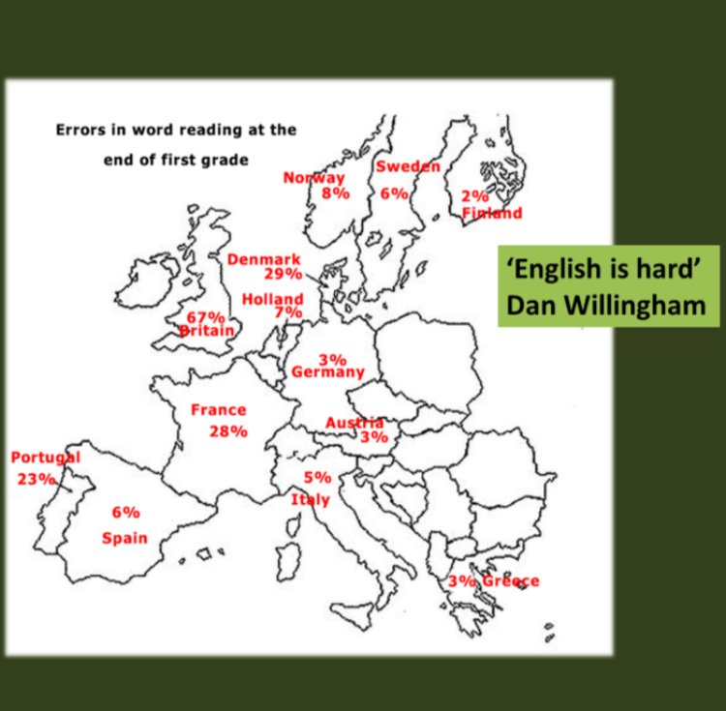
Gwraidd y Broblem
The Nature of the Problem

Slide 5
English spelling is difficult, but it is not as chaotic as is often claimed. An explanatory perspective can make things easier.
Crystal (2012, p.6)

Slide 6
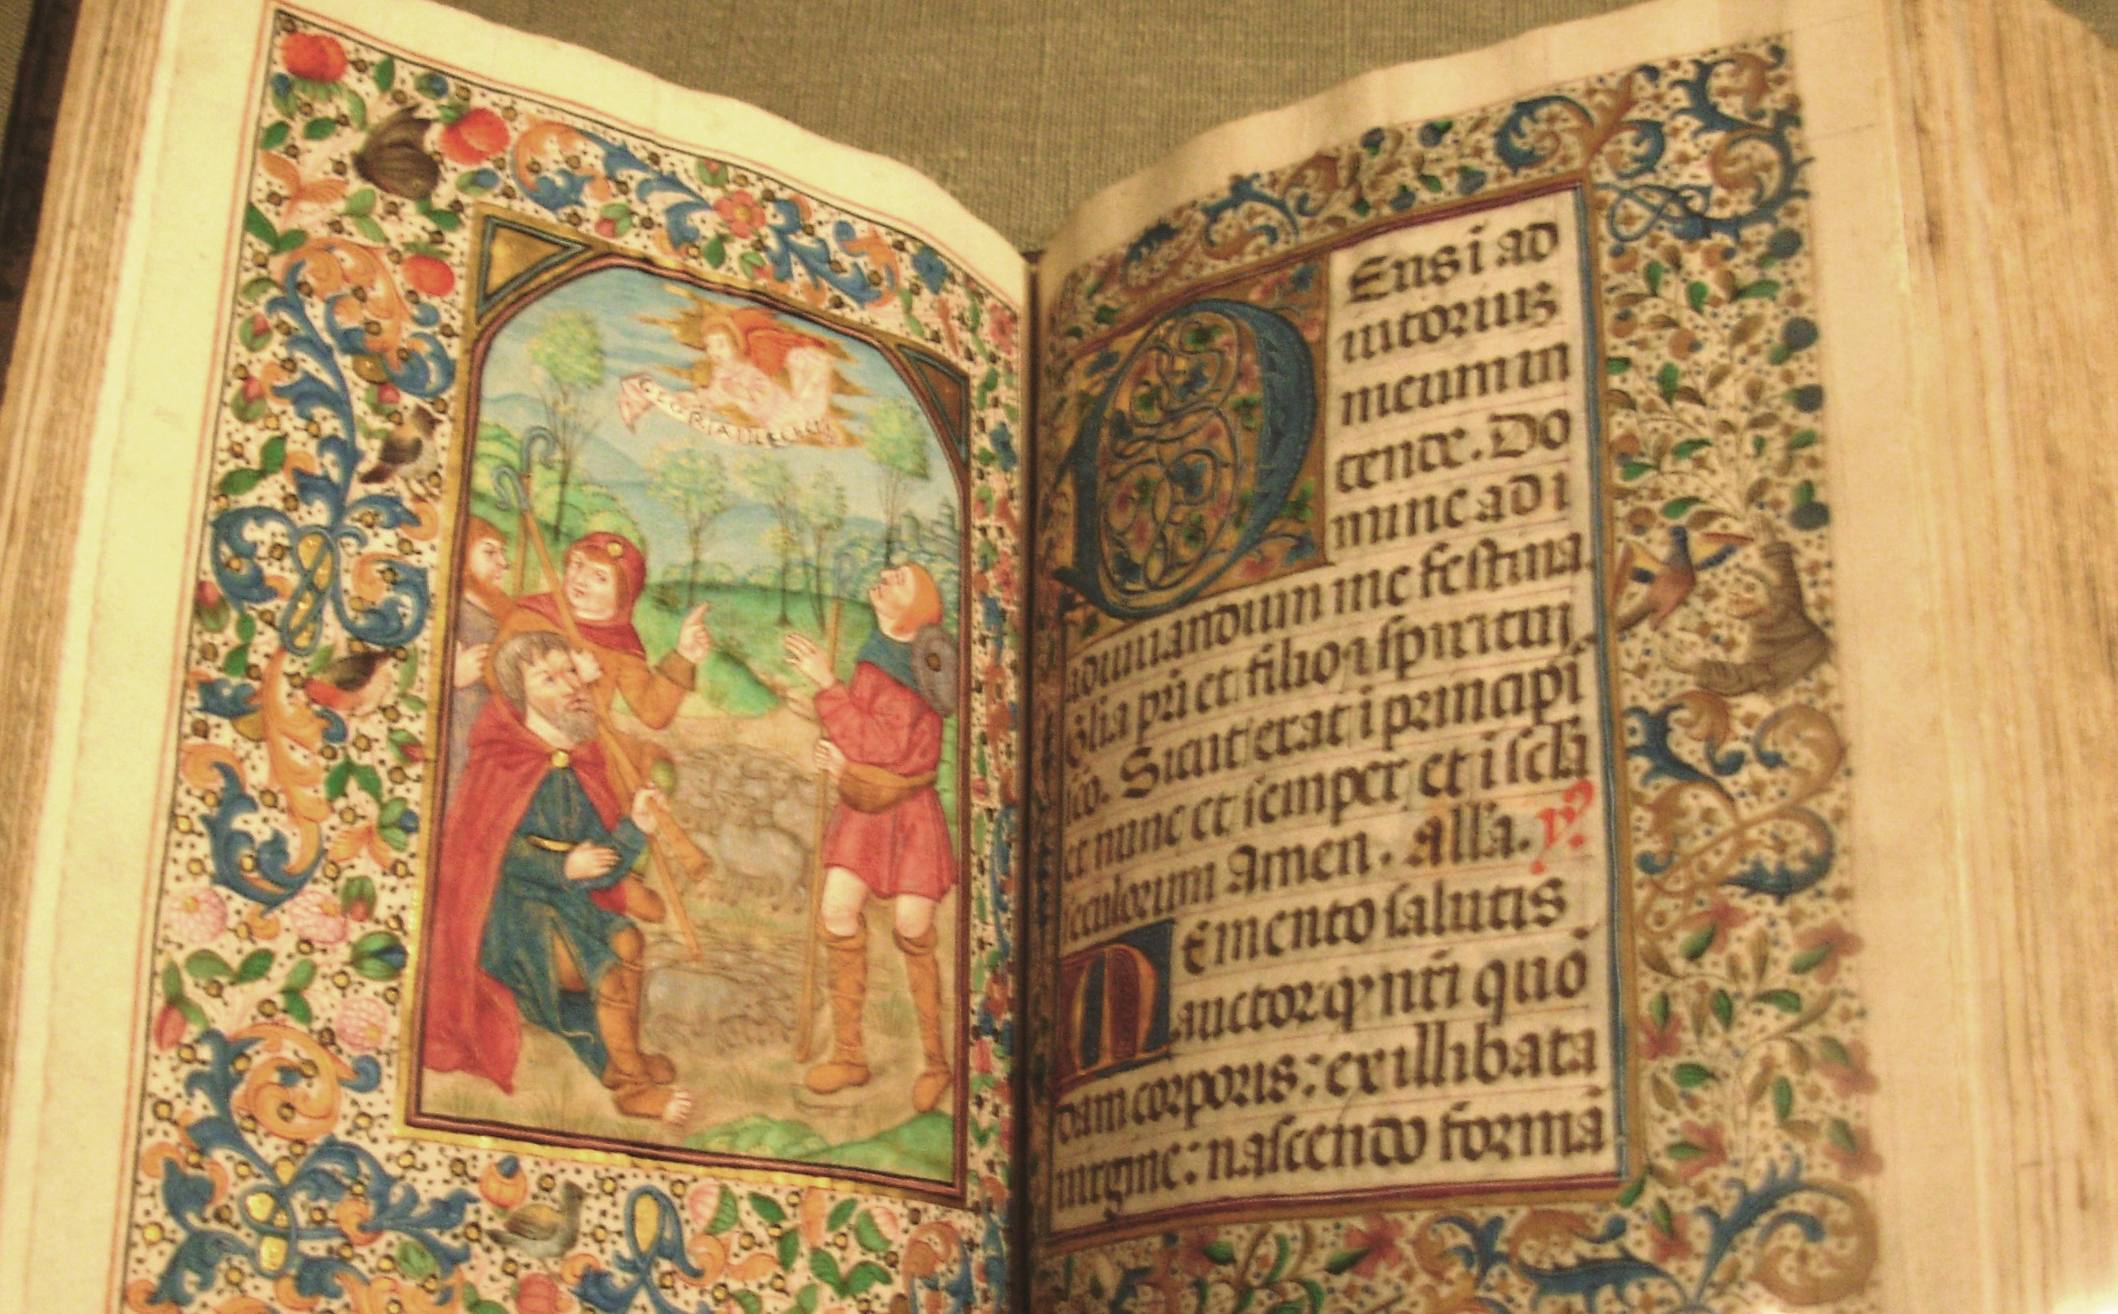
O Ladin i Eingl-Sacson
From Latin to Anglo-Saxon
This Photo by Unknown Author is licensed under CC BY-SA
Notes:
p.12 and 13. the problem

Slide 7
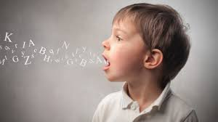
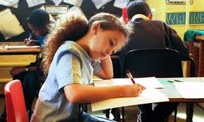
Synau lleferydd i systemau ysgrifennu
Speech sounds to writing systems
phonology
orthography
Notes:
How will we tackle this

Slide 8
Defnyddio’r Wyddor Rufeinig
Use the Roman Alphabet
Let’s write down the sounds (phonology) of Anglo-Saxon using the Roman letters (orthography).
A B C D E F G H I K L M N O P Q R S T V X Y Z
Notes:
23 letters at that time – should be plenty

Slide 9
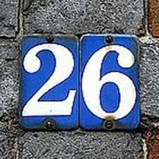

Mynachod – mae gennym broblem
Monks - we have a problem
44 speech sounds (phonemes)
24 consonant
20 vowels
26 letters of the alphabet
21 consonants
5 vowels
Notes:
The roman alphabet had to be adapted/ dialect

Slide 10
Orgraff
Orthography
Compared to other languages English has a:
Deep Orthography
These are writing systems that do not have a one-to-one correspondence between spoken sounds ( phonemes) and the written letters that represent them.

Slide 11
Tynnwch lun o’r tabl hwn yn eich llyfr nodiadau...
In your notebook draw this …
Never heard of… | Heard – not sure of meaning | Know what it means: can give an example and explain to others

Slide 12
Ysgrifennwch y geiriau hyn
Write down these words
Blend
Segment
Homophone
Homograph
Phonology
Orthography
Phoneme
Grapheme
Digraph
Notes:
Self audit

Slide 13
Ffonem
Phoneme
The smallest unit of sound in a word
For you to practise:
Articulation of Phonemes
Notes:
There is a standardised articulation of the phonemes for English – you need to do this otherwise we will be in the same position as the monks

Slide 14
word | grapheme | grapheme | grapheme | grapheme
bed | b | e | d
hiss
church
through
knight
street
eight
scrunch
‘
‘

Slide 15
word | grapheme | grapheme | grapheme | grapheme | grapheme
bed | b | e | d
hiss | h | i | ss
church | ch | ur | ch
through | th | r | ough
knight | kn | ight | t
street | s | t | r | ee | t
eight | eigh | t
scrunch | s | c | r | u | n | ch
‘
‘
Notes:
1,2,3,4 letters

Slide 16
One phoneme (sound) can be represented by 1,2,3,4 graphemes (letters).
Digraph – two letters one sound (/sh/)
Trigraph – three letters one sound (/igh/)

Slide 17
Cyfuno a segmentu
Blend and segment
Blend – merge the phonemes to read
Segment – listen to the phonemes to write/spell

Slide 18
Cod yr Wyddor
Alphabetic Code
Deep orthography:
The same grapheme can represent different phonemes e.g. cheap chef
And …
The same phoneme can be represented by different graphemes e.g. moon flute

Slide 19
ough

Slide 20
Gellir cynrychioli’r un ffonem gan raffemau gwahanol
The same phoneme can be represented by different graphemes
Rug
Horror
Writing
Rhinocerus

Slide 21
Same phoneme (sound)
Different grapheme (written representation)
Notes:
On the card on your table write down a list of words where the same sound is represented by different phonemes

Slide 22
Ydy hi’n iawn i addysgu’r ‘rheolau’ hyn?
Is it ok to teach these ‘rules’?
Alliteration: words beginning with the same letter
In English, you use ‘a’ before words beginning with a consonant and ‘an’ before words beginning with a vowel?
Notes:
Themed Days – each day looks at a specific aspect of the research process

Slide 23
a university
an x-ray

Slide 24
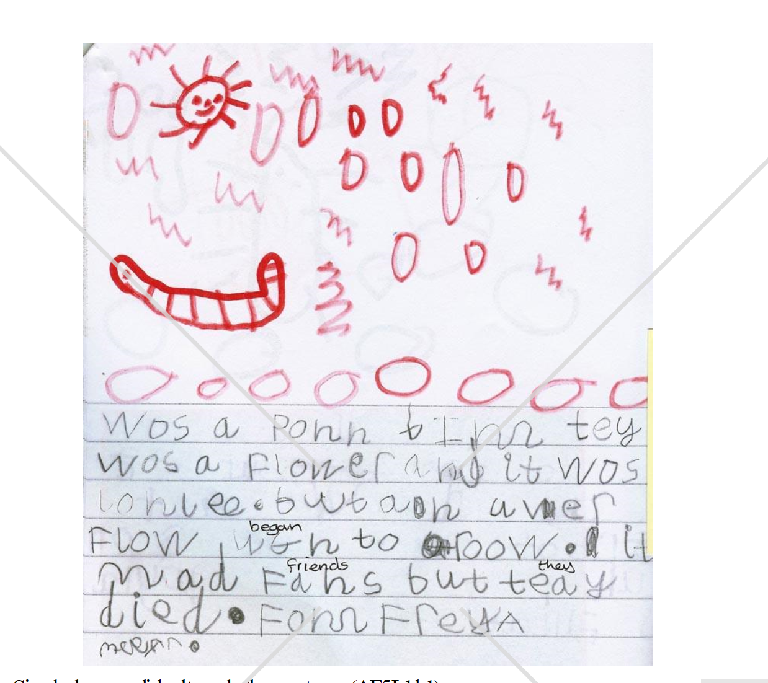
Yn ffoneteg gredadwy
Phonetically plausible

Slide 25
Geirdarddiad
Etymology
Etymology explains many of the notorious confusable words in English spelling. Silent letters also reflect an earlier period in language history.

Slide 26
Invasion – lots of French and Latin but Old Norse (the language of the Vikings is exciting!)
Thursday
reindeer
glitter
plough
happy
anger
irk

Slide 27
Sveinsey
Notes:
Swansea

Slide 28

Rhowch hyder ac esboniwch
Give confidence and explain
However, illogical it may seem, the English language is alphabetic and each phoneme is represented by some combination of the 26 letters of the alphabet

Slide 29
Bob amser
Always
Check children can hear the phonemes
Show the written word and articulate the phonemes as you write
Use the word in context (homophones)
Use etymology to spark interest and explore patterns

Slide 30
Tynnwch lun o’r tabl hwn yn eich llyfr nodiadau...
In your notebook draw this …
Never heard of… | Heard – not sure of meaning | Know what it means: can give an example and explain to others
Phonology Orthography Phoneme Grapheme Digraph Blend Segment Homophone homograph

Slide 31
Siartiau Cod yr Wyddor
Alphabetic Code Charts
Alphabetic Code Charts
https://larkhall.lambeth.sch.uk/files/9714/4829/4664/phonics-sound-chart.pdf

