Slide 1



Consultancy Project
Role of a Management Consultant
Types of Consultancy
Reasons for Engagement

Slide 2


Last time we….
Reviewed the module’s aims and objectives and the assessment process
Began to consider the role of a consultant
Touched on the impact of change on organisations
Considered some possible and previous research topics

Slide 3
Let’s check ….
Identify some organisations and explain why they might need help
5 Minutes – work in pairs

Slide 4

Today’s Objectives
To recognise the contribution Consultancy plays today
To consider the benefits it offers organisations
To examine the different types of consultancy activity and business sectors involved
To begin to consider the issue of client engagement
Tutorial: Choosing your topic
http://youtu.be/SWDMtLk1-EM

Slide 5

Definition
“A consultant is an independent advisor who adds value by helping managers to identify and achieve beneficial change appropriate to their situation”
(Newton, 2010:6)

Slide 6
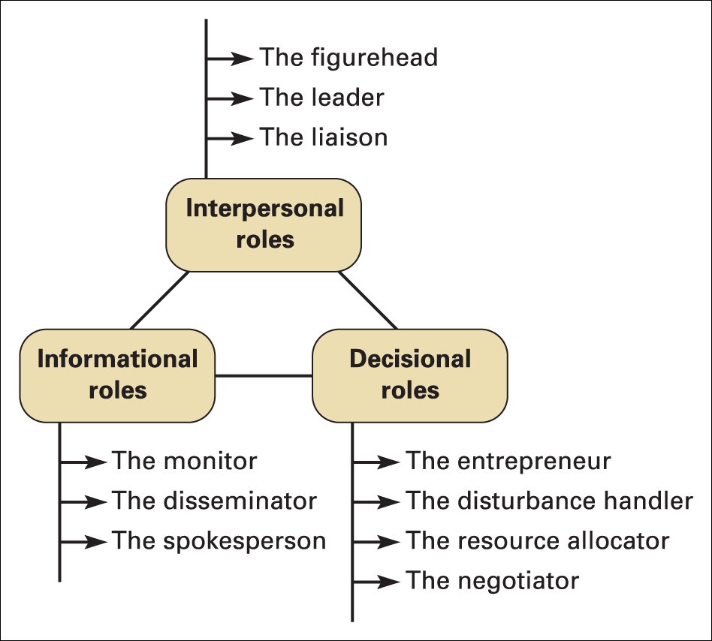
Mintzberg’s Managerial Role
Consulting is a managerial activity!!!

Slide 7

Defining management consultancy
The MCA’s definition of management consultancy is:
  Management consultancy is the creation of value for organisations, through the application of knowledge, techniques and assets, to improve performance. This is achieved through the rendering of objective advice and/or the implementation of business solutions.
This clearly states that its concern is to create value for organisations

Slide 8

A 1960s joke…….
A management consultant is someone who will borrow your watch to tell you the time
(Sturdy et al, 2009)
….be assured that the client is someone with a very expensive watch who doesn’t know the time of day (The Times, 16/10/14)

Slide 9

Benefits and risks: what are they?
In groups of 4, consider the following:
a. What are the potential benefits of employing a
management consultant?
b. What are the potential risks?
Appoint a spokesperson to feedback your thoughts to the
rest of the class

Slide 10

Employing Management Consultants: benefits & risks identified
BENEFITS
RISKS
Fresh ideas
Independent
Professional
Specialist skills
Funding
No employment costs
Short term or long term solutions
Costs
Lack of control
External Issues

Slide 11
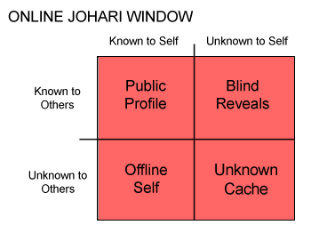
Johari window
Luft & Ingram (1955) developed the Johari model, which is most often applied to individuals
However, this model is equally applicable to organisations and perhaps reveals the added value of consulting

Slide 12
Johari window (Biggs, 2010)

Slide 13
Adding value – research
Ringland and Shaukat (2004) summarised research that found management consultancies were employed in five key areas consisting of:
  Implementation
  specialist knowledge
  blame
  independence/impartiality
  validation/assurance

Slide 14
Ringland and Shaukat (2004)

Slide 15
Summary
Management consulting can be defined as an industry and practice
It concerns adding value to the client organisations
The Johari window can be used to illustrate how consultancy adds value
Ringland and Shaukat (2004) found there were also other areas where consultancy adds value

Slide 16
Further reading
Biggs, D.M. (2010), Management Consultancy: A guide for students London: Cengage Ltd – Chapter 2
Sturdy, A., Handley, K., Clark, T. and Fincham, R. (2009), Management consultancy boundaries and knowledge in action. Oxford: Oxford University Press
Clark, T. and Salaman, G. (1998a), Creating the 'Right' Impression: Towards a Dramaturgy of Management Consultancy. Service Industries Journal, 18(1), 18-38
Costas, J. and Fleming, P. (2009), Beyond dis-identification: A discursive approach to self-alienation in contemporary organizations. Human Relations, 62 (3), 353-378
Ringland, G. and Shaukat, A. (2004), An uncertain future for management consulting. European Business Forum, 19, 58-61

Slide 18
What is management consultancy
What types of firms exist within management consultancy?
Do these firms operate in different markets or industries?

Slide 19
Consultancies ARE different

Slide 20

Fields of consulting activity
Consultancy in
  SMEs
  Public sector
  Large corporations
  International

Slide 21

SME’s
Some 23 million SMEs provide around 75 million jobs and represent 99% of all enterprises in the 25 countries that make up the enlarged European Union
SMEs are also important for other large economies such as the US
Most business research is only conducted in larger organisations (Biggs & Crumbie, 2000; Mughan, Lloyd-Reason & Zimmerman, 2004).

Slide 22

SME’s
SMEs prefer sustained support almost like having a trusted advisor on hand to discuss issues tends to be different and take on the role of trusted advisor than being more project based (Harris-Loxley & Page, 2001)
Thus project based consulting is unlikely to work with SMEs as with larger firms
However, this may not be the case if the firm is going under

Slide 23

Public Sector
Public sector organisations are becoming more business-like in their focus
As such they use management consultancies to install business practices and culture from the private sector
Although sometimes, theire IT investment, etc. can be greater than their private counterparts

Slide 24

Public Sector
Roodhooft and Van Den Abbeele (2006) argued that consultancies are used by the public sector due to the following reasons:
  To reduce workload in the organisation
  To provide increased knowledge or competence due to the lack of this expertise existing in the organisation
  To provide a third party, independent perspective on an issue or problem
  To use consultants as ‘change agents’ bringing in public sector reform

Slide 25

Large corporations
Large corporations are typically difficult clients but the rewards and opportunities can be great (Jeans & Page, 2001)
Often it is difficult to get the whole picture within the client
So the focus here is using a variety of sources to back-up opinions and perspectives

Slide 26

Large corporations
Jeans & Page, (2001) argue that the following are essential in consulting with large corporations:
  Taking matters at face value and not getting collaborative information
  Separating yourself from the clients politics
  Knowing the scope of the project and avoiding project creep
  Not out staying your welcome

Slide 27
Summary
There are generalist and niche or specialist firms
Bigger is better (especially in terms of rates)
Consultancy in SMEs is not typically project based
Public sector organisation use management consultancies to install business ideas/practices
Large corporations are typically difficult but the opportunities can be great
International consultancy is very different from consultancy in the country of origin and understanding this is key for success

Slide 28
Further reading
Biggs, D.M. (2010), Management Consultancy: A guide for students London: Cengage Ltd – Chapter 3
Inside Careers (2009/10) The Inside Careers Guide to Management Consultancy. Published in partnership with the IBC and MCA. Available online at www.insidecareers.co.uk.
Gerstner, L.V. (2002), Who Says Elephants Can't Dance?: Inside IBM's Historic Turnaround. HarperBusiness
Harris-Loxley, R. and Page, T. (2001) Small and medium-sized firms In, Sadler, P. (Ed) Management Consultancy: A Handbook of Best Practice. Kogan Page Ltd: London.

Slide 29
David Biggs

Slide 30

Range of consultancy activity
Management consultants by their very nature tend to have specialist knowledge
The Institute of Business Consulting defined this as:
    Business strategy
    Manufacturing and business services
    Marketing
    Financial and management controls
    Human resources
    Information technology
    Environmental management
    Quality management

Slide 31
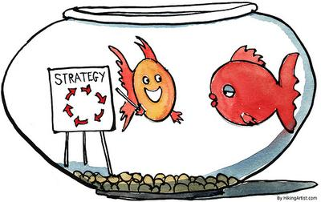
Business strategy
Strategy may be defined as the policies and procedures in an organisation that gives it a sustained competitive advantage (Lawler, 2006; Legge, 2005)
Business strategy involves more than just specifying an organisation’s mission, vision and objectives but also aiding the company through projects or programmes of growth
Strategy needs to take into account the key stakeholders of the business (Obolensky, 1994)

Slide 32

Manufacturing and business services
Manufacturing is the use of machines, tools and people to create objects for use (by other manufacturers) or for sale either directly or via a retailer
It typically involves large scale industrial production whereby raw materials are manufactured into finished goods
Consultancies can work in this area examining issues such as production, quality control, use of human resources

Slide 33

Financial and management controls
Financial planning and control are essential for any business (Collis & Hussey, 2007; Kind, 2001)
Consultancy in this field may range from implementing budgetary control, financial planning, or calculating large investments in capital
Area fraught with difficulties: overspends/accountability/politics

Slide 34

Marketing
The American Marketing Association defines the activity of marketing as:
Marketing is the activity, set of institutions, and processes for creating, communicating, delivering, and exchanging offerings that have value for customers, clients, partners, and society at large
Consultancy may examine marketing as
  a function (examining a clients sales activity) or
  market research (e.g., consultation)

Slide 35

Human resources
Human resource management (HRM) which may be defined as the strategic and consistent approach to the management of individuals within an organisation
Through the management of the organisation's most valued assets, great business benefits can be released (Hackman & Oldham, 1975)
HRM represents a major investment in terms of what has been spent on individuals not only to recruit them but also to train and develop them into an effective employee

Slide 36

Information technology
Projects and programmes in information technology (IT) or more often name Information Computer Technology (ICT) can range in size like projects
Smallest may be simply investigating why users are not using a particular programme in terms of human machine interaction (e.g., Biggs & Marshall, 1999)
Other projects, may be vast such as NPfIT, a computer system being developed for the NHS may be vast (Brennan, 2005)

Slide 37

Environmental management
Environmental management is a growing area for consultancy
Projects within this area may include urban, regional and international development planning
Projects may seek to improve the quality of lifestyle for poorer nations
Other projects demonstrate how physical, economic, ecological and sociological aspects manifest in our environment for the good of all human kind

Slide 38

Quality management
These types of project range in scope from revising how a department measures performance through to large scale implementation of quality procedures
Investigate the existing quality procedures of a company and then revise this setting out policy, performance measures and revised quality assurance
May involve satisfying the requirements of quality assurance bodies (e.g., ISO9001)

Slide 39
Range of consultancy activity
All of these areas can have textbooks and even degree programmes in their own right!
Human resources for instance can be completed from the CIPD (personnel & HRM) angle
Human resources can also employ business/occupational psychologists for:
  Selection
  Training
  Motivation, etc

Slide 40
Further reading
Biggs, D.M. (2010), Management Consultancy: A guide for students London: Cengage Ltd – Chapter 10
Lawler, E.E. (2006) Business strategy: creating the winning formula In, Gallos. J.V. (Ed) Organisational Development San Francisco: Wiley & Sons
McLarty, R. and Robinson, T. (1998) The practice of consultancy and a professional development strategy Leadership & Organization Development Journal. 19, 5, 256–263

Slide 41

8 pre-requisites for selling consultancy
There is a client
The client has a currently unfulfilled need
The client believes that they require help to resolve this need
The client knows about you and your services
The client perceives that you are capable of fulfilling this need
You (or someone else acceptable to the client) are available to fulfil the engagement
The client has a budget/finances to pay for your services
The client has authority to spend the budget/finances

Slide 42

Product Types: who uses consultants and why?
Who?
Public, Commercial and Voluntary sectors
Large and small organisations
Why?
Support/progress aims and objectives
Process Improvement
Operations Management
Motivation
Systems
Product Performance
Service Quality

Slide 43

Consultancy Services
Business Strategies
Finance
Management
HR/Personnel Resourcing & Development
IT Marketing / E Business
Marketing
Supply Chain
Tourism/Events
Sports Programming

Slide 44

Consultancy Role: what may be expected?
Varied activities
Specialist skills
Professional Expert
Consultation
Facilitator
Advisor
Entrepreneur
Innovation
Teamwork / working alone
Strategic Solutions
Project Management

Slide 45
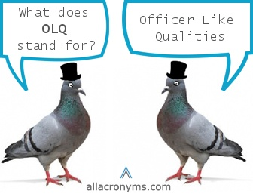
Consultancy
Qualities & Skills
Qualities?
Solutions person
Ideas person
Learning styles
Professionalism
Team player
Management understanding
Appreciation of corporate cultures
Confidentiality
Skills?
Communication skills
Listening skills
Leadership skills
Marketing skills
Networking skills

Slide 46

Skills needed to succeed!
Ability to identify your competitive advantage
Create a dynamic marketing plan
Qualifications, skills and experience
Ability to write proposals
Effective pricing for your service
Funding support and guidance
Market positioning
Reputation

Slide 47

Consultancy Research
Process
Requirements:
Identify issues /hypothesis
Research Methods
Data Collection:
Interviews – clients, staff or management
Mystery shoppers/guests
Focus Groups
Workshops
Analysis
Report

Slide 48
Consultancy Reports
Based on research & involve:
detailed business proposals
presentation of findings
report writing
Via:
Presentations
Reports
Expectations may include:
Identification of options
Putting forward solutions
Consideration of costs & resource issues
Implementation strategies
Review and feedback
Assist clients at all stages
Project management

Slide 49

What sort of projects?
Look for those that……
Have the potential to be well-defined in terms of objectives and outcomes
Relate to a well-defined part of the organisation or business unit
Are sponsored by someone of seniority in the organisation
Are meaningful to the business

Slide 50

BUT……
Offer a broad-based management experience
Don’t demand too specific and advanced a knowledge by you
Go for positive projects that let you show off your range of management skills, get you working with someone senior on something that they’d like you to do for them
Extra pair of hands……do that project they’ve been putting off.

Slide 51


Ideas that could add
How could a hotel increase use of the leisure facilities/health club?
New procedures –e.g. complaints systems?
Assessment of how good internal communication systems are
Brand extension opportunities
Review of marketing effectiveness
Promotion of corporate social responsibility or community engagement
Market research into a new product/service

Slide 52
Today’s Objectives
To recognise the contribution it plays today
To consider the benefits it offers organisations
To examine the different types of consultancy activity and business sectors involved
To begin to consider the issue of client engagement
Tutorial: Choosing your topic – book it!!

Slide 53

Next week:
The Consultancy Process: Bid to Delivery
Working with Clients
The Consultant in Action –
The Hotel Inspector

