Slide 1
Business & Society
Ethics, Sustainability & Stakeholder Management
10th Edition
© 2018 Cengage

Slide 2
Chapter 6
Issue, Risk and Crisis Management

Slide 3
Learning Outcomes
Distinguish between risk management, issue management, and crisis management.
Describe the major categories of risk and some of the factors that have characterized risk management in actual practice.
Define issue management and the stages in the issue management process.
Define crisis management and identify four crisis stages.
List and discuss the major stages or steps involved in managing business crises.

Slide 4
Chapter Outline
The Relationship Between Risk, Issue, and Crisis Management
Risk Management
Issue Management
Crisis Management
Summary

Slide 5
Risk, Issue & Crisis Management
With little government oversight, the consumer is forced to rely on businesses to act responsibly.
But such tragedies, and the financial scandals of many corporations, continue to erode consumer trust in businesses.
Major external social events not caused by business also affect businesses, and firms must prepare to deal with them.
No company is immune to the threat of a crisis, but few prepare.
Managerial decision-making processes should include Risk Management, Issue Management, and Crisis Management.

Slide 6
Relationships Between Risk, Issue, and Crisis Management (1 of 2)
Differentiating between these 3 is difficult. Many product managers cannot differentiate between “risks” and “issues,” which has led them to be labeled the Siamese twins of public relations.
The Issue Management Council definitions:
  Issue – a gap between a firm’s actions and stakeholder expectations
  Risk – a potential issue that may or may not occur
  Crisis – an issue that has escalated to a critical state

Slide 7
Relationships Between Risk, Issue, and Crisis Management (2 of 2)
Goal: To be effective, risk, issue and crisis management must close the gap between the firm’s situation and its stakeholders’ expectations.
Many of the crises firms face today arise out of issue categories they are monitoring and prioritizing through issue management systems.
Risk Management may keep issues from arising
Effective issue management may enable the firm to avoid a crisis, or minimize its impact, and is vital to post-crisis management.

Slide 8
Risk Management (1 of 2)
Risk management concerns potential issues; it addresses an issue that has not yet occurred, and tries to keep the issue from arising.
A “rules” approach to risk management can help prevent internal risks, but not those that stem from firm strategy or risks in the external environment.
  Example: In 2007, Tony Hayward, new CEO of British Petroleum (BP) promised to make safety his priority. His new rules required that employees not text while driving, and that they use lids on their coffee cups while walking. Of course, those rules did not prevent the Deepwater Horizon from exploding three years later.

Slide 9
Risk Management (2 of 2)
A new framework for Risk management divides it into three categories:
  Preventable risks – internal risks that offer no strategic benefit (BP’s coffee lids)
  Strategic risks – risks taken to achieve greater returns (BP’s deep drilling)
  External risks – external risks that cannot be controlled (natural disasters and economic shocks)

Slide 10
Risk Management & Sustainability
Sustainability involves living in the present in a way that does not compromise the future.
Risk Management involves taking action today that will mitigate or prevent a problem that could arise in the future.
Both are concerned with the future consequences of present-day actions.
Risk-shifting may damage the sustainability of others.

Slide 11
Issue Management -
is a process by which organizations:
  identify issues in the stakeholder environment,
  analyze and prioritize them in terms of their relevance to the organization,
  plan responses to the issues, and then
  evaluate and monitor the results.
It is helpful to think of issue management in connection with sustainable strategic management process, enterprise-level strategy, corporate public policy, and integrated reporting.

Slide 12
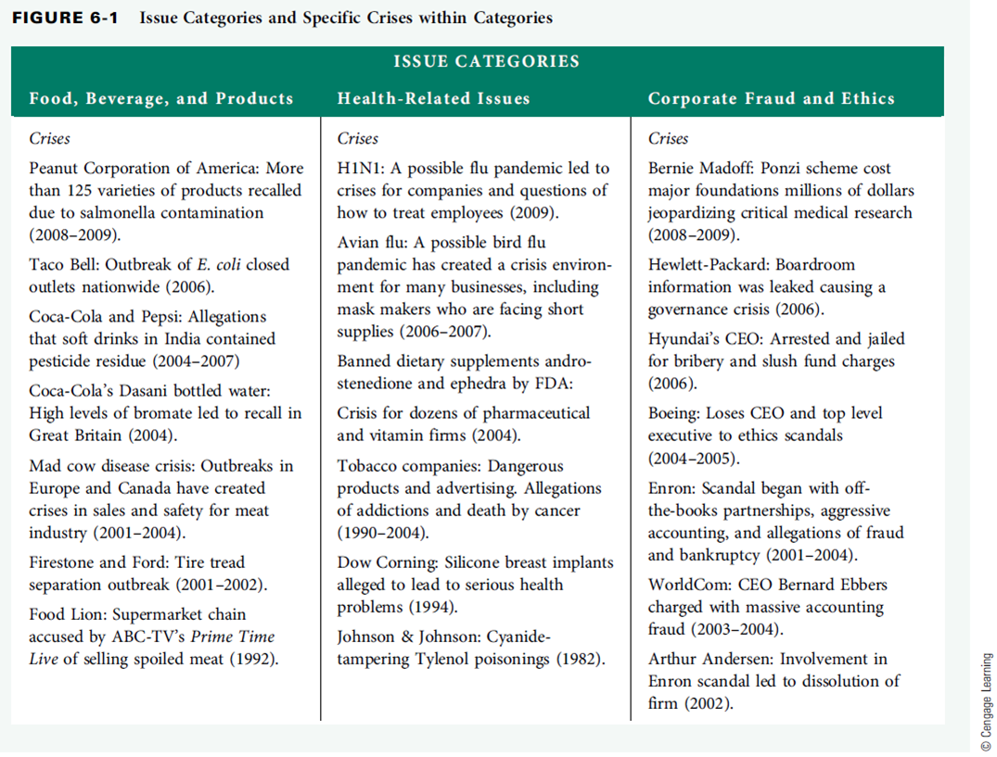
Fig 6-1

Slide 13
Portfolio Approach -
Experience with prior issues likely influences future issues
Provides focus and coherence to the firm’s dealing with the mix of issues it faces
Failure to adopt certain issues into the portfolio does not signal neglect, but is part of a rational process of issue management in which strategic priorities are vital

Slide 14
Issue Definition -
A gap between what stakeholders expect and what the firm is doing.
The gap typically involves debate, controversy, or differences of opinion that must be resolved.
At some point, the organization must make a decision on the matter, but that does not mean the issue is resolved.
Once an issue becomes public, its resolution becomes increasingly more difficult.
Issues are ongoing, and require ongoing responses.

Slide 15
Emerging Issues -
Characteristics of an emerging issue -
The terms of the debate are not clearly defined.
The issue deals with matters of conflicting values and interest.
The issue does not lend itself to automatic resolution by expert knowledge.
Issue is often stated in value-laden terms.
Trade-offs are inherent.

Slide 16
Issues Management Process-
Issues can be identified earlier, more completely, and more reliably.
Early anticipation:
  Widens the range of options.
  Permits study and understanding of the full range of issues.
  Permits organization to develop a positive orientation towards the issues.
The organization will have earlier identification of the stakeholders.
The organization will be able to supply information to influential publics earlier and more positively, creating better understanding.

Slide 17
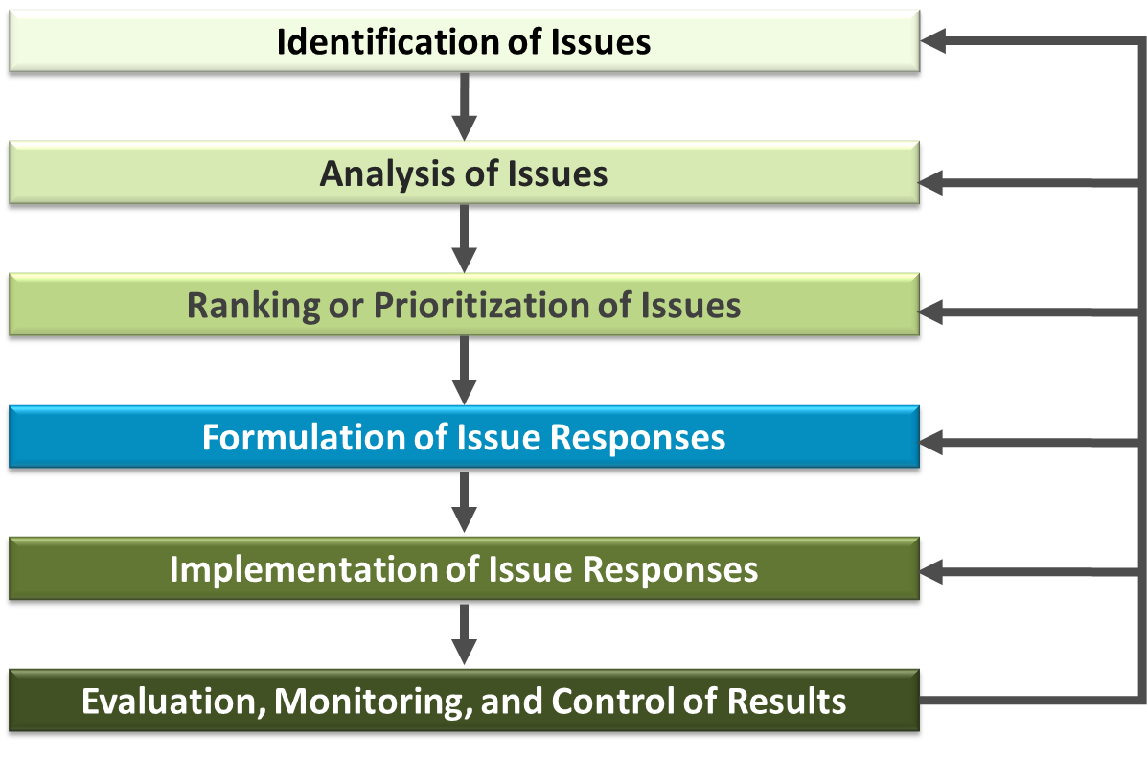
Model of Issues Management Process

Slide 18
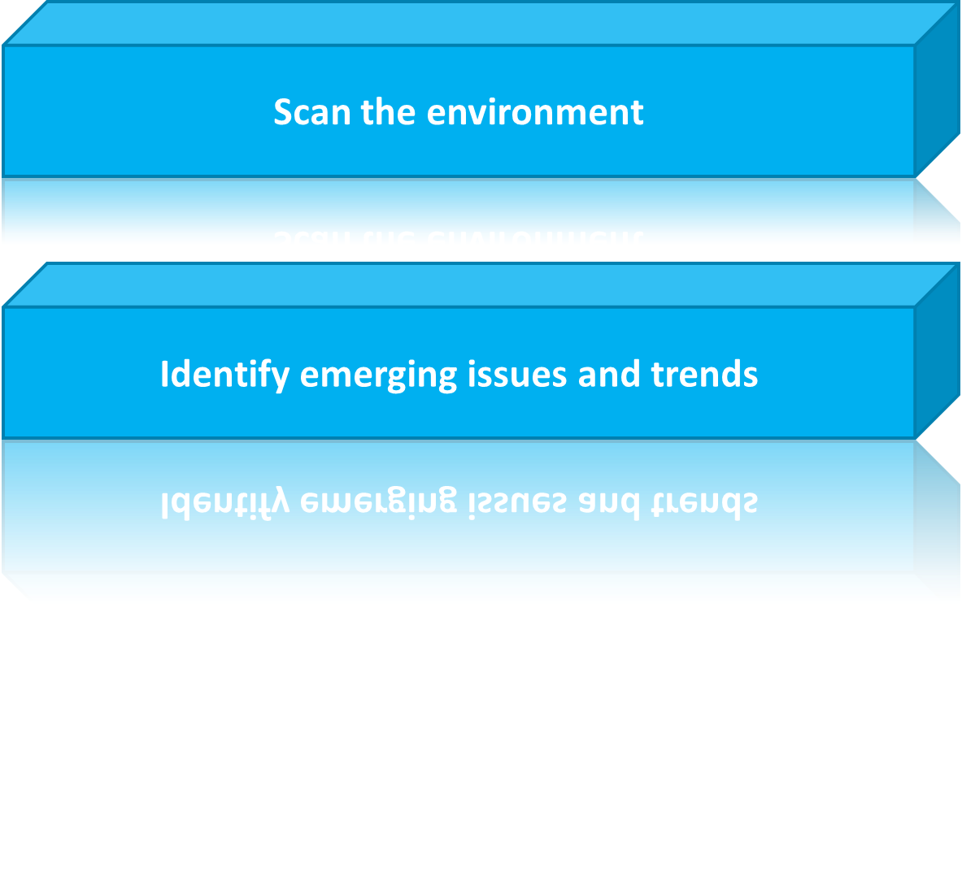
Identification of Issues (1 of 2)

Slide 19
Identification of Issues (2 of 2)
Five Leading forces as predictors of social change:
  Events
  Authorities or advocates
  Literature
  Organizations
  Political jurisdictions
If these five forces are monitored closely, impending social change can be identified, and sometimes predicted.

Slide 20
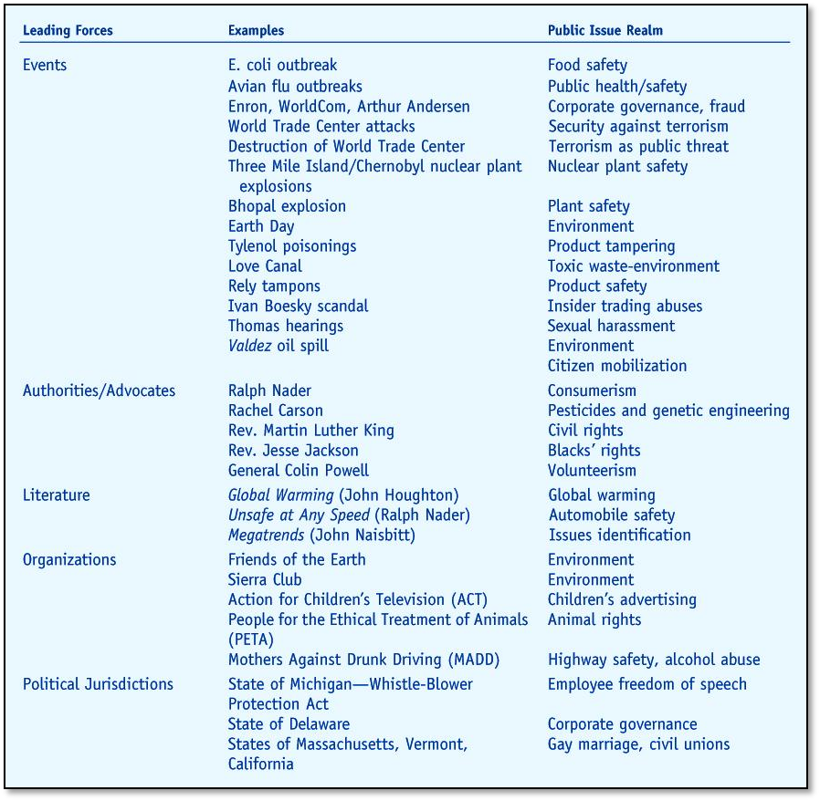
Examples of Forces Leading Social Change

Slide 21
Issue Selling and Buying
Issue selling -
Relates to middle managers exerting
upward influence in organizations as they try to attract the attention of top managers.
Issue buying -
Top managers adopt a more open
mind-set for the issues that matter to their subordinates.

Slide 22
Analysis of Issues -
Who (which stakeholder) is affected by the issue?
Who has an interest in the issue?
Who is in a position to exert influence?
Who has expressed opinions on the issue?
Who ought to care about the issue?
To help with issue analysis:
Who started the ball rolling? (Historical view)
Who is now involved? (Contemporary view)
Who will get involved? (Future view)

Slide 23
Ranking or Prioritization of Issues
Two essential questions -
  How likely is the issue to affect the organization?
  How much impact will the issue have?
Once these questions are answered, it is necessary to prioritize them as to their importance or relevance to the organization.
Those listed at the top will receive the most attention and resources; those at the bottom may be removed from consideration.

Slide 24
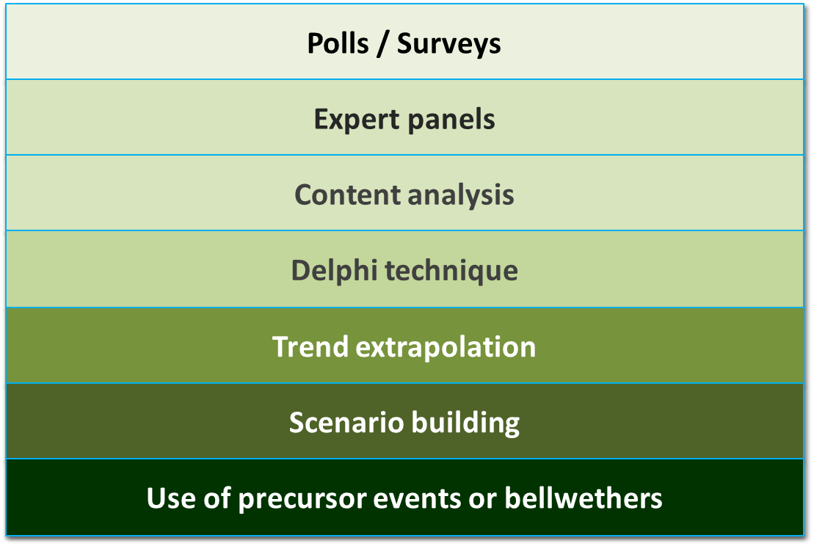
Other Issues: Ranking Techniques

Slide 25
Formulation and
Implementation of Response
Formulation -
The response design process.
Implementation -
The action design process.
  Clarity of the plan
  Resources needed to implement the plan
  Top management support
  Organizational structure
  Technical competence
  Timing

Slide 26
Evaluation,
Monitoring, and Control
Companies should continually evaluate the results of their responses to issues.
Ensure that actions are kept on track.
  Includes careful monitoring of stakeholder opinions.
  A form of stakeholder audit (similar to a social audit) can be used.
Information from this stage helps firms to make adjustments to the process as needed.

Slide 27
Issue Development Process
Issues Development Process -
The growth process or life cycle of an issue helps management recognize when an event or trend is becoming an issue.
The process has four stages:
  Felt need
  Media coverage
  Leading political jurisdictions
  Regulation or litigation

Slide 28
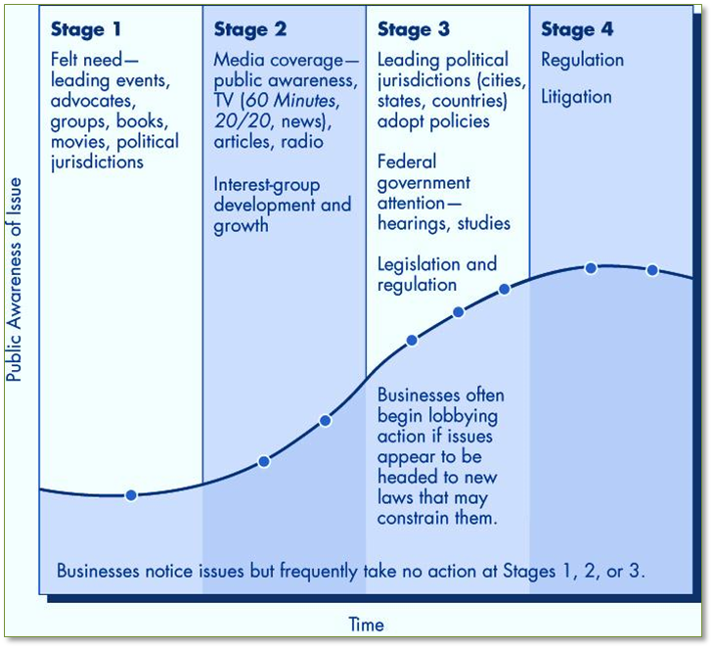
Issues Development Life Cycle Process

Slide 29
Illustrations of Issue Development
Environmental Protection
Social expectation manifested in Silent Spring by Rachel Carson.
Eugene McCarthy’s political platform
Legislation in 1971-1972 with creation of the EPA
Emissions standards, pollution fines, product recalls, environmental permits
Product or Consumer Safety
Social expectation manifested in Unsafe at Any Speed by Ralph Nader
Political issue through the National Traffic Auto Safety Act and Motor Vehicle Safety Hearings
Social control reflected in ordering seatbelts in all cars, defects litigation, product recalls, and driver fines

Slide 30
Issue Management in Practice
Issue management covers a range of public relations and management activities.
Companies that adopt issues management processes:
  Develop better overall reputations
  Develop better issue-specific reputations
  Perform better financially
The most successful firms sought close-knit ties with external and internal stakeholders, and successfully incorporated their values and interests into management decisions.

Slide 31
Crisis Management -
A crisis can rip the foundation of an organization to shreds if top management does not respond:
  quickly
  decisively, and
  effectively
A strong and effective response can strengthen an organization in the long run.
Best examples:
  Prudential’s response, including donations and volunteers, to Japan’s earthquake and tsunami
  Johnson & Johnson’s recall of their product Tylenol, tainted through no fault of their own

Slide 32
Crisis Management
How NOT to manage a crisis:
When Tiger Woods crashed his Cadillac into a tree in his community, the media converged. Allegations of serial infidelity arose, and the crisis escalated into an organizational crisis for his billion dollar empire. Woods said nothing for days, then spoke vaguely regarding the accusations.
Rules of crisis management:
Don’t wait.
Don’t run from the truth.
Don’t hide.

Slide 33
The Nature of Crises
There are many definitions of crisis; here are two:
A crisis is an extreme event that may threaten your very existence. At the very least, it causes substantial injuries, deaths, and financial costs, as well as serious damage to your reputation.
An organizational crisis is a low-probability, high-impact event that threatens the viability of the organization and is characterized by ambiguity of cause, effect, and means of resolution, as well as by a belief that decisions must be made swiftly.

Slide 34
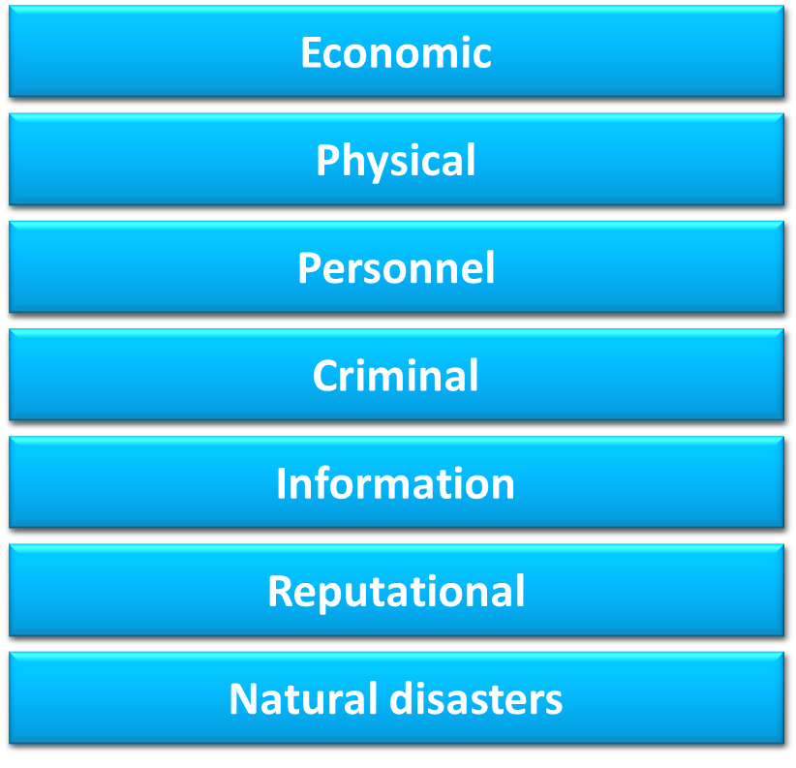
Types of Crises

Slide 35
Outcomes of Major Crises
After major crises, companies reported:
The crises escalated in intensity
The firm was subjected to media and government scrutiny
The crises interfered with normal business operations
The crises damaged the companies bottom line
Resulted in major power shifts; those who handled the crisis well, rose; those who fumbled, lost

Slide 36
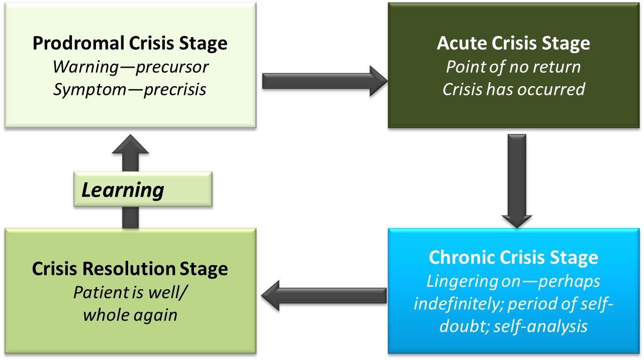
Crisis Management: Four Stages

Slide 37
Managing Business Crises
Five practical steps in managing crises
  Identifying areas of vulnerability
  Develop a plan for dealing with threats
  Forming crisis teams
  Simulating crisis drills
  Learning from experience
Effective crisis management requires tailoring a program to a firm’s industry, business environment and crisis management experience.

Slide 38
Ten Steps of Crisis Communications
Identify your crisis communication team
Identify key spokespersons, authorized to speak for the organization.
Train your spokespersons.
Establish communications protocols.
Identify and know your audience.
Anticipate crises.
Assess the crisis situation.
Identify key messages to communicate to key groups (speak first to internal stakeholders).
Decide on communication methods.
Be prepared to ride out the storm.

Slide 39
Successful Crisis Management (1 of 2)
Being prepared for a crisis:
Example: After Hurricane Katrina, both Walmart and Home Depot stood out for their preparedness and assistance.
Learning from Crises:
CEOs coping with Katrina learned:
  Take care of your employees
  Keep communication lines open
  Get ready for the next disaster

Slide 40
Successful Crisis Management (2 of 2)
Schwan’s was notified of a possible salmonella outbreak involving its products.
It immediately shut down, halted all sales and production, and invited the state health department, the department of agriculture, and the FDA in to the plant to investigate.
Within 24 hours, it set up a hotline to answer consumer questions, contacted employees and managers to staff the hotline, prepared for a product recall, and began working with its insurer.
Medical treatment was given, bills paid and losses reimbursed to those affected, and after one year, most claims were resolved. The source of contamination was discovered (a supplier) and Schwan’s began preparing to prevent a reoccurrence.

Slide 41
Key Terms
acute crisis stage
chronic crisis stage
crisis
crisis communications
crisis management
crisis resolution stage
crisis teams
emerging issue
external risks
issue
issue buying
issue definition
issue development process
issue management
issue selling
portfolio approach
preventable risks
prodromal crisis stage
risk management
strategic risks

