Slide 1
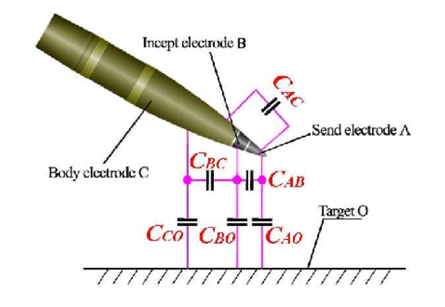
Principles of OME
Level 4
ACDA4019
Fuzing

Slide 2
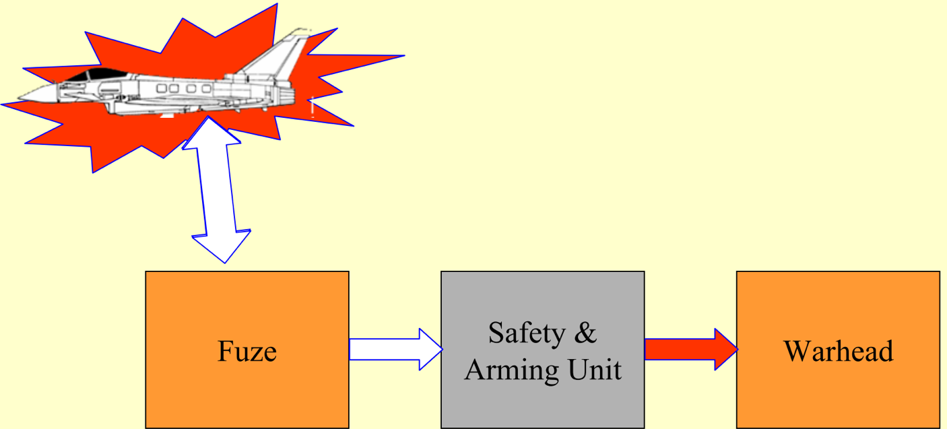
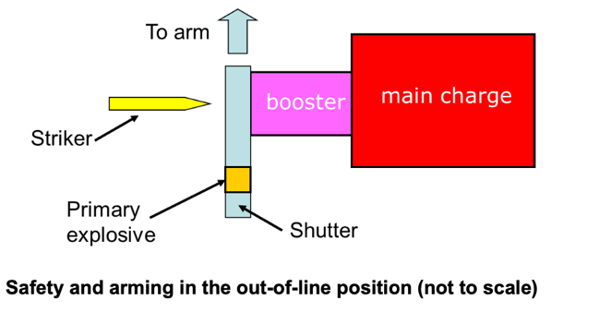

Slide 3
Subjects.
Types of Fuze.
Functionality
Environment
Construction
Explosive Train
Safety Mechanisms.
Future.

Slide 4
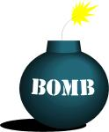

Fuse
Fuze
13 Amp
X


Slide 5
Ammunition natures.
Most types of projectile, Medium Calibre upwards.
Artillery.
Mortar.
Missiles, inc torpedoes.
Bombs.
Special applications eg anti-structures.
Mines

Slide 6
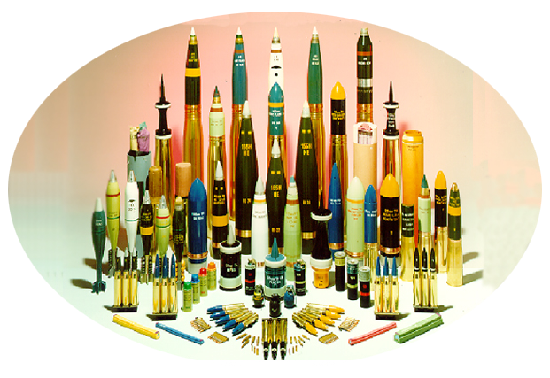

Slide 7
Generic Functions of a Fuze
Maintain safety of the shell/warhead filling during storage, transport, handling and firing until after deployment or launch and the target is sensed.
Function the payload/filling reliably at the required time.
It is a one-shot device with a 20 year shelf-life.

Slide 8
Design for Safety.
Premature function of ammunition leads to casualties of our own troops, civilians and equipment.
Numerous Design Safety Principles, usually governed by OB Procs, DefStan, Stanags, Mil Specs.
Typically probability of accidental arming or function of a fuze < ‘1 in a million.’
= NEVER.
Key Features
Must remain Safe under all anticipated conditions.
Arming is distinct from initiation, sensing.
Use of proven materials, explosives, compositions.
Safe to assemble, for user and manufacturer – an ability to check safety.
Out of line system usually.
No single mode failure – implies minimum 2 safety locks.

Slide 9
Reliability.
Usually defined by system requirement.
Typically 97 – 99.9%
  Influenced by system requirement.
  Overall cost of system delivery.
  1st shot reliability - (lets the bad guys know where you are !)
NB. Reliability has an implicit safety requirement and is becoming increasingly important particularly in training.
  A blind or dud round creates a hazard;
  An off-course missile normally requires S/Destruct.
  Also anti-aircraft ~25mm (missed target)
An added safety device can degrade reliability.

Slide 10
Fuze Output
2 Main types.
HE/Detonating output.
  To function a HE shell or warhead.
Igniferous Output.
  Initiate Carrier Shell with sub-munitions
    – eg warhead or bomblets. (each with fuze)
  May simultaneously ignite payload (illuminating rounds, smoke)

Slide 11
Typical Fuze construction.
3 main elements –
Sensing and initiation.
  Mechanical (Striker- Nail) and/or Electronic (RF, magnetic).
  Time.
Arming/Safety mechanism.
  Conventionally out of line mechanical systems favoured, occasionally in-line systems.
Explosive train
  To suit system function.

Slide 12
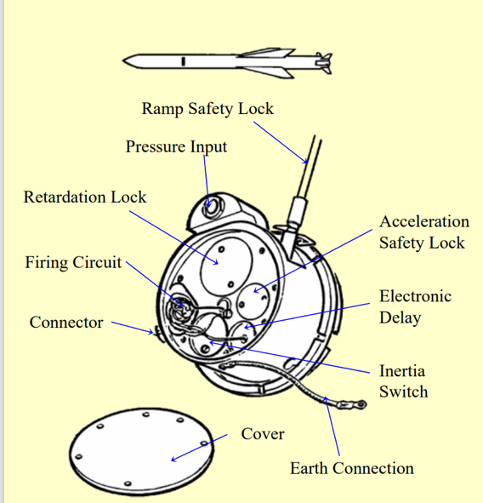
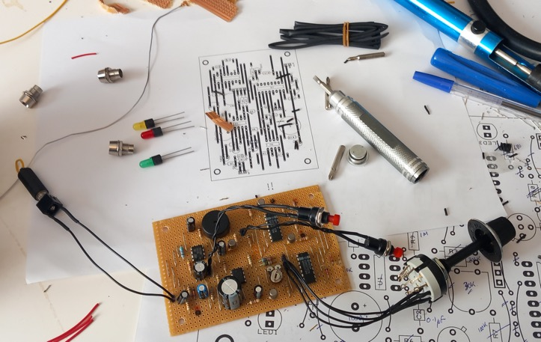
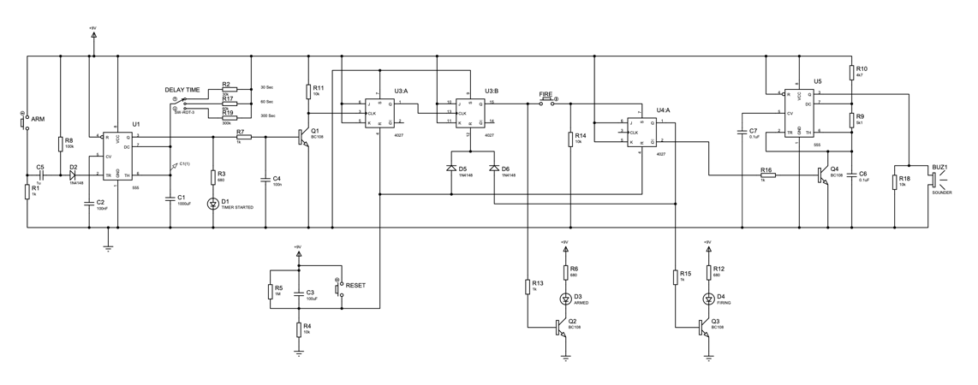
Putting it all together – Exocet SAU.

Slide 13
Proximity Fuze - schematic
Sensing and initiation.
  RF transmitter/detector.
  Processing Electronics.
Arming mechanism.
Explosive train
Battery

Slide 14
Types of Fuze. - By Position.
Nose - Most common.
Base – Often to prevent interference with system effect, eg HESH or shaped charge.
Distributed – Typically in a missile warhead system where arming, initiation and target sensing may be remote from each other.
Design principles essentially same for all.

Slide 15
Class of Fuze. (by functionality) cont.
Proximity.
  Initiates close to rather than by contact – usually RF transmitter, could be magnetic.
Time.
  Chemical time – generally obsolete
  Mechanical Clockwork – obsolescent, some in service.
replaced by
  Electronic Time – more accurate.
All require datum time, normally shot-start as the reference time. Fuze is set normally before loading.
Time may also be used to determine a proximity event - hence term Variable Time for proximity.

Slide 16
Typical Explosives.
Detonator. Sensitive to Stab, Flash, Electric. 100-150 mg. Sometimes 2 for multi-function.
Stemmed Charge, Debrix, CE.
Booster, Debrix, PETN, Rowanex, Gunpowder

Slide 17
System Launch Environment
High ‘g’ thrust – ‘set-back’
Angular Acceleration.
Spin.
Velocity
Spin Decay.
Yaw.
Impact.

Slide 18
System Launch Environment
Flick Ramming.
High ‘g’ thrust – ‘set-back’
Low ‘g’ thrust – (rocket)
Angular Acceleration.
Balloting
Spin.
Velocity.
Low ‘g’ retardation.
Spin Decay.
Yaw.
Manouver (eg apogee)
Rain/Hail
Impact.

Slide 19
System Launch Environment
Flick Ramming.
High ‘g’ thrust – ‘set-back’
Low ‘g’ thrust – (rocket)
Angular Acceleration.
Balloting
Spin. – centrifugal force.
Velocity - Air turbine.
Low ‘g’ retardation.
Spin Decay.
Yaw.
Manouver (eg apogee)
Rain/Hail
Impact.
Useful Energy Sources

Slide 20
Other Energy sources.
System Energy.
  Batteries. (Reserve Cells)
  Gas Pressure (rocket motor)
  Compressed springs.
  Pyrotechnics (gas-motors & delays)
  User (Safety Pins !)
  Lanyards
Stored Energy is generally not favoured for safety mechanisms; best practise is to draw energy from the (unique) launch environment.

Slide 21
Concept of ‘Safe-sealing’
A Primary explosive (more sensitive than Tetryl) must be out of line and must not function or degrade the explosive train if accidentally initiated.
SAFE ARMED
Exceptions. High Energy Devices. Operate at 500V+.
Slapperplates, EFI’s. Usually contain secondary explosive (eg HNS)
NB These require intrinsically safe circuits, safety is determined by control of independent electro-mechanical safety breaks. (high integrity switches)

Slide 22
Arming
Must be unique to launch .
ie Not affected by Drop, Vibration, normal Manufacture To Target Sequence.
Safety Mechanism is a ‘combination lock’,
  - launch environment is the key.
Armed when safety devices are overcome, awaiting receipt of a firing signal.
Required to cope with a variety of charges.

Slide 23
Safe – Arming Delay.
A system is normally required to have an arming delay to ensure safe-separation from the user.
Prevents premature function in the vicinity of the launch platform.
Often a distance measuring device to cope with varying projectile velocity.
Protects the ‘Goodies.’

Slide 24
Arming Devices
Shear Devices – prevent movement until a threshold load.
Springs - prevent movement until a threshold load (for a finite time).
Arming Sleeves – eg for Ball Release
Detents – a catch
Shutters. – a barrier to the explosive chain.
Escapements – control movement.
Switches – for electrical power.
Gas motors – for powered movement.

Slide 25
Function of a Mechanical Fuze

Slide 26
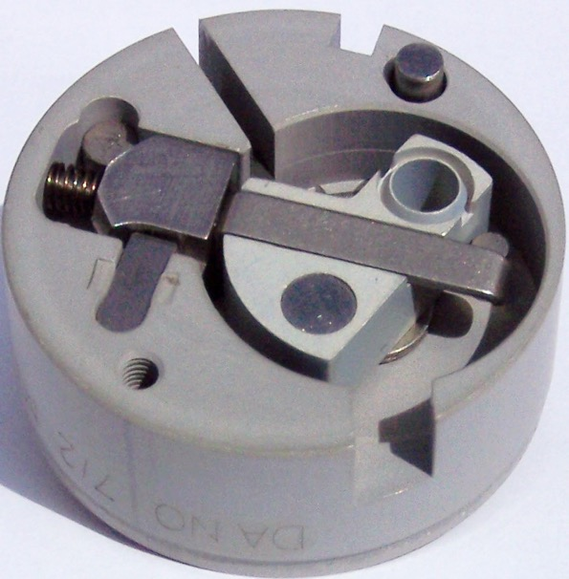
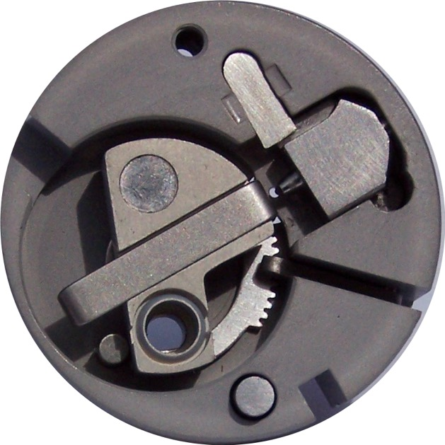
Delayed Arming Unit (DAU)
Stored & Safe Position.
Axial Detent Down on Setback. Radial Plunger spun out.
DAU shown is from a HESH round Fuze

Slide 27
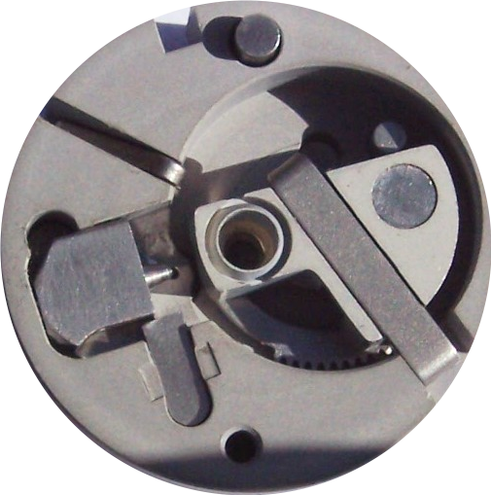
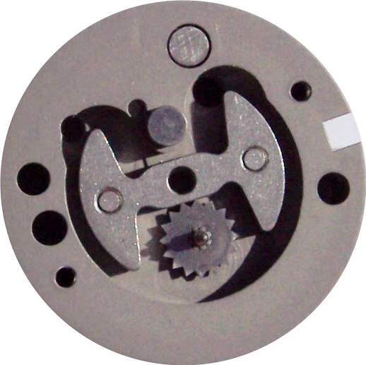
Locking Arm Set Forward
Shutter Rotated to Arm.
View of Rear with cover removed to show Pallet Mechanism (delays shutter motion.)
Locking Lever Out
Detonator In-Line
See SAU animation

Slide 28
An Electronic Proximity Fuze
4.5”HE. IA
NOSE
ASSEMBLY
FOAM
FILLING
CONTACT
RING
CIRCUIT
BOARD
LOCKING
RING
PROTECTIVE CAN
ENERGISER
BODY
GAINE (Mech + booster)
DEBRIX STEMMING
LOCKING RING
END CAP
DEBRIX PELLET

Slide 29
Electronics Ruggedness.
Solid-state
Surface Mount
Low mass – large footprint
Avoid flexing – usually supported in a potting medium. (beware dielectric effects).
Crystals can be problematic, rely on RC timers.
Firing circuits encased if PID required. – Functionality after impact.

Slide 30
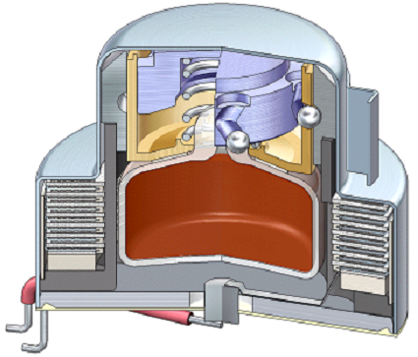
Energiser (Battery)
Also known as
‘reserve cell’
See Battery animation

Slide 31
Ballistic Phases (1)
INTERNAL BALLISTICS
FIRING VEHICLE
TARGET
Initial Projectile Motion –’Shot start’
Fuze axial detents Set-back
Batteries energised

Slide 32
Ballistic Phases (2)
INTERNAL BALLISTICS
FIRING VEHICLE
TARGET
Peak Pressure and High Acceleration.
Spin increases.
Thrust ‘freezes’ fuze mechanism.
A 1gram component ‘weighs’ 20kg !

Slide 33
Ballistic Phases (3)
INTERMEDIATE BALLISTICS
FIRING VEHICLE
TARGET
Acceleration decreasing , maximum spin.
Axial detents held back by ‘ spin locks’. Radial detents out
Fuze mechanism free to move. Final arming begins
Battery power >50%
(Muzzle shock)

Slide 34
Ballistic Phases (4)
EXTERNAL BALLISTICS
FIRING VEHICLE
TARGET
At arming distance (c. 200m)
mechanical arming complete.
Batteries at full power.
Will function in PD or Graze mode.
Target approach.
Proximity circuits switched on.
Target detection mode.

Slide 35
Ballistic Phases (5)
TERMINAL BALLISTICS
FIRING VEHICLE
TARGET
Detonation at optimum distance above target in Proximity mode.
Impact function in PD mode or as ‘back-up’

Slide 36
Proximity Fuzes
Selectable sensitivity for burst height.
  Target signatures vary
  Optimum height varies
RF environment
  Radars.
  TV, Radio,Mobile,
  ECM
Solutions to interference.
  Choice of Frequency.
  Detection Algorithm (Pattern)
  Sensor & Transmitter Disabled until target.

Slide 37
Setting.
Function - Proximity, Sensitivity, Time, PID
Hand, inbuilt switch. (cheap, easier logistics)
Contact Setters.
Inductive Setting
Feedback to confirm setting.
Interface with battlefield comms.
Often a default setting, eg Medium Height Proximity with PD back-up.

Slide 38
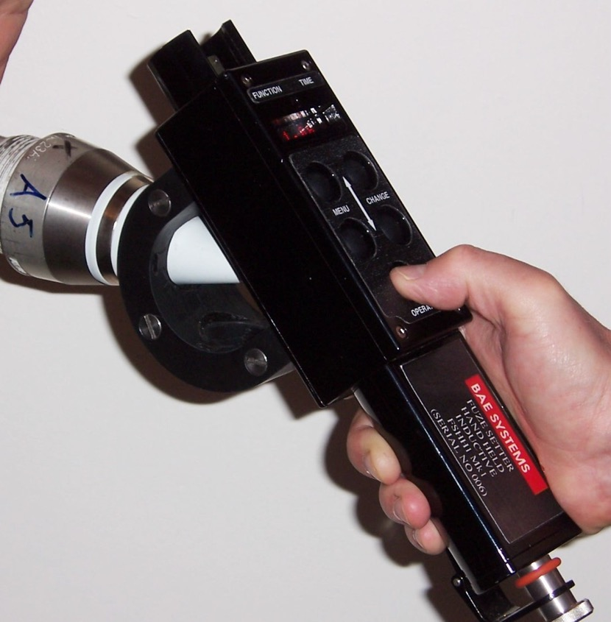
Inductive Setter

Slide 39
Typical testing methods.
Development
  Environmental stressing – On system unless simulation data available. – representative of MTTS.
  ETIT. Safe-Seal.
  ETD. Take-over.
  Jumble, Jolt,
  Spin Testing.
  Ballistic matching.
  Safe-Arming Distance
  Recovery; Overwater, Vertical, Aerobutt.
  (Components, assemblies or full fuze)
  Overpressure Gun Firings.
Production Tests.
  Function Tests; eg Electrical, Spin.
  Proof. Usually gun-firing, may include some elements of above.
  In Service Surveillance

Slide 40
Future.
Safety + High cost of proving (a relatively low cost system) leads to slow development by maturity rather than step change/novel design.
Today’s trend is for Multi-function, standardised, interoperable fuzes.
  Minimises re-fuzing, reduced logistic burden.
  IM. - little overall impact on reaction but ALARP.
Future.
  Increased functionality. Smart weaponry, GPS, course correction, reduces space for conventional function, power supplies an issue.
  Integrated systems, function selection after launch, distributed, multi-point initiaition.
  MEMS. (Micro-Electro-Mechanical Systems)
  RPV’s – New environments, new requirements.

Slide 41
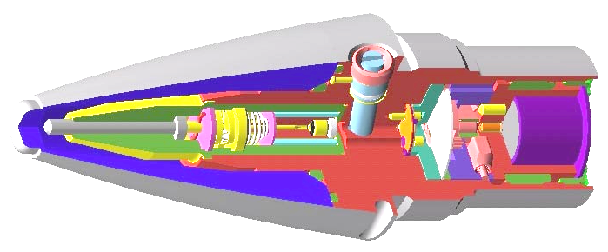
Future.
Mechanical
Technology
~100
Proximity
Antenna
Processor
Power Supply
SAU
Mag
Smart
~400
GPS/Course correction/ Processing
Inductive set
~1-2k

Slide 42
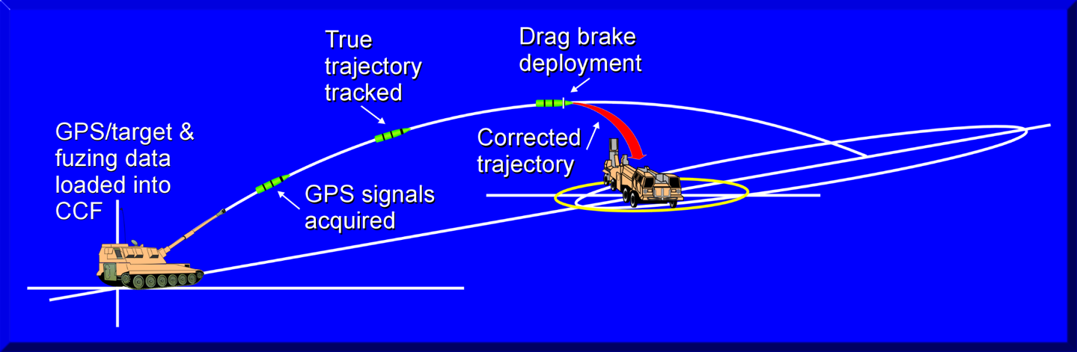
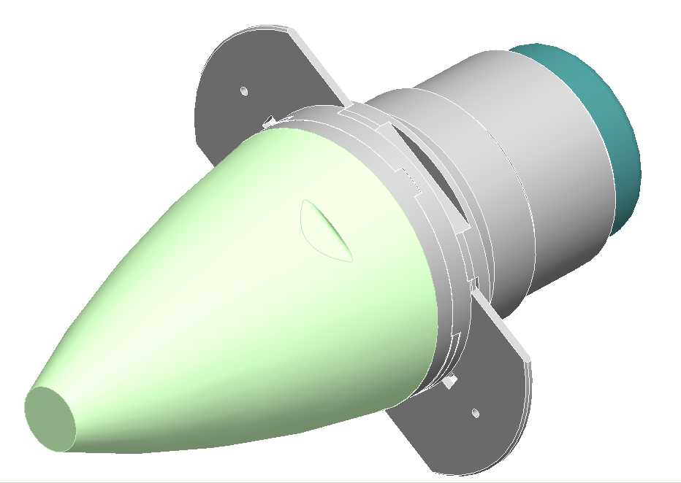
Course Correction
Pros –
Accuracy – Less rounds.
Interchangeable.
Consider-
Complimentary not replacement.
Complexity v Cost v Need
Correct for range.
Correct for range & bearing.

Slide 43
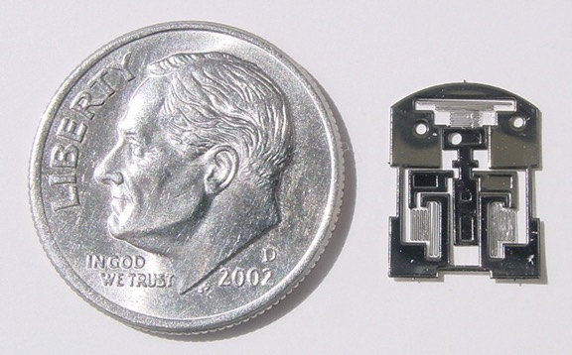
Miniaturisation
5% of payload
105/155mm
30% of payload
25mm

Slide 44
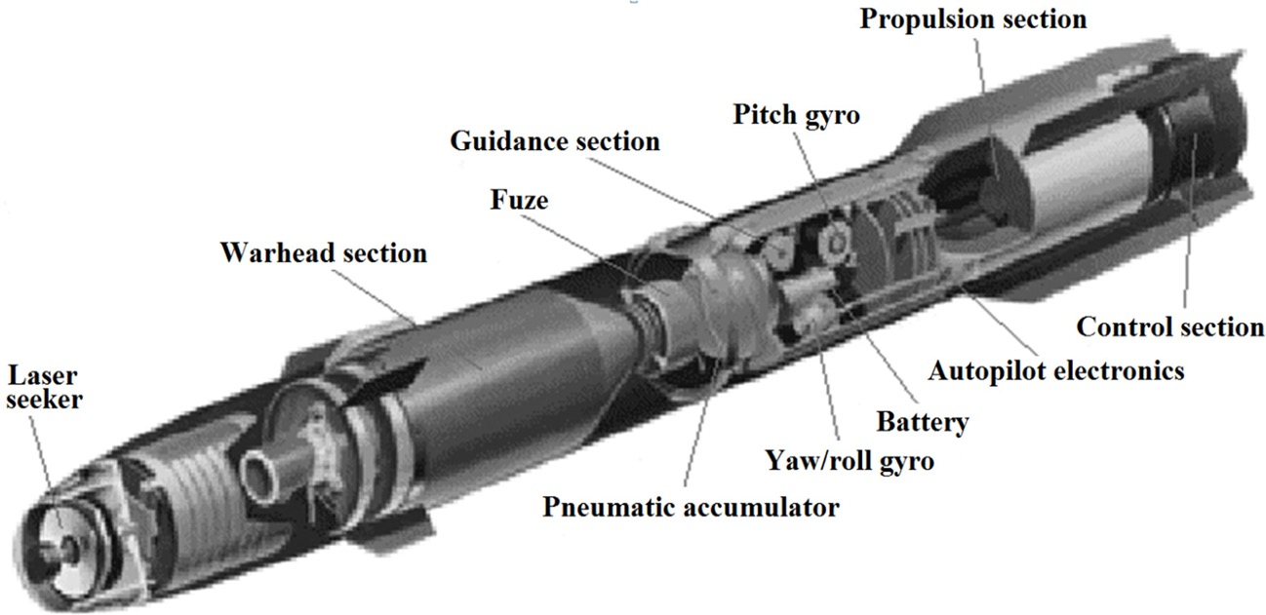
Questions?

