Slide 1


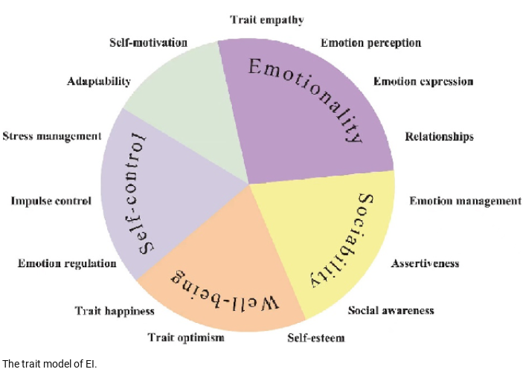
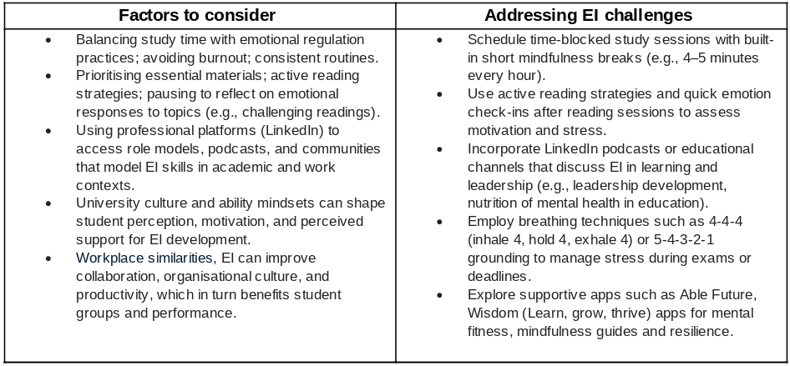
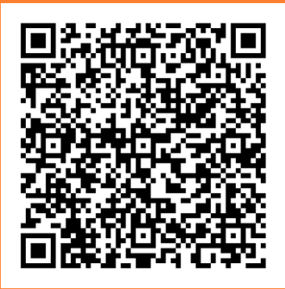
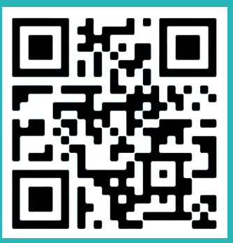
UNDERSTANDING EMOTIONAL INTELLIGENCE
What is emotional intelligence?
Emotional intelligence is the ability to recognise, understand, manage and use emotions, in yourself and in others. to improve thinking, decision and social interactions. (Bușu, A.F., 2020).
Introduction
Controlling emotions and developing mindfulness as a student
Emotional intelligence (EI) refers to the ability to perceive, understand, manage, and use emotions effectively in oneself and others. In academic settings, EI influences study habits, engagement, communication, stress management, and overall performance. This poster critically discusses how one’s own emotions affect EI, and in turn, student outcomes such as learning, motivation, and perceived organisational culture within educational contexts. By incorporating evidence from psychology and education research, the piece highlights practical strategies, supportive tools, and potential barriers that influence EI development for students, lecturers, and workplace-related learning environments (Gant, et al, 2014).
  Use pre- and post-study routines to modulate arousal (e.g., short breathing exercises before exams or presentations).
  Implement brief daily mindfulness activities (2–10 minutes) to reduce cognitive load and improve focus.
  Schedule weekly reflection sessions to assess emotional triggers during study sessions, group projects, and exams, adjusting strategies accordingly.
How can someone develop emotional intelligence?
  Develop self-awareness and self-regulation through structured reflection, journaling, and feedback loops (e.g., prompts after studying or group work) to recognise personal emotions and patterns (Bratton, et al, 2011).
  Practice social awareness and relationship management by engaging in active listening, seeking constructive feedback, and adapting communication styles to different audiences (peers, tutors, group members (Gkintoni, E, et al, 2017).
Reference list
  Bratton, V.K., Dodd, N.G. and Brown, F.W., 2011. The impact of emotional intelligence on accuracy of self‐awareness and leadership performance. Leadership & Organization Development Journal, 32(2), pp.127-149.
  Bușu, A.F., 2020. Emotional intelligence as a type of cognitive ability. Revista de Științe Politice. Revue des Sciences Politiques, (66), pp.204-215
  Gkintoni, E., Halkiopoulos, C., Antonopoulou, H., & Togias, P. (2016). Emotional intelligence in social network consumers. SSRN Journal. https://doi.org/10.2139/ssrn.
  Gkintoni, E., Papavasileiou, N., Antonopoulou, H., Halkiopoulos, C., & Stamoulis, G. (2017). Decision making with machine learning techniques in consumer performance: empathy, personality, emotional intelligence as mediators. SSRN Journal. https://doi.org/10.2139/ssrn.4314614
  Goleman, D. (1995). Emotional intelligence. Bantam Books, Inc
  Grant, L., Kinman, G. and Alexander, K., 2014. What's all this talk about emotion? Developing emotional intelligence in social work students. Social Work Education, 33(7), pp.874-889
  Yang, Lei & Duan, Manfu. (2023). The role of emotional intelligence in EFL learners’ academic literacy development. Heliyon. 9. e13110. 10.1016/j.heliyon.2023.e13110..
  https://www.healthassured.org/wisdom-app/
  https://able-futures.co.uk/
Chart from Yang, et al (2023
Lecture name: Sujeewa Herath Mudiyanselage
Component 1 - Poster Presentation
Student name: Chelsea Ward
Student number: 2322953
Module: LCLM5006
able-future app
Widsom app

