Slide 1
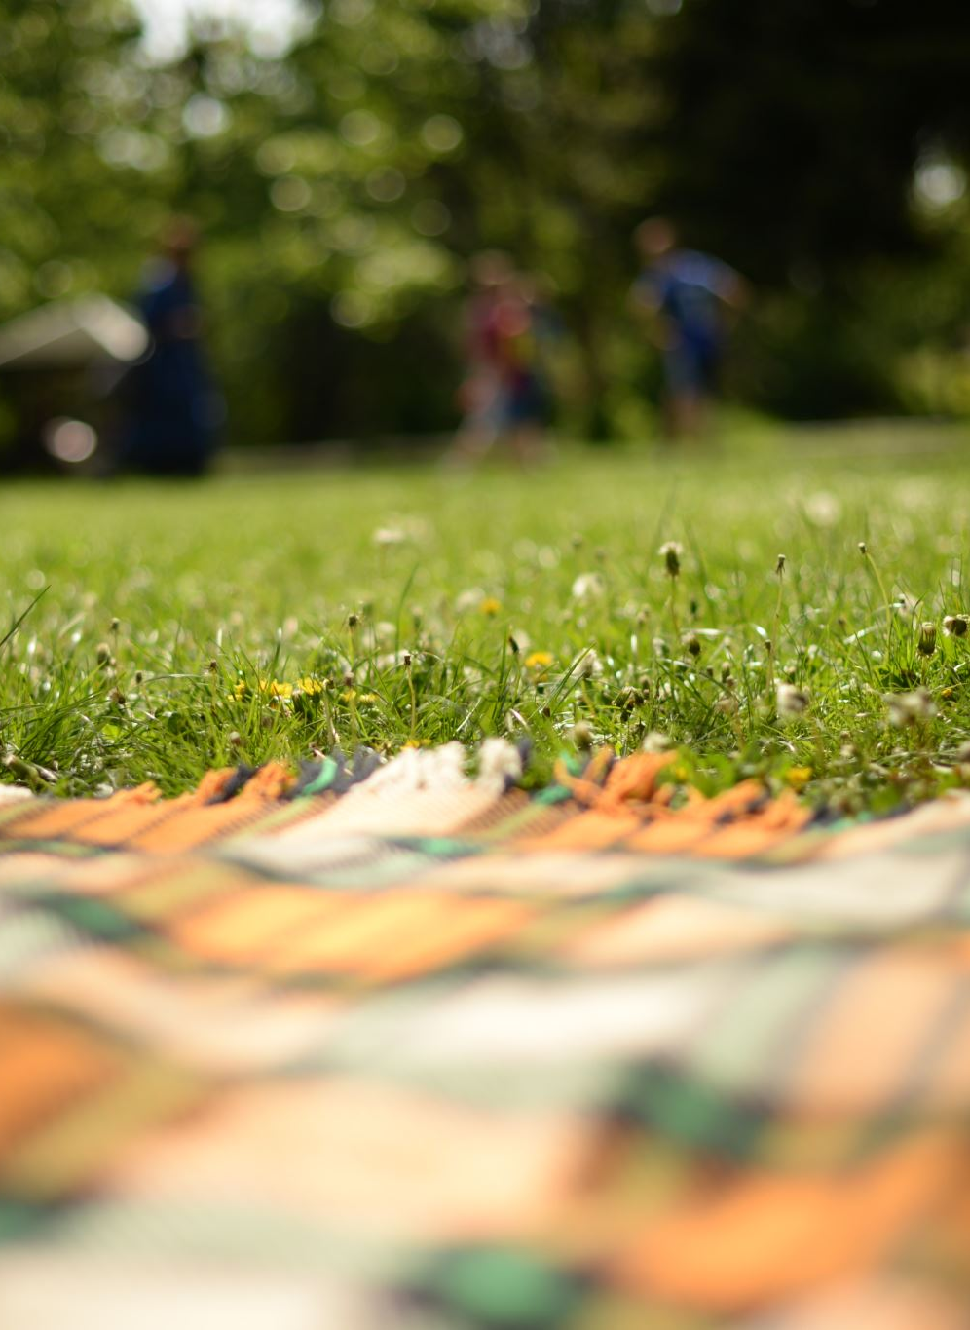
Outdoor Learning Resources
An independent project by Ed Petcher

Slide 2
Introduction
Creation of six outdoor learning resources for teachers
Made worksheets to accompany these sessions
Followed the theme 'the life of a bug'
One for each 'Area of Learning and Experience'
Linked directly to the 'Four Purposes'

Slide 3
Key Research
French et.al's (2022) 'State of Outdoor education report'
'Outdoor learning in early childhood education: exploring benefits and challenges' (Kiviranta et.al, 2024)
'The Well-being of Future Generations Act (Wales)' (2015)
'The Four Purposes' (gov.wales, 2015)
The 'Curriculum for Wales Guidance' (2020)
Harveys OL Cards
NRW OL Cards
'Outdoor Learning Made Easy' OL Cards

Slide 4
Process
Decided it would be an interesting area to explore
Researched existing resources
Developed understanding of Curriculum for Wales (2022)
Looked at literature surrounding OL in Wales
Researched wider barriers to OL
Developed a rationale based on these findings

Slide 5
Results
Limited resources that address the new curriculum
No tips offered in the resources addressing delivery styles
Teachers are not trained to teach outdoors
The curriculum advises outdoor learning as a mode of delivery
Socioeconomic status and teacher willingness are barriers to outdoor learning

Slide 6
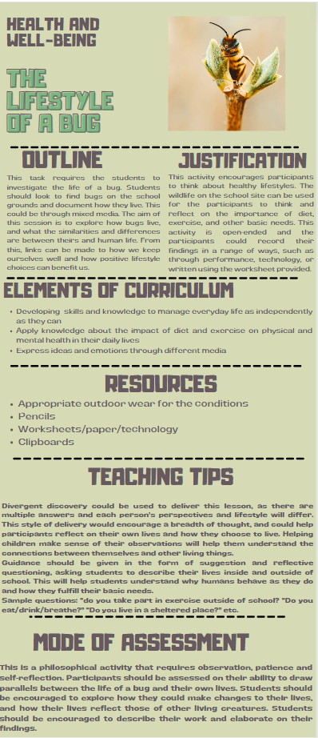
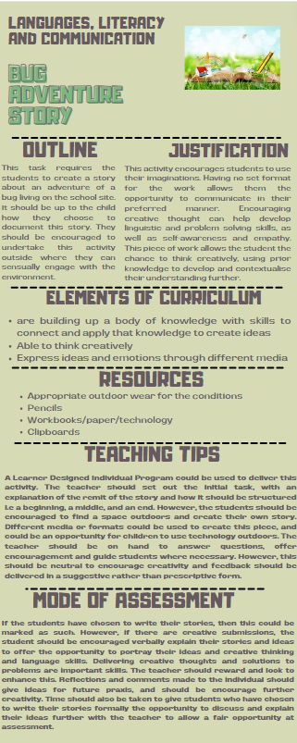
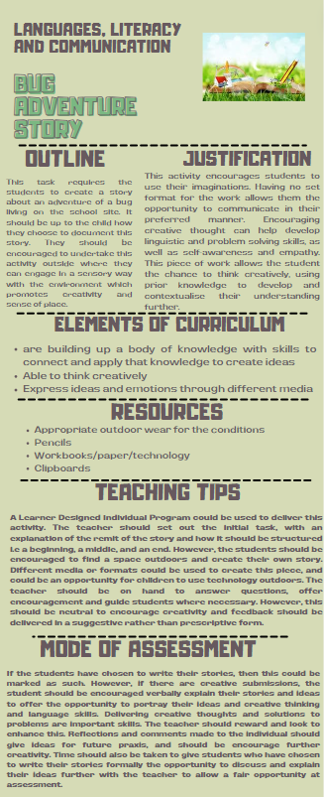
Resources

Slide 7
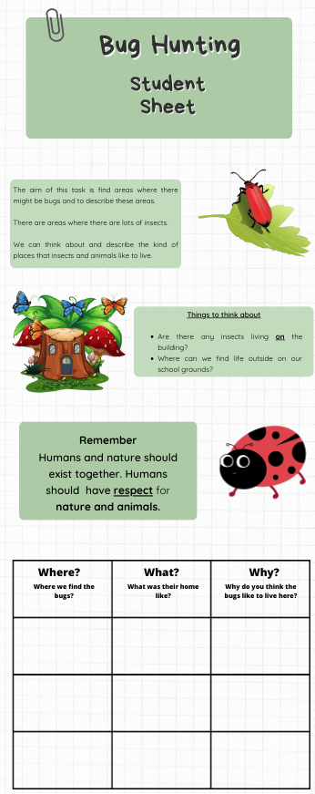
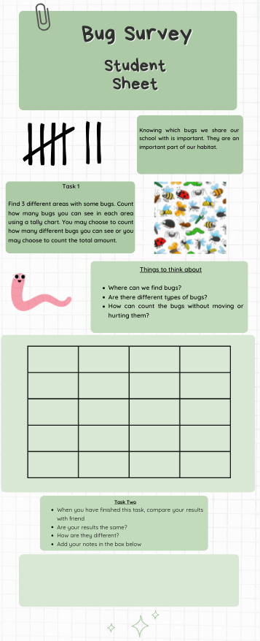
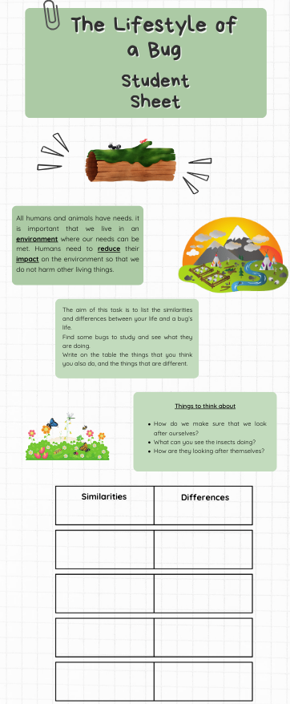
Worksheets

Slide 8
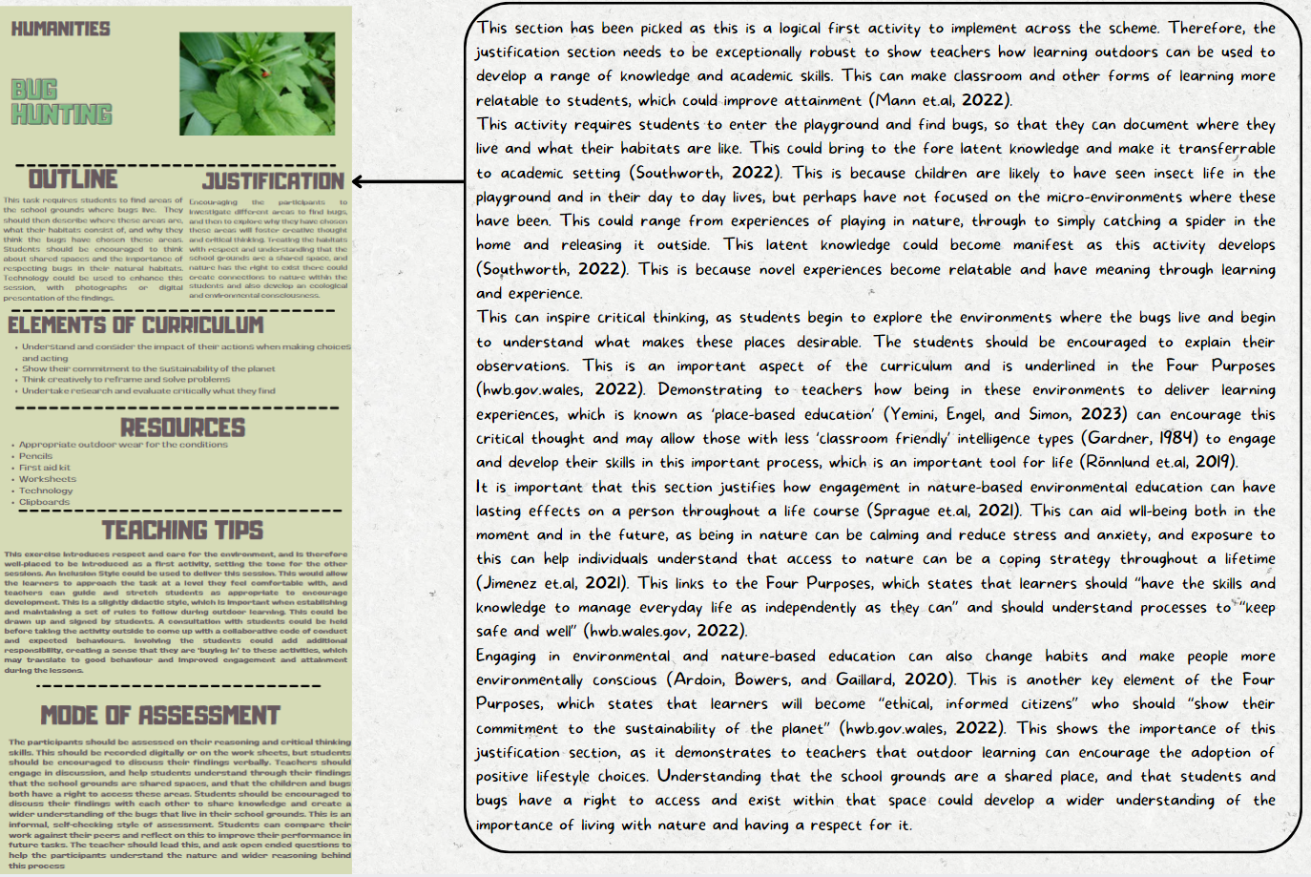
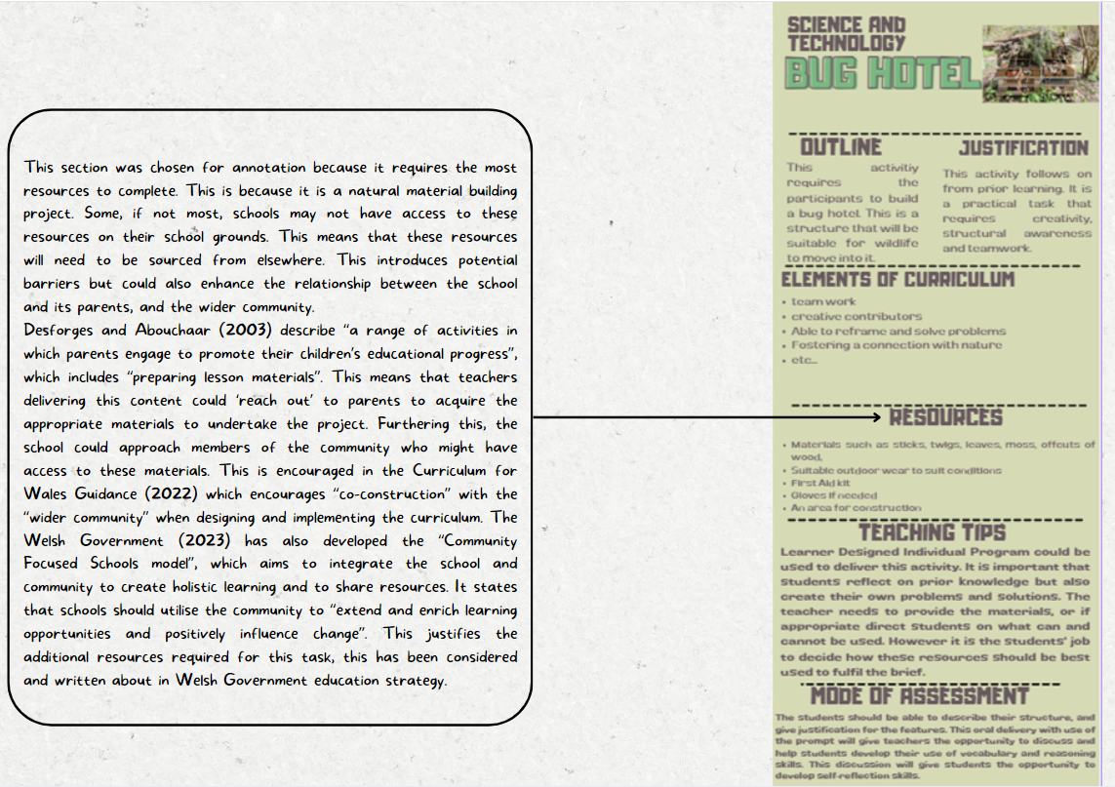
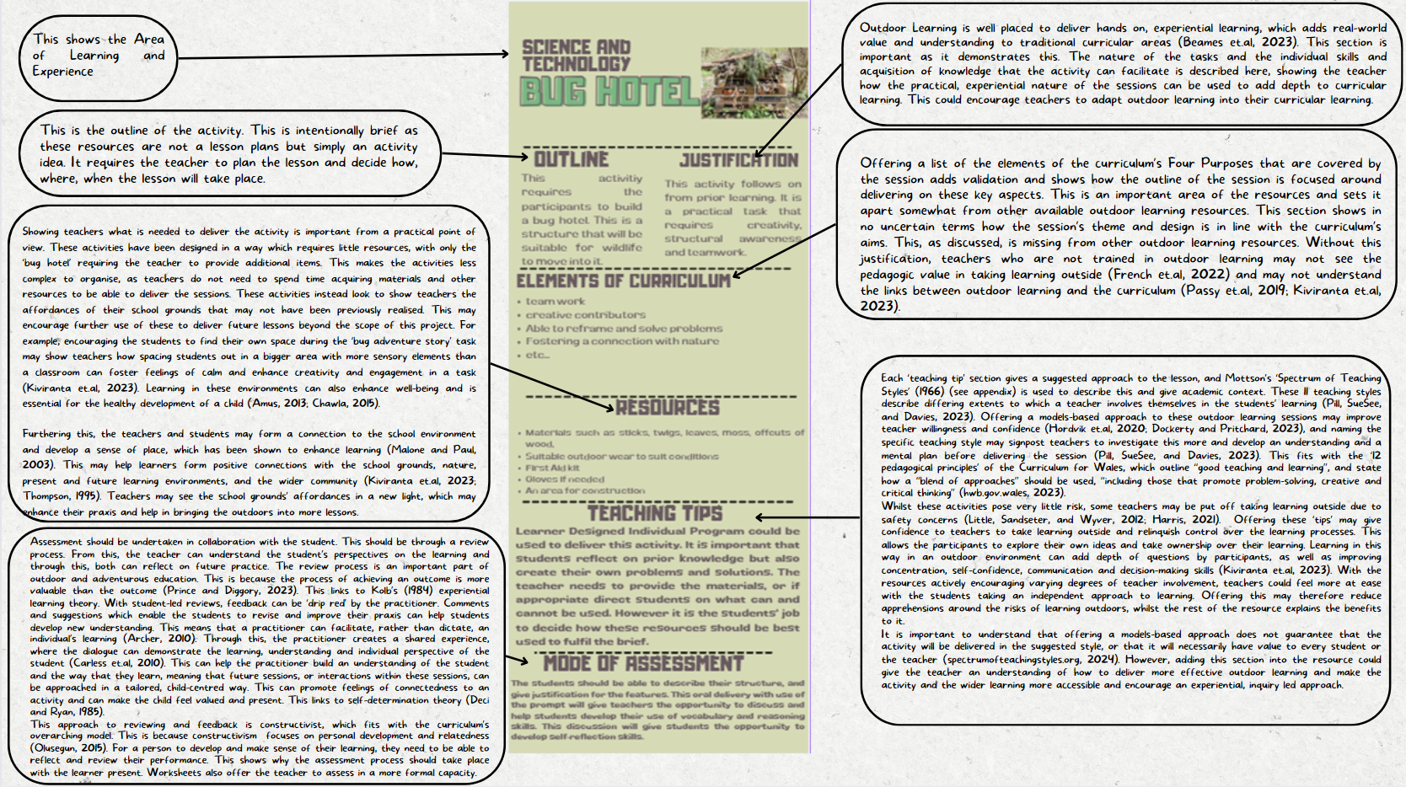
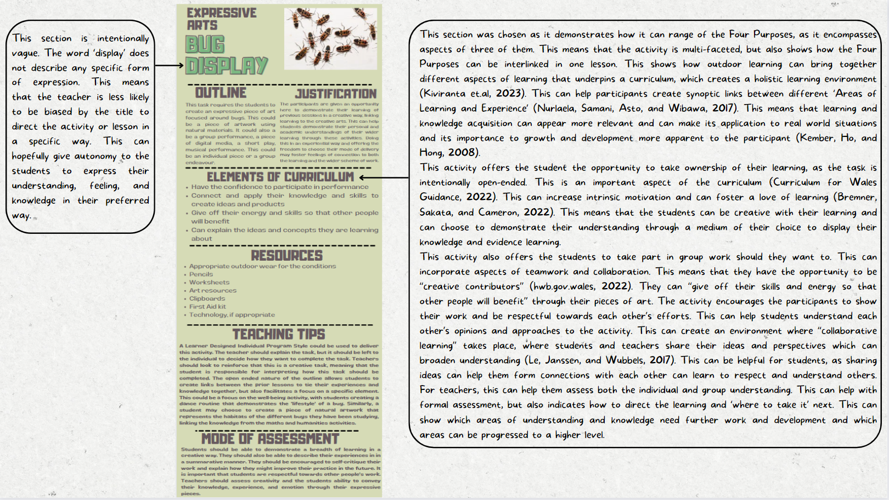
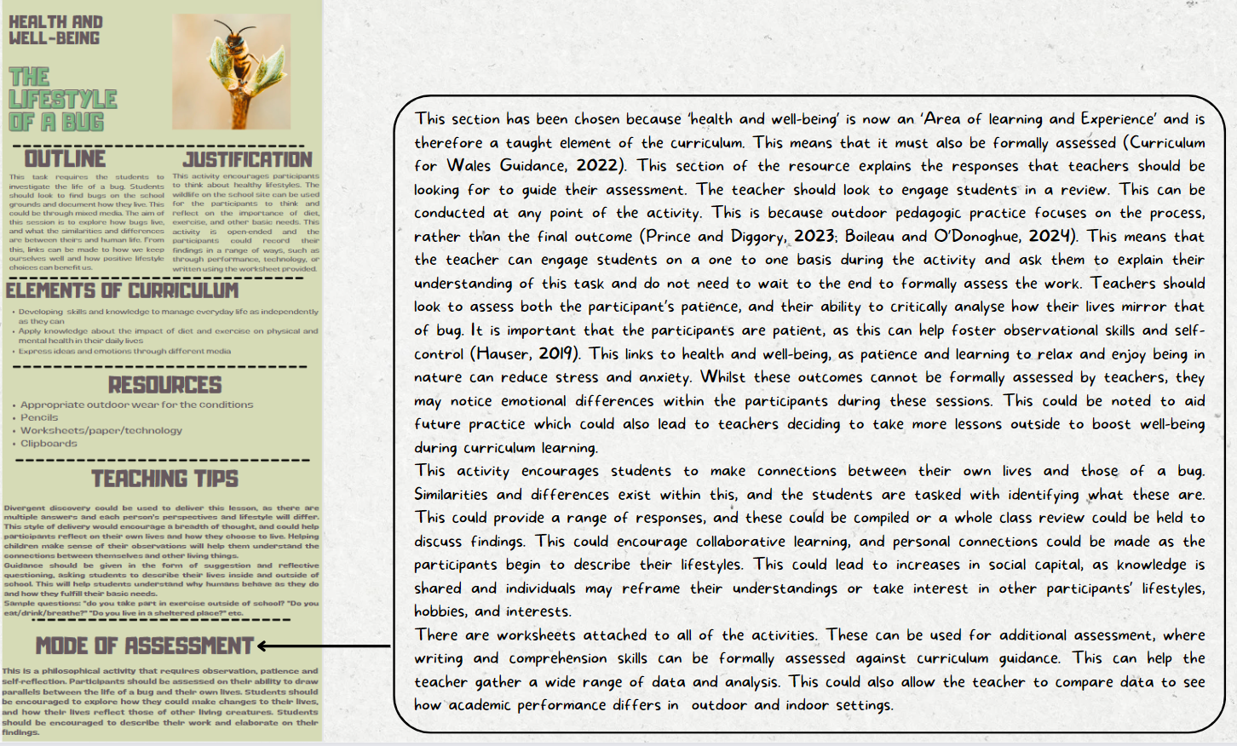
Justification for Resources

Slide 9
Reflections
Project felt more involved than a narrative review might have
Allowed for creativity
Required time and effort to develop the resources

Slide 10
Thanks for Listening!
Any Questions...

Slide 11
References
Curriculum for Wales Guidance (2020). Cardiff: Education Wales.
Developing a vision for curriculum design (2022a) Hwb. Available at: https://hwb.gov.wales/curriculum-for-wales/designing-your-curriculum/developing-a-vision-for-curriculum-design/#curriculum-design-and-the-four-purposes (Accessed: 01 March 2024).
French, G. et al. (2022) Teaching and learning in the outdoors: the current state of outdoor learning in schools in Wales. Bangor: Welsh Government.
The well-being of future generations (2015) GOV.WALES. Available at: https://www.gov.wales/well-being-of-future-generations-wales (Accessed: 19 April 2024).
Kiviranta, L. et al. (2023) ‘Outdoor learning in early childhood education: Exploring benefits and challenges’, Educational Research, 66(1), pp. 102–119. doi:10.1080/00131881.2023.2285762.
Natural Resources Wales / resources for educators and teachers (no date) Natural Resources Wales /. Available at: https://naturalresources.wales/guidance-and-advice/business-sectors/education-and-skills/looking-for-learning-resources/?lang=en (Accessed: 19 April 2024).
Outdoor Learning Handbook & Cards (2024) HARVEY Maps - for walking, hiking, cycling and fell running. Available at: https://www.harveymaps.co.uk/acatalog/Outdoor-Learning-Cards-MOLC.html (Accessed: 19 April 2024).
Sample LKS2 activities (7-9 yrs) (2024) Outdoor Learning Made Easy. Available at: https://www.outdoorlearningmadeeasy.co.uk/teachers-sample-categories/sample_lks2/ (Accessed: 19 April 2024).
The well-being of future generations (2015) GOV.WALES. Available at: https://www.gov.wales/well-being-of-future-generations-wales (Accessed: 19 April 2024).

