Slide 1

Evidence Based Policing
Week 3 – Part 2
Justice
Dr. Luke Roach
L.roach@UWTSD.ac.uk

Slide 2
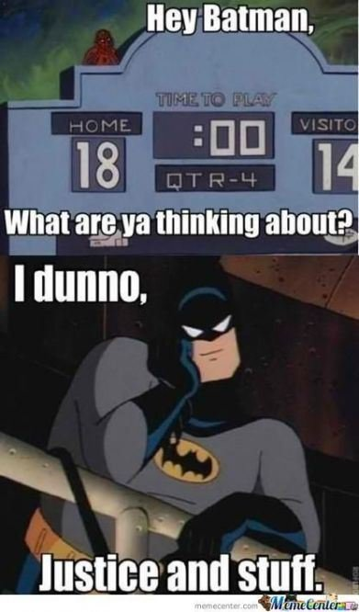
What is Justice?

Slide 3
Short film about Justice
https://www.youtube.com/watch?v=H0CTHVCkm90&feature=youtu.be

Slide 4
What is Procedural justice?
Procedural Justice is the demonstration that the decisions and procedures made and carried out by the contributors of the Criminal Justice System are made fairly.
Fairness in the Criminal Justice System is crucial to gain and maintain the support of the public and from a policing perspective to establish and develop community engagement.
To demonstrate ‘Procedural Justice’ Tyler (1988) suggests there are seven aspects:

Slide 5
Procedural Justice
Ethicality
Honesty – A demonstrated effort to be fair
Motivation of Organisation
Representation – Community Involvement and Engagement
Quality of Decisions
Error Correction
Organisational bias

Slide 6
An overview of crime statistics
Official statistics started in 1857
  used to help determine allocation of resources
  a measure of the country’s moral health
Police recording practice has become more consistent since the Simmons Report (2000) and the NCRS (2002) but the ONS still doesn’t regard police statistics as reliable
The Crime Survey for England and Wales provides useful information e.g. on reporting levels.

Slide 7
Victims and Victimology

Slide 8
4 Main Themes
1. Victim Precipitation Theory
e.g. where victim initiates the confrontation
2. Lifestyle Theory
Where someone’s lifestyle increases exposure to criminal activity
3. Deviant Place Theory
Where dangerous places are visited/frequented
4. Routine Activities Theory
See last video

Slide 9
Victims and victimology
The term Victimology was first introduced by Benjamin Mendelsohn in 1947 to describe the scientific study of crime victims.
Criminology – the study of criminals (what they do, how they do it, how the CJS responds to them,
Victimology – the study of victims, the causes of victimisation, and how the society assists and deals with victims

Slide 10
Victims and victimology
Rather than simply WONDERING why young people are more likely to become victims of crime than older people victimologists carry out RESEARCH in order to identify the REASONS why young people are more likely to become victims of crime than older people

Slide 11
Modern Victimology
Made up of the following topics
Crime Victims
Consequences of Victimisation
Interaction of Victims with CJS
Interaction of victims with Social Service Agencies and programmes
Prevention of Victimisation

Slide 12
The “Typical” victim
Research shows that the ‘typical’ victim is a young male who lives in an urban area, of course other people also become the victims of crime such as children, women, the elderly etc.
Additionally vulnerable persons such as the homeless, persons suffering from mental illness and disabled persons are at increased risk.

Slide 13
Causes of Victimisation
Why are certain persons selected as victims?
Wrong time wrong place?
Easy target?
Bad luck?

Slide 14
The ‘ideal’ victim
Notion developed by Christie (1986) illustrating the ideological ways in which victims (and offenders) are portrayed, it had Six major attributes:
The victim is weak (old/young/female/sick)
The victim is not acting virtuously (prostitute/’asked for it!)
The victim is blameless
The victim and offender are unrelated and unknown
The offender is ‘big and bad’
Victim has the right combination of power, influence or sympathy to gain victim status.

Slide 15
Repeat victimisation
When the same person or place suffers from more than one incident over a specified period.
Once victimised, a person or place is more likely to be victimised again than one that has not.
The risk of re- victimisation increases the more a person or place has been victimised.

Slide 16
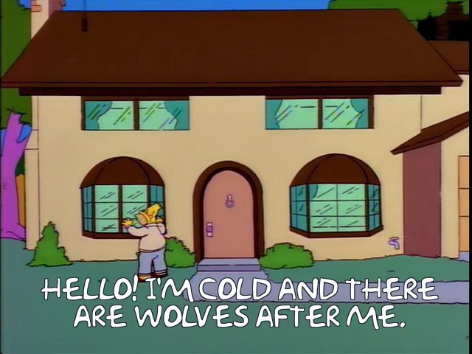
Vulnerable Individuals and
Vulnerable Groups

Slide 17
Prejudice and Discrimination
Background:
Eugenics Movement 1800 – 1900
Nazi Germany 1930 – 1940’s
Macpherson Report - 1999 (Stephen Lawrence)

Slide 18
What is Eugenics?
https://www.youtube.com/watch?v=JeCKftkNKJ0

Slide 19

Theories or Concepts associated with Vulnerability:
Prejudice
Discrimination
Stereotyping
Ethnocentrism
Stigma
In/Out Groups
Inter Group Threat theories
Social Identity Theories

Slide 20
Hatred in society that make people vulnerable and victimizable
Racism
Ageism
Sexism
Disability
Homophobia
Islamophobia
Xenophobia (Hatred or fear of foreigners or cultural strangers)

Slide 21
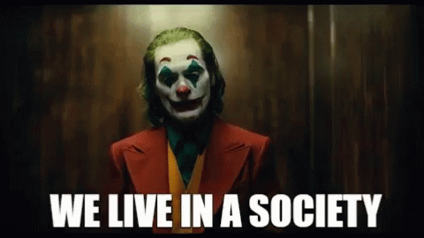
What is society?
Made up of a variety of groups Identified by such characteristics as:
Gender, Skin Colour, Profession, Sexual Orientation, Nationality, Social Class, Gang membership, Age, University,
Additionally by fashion or lifestyle choice e.g. Skinheads, Gamers, Sporting Activity, Musical tastes etc.

Slide 22
What is prejudice?
Might be Directed to Individuals or Groups:
To pre-judge someone based on assumed group or individual characteristics
Prejudice might be Positive or Negative but relates to making a judgement about someone that lacks a factual basis.

Slide 23
Prejudice
Positive Prejudice
Biased Towards
Negative Prejudice
Biased Against (Mental Attitude)
Supportive of
Unfair Treatment in Favour of
Hostile Towards
Hatred
Behaviour/Treatment

Slide 24
References
Beccaria, C. (1764) An essay on crimes and punishments, published 1872, Albany: W.C. Little & Co.
Becker, G. (1968) ‘Crime and punishment: an economic approach’, Journal of Political Economy, 76 (2): 169–217.
Bentham, J. (1789) The Principles of Morals and Legislation, http://www.econlib.org/library/Bentham/bnthPML.html
Bouffard, L. & Bouffard, J. (2011) “Understanding Men’s Perceptions of Risks and Rewards in a Date Rape Scenario”, International Journal of Offender Therapy and Comparative Criminology, 55(4) 626–45.
Clarke, R. (1980) “’Situational’ crime prevention: theory and practice”, British Journal of Criminology, 20,2,136-47.
Clarke, R.V. & Felson, M. (1993) “Introduction: Criminology, Routine Activity and Rational Choice” in R.V.Clarke & M.Felson (eds) Advances in Criminological Theory 5, New Brunswick N.J.: Transaction Publishers.
Cullis, J. & Lewis, A. (1997) “Why people pay taxes: from a conventional economic model to a model of social convention”, Journal of Economic Psychology, 18,305-321.
Fisher, B., Cullen, F. & Turner, M. (2002) “Being pursued: stalking victimization in a national study of college women”, Criminology & Public Policy, 1,2,257-308.
Newburn, T. (2013) Criminology, London: Routledge.
Tillyer, M.S. (2011) “Routine activities theory and rational choice theory” in C.D.Bryant (ed) The Routledge Handbook of Deviant Behavior, New York: Routledge.
Westmarland, L. (2006) “Classicism” in E.McLaughlin & J.Muncie (eds) The Sage Dictionary of Criminology, London: Sage

Slide 25
Week 3 Lectures completed!
Thanks for watching!
See you all in the workshop!

