Slide 1
Victims
Week 8

Slide 2

Victims Lesson Outcomes
So far considered offenders, where they are homed
Victimology
Victims Code
Rights of victims
Repeat victims

Slide 3
Assignment 2 Questions linked to session
Investigate the experiences of vulnerable victims within the UK criminal justice system. How are their needs addressed, and what additional measures are needed to ensure their protection and support?
Explore the comparative effectiveness of restorative justice versus traditional criminal justice approaches in the UK. How do outcomes such as offender rehabilitation, victim satisfaction, and community safety differ between these approaches?

Slide 4

Definitions
Victim: Someone or something that has been hurt, damaged, or killed or has suffered, either because of the actions of someone or something else, or because of illness or chance. (Cambridge English Dictionary).
Victim:
a person harmed, injured, or killed as a result of a crime, accident, or other event or action.
a person who is tricked or duped.
a person who has come to feel helpless and passive in the face of misfortune or ill-treatment.
a living creature killed as a religious sacrifice. (Oxford English Dictionary)

Slide 5
Theories of Victimology
Policing today has regular contact with victims of crime
Nature of the criminal justice system especially policing has changed in the last 20 years – more MH, vulnerability and risks
Wrong place at the wrong time?
Situations that they do not want to leave = becoming a victim?
Victim Proneness?

Slide 6
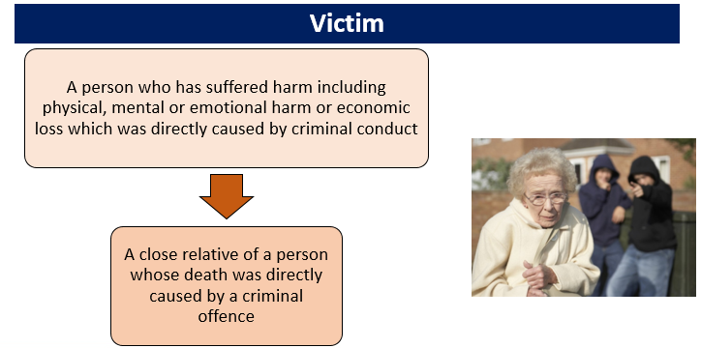
Notes:
What makes someone a victim? - Under the revised (2020) Victims' Code, a 'victim' is defined as:
The term close relative includes bereaved relatives or partners (including same sex partners) in homicide and fatal road traffic cases, as well as parents or carers where the victim is a child or a vulnerable adult.
Small businesses are included, but large retailers or corporations do not come within the definition of victim.
It is important to note that the victim can also be the complainant i.e a person who makes a formal complaint in a court of law.

Slide 7
Who is a Victim?
The Victims Code acknowledges that the terms ‘complainant’ and ‘survivor’ are often used in the criminal justice system to describe a person who has made a criminal allegation to the police.
Definition of a ‘victim’ is: a person who has suffered harm, including physical, mental or emotional harm or economic loss which was directly caused by a criminal offence.
A close relative of a person whose death was directly caused by a criminal offence.
Under Victims Code if you are the parent of the victim if the victim is under 18 years of age.
Parent or family member have rights if a victim has a mental impairment or badly injured due to criminal offence – cannot communicate / lacks the capacity to do so.
All service providers must have the victim’s best interests as their primary consideration and take the victim’s age, maturity, views, needs and concerns fully into account.
Notes:
https://www.gov.uk/government/publications/the-code-of-practice-for-victims-of-crime

Slide 8
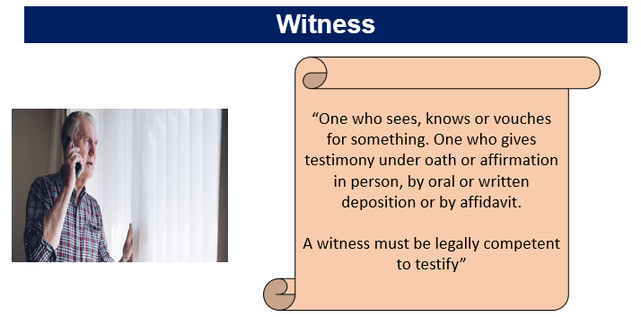
Notes:
what does the term ‘witness’ mean to you? - A witness is someone who stands up in court to state what they know after taking an oath to tell the truth (unless they are under 14 years of age, in which case their evidence is unsworn). An individual can be both a victim and a witness.
Witnesses play a vital role in bringing criminals to justice. In general, being a witness is a voluntary process (the person is prepared to make a statement and possibly go to court to give evidence).
The Criminal Justice System (CJS) has to categorise victims and witnesses so that the best evidence can be presented to the court, which leads ultimately to a fair and balanced trial

Slide 9
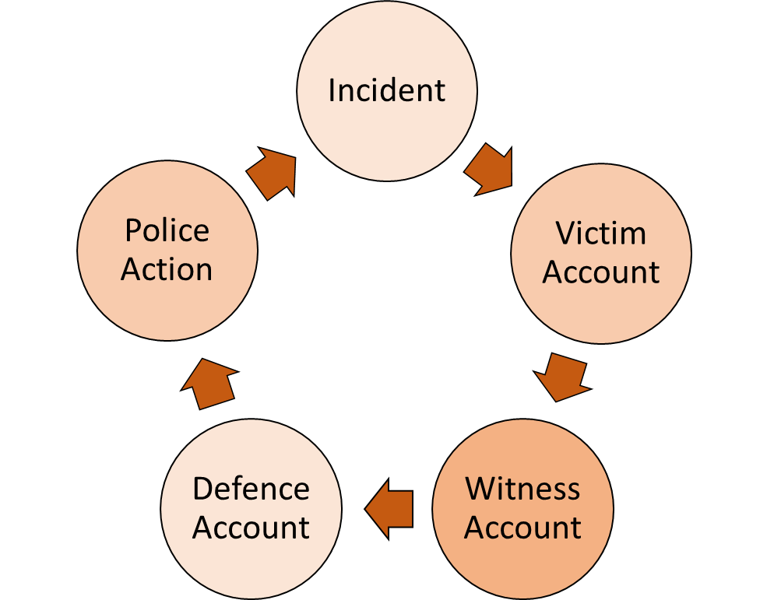
Victim, Witness and Defence Accounts / Evidence
Notes:
Why are victims and witnesses important? – In relation to obtaining best evidence from Victims, Witnesses and Defendants, it would be best practice where you can to separate all involved to take accounts, which will help assist you in making decisions.
There are some areas for consideration:
•There will be a variance in accounts – each person will see things from a different perspective i.e. angle of viewpoint.
•Are there any other information sources that can be obtained? – CCTV
•It is important to keep the defendant/suspect from the victim and witnesses where possible, to prevent an escalation of the situation
•It is also important that the account are taking separately in order to obtain the accounts are as sterile as possible and can prevent ideas being planted by over hearing accounts, whereby a witness who did not see something may turn around and say ‘I saw this happen…’ when they did not, but said it because the victim or another witness had said it. Even if this is not malicious, it can happen.
•Dependant on the course of action you will take e.g. arrest, PCR, PND, the defendant will give an account either in a PACE custody based interview, or on the street whereby you will issue the correct disposal.
•Incident – what has happened; to whom; timings;
•Victim account - note injury, damage or theft etc.
•Witness account – what have they seen, where were they when it happened, is there any CCTV
•Defence account – Interview in Custody; contemporaneous account; Body Warn, EPNB
•Police Action – Examples can be: Report for prosecution; arrest and charge; No further action. In essence, we must use the necessary legislation that is applicable at the time, or if other issues arise. Remember unconscious bias and try not to react on it

Slide 10
The Importance of Victims & Witnesses in the Criminal Justice System
Allows the criminal justice system to succeed
Narrows the justice gap
Helps avoid ineffective trials
Government initiated changes
Notes:
Victims & witnesses provide information, intelligence & evidence which enables offenders to be brought to justice. The criminal justice system relies on them to help identify offenders and give evidence. They are essential to successful prosecutions.
A better level of service from the police means a victim is more likely to stay engaged with the system and help bring the offender to justice.
Justice gap - the difference between the number of recorded crimes and the number of convictions.
Ineffective trial - Witness non attendance at court is the most common cause of an ineffective trial (ineffective trials are one reason that a case may not lead to a conviction).
A witness might decide not to give evidence in court for a variety of reasons, including:
•Intimidation
•Underestimating the importance of their evidence to the trial
•A lack of the support needed to enable them to attend court; or
•Unwillingness to be involved in the criminal justice system.
A better level of service from the police means a victim is more likely to stay engaged with the system and help bring the offender to justice.
•
In 2005, the government initiated changes to the criminal justice system to improve the level of care provided to victims and witnesses, bring more offenders to justice and so increase the delivery of justice by:
•Reducing the time between point of charge and trial
•Improving witness attendance at court
•Providing special measures, enabling witnesses to give the best evidence
•Setting up a single point of contact to provide focussed help and support for witnesses
•Improving victim and witness satisfaction with the criminal justice system.

Slide 11
Hans Von Hentig Theory 1948
Victim Precipitation Theory
victims were passive actors – The wrong place at the wrong time!
“. . . Clear distinction between the one who does and the one who suffers”
Considered victims that co-operates, conspires or provokes being a victim.
Certain individuals were ‘victim prone’ – 13 predispositions that provokes victimisation
Others - Mendelsohn stated victims guilt contributes to the crime

Slide 12

Nils Christie (1986) conception of an "ideal victim".
Little Red Riding Hood fairy tale victim: a young, innocent female out doing good deeds who is attacked by an unknown stranger’
Is it merely a fantasy?
‘
Notes:
Wayne Couzens
Yorkshire Ripper

Slide 13
Victim Blaming - Today
Police call to pub
Fight between 2 men – one on floor with minor face injury
Police state the victim was heavily intoxicated and became aggressive towards another customer
Response – defend self by punching the drunk male
Victim Precipitated or started the event
Victims can be passive or active which leads to their victimisation

Slide 14
Lifestyle Theory
Victims creating and increasing the risk of becoming a victim of crime
Intoxicated individuals' inhibitions are lowered and become vulnerable there may be an increase to an attack by a predator who takes advantage of an individual
Nighttime economy
Walking unlit areas / drinking excessively / walking alone
Risk Factors

Slide 15
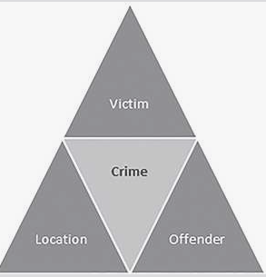
Routine Activity Theory
Requires 3 factors to be in place for a crime to occur
Victim / Offender / Location = All align increase of an offence taking place
Allows police to address Crime Prevention / Anti-social behaviour
Problem Analysis Tringle (PAT)

Slide 16

Deviant Place Theory
Individual who occupies a dangerous place is more likely to become a victim of crime
Victims do not have active involvement in the impending crime
Policing example criminal damage to a property on a housing estate which is suffering from youths gathering in communal areas.
Damage caused but not directly at the individual who suffers.

Slide 17
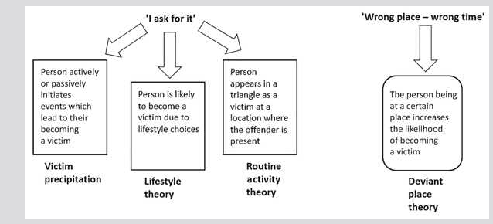

Slide 18
Becoming a victim – other factors
ACE’s
  Baby Peter 2007 criticism in report about police failing to challenge mother’s account / Delays in taking photos and investigating - Open mind & Professional curiosity
Stockholm Syndrome
  victims / hostages were hostile to police and CJS but SS is a coping strategy
Multiple Adversities
  Families face number of issues that impact the family. Domestic abuse / Substance abuse / MH
Poly Victimisation
  For police having an empathetic approach and knowledge of referral agencies. This refers to having experienced multiple victimisations

Slide 19

The Pattern
Once victimised, a person or place is more likely to be victimised again than one that has not. Furthermore, the risk of re- victimisation increases the more a person or place has been victimised.
Examples of cases that you can think off?
Notes:
Fiona Pilkington
Diana Lofthouse

Slide 20
Repeat Victimisation (RV) - Multivictimisation
“A victim of the same type of crime more than once in the last year”
1982 British Crime Survey reported that 70% of incidents were reported by 14% of the same respondents.
When the same person or place suffers from more than one incident over a specified period.
  Is that offenders who target vulnerable individuals or
  Vulnerable individuals who are at risk of receiving attention
  Officers – consider joined-up approach from multi-agency partners
Example – County Lines & YP – suffer assaults, child exploitation, sexual assaults
Gang – target vulnerable yp
Notes:
Some individuals and communities are more likely to experience repeat victimisation:
Residential areas where a high proportion of older people live (including council owned properties and sheltered housing organisations)
Areas where young people congregate, eg local parks
High density housing estates, either council or privately owned
Industrial and/or business areas
Areas with a collection of shops eg shopping centres
Certain types of criminal activity are more common in cases of repeat victimisation; criminal damage/vandalism, burglary (both dwelling and commercial), theft (including theft of or from motor vehicles), assaults, domestic abuse, robbery, sexual offences and fraud.
Repeat Victimisation is often not reported to the police, or alternatively, the victim may report the crime but not give the full picture. A victim’s reasons for not reporting (or under-reporting) crimes may include that they may:
be too embarrassed or afraid to tell anyone
wish to maintain their privacy or deal with the matter themselves
believe the police would not or could not do anything
be desensitised or resigned to crime as ‘a common occurrence’
fear reprisal (e.g. in the case of sexual assault by a family member)
dislike or fear the police
be discouraged, following a negative previous experience of police or courts.

Slide 21
Victims History
Mid 1800’s theorist development of why people become victims
By the Twentieth Century victims were the ‘forgotten element’ in the Criminal Justice Process.
Started a ‘Victim Movement’ This drew attention to the problems victims faced within the criminal justice system. 1940's victims voice
Nineteenth Century and before Professional Police Forces the victim initiated criminal prosecutions.
Notes:
Wolfgang, Marvin - •Patterns in Criminal Homicide (1958)
•‘victims were a direct positive precipitator in the crime’
•588 homicides Philadelphia 26% of homicides was victim-initiated
•Inspired other studies Amir Patterns of Forcible Rape (1971)
•646 forcible rapes in Philadelphia
•19% of these rapes were victim-initiated (agreeing to sexual relations but retracting)
•Was criticised Feminist movement, police attitude to rape victims, factors on the victim “ walk in dark alleys after dark”.
•Rape victims blamed for what they wear, drunk, nightclubs, sexual partners – always revisited evening today.

Slide 22
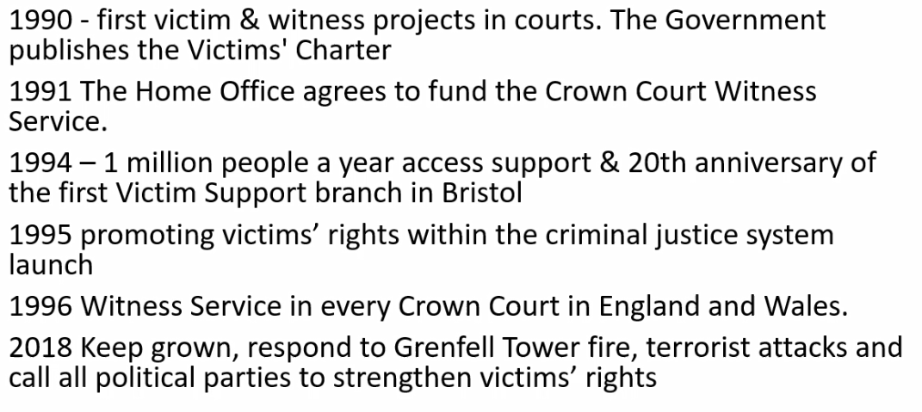
Victim's movement

Slide 23
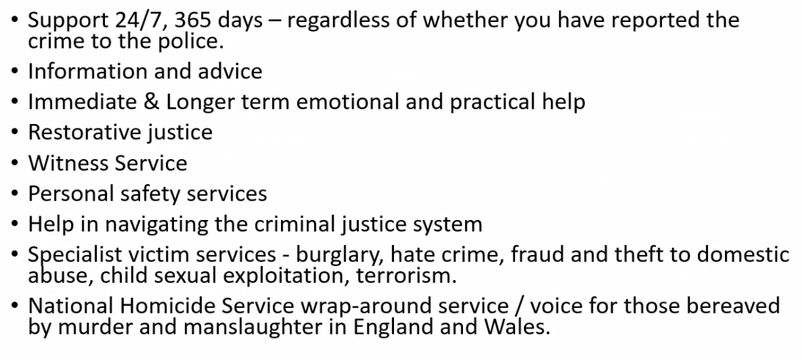
Today's Victims

Slide 24
Impact of Crime and on victims & Witnesses?
Victims may:
Suffer short term & long term effects
They may have friends, partners & children who may also be affected by the crime
They may have a strong reaction to the crime even if others do not think of the crime as very serious
Notes:
What do you think the impact of crime and ASB has on victims and witnesses? –
Crime and ASB can affect people in many different ways. Although a crime may take only a relatively short time to commit, the effects on the victim can be long-lasting; in some cases for the rest of the victim’s life.
Individual reactions may depend on:
•The type of offence
•Whether they knew the perpetrator
•The support they get from their family, friends, the police and other people they come in contact with
•Their vulnerability
•Their past experiences.

Slide 25
Short Term Impact of Crime
•Nervousness, anxiety, sleeplessness
•Powerlessness, vulnerability & self blame
•Fear of a repeat attack
•Vulnerability to repeat attack
They might also be:
•An increase in fear of crime
•A lack of faith in the police
Notes:
How might this manifest itself within communities? –Crime can be hard to cope with as there is the knowledge that it was probably committed deliberately, unlike an accident where there is normally no harm intended. This can make the victim feel powerless and vulnerable.
This can be especially difficult to deal with if the offence is repeated or ongoing, which is often the case with domestic abuse, racially or religiously motivated crimes, or ASB.

Slide 26
Longer Term Impact of Crime
Feelings of powerlessness
Vulnerability to repeat attack
Depression or anxiety related illnesses
Post Traumatic Stress Disorder
Inappropriate behaviour towards suspect (vigilante behaviour if police take no action)

Slide 27
Needs of victims and witnesses
Reassurance
Emotional vent
Explanation & advice
Regain control
A single point of contact
Quality of service
Updates
Medical needs
Notes:
Reassurance: the victim or witness may feel vulnerable or unsafe. They may need reassurance regarding their personal safety and regarding any unreasonable fears they have in terms of their personal vulnerability and fear of repeat attacks.
Emotional Vent: They may feel angry and need to express their feelings - allow them to talk and ‘let off steam’.
Explanation: An explanation regarding the police role and functions will help them to gain confidence in the police and an understanding of the processes should the matter go to court.
Regain feeling of Control: Confirming their ability to make decisions related to their case will help them to feel in control but at the same time the officer must assess their needs regarding the level of support needed
Single Point Of Contact: Providing a name and telephone number is important for any follow-up.
Quality of service: The service they are given at this stage will set the scene for any later involvement in the CJS – for instance whether they will eventually be prepared to give evidence.
Victims can be advised about the Victim Support Scheme and any further appropriate support agencies recommended.

Slide 28
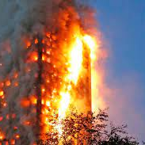

What victims want
2017 Grenfell Tower
Terrorist attacks Manchester and London
Both brought focus on how victims are treated within the CJS
Treated fairly, with proper dignity, with clear, timely & accurate information.

Slide 29

Grenfell Tower
Deaths were the result of policies of previous government parties – social housing/safe housing
4 days after no visit from local authority of Government personnel
PM 30 min visit but kept away from public ‘safety concerns’

Slide 30
Victim’s rights
Changes in the laws = RIGHTS!

Slide 31
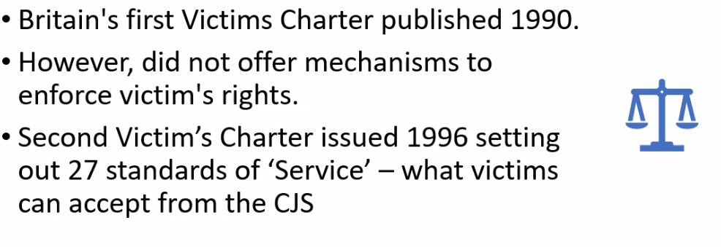
Victim Support

Slide 32
Victim Strategy
Progress made:
2006 Code of Practice for Victims
  What victims are entitles too.
2010 first Victims Commissioner appointed
2012 ‘Get it Right for Victims & Witnesses’ paper by Govt. makes sure victims get support

Slide 33
Victims Commissioner
Baroness Helen Newlove – appointed 2023
The Victims’ Commissioner is appointed by ministers but is independent of government / CJS agencies and free to advise, challenge and offer own views
Represent all victims and witnesses, particularly the most vulnerable members of our community.
Commissioner raises priorities for change with policy makers
Encouraging responsibility with all CJ agencies to ensure the voices of victims and witnesses are heard and that each organisation takes responsibility for them
Notes:
https://victimscommissioner.org.uk/victims-commissioner/

Slide 34
Code of Practice for Victims of Crime in England & Wales - Victims Code
The Code was established by the Domestic Violence, Crime and Victims Act 2004
Came into effect in 2006.
The Code sets out what each criminal justice agency must do for victims and the timeframe in which they must do it.
The Code of Practice for Victims of Crime is a statutory code that sets out the minimum level of service that victims should receive from the criminal justice system.
The Code has statutory force, which means that the CJS has a legal duty to carryout a service
Notes:
https://www.gov.uk/government/publications/the-code-of-practice-for-victims-of-crime

Slide 35
Victim's Rights
To be able to understand and to be understood
To have the details of the crime recorded without unjustified delay
To be provided with information when reporting the crime
To be referred to services that support victims and have services and support tailored to your needs
To be provided with information about compensation
To be provided with information about the investigation and prosecution
To make a Victims Personal Statement
To be given information about the trial, trial process and your role as a witness
To be given information about the outcome of the case and any appeals
To be paid expenses and have property returned
To be given information about the offender following a conviction
To make a complaint about your Rights not being met
Notes:
https://www.victimsupport.org.uk/help-and-support/your-rights/victims-code/
https://www.gov.uk/government/publications/the-code-of-practice-for-victims-of-crime

Slide 36
Right 1 – To be able to understand and to be understood
What this means:
From the first point of contact and throughout the investigation process, they need to establish if:
English is the victim's first language (written and verbal)
they can understand the victim (verbally and in writing)
the officer/staff member can be understood by the victim (verbally and in writing)
How to do this
CJS staff should:
positively engage with victims at the time a crime is reported (trauma informed practice) – especially where people are finding it difficult to understand
avoid jargon and abbreviations
know how to access and have ready access to translation and interpretation services

Slide 37
Right 2 – To have the details of the crime recorded without unjustified delay
What this means:
The crime should be recorded as soon as possible after the crime is reported.
How to do this
CJS staff should take responsibility for recording the crime, where appropriate.

Slide 38
Right 3 – To be provided with information when reporting the crime
What this means
Within five working days (one working day for victims entitled to enhanced rights) of the crime being reported, victims must be provided with written confirmation that includes:
contact details of the investigating officer
a crime reference number
details of the offence
the criminal justice process and what will happen next
what support services are available and how to make contact

Slide 39
Right 4 – To be referred to services that support victims and have services and support tailored to their needs
What this means
This must happen within two working days of a crime being reported, and continue throughout the criminal justice process.
How to do this
Police officers and staff should:
positively engage with victims at the time a crime is reported (trauma informed practice)
conduct an initial victims needs assessment at the earliest opportunity
consider if the victim is eligible for enhanced rights and/or special measures at court
take responsibility and instigate referrals where requested and provide information where appropriate
share information with other agencies, so the victim doesn’t have to repeat themselves
reassess the needs of the victim should anything change

Slide 40
Right 5 – To be provided with information about compensation
What this means
Within five working days (one working day for victims entitled to enhanced rights) of the crime being reported, they must tell the victim about how to claim compensation for any loss, damage or injury caused as a result of crime.
How to do this
Police officers and staff should:
be aware of the eligibility criteria
provide contact information for the Criminal Injuries Compensation Authority
where there has been loss or damage, obtain and supply supporting evidence to the Crown Prosecution Service to enable an application to the sentencing court as appropriate

Slide 41
Right 6 – To be provided with information about the investigation and prosecution
What this means for police officers and staff
Officers and staff must, within five working days (one working day for victims with enhanced rights) of a key decision point in the investigation, update victims about the decisions and where applicable explain it to them.
How to do this
Police officers and staff should ensure victims are updated within five working days (one working day for victims with enhanced rights) of the following decision points:
suspect arrested
interviewed under caution
released without charge
released on police bail or under investigation
bail conditions changed or cancelled
suspect charged
decision not to investigate
decision not to prosecute
decision to administer an out of court disposal
Police personnel must discuss and agree with the victim the frequency of updates as well as how they would like to receive those updates, including their preferred method of contact.

Slide 42
Right 7 – To make a victim personal statement (VPS)
What this means
A victim has the right to make a VPS to explain in their own words how a crime has affected them, at a time when it suits them at any point prior to sentencing.
Police officers and staff must:
provide victims with information about the VPS process when a crime is reported. They should be able to explain what it is, and how a VPS differs from a witness statement
make sure they are well briefed on the process of making a VPS and should be able to signpost victim’s accordingly
explain to the victim that their VPS will be available to the defence and they could be asked questions about it in court
explain to the victim that their VPS could be reported on by the media if read in open court
be open and willing to take a VPS whenever the victim is ready. They will be flexible, a victim may request a copy of their statement from the police at any time and should be given an opportunity to make an additional personal statement to reflect the changing impact the crime has had on them, if relevant

Slide 43
Right 8 – to be given information about the trial, trial process and a victim's role as a witness
What this means
Once it has been decided that a case is going to court, a Witness Care Unit must update a victim with certain information about the hearing (within five working days for all cases, within one working day under enhanced rights).
How to do this
By providing information regarding:
time, date and location of any hearing (within one working day for all victims)
the outcome of any bail hearing (and changes to these bail conditions and the reasons for those changes)
if an arrest warrant has been issued for the suspect and the outcome of a hearing if the suspect is re-arrested
the outcome of any hearing if the suspect has been re-arrested
If the suspect pleads not guilty and the victim is required to attend court, they have the right to be told:
by the Witness Care Unit if they are required to give evidence within one working day (for all victims) of receiving the information from the Crown Prosecution Service
to have their needs assessed and be offered a referral to a witness support service or another support service
of the outcome of any special measures application

Slide 44
Right 9 – To be given information about the outcome of the case and any appeals
What this means for police officers and staff
The Witness Care Unit must, within one day of receiving the information from the court, update the victim regarding the outcome of the case, including – where available – a brief summary of the reasons for the decision.
How to do this
The Witness Care Unit will:
notify and explain the outcome of the trial hearing to the victim
explain the meaning of the sentence and provide information about the 'unduly lenient' sentence scheme
tell the victim how their VPS was used by the court
notify the victim if there is an appeal against conviction or sentence and its outcome
be referred to the Crown Prosecution Service if there are questions the Witness Care Unit cannot answer, and have a meeting set up with the CPS, if the victim is a bereaved close family member
assess the needs of the victim following the conclusion of the trial and sentencing, and provide information and make referrals where appropriate

Slide 45
Right 10 – To be paid expenses and have property returned
What this means for
The victim has a right to be paid certain expenses by the Crown Prosecution Service if they attend court and give evidence. If the police took any of their property as evidence, victims have the right to get it back as soon as it is no longer required.
How to do this
Witness Care Units can help victims with any questions about claiming expenses.
Police officers and staff should carefully consider the need to continue to retain a victim's property and whether it is absolutely necessary and, if not, be proactive in returning property without delay.
Being without your belongings longer than is necessary, as well as being an inconvenience, can add to the trauma of what has happened. Therefore, be mindful of the necessity of retaining a victim's property.

Slide 46
Right 11 – To be given information about the offender following a conviction
What this means
Where eligible, a victim or bereaved family members have the right to be provided with information about the offender and at key stages of their sentence.
victims also have a right to be consulted by the police if an offender makes an application for a review of their sex offender notification requirements.
How to do this
Witness Care Unit or Youth Offending Team will automatically refer the victim (or bereaved family member) to the National Probation Service Victim Contact Scheme. This must happen within 10 working days of sentencing. A victim has the right to be automatically referred.
The police should contact the victim whenever an offender makes an application to review their Sex Offender Notification Requirements, and allow them to provide their views on the application. Where appropriate, the victim's views should be considered.

Slide 47
Right 12 – To make a complaint about a victim's rights not being met
What this means
If a victim considers they have not received any of their rights under the Code, they should be facilitated to make a complaint.
How to do this
Police officers and staff should:
be open and willing to discuss any concerns with a victim
provide information about their forces formal complaints procedure
take responsibility for providing this information and know where to find information regarding other criminal justice agencies complaints procedures, if required
not dismiss or diminish a victim's feelings about their treatment
not 'hand off' the responsibility of the provision of assistance to multiple different staff and teams, remember the aspiration to provide one single point of contact

Slide 48
Victim Personal Statement
A VPS is a statement is given to police from a victim of crime (or any agency assigned by the police to take the VPS on their behalf)
A way of telling the CJS how victims have suffered & the impact - physically, emotionally, psychologically, financially or in any other way
Victims voice within the CJS
It is not a witness statement – that focuses on the crime VPS focus on the impact
Court’s will take into account the impact of the offence on victims from the VPS
It is considered in the sentencing of the offender.

Slide 49

VPS
Made before sentencing - made at any time prior to the sentencing of the offender. If offender is found guilty the VPS is used by courts when sentencing.
Parole Boards - VPS can be updated for submission to a Parole Board. It tells the PB the impact of a crime on the victim - safe to release / conditions or to remain in prison.

Slide 50
Victim Personal Statements
Victims' choice to make one
‘VPS can work, do work (for those who bother to make them)’ Chalmers et al., 2007
Evidence that giving VPS help towards the healing and recovery of victims. Anger and anxiety decrease for some victim's
Effectiveness to ease emotional recovery is widely debated
VIS can fail to meet victims' expectations may lead to dissatisfaction (Ashworth, 2000; Edwards, 2001; Sanders et al., 2001)

Slide 51
VPS & Parole
Parole Boards considers whether an offender can be released from prison/conditions or moved to an open prison.
Certain victims will be able to write a VPS telling the Parole Board what impact releasing the offender or changing their custodial conditions will have on them.
VPS can help the Parole Board to set appropriate licence on offenders - exclusion zones / preventing offender contact
VPS for the Parole Board given to all victims who have opted in to the Victim Contact Scheme, which is available for victims of violent or sexual offences where the offender is sentenced to 12 months or more in prison.
The process of creating a VPS for the Parole Board is separate to the process of making a VPS to be considered in court.

Slide 52
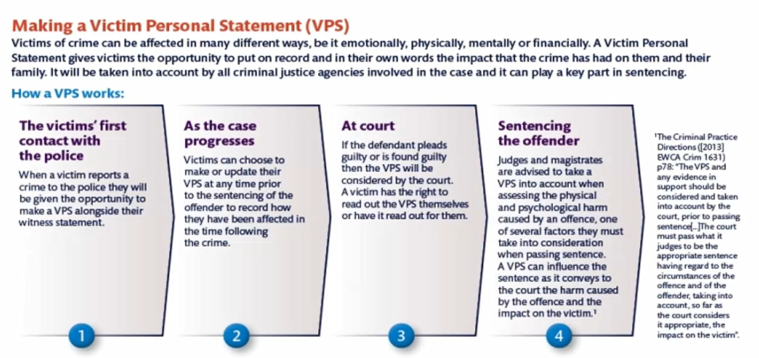

Slide 53


Violet-Grace
83 MPH in a 30 MPH road
Went on the run to Amsterdam
Death by DD = Section 1 of the Road Traffic Act 1988, carries a maximum penalty of 14 years in prison
Received 9.5 years
Sentenced increased due to social media in prison
Notes:
Aidan Mcteer 2017
https://www.bbc.co.uk/news/uk-england-merseyside-41345828

Slide 54
Violet-Grace
VIS - The defendant would find it “too upsetting”
CPS barrister highlighted parts of the personal statement which they could not read out
The whole purpose of the victim statement is the impact on the victims and the survivors, not the defendant.
October 2017, the government promised life sentences for death by dangerous driving.
“Innocent people have been killed, but nothing has changed. The law is out of date” (parents of Violet).
Notes:
https://www.theguardian.com/uk-news/2019/jul/10/parents-victim-statement-edited-to-spare-feelings-of-driver-who-killed-child

Slide 55
Standford Rape Case 2015
The Victim: Chanel Miller raped by Brock Turner
Chinese-American woman
Court questioned victim on what she was wearing; why did she go to the party; her relationship with boyfriend plus what she had drunk that night.
Felt that she was being interrogated
‘revictimized’
“did you know he is a good swimmer?”
Notes:
https://www.independent.co.uk/news/people/stanford-rape-case-read-the-impact-statement-of-brock-turner-s-victim-a7222371.html

Slide 56
Standford Rape Case
Rapist: Brock Turner
Was sentenced for 6 months in an County Prison
Son's life had been "deeply altered forever"
On sex offenders register
Judge was criticised of being too soft stating that prison would have ‘severe impact’ on him. Should have served 14 years
Same judge gave a Latino man 3 years for same crime
Affluent white male hired a powerful legal team and private investigators and got expert witnesses.
Turner could have been an Olympic swimmer – said on many times
Notes:
https://www.independent.co.uk/news/world/americas/stanford-rape-case-judge-aaron-persky-brock-turner-latino-man-sentence-a7110586.html

Slide 57
Task
Review The Standford Rape Case 2015
Independent News Paper:
Stanford University rape case: Victim's letter in full | The Independent | The Independent

Slide 58
Enhanced / Special Services
The victim’s code defines 4 distinct ‘cohorts’ of victims who should qualify for an ‘enhanced service’
Victims of serious crime; persistently targeted victims; vulnerable victims and intimidated victim.
The categories are designed to ensure that victims who are most in need will be able to access enhanced support.
Entitlement can over lap more than one category.

Slide 59
Distinct ‘cohorts’
Victims of the most serious crime
Domestic abuse
Sexual offences
Terrorism
Hate crime
Human trafficking
Attempted murder
Wounding / causing grievous bodily harm with intent
False imprisonment
Arson with intent to endanger life
Kidnap

Slide 60
Who we should be focusing on
 | Victims of the most serious crime
 | Domestic abuse | Sexual offences | Terrorism
 | Hate crime | Human trafficking | Attempted murder
 | Wounding / causing grievous bodily harm with intent |  | False imprisonment
 | Arson with intent to endanger life |  | Kidnap
 | Persistently targeted victims
 | A victim that has been targeted repeatedly as a direct victim of crime over a period of time; particularly if they have been deliberately targeted; or they are a victim of a sustained campaign of harassment or stalking.
 | Vulnerable victims
 | All victims who are under 18 years of age at the time of the offence.
 | Victims whose quality of the evidence is likely to be affected because they:
 | suffer from mental disorder within the meaning of the Mental Health Act 1983
 | have a significant impairment of intelligence and social functioning
 | have a physical disability or is suffering from a physical disorder.
 | Intimidated victims
 | Victims whose quality of evidence may be affected because of fear or distress about testifying in court. When assessing whether a victim is intimidated, the service provider must take account of:
 | behaviour towards the victim on the part of the accused, members of the family or associates of the accused, and any other person who is likely to be an accused or witness in a potential court case
 | the nature and alleged circumstance of the offence to which a potential court case relates. Victims of a sexual offence or human trafficking will automatically be considered to be intimidated
 | the victim’s age and, if relevant, the victim’s social and cultural background, religious beliefs or political opinions, ethnic origin, domestic and employment circumstances.
The victim’s code of practice (VCOP) defines 4 distinct ‘cohorts’ of victims who should qualify for an ‘enhanced service’ and referral to support
Notes:
Crime currently 32%
ASB 6 % real concern that we are not identifying the right cohort and people going under the radar.

Slide 61
Special Measures
These are in place so that those who need extra support to give the very best evidence in court
The Youth Justice and Criminal Evidence Act 1999 set out a number of special measures that assist vulnerable and intimidated witnesses (both adults & children) to improve the quality of their evidence.
Achieving Best Evidence
Vulnerable witnesses include children under 18 years old and people with a mental disorder, people significantly impaired by intelligence and social functioning, people with a physical disability.

Slide 62
Special Measures
Screening the witness from the accused
Giving evidence by means of a TV link
Removal of wigs & gowns
Video recorded interview
Notes:
The Youth Justice and Criminal Evidence Act 1999 sets out a number of special measures that assist vulnerable and intimidated witnesses (both adults & children) to improve the quality of their evidence.
(Achieving Best Evidence). It applies to both prosecution and defence witnesses (but it does not apply to the accused).
Consideration as to which, if any of the special measures should be made available will be made by the investigating officer, the Crown Prosecution Service and the Court.
Child witnesses under the age of 18 will automatically be eligible for special measures
Screens: the witness sits behind a screen and can be seen by the judge/jury but not the accused (or the public depending on how intimidated they are)
Live TV link: enables the witness to give evidence during the trial through a televised link to the courtroom. Can be from a remote location with evidence being given as though they were actually in court.
Removal of wigs or gowns by judges and barristers: usually for children to appear less formal
Video recorded interview: a video-recorded interview with a vulnerable or intimidated witness before trial may be admitted by the court as witness evidence-in-chief - for adult complainants in sexual offence trials in the Crown
9 Safe video link – evidence facility sites in the SWP area Barry
Swansea
Neath
Maesteg
Tonypandy
Aberdare
Merthyr
Cardiff x 2.

Slide 63
Special Measures
Giving evidence in private
Examination of witnesses through intermediary
Aids to communication
Using video recording for giving evidence
Notes:
Giving evidence in private – members of the public and press (except for one named person to represent the press) may be excluded from court in cases involving sexual offences or intimidation by someone other than the accused.
Examination of witness through intermediary - accredited specialists who help with communication difficulties. Can assist victims when being interviewed by police & at court. They explain questions & answers to help witness without changing substance of evidence. Might be used to help young children or adults who have suffered a stroke or other brain injury.
Aids to communication – This can include computers, voice synthesisers, symbol boards and books. The case of R v Watts [2010] EWCA Crim 1824 is a leading example of the use of this special measure, which was granted in combination with a number of other special measures to enable non-verbal witnesses with severe communication needs to give evidence.
Video recorded cross examination/re-examination – Section 28 (pre-recorded cross exam) is now available to all S17 witnesses (inc 17.4 and 17.5 etc). Please bear in mind that S28 cannot be used without S27 (VREIC). It is only applicable in Crown Courts cases.

Slide 64
Witness Care Units (WCUs)
Provide single point of contact for victims & witnesses
Keep witnesses informed about their case
Conduct a needs assessment & arrange tailored support for witnesses
Provide a dedicated witness care officer
Notes:
The aim of witness care units is to provide a single point of contact for victims and witnesses
for information about the progress of their cases and to minimise the stress of attending court.
Witness Care Units are in place across England and Wales and are jointly staffed by the police and the Crown Prosecution Service.
Witness Care Units manage the care of victims and witnesses from the charging of the defendant(s) through to the conclusion of a case. The service to victims and witnesses includes:
•a single point of contact for victims and witnesses
•communication with victims and witnesses to inform them of the case outcome or trial result, thanking them for their contribution to the case and offering post case support from the relevant support agency.
•a full needs assessment for victims and witnesses with particular support needs, who are required to attend court, to ensure they are able to get to court and give their best evidence;
•dedicated witness care officers to guide and support individuals through the criminal justice process and to co-ordinate support and services;
•continuous review of victim and witness needs throughout the case
•
Under the Code of Practice for Victims of Crime, which came into force on 1st April 2021, the Witness Care Unit has a legal obligation to:
•tell them if they will be required to give evidence and give them a copy of the 'Witness in court' leaflet or other relevant leaflet
•tell them the dates of the court hearings
•tell them about court results and explain any sentence given within one day of receiving the outcome from the court.

Slide 65
Victims = Family Liaison Overview
FLOs are specially trained to provide a two-way flow of information between bereaved families and investigation teams. Usually assigned to incidents such as fatal accidents, murders or unexplained deaths, or disasters involving multiple fatalities.
How Family Liaison can provide additional information regarding support to officers in providing victim care
Reducing the potential for victims to become dependent on police
Creating an exit strategy
Managing complaints, sharing good practice & lessons learned
Notes:
The primary role of the FLO is that of an investigator to assist the SIO/SIM to achieve their aims and objectives. This will include the day-to-day management of the interaction with the family in the investigation and close liaison with the SIO/SIM to ensure families are treated appropriately, professionally and with respect for their needs. It may involve working in a range of different situations in demanding and often stressful conditions over sustained periods of time. Those performing the role of FLO must always act with the highest degree of professionalism and integrity and carry out their duties with sensitivity.

Slide 66
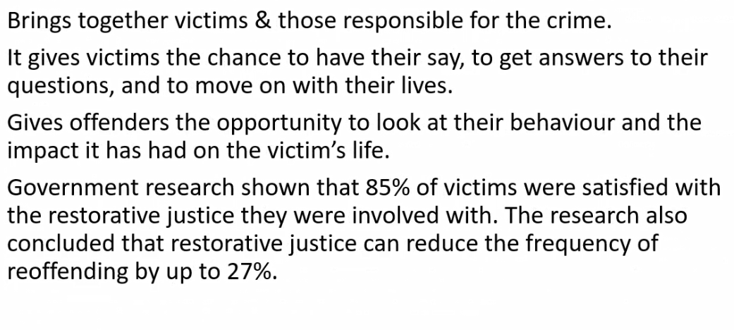
Restorative Justice
Notes:
https://restorativejustice.org.uk/resources/evidence-supporting-use-restorative-justice

Slide 67
Restorative Justice
Brings together victims & those responsible for the crime.
It gives victims the chance to have their say, to get answers to their questions, and to move on with their lives.
Gives offenders the opportunity to look at their behaviour and the impact it has had on the victim’s life.
Research shown that 85% of victims were satisfied / reoffending rates reduced
Rules around the use / trained leader / offender must accept responsibility

Slide 68
Restorative Approach / Justice
Save’s money - diverting people away from prosecution and by reducing reoffending
Saving the whole CJS
Needs of victims
Reduces the frequency of reoffending.
Improves victim satisfaction
Victim’s commissioner – Review conducted: RJ could be used more, victims were satisfied, RJ satisfied the victim’s needs.
Notes:
https://restorativejustice.org.uk/resources/evidence-supporting-use-restorative-justice
https://yjresourcehub.uk/restorative-approach/item/360-victims-commissioner-review-into-restorative-justice.html

Slide 69
Victimisation & becoming a perpetrator
Victimisation not the end point
Being a victim can lead to being the offender
Plummer & Cossins (2018) victim of child sexual abuse major factor to becoming an offender
“existence of a cycle of abuse for male child sexual abuse victims who had experienced particular abuse characteristics”

Slide 70
Further Information
http://www.victimsupport.org.uk
https://www.victimsinformationservice.org.uk
Notes:
April 2015: The Ministry of Justice launched their Victims’ Information Service, a website containing information about reporting a crime and going to court.
The site offers victims support in two specific areas:
What happens after a crime which includes reporting a crime, the police investigation, going to court, and after an offender is sentenced and
The support a victim should receive as their case progresses from making a Victim Personal Statement to extra help in court.

Slide 71
Webpages
https://www.cps.gov.uk/sites/default/files/documents/legal_guidance/joint-agency-guide-victim-personal-statement_0.pdf
https://assets.publishing.service.gov.uk/government/uploads/system/uploads/attachment_data/file/831968/victims-code-poster.pdf
https://www.cps.gov.uk/sites/default/files/documents/legal_guidance/joint-agency-guide-victim-personal-statement_0.pdf

