Slide 1
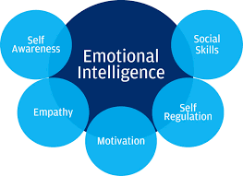
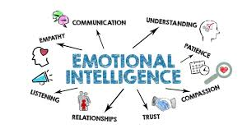
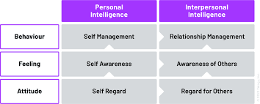
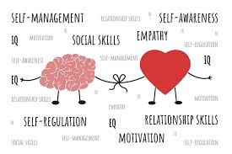
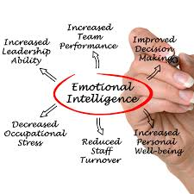
BMSW6106 Evaluation of Emotional Intelligence in Workplace Context
Student Name: Andrey Nieche
Introduction to Emotional Intelligence (EI)
Emotional Intelligence (EI) means an ability to know and use one’s own emotions, as well as either recognize or influence the emotions of others. EI was coined and popularized by (Mayer and Salovey, 2020), and has an important role in influencing workplace interactions, decisions, leadership, teamwork and performance (Goleman, 2021). Indeed, emotional intelligence is also important for improving one’s professional skills as well as one’s personal growth, emotional and mental well-being and resilience.
Theoretical Frameworks Applied
1. Goleman’s Five Components of EI
• Self-awareness – Knowing one's own feelings.
• Self-regulation – Controlling impulses and moods.
• Motivation – motivated to reach goals.
• Empathy – Recognising the feelings of others.
• Social skills – Developing friendly interactions.
Application to My Practice: And I have paid particular attention to self-regulation and empathy. My social skills and self confidence in high stake conversations are still being developed.
2. Mayer and Salovey’s Four-Branch Model
• Sensualising feelings
• Using feelings to help one think
• Emotional awareness
• Handling emotions
Application: This model has given me some sense that emotions are much more than reaction, that they make good data as part of decision making and problem solving.
Reflecting on My Emotional Intelligence
As I think about my emotional intelligence, I think of things where I am strong and things I can install more time to bolster my emotional intelligence. My way of being is that I am empathetic, patient, and responsive, not reactive. But that can be hard as setting emotional boundaries especially in high demanding environments. I understand what I am emotionally triggered by, and I work very hard to develop healthy coping strategies (Imperato and Strano-Paul, 2021). I have noticed that there is a big correlation between my emotional regulation and the amount of work I can get done effectively with colleagues and respond positively to feedback.
(2) Types of EI Skills
A. Empathize with Others
Empathy is being in tune with others’ emotions and their views. It fosters a psychological safe environment for people by curbing misunderstandings in the workplace.
Example in Practice: During a software project, I found my colleague was unusually quiet. I didn’t ignore it anymore and scrambled to ask them if they were okay. Now, they told us that they were going through something personally. It developed empathy that led to trust and cohesion in the team.
B. Acknowledge and Give Constructive Feedback
Constructive feedback with an emphasis on checking with the other person on emotional state is an essential EI skill.
Example in Practice: The advice I’ve received is to preface feedback from struggles with a positive observation. Maintaining good team dynamics has been achieved through this “feedback sandwich” approach.
C. Think Before Speaking or Acting
This is a skill of pausing, to imagine the impact of one’s words and actions and during emotional situations.
Example in Practice: I would defend myself when I was criticized. I ask clarifying questions and then respond thoughtfully now, a moment after the comment. The battle of unnecessary conflict has been reduced greatly.
Critical Appraisal of EI and Mindfulness in the Workplace
According to Jiménez-Picón et al (2021), Together, EI and mindfulness provide a powerful approach for the workplace wellbeing and performance. Mindfulness is an ability to bring forward present moment awareness and to reduce the tendency to react emotion all in an automatic way. In cooperation with EI, it facilitates better stress management, communication clarity and resilient leadership.
According to Cherniss (2020) research points out that almost 80 percent relationship between top performers and others is associated with emotional intelligence. Additionally, the mindfulness training improves cognitive flexibility, emotional balance and empathy urgent aptitudes for the malleable working condition.
However: Whilst EI is fabulous, developing it is often difficult, particularly in high pressured workplaces where emotions can be turbulent. EI training must be invested in by organisations and incorporated into the organisation’s culture. In addition, mindfulness is a practice that is not consistent unless the leadership role models its use.
Recommendations:
• Conduct EI assessments whilst in recruitment and professional appraisals.
• Work on the offer of mindfulness and emotional intelligence workshops.
• Create a psychological and emotional safe culture.
Potential Benefits of EI
A. Communication
EI makes us better listeners, actively listening, inferring and responding in congruence with the non-verbal signals that are being sent. As I’ve learned to reason with emotions, managing conversations that get tough, I’ve also learnt to communicate better. Instead of defensive reactions, I am now trying to be creating the right space so people can speak freely.
Benefit: Communication improves collaboration, reduces conflict and increases the amount of trust in workplace relationships. In high stress discussions emotional regulation helps keeping body professional.
Application: For example, at the university, when I was engaged in a group project, I provided empathy and perspective taking to shift the voices which meant there was a more inclusive and productive outcome.
B. Decision-Making
Emotionally intelligent people could make a balanced decision since they can see how emotions affect judgement. But emotional awareness can separate fact from feeling and give you a basis in cool to understand the nature of your emotional involvement.
Benefit: EI encourages objectivity and reduces ‘impulsive or emotionally driven errors.
Application: In the previous work placement, I finished out a customer complaint. On the one hand, I made a fair decision and was calm during the whole thing, considering the client and managing per the business’s policy.
C. Mental Health
It is important for us to be self-aware and emotionally regulated. Knowing how I react to certain stresses and patterns of emotional reactions can help prevent me from burning out.
Benefit: The beneficial effect of EI includes reduction in anxiety, enhancement of the self-esteem and better coping strategies.
Application: Now when I am overwhelmed, I journal and practice mindfulness to reframe the negative thought and get back on track.
(3) How I Could Improve My EI
A. Empathize with Others' Feelings
Personally, I believe that I have empathy, but one can have empathy and make it better over time by intentional practice and reflection.
Strategy for Improvement: We will start out by practicing active listening without judgment, validating emotions, and asking open ended questions that will make understanding other people easier and build better relationship.
Action Plan: Attend workshops and involve yourself on participation in peer support groups concerning listening and conflict resolution.
B. Be Willing to Take Responsibility
There is some level of emotional maturity when you take responsibility for emotional reactions and behaviours especially when something is not working out.
Strategy for Improvement: I will sincerely apologise when I realise that I have hurt someone and do not have excuses. This creates an accountability, builds the trust and respect.
Action Plan: A reflection journal to reflect on the interactions that have occurred in day to day and notice when I should have reacted differently.
C. Write it Down
Journaling allows for the processing of emotions by recognizing the pattern in behaviour and thought.
Strategy for Improvement: Write emotional journal for daily reflections of my feelings, interaction and reactions on different situations.
Action Plan: Journaling acts as a tool that enables self-awareness and emotional vocabulary, which create my ability to articulate emotions in future situation.
Conclusion and Final Reflections
As well as beneficial, this is crucial to be able to cope with the complexity of modern workplaces. Having got my mind around EI, I have started using it in my daily life professionally and personally. I have become able to communicate, decide, and manage my own mental health needs more. From here on, I'll graduate these skills by active empathy, accountability, journaling & mindfulness.
EI is a lifelong journey and with conscious effort I am sure it would improve every aspect of my work my relationships, myself and my leadership potential.
Reference
Cherniss, C. (2020). Emotional intelligence: Toward clarification of a concept. Industrial and organizational psychology, 3(2), pp.110-126.
Goleman, D. (2021) Leadership: The Power of Emotional Intelligence. 2nd edn. Northampton: More Than Sound.
Jiménez-Picón, N., Romero-Martín, M., Ponce-Blandón, J.A., Ramirez-Baena, L., Palomo-Lara, J.C. and Gómez-Salgado, J. (2021). The relationship between mindfulness and emotional intelligence as a protective factor for healthcare professionals: systematic review. International Journal of Environmental Research and Public Health, 18(10), p.5491.
Mayer, J.D. and Salovey, P. (2020) ‘The Ability Model of Emotional Intelligence: Principles and Updates’, Emotion Review, 12(3), pp. 195–203.

