Slide 1
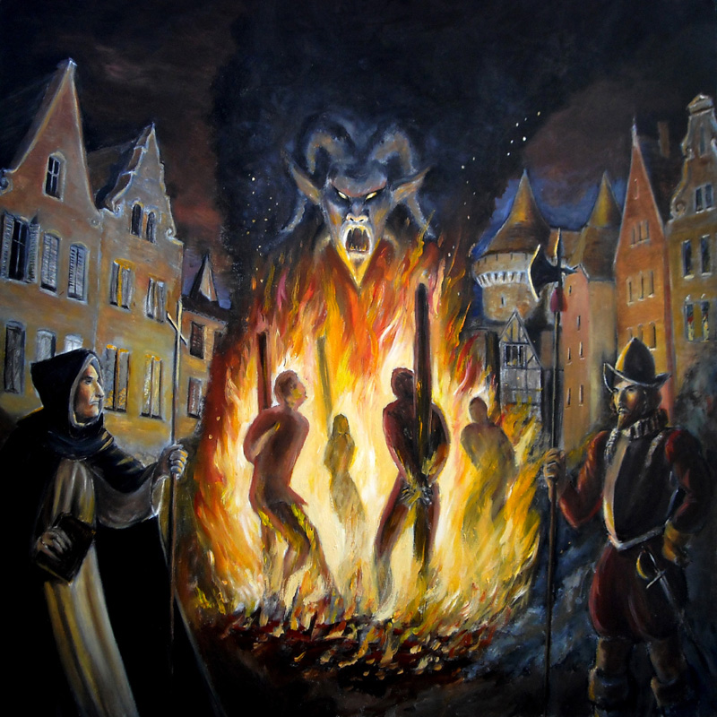

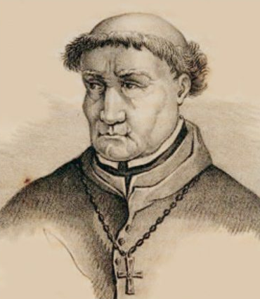
Could the Inquisition be Considered a Tyrannical Political Entity?
Tyranny and Revolution in the Ancient World (HPHI5909/HPHI6909)
By Alex Hales-Owen

Slide 2
What is the Purpose of this Presentation?
What Was the Inquisition? How did it Operate?
To observe the Inquisition in contrast to what is defined as Tyranny. Looking at a few Inquisitions, with a primary focus on the Spanish Inquisition.
How did the Inquisition justify its power?
Is religious power different to state power?
When and why was it considered a Tyranny, and by whom?
Conclusion: Was the Inquisition the embodiment of Tyranny?

Slide 3



What is Tyranny?
Tyranny : ‘The Cruel and Unfair use of power by a person or a small group to control a country or state’
Tyrant : ‘A cruel Ruler who has complete power over the people in their Country.’
Oxford Dictionary, Oxford Students Dictionary, (Oxford: Oxford University Press, 2007) p.746.
Ibid, p.746.

Slide 4
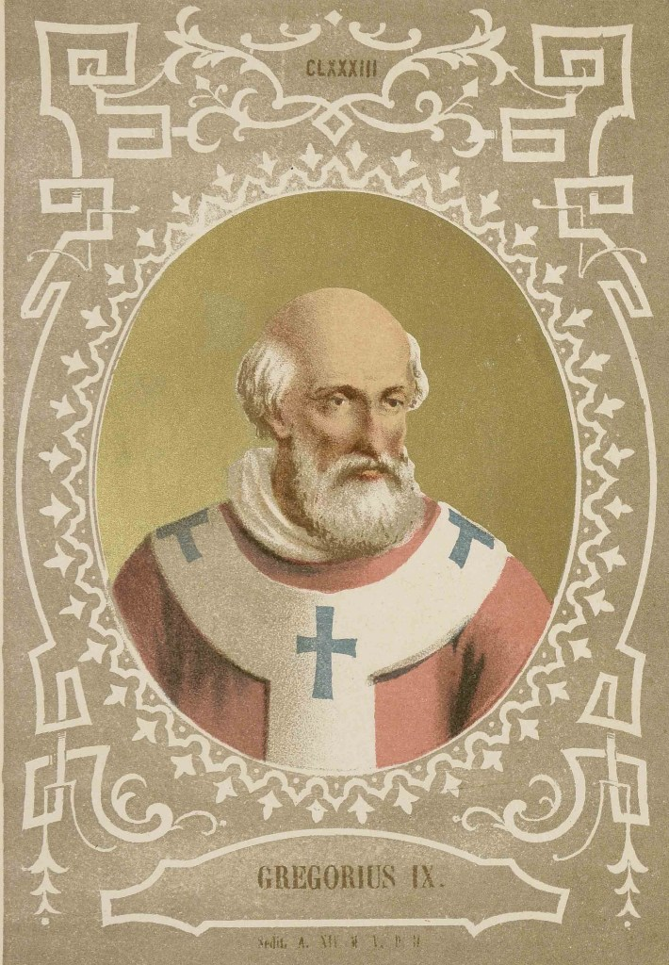
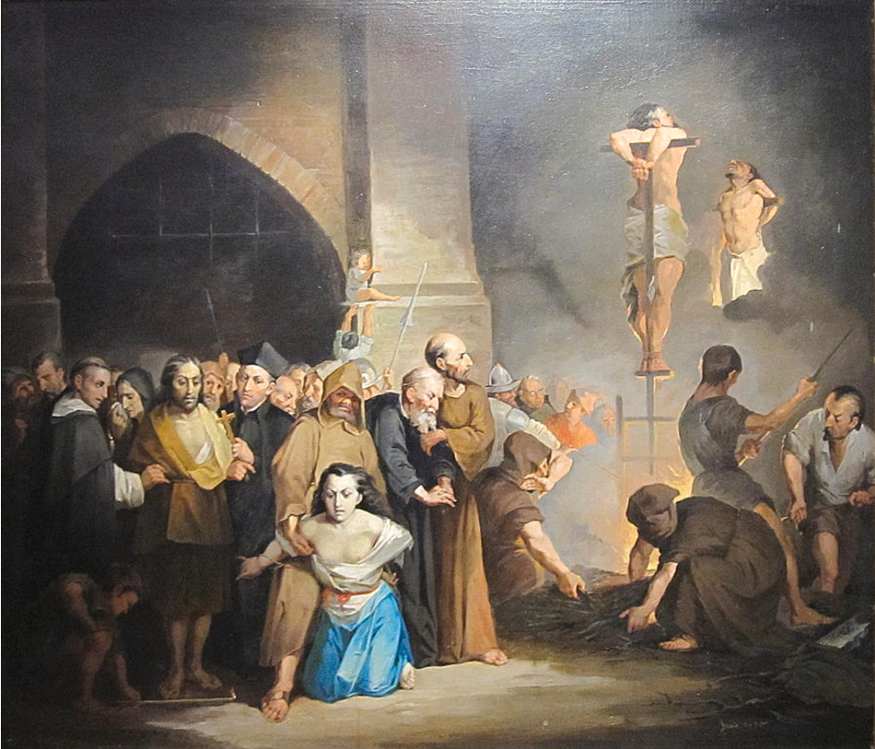
What Was the Inquisition?
A Medieval Catholic Organisation, formed to root out and punish those they considered to be guilty of any ideals of which they interpret to be against the values of the Catholic Church.
Formed by Pope Gregory IX in 1231, when he appointed the first ‘Inquisitors of Heretical Depravity.’
Inquisitors would use a wide range of techniques to identify and punish people, often without trial.
1
Cullen Murphy, God's jury: the inquisition and the making of the modern world (London: Allen Lane, 2012) p.9.
Ibid, p.83.

Slide 5
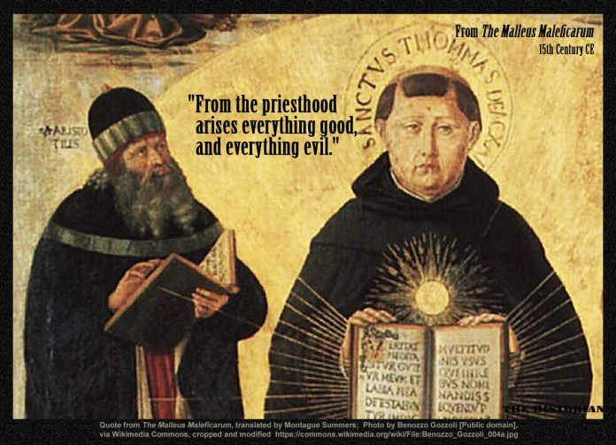
Who Were Heinrich Kramer and Jakob Sprenger?
German Inquisitors born between 1430 and 1440. Focused primarily on hunting Witches.
‘They showed themselves most zealous in the work which they had to do, and especially did they make inquisition for witches and for those who were gravely suspect of sorcery, all of whom they prosecuted with the extremist rigour of the law.’
Montague Summers, The Malleus Maleficarum, (London: John Rodker, 1487). p.n17

Slide 6
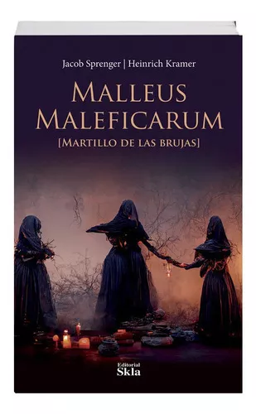
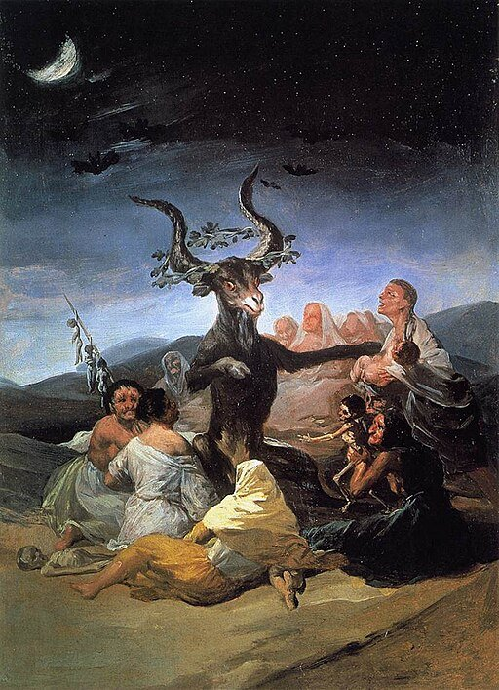
Inquisition Power as justified by Kramer and Sprenger
‘For the divine law in many places commands that witches are not only to be avoided, but also they are to be put to death, and it would not impose the extreme penalty of this kind if witches did not really and truly make a contract with devils in order to bring about real and true hurts and harms’.
Heretics and Witches were the ‘bane of social order’ conspiring against civilization.
‘irrational beasts’.
A Witch’s ‘reward shall be death by the sword of the executioner’.
Heinrich Kramer & Jakob Sprenger, The Malleus Maleficarum, (London: John Rodker, 1487). Translated by Montague Summers in 1928. p.2.
Summers, p.n19.
Kramer & Sprenger, p.132.
Ibid, p.5.

Slide 7
Tomas de Torquemada – The First Grand Inquisitor
Born in Spain in 1420.
Friar and Holy Roman Catholic Inquisitor of the Spanish Inquisition.
Jews were already punished by Laws in Spain at the time, forcing them to stay in Ghettos overnight, and preventing them from interacting with Christians.
‘Fear became a way of life in Spain’.
Responsible for countless deaths.
Enid A. Goldberg & Norman Itzkowitz, Tomas de Torquemada: Architect of Torture During the Spanish Inquisition, (New York: Franklin Watts, 2007). p. 12.
Ibid, p.19.

Slide 8
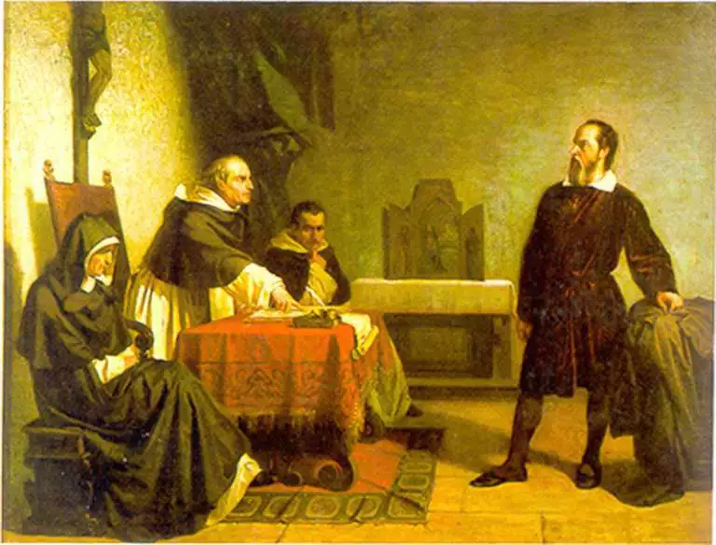
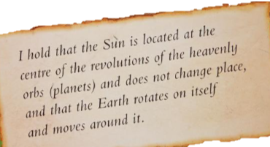
The PUNISHMENT of Galileo Galilei
Born in 1564.
December 1609: Creates his 20x Telescope.
1616: His findings contradicted the Church’s philosophy that the Earth marked the center of the universe, and the Roman Inquisition warned him against publishing his findings. Though he could present them as scientific or mathematical hypotheses.
1632 – 1633: He is called before the inquisition and imprisoned. All his work would be banned.
1634 – 1642: Placed under house arrest until he passed away. He continued his work throughout.
J.L. Heilbron, Galileo, (Oxford: Oxford University Press, 2010) p.1.
Ibid, p.150.
Ibid, p.219.
Ibid, p.316.
Ibid, p.329.

Slide 9
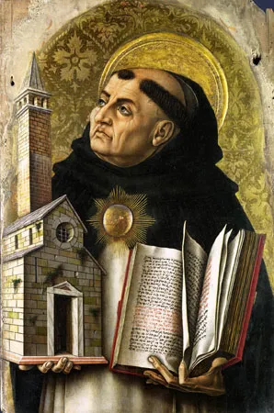
ST. Thomas Aquinas on Heretics
‘They deserve not only to be separated from the Church by excommunication, but also to be severed from the world by death.’
‘Wherefore if forgers of money and other evil-doers are forthwith condemned to death by the secular authority, much more reason is there for heretics, as soon as they are convicted of heresy, to be not only excommunicated but even put to death.’
Project Gutenberg, Thomas Aquinas, The Project Gutenberg eBook of Summa Theologica, Part II-II, (1265-1274.) Question 11, Article 3.
Ibid. Question 11, Article 3.

Slide 10
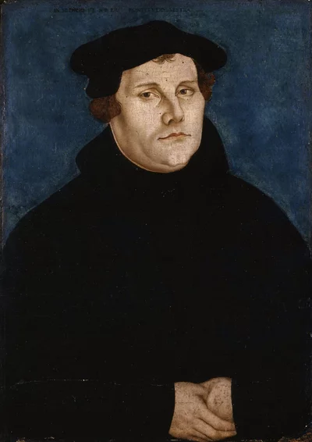
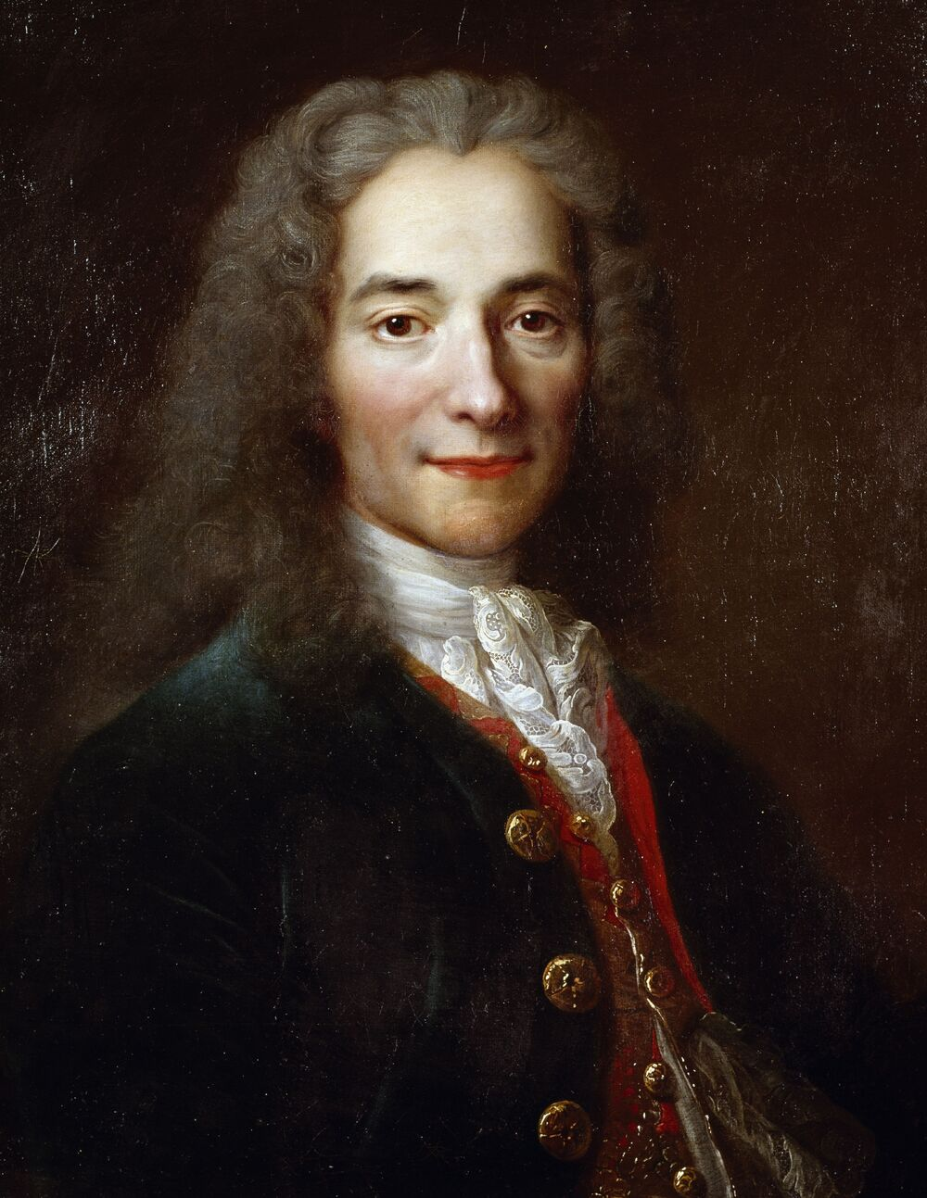
Philosophers who reject the Ideals of the Inquisition or May Consider them Tyrannical
‘The Pope has neither the will nor the power to remit any penalties, except those which he has imposed by his own authority, or by that of the canons.’ – Martin Luther (1517).
‘If you have a belief, you will be a tyrant to impose it on others.’ – Voltaire (1763).
Martin Luther, ‘Ninety-Five Theses’, in Ninety-Five Theses, (New York: P.F. Collier and Son, 1910) p.265.
Voltaire, Treatise on Tolerance, (Cambridge: Cambridge University Press, 2000) p.134.

Slide 11
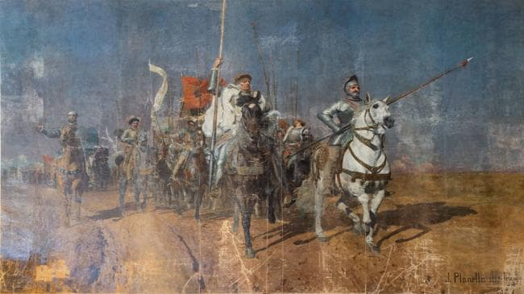
Comuneros Revolution
1520 – After a long build-up from the late 1490s, increases in taxation, violent retaliation to protests, and many injustices; Revolution began.
The Inquisition, which functioned as a private police force for the state, was hit so heavily by the rebellion in 1520 that its weakened state could ‘undermine the royal authority.’
By November 1520, King Charles’ government had essentially been toppled and the Revolution seized control of Castile.
1521- with the support of King Manuel of Portugal, King Charles was able to re-establish a strong military foothold. He offered concessions. The remaining rebels were defeated in April.
In the years during and after the Rebellion, the Inquisition's fury surged as they would charge more and more people with Witchcraft and Blasphemy.
Stephen Haliczer, The Comuneros of Castile : the forging of a revolution, 1475-1521, (Madison, Wis. : University of Wisconsin Press, 1981). p. 79.
Ibid, p.152.
Ibid, p.179.
Ibid, p.181.
Ibid, p. 244.

Slide 12
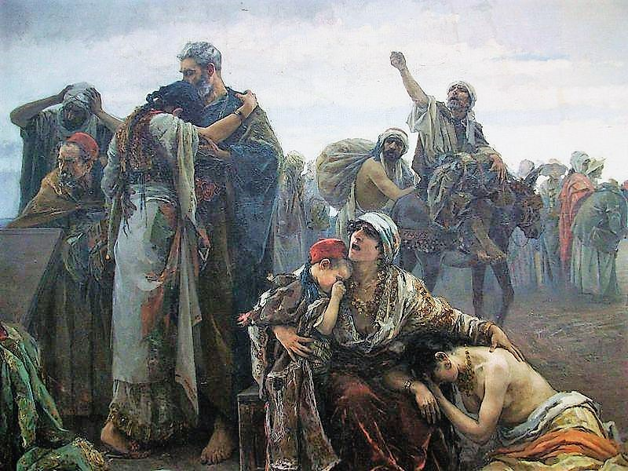
The Morisco Revolt
Muslims and Jews in Spain are forced to convert to Christianity or leave the country, by rule of King Ferdinand and Queen Isabella. Muslim converts became known as ‘Moriscos’.
The Spanish Inquisition launches investigations to test the legitimacy of the converts. Speaking or writing Arabic was not allowed, Arabic books were burned, torture and executions were common.
1568- Revolution began, a direct result of both the State Laws, and the acts of the Inquisition.
1569- Moriscos capture the city of Grenada.
1570-1571 the rebellion would suffer a series of defeats leading to its end.
Henry Charles Lea, The Moriscos of Spain; their conversion and expulsion, (New York: Greenwood Press, 1968). P. VIII.
Ibid, p.378.
Ibid, p.234.
Ibid, p.262.
Ibid, p.328.

Slide 13
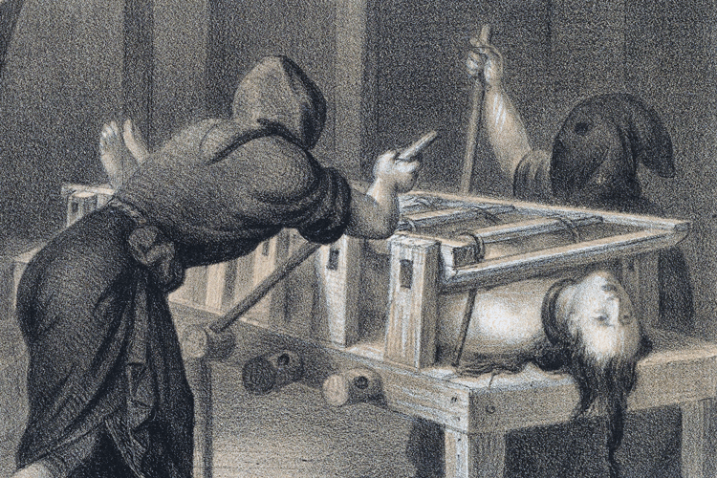
the Inquisitions could have been tyrannical Political entities
In Spain: ‘The constitution decreed that heretics when so condemned by the Church and delivered over to the secular arm should be condignly punished.’
Roman Inquisition: ‘Within its own territories Church and State were the Exact same thing.’
20th Century: ‘Inquisitions lay fully in the hands of the state and required no Religious dimension at all’
Acts of torture and brutality were utilised as the inquisition enacted the will of the Church and the state.
Raphael Sabatini, Torquemada and the Spanish Inquisition: a history, (London: S. Paul, 1913). P.43.
Murphy, God's jury, p.22.
Ibid p.22.

Slide 14
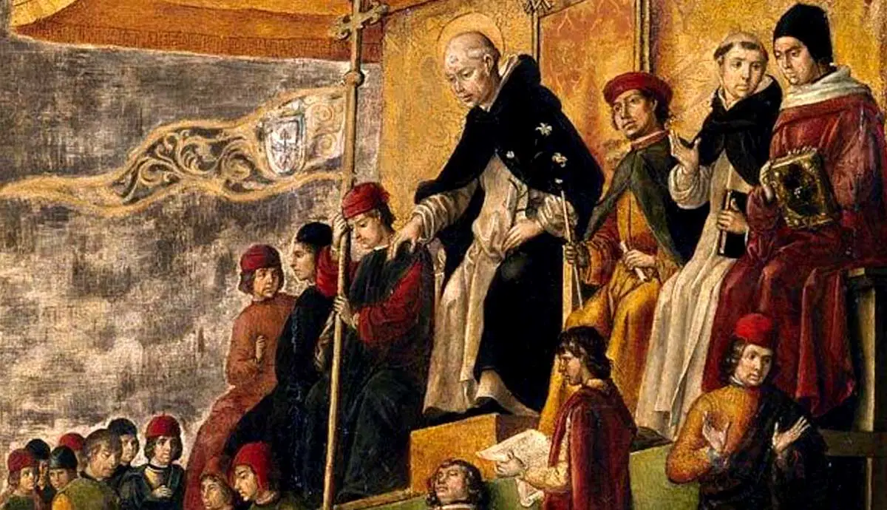
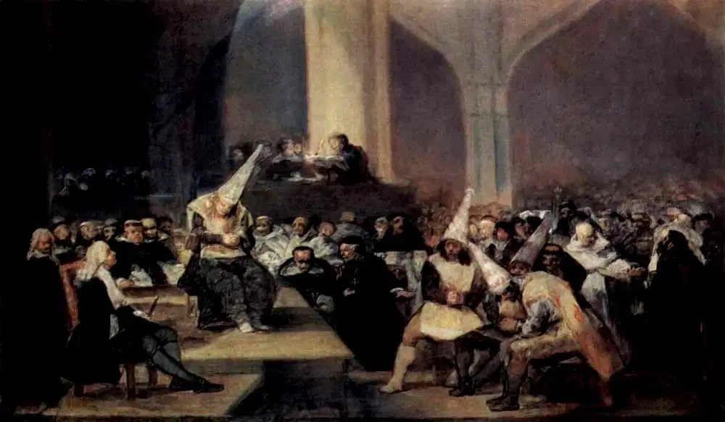
The Inquisitions may not have been Tyrannical Political Entities
The Spanish Inquisition often faced conflicts with other official Courts, one instance in 1503 a man named Francisco Cabeza was wanted by both the Inquisition and the Police, and violence broke out between the factions. Both the police and Inquisitors involved were punished.
The Inquisition was created to serve the will of the Pope, not that of the state.
Pope Gregory IX was against torture and many other brutal measures taken on by the Inquisition.
Haliczer, The Comuneros of Castile. p. 79.
Murphy, God’s Fury, p.9.

Slide 15

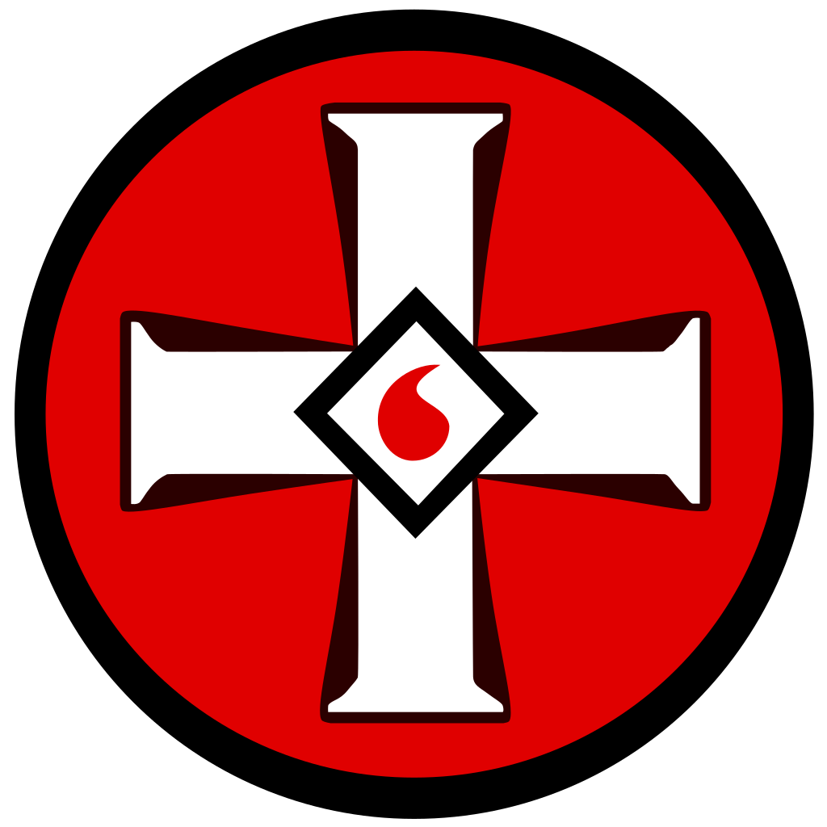
Could Inquisitions Still Exist Today?
‘Even today, there are investigations that go too far.’ ‘We have a word for fanatical investigations like these, we call them inquisitions.’
‘They are not confined to religion, they can be Political as well.’
‘Modern society has made a scapegoat of faith.’
Goldberg and Itzkowitz, Tomas De Torquemada, p.121.
Ibid p.121.
Murphy, God's jury, p.21.
Karen Armstrong, Fields of Blood: Religion and the History of Violence, (New York: Alfred A. Knopf, 2014) p.7.

Slide 16
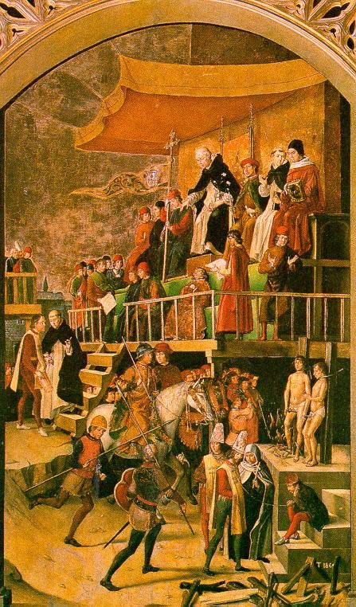
Conclusion: Could the Inquisitions be considered Tyrannical Political Entities?
The Inquisition were designed to root out and punish heretics on behalf of God and the Pope.
They were affiliated with the State, and oftentimes the laws of the Pope and the State were similar.
An attack on the State or the Inquisition often meant an attack on the other.
The power of the Inquisition was at the disposal of the State in many instances.
Whilst the Inquisition themselves may not have always been a fully tyrannical political entity, they certainly acted as such by the 1500s.

Slide 17
Thank You!
Any Questions?

Slide 18
Bibliography
Armstrong, Karen Fields of Blood: Religion and the History of Violence, (New York: Alfred A. Knopf, 2014)
Goldberg, Enid A. & Itzkowitz, Norman, Tomas de Torquemada: Architect of Torture During the Spanish Inquisition, (New York: Franklin Watts, 2007).
Haliczer, Stephen, The Comuneros of Castile : the forging of a revolution, 1475-1521, (Madison, Wis. : University of Wisconsin Press, 1981).
Heilbron, J.L. Galileo, (Oxford: Oxford University Press, 2010).
Kramer, Heinrich & Sprenger, Jakob The Malleus Maleficarum, (London: John Rodker, 1487). Translated by Montague Summers in 1928)
Lea, Henry Charles The Moriscos of Spain; their conversion and expulsion, (New York: Greenwood Press, 1968).
Luther, Martin ‘Ninety-Five Theses’, in Ninety-Five Theses, (New York: P.F. Collier and Son, 1910). p.265.
Oxford Dictionary, Oxford Students Dictionary, (Oxford: Oxford University Press, 2007).
Project Gutenberg, Thomas Aquinas, The Project Gutenberg eBook of Summa Theologica, Part II-II, 1265-1274.
Sabatini, Raphael, Torquemada and the Spanish Inquisition: a history, (London: S. Paul, 1913).
Summers, Montague The Malleus Maleficarum, (London: John Rodker, 1487).
Voltaire, Treatise on Tolerance, (Cambridge: Cambridge University Press, 2000).

Slide 19
List of Images Used
Banti, Christiano, ‘Galileo facing the Roman Inquisition’ (1857). <https://www.planetary.org/space-images/20130128_galileo_facing_roman_inquisition> [Accessed 07/12/2024].
Berrugette, Pedro, ‘Burning of the Heretics – Dominicans at the Inquisition’, (1490) <https://www.heiligenlexikon.de/Glossar/Inquisition.html> [Accessed 14/12/2024].
Berruguete, Pedro, ‘Saint Dominic presides over an Auto-da-Fé’ (1490-1499) <https://www.thecollector.com/what-was-the-spanish-inquisition/> [Accessed 14/12/2024].
Cranach, Lucas, ‘Martin Luther’ (1529) <https://www.npr.org/2016/11/20/502437123/how-technology-helped-martin-luther-change-christianity> [Accessed 07/12/2024].
Crivelli, Carlo, ‘Thomas Aquinas’ (1476) <https://de.wikipedia.org/wiki/7._M%C3%A4rz#/media/Datei:St-thomas-aquinas.jpg> [Accessed 14/12/2024].
Goya, Francisco, ‘The Tribunal of the Inquisition’, (1814) <https://www.thecollector.com/what-was-the-spanish-inquisition/> [Accessed 14/12/2024].
Goya, Francisco, ‘Witches’ Sabbath’, (1797-1798). <https://www.historyisnowmagazine.com/blog/2024/7/21/the-inquisitions-of-the-middle-ages-part-4-what-was-the-spanish-inquisition> [Accessed 07/12/2024].
Gozzoli, Benozzo, ‘Quote from The Malleus Maleficarum’ (1971) <https://thehistorianshut.com/2017/02/27/the-malleus-maleficarum-heinrich-kramer-and-james-sprenger/> [Accessed 01/12/2024].
Largillière, ‘Voltaire at 24’, (1718) <https://litterature.fandom.com/fr/wiki/Voltaire?file=531px-Voltaire.jpg> [Accessed 07/12/2024].
Martins, António, ‘Blood Drop’, (1998) <https://www.fotw.info/flags/us%7Dkkk.html> [Accessed 14/12/2024].
Napier, Gordon, ‘Inquisition, Oil on Board’ (2009) <http://dashinvaine.co.uk/inquisition%20fin%20page.htm> [Accessed 30/11/2024].
Panigati, Oleografia & Milano, Meneghini, ‘Gregorius IX. Gregorio IX’, (1879) <https://commons.wikimedia.org/wiki/File:Gregorius_IX._Gregorio_IX,_papa._Ugolino_di_Anagni.jpg> [Accessed 01/12/2024].
Pinto, Joakin, ‘The Inquisition’, 2021 <https://pixels.com/featured/the-inquisition-joaquin-pinto.html> [Accessed 01/12/2024].
Planella , Juan, ‘The Communards of Castile’ (1887) <https://www.elnortedecastilla.es/culturas/arte/valladolid-destapa-secretos-comuneros-cuadro-oculto-anos-20230313215811-nt.html?ref=https%3A%2F%2Fwww.elnortedecastilla.es%2Fculturas%2Farte%2Fvalladolid-destapa-secretos-comuneros-cuadro-oculto-anos-20230313215811-nt.html> [Accessed 14/12/2024].
Puig Roda, Gabriel ‘Expulsion of the Moriscos’ (1894) <https://www.flickr.com/photos/30348759@N04/52013597159/> [Accessed 12/12/2024].
Riva Palacio, Vicente, ‘The Torture of Isabel Rodriguez’, (1870) <https://news.berkeley.edu/2022/07/20/the-tortures-of-the-spanish-inquisition-hold-dark-lessons-for-our-time/> [Accessed 07/12/2024].
Unknown Artist, ‘Chief Inquisitor Tomás de Torquemada’ (unknown date) <https://www.thevintagenews.com/2017/05/09/tomas-de-torquemada-the-first-grand-inquisitor-of-the-spanish-inquisition-who-was-reportedly-responsible-for-the-deaths-of-2000-people/>
Unknown Artist, ‘CIA Seal’ (1947) <https://logos-world.net/cia-logo/> [Accessed 14/12/2024].

