Slide 1
Health and Safety Guide in Housekeeping

Slide 2
Introduction
Establish a safe climate for staff and visitors (Yusof, Mohammad, and Ismail, 2021).
Stock all the essential requirements
Maintain a record for health and safety measures.
Notes:
Establishing such a protected climate is a main issue for all administrations as it is straightforwardly connected with the increment or decline of clients. The lodging needs to guarantee that the visitor, representatives and the actual inn is protected. Shielding of resources is a major prerequisite for all organizations (Yusof, Mohammad, and Ismail, 2021). Hilton Garden Inn Luton need to stock all the essential requirements organize training for staff and create a rule book regarding health and safety measures that can reduce the risks and help to run the business with ease.

Slide 3
Identifying risk related to housekeeping safety
Risk identification is a necessary action (Agarwal, Page, and Mawby., 2021).
Slips and falls on a wet floor and chemical exposure from a cleaning agent.
Infectious disease can harm both the staff and visitors.
Notes:
Distinguishing risk is important to keep up with the harmony among clients and staff (Agarwal, Page, and Mawby., 2021). Accidents involving slips and falls on a wet floor, and chemical exposure from cleaning agents are potential risks to housekeeping safety of Hilton Garden Inn Luton. Infectious diseases brought on by waste disposal. Knee wounds from dull movement and muscle and back wounds from significant burden lifting are some identifying risk factors in the context of safety measures related to housekeeping.

Slide 4

Industry best practices and regulations related to housekeeping safety
The hotel's housekeeping department is crucial.
Housekeeping office guarantees tidiness (Siaw, and Siaw, 2021).
reliably evaluate and fix mechanical assemblies, give proper signs.
Notes:
The housekeeping department of Hilton Garden Inn Luton is crucial to its overall success because it not only improves every aspect of the hotel but also generates the most revenue. With headways in innovation and modernisation, the essence of housekeeping has changed. The housekeeping office guarantees the tidiness, protection and stylish beseech of the inn (Siaw, and Siaw, 2021). Assigning time for staff to immaculate and clear all logs from the workplace, reliably evaluate and fix mechanical assemblies, give proper signs for risks, and set up a security manual for all workers are some best practices for the housekeeping staff.

Slide 5
Necessary precautions to prevent accidents and injuries
Precaution is necessary to avoid accidents (Tsai, et al., 2020).
Try to keep in stock the security extras and gear
Use appropriate signs to warn visitors and employees about their health.
Notes:
Some necessary precautions to avoid accidents and injuries are to create a plan for the preventative maintenance of all equipment (Tsai, et al., 2020). Try to keep stock of the security extras and gear. guarantee that harmful synthetic substances are appropriately marked and put away in shut cupboards of Hilton Garden Inn Luton. Use appropriate signs to warn visitors and employees about their health. Orchestrate security review in the manager's everyday exercises. Sort out preparing to prepare the staff about the hardware and their utilization. Keep up with the specific security records and Spread out a security board. Explore and investigate all incidents and wounds

Slide 6
Procedure for room cleaning that incorporates safety measures
Adopting an appropriate procedure helps to avoid safety challenges.
Cleaning procedures help visitors in their future approach with the business.
Before starting the process, staff should put on gloves (Sadhale, 2021).
Notes:
Adopting an appropriate procedure in cleaning helps to avoid safety challenges and maintain the safety measures of visitors and staff. Because of their visibility, interactions with guests, and obligations to maintain clean, hygienic and comfortable rooms, room attendants play an important role in the organization. These pass a basic message to the visitors in terms of cleanliness, well-being, support and presence of areas. To maintain safety measures in Hilton Garden Inn Luton, the housekeeping staff should put on gloves and be ready with all essential materials for cleaning (Sadhale, 2021).

Slide 7
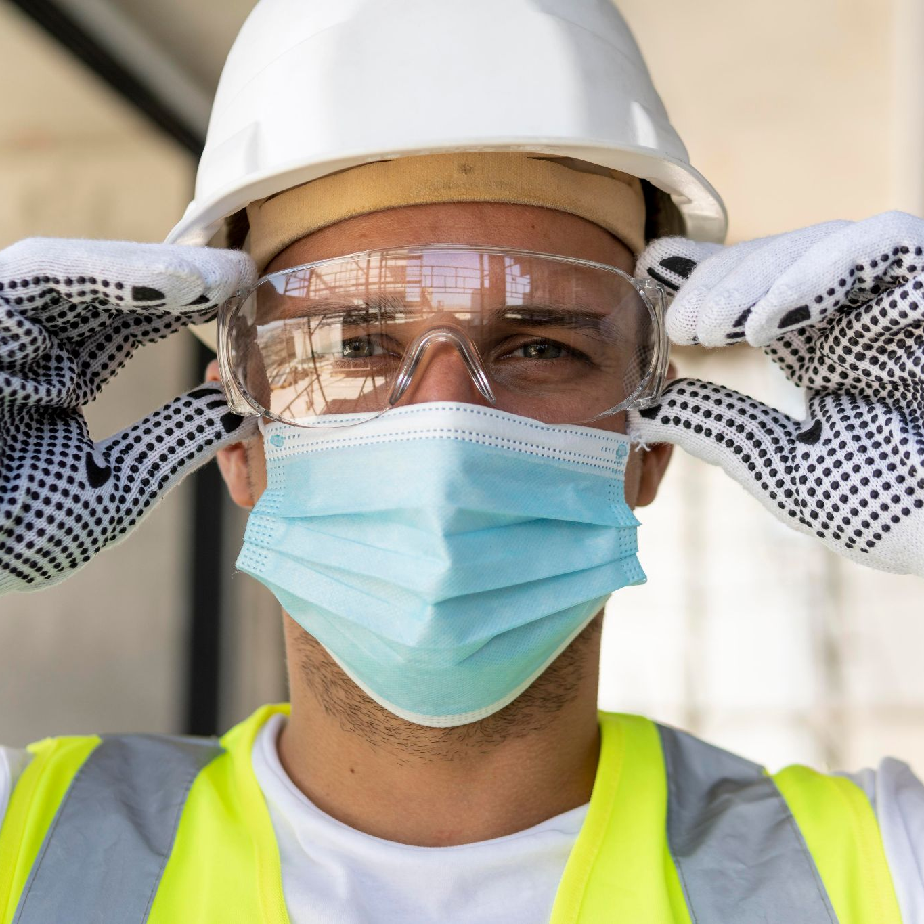
Cont.
Prepare the area for cleaning by removing the wet materials and wipes.
Checking all wires and lights are functioning correctly.
If there is any deficiency and a quick action is required (Chigurupati, et al. 2020).
Notes:
After being ready with the materials, they need to prepare the area for cleaning by removing the wet materials and wipes, removing the garbage from the rooms, and cleaning the bathroom by checking all wires and lights are functioning correctly. They have to restock all required materials in the rooms. Hilton Garden Inn Luton need to take immediate action to the concerned team if there is any deficiency and quick action is required to maintain the health and safety measures of both the staff and visitors (Chigurupati, et al. 2020).

Slide 8
Essential equipment used for safely during room cleaning
Always restocking the essential materials is necessary (Bi, et al., 2020).
A microfiber cloth is the best tool for cleaning surfaces in rooms.
vacuum cleaners and cleaning machines help to rejuvenate the shine.
Notes:
To stock every one of the fundamental types of gear to handle well-being issues at any time is the essential worry of any industry to save the resources and picture of the brand (Bi, et al., 2020). There are different types of essential room cleaning equipment: manual equipment. A microfiber cloth is the best tool for cleaning surfaces in rooms, bathrooms, and other common areas. It is fragile and shouldn't scratch surfaces. Some mechanical equipment of Hilton Garden Inn Luton are vacuum cleaners and cleaning machines.

Slide 9
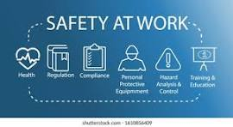
Practical solutions to mitigate to potential hazards in room cleaning
Possible dangers and providing useful answers help to mitigate the scenarios.
Musks, gloves should be used to avoid health related hazards(World Health Organization, 2020).
Lifting kits with ergonomic design can be used to prevent strains.
Notes:
It desires to make specific prosperity of individual visitors while addressing possible dangers and providing useful answers to moderate them to encourage completely safe environmental elements for anyone included. To keep away from hurtful substance openness, Individual Defensive Gear or PPE packs like gloves, and musks can be utilized (World Health Organization, 2020). Lifting kits with ergonomic design and adjustable cleaning tools can be used to prevent musculoskeletal strains.

Slide 10
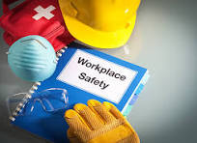
Conclusion
Safeguarded environment is a central concern for all organizations.
To stock every fundamental requirement should be the primary concern.
Following safety measures can help to avoid the safety hazards.
Notes:
Laying out such a safeguarded environment is a central concern for Hilton Garden Inn Luton as it is directly associated with the augmentation or decline of clients. To stock every one of the fundamental necessities and sort out preparing for staff and make a standard book in regards to wellbeing and security measures can diminish the dangers and help to maintain the business effortlessly.

Slide 11
References
Agarwal, S., Page, S.J. and Mawby, R., 2021. Tourist security, terrorism risk management and tourist safety. Annals of Tourism Research, 89, p.103207. Available at:https://pearl.plymouth.ac.uk/bitstream/handle/10026.1/17051/ATR-D-20-00859_R2.pdf?sequence=1 (Accessed on 7 February 2024)
Aristyawati, N.L., Budasi, I.G. and Wedhanti, N.K., 2020. An Analysis Of Jargons Used By The Housekeeping Department At The Lovina Bali Hotel. Indonesian Journal of Educational Research and Review, 3(2), pp.72-80. Available at: https://ejournal.undiksha.ac.id/index.php/IJERR/article/download/26537/pdf (Accessed on 7 February 2024)
Bi, J.W., Liu, Y., Fan, Z.P. and Zhang, J., 2020. Exploring asymmetric effects of attribute performance on customer satisfaction in the hotel industry. Tourism Management, 77, p.104006.Available at:https://drive.google.com/file/d/1RrGis5Ixua8pAqkfC3pu6sqWy4EO7OTu/view (Accessed on 7 February 2024)
Chen, X.A., Wang, R. and Zhang, J., 2022. Divide and conquer: A hygienic, efficient, and reliable assembly line for housekeeping. Manufacturing & Service Operations Management, 24(2), pp.938-955.Available at:https://ink.library.smu.edu.sg/cgi/viewcontent.cgi?article=7731&context=lkcsb_research(Accessed on 7 February 2024)
Chigurupati, R., Panchal, N., Henry, A.M., Batal, H., Sethi, A., D’innocenzo, R., Mehra, P., Krishnan, D.G. and Roser, S.M. (2020). Considerations for Oral and Maxillofacial Surgeons in COVID-19 Era: Can We Sustain the Solutions to Keep Our Patients and Healthcare Personnel Safe? Journal of Oral and Maxillofacial Surgery, 78(8), pp.1241–1256. doi:Available at:https://doi.org/10.1016/j.joms.2020.05.027 .(Accessed on 7 February 2024)
Choy, M., Cheng, J. and Yu, K., 2021. Evaluating the environmental sustainability strategies of the housekeeping department: the case of an international hotel chain in Hong Kong, China. Tourism Critiques: Practice and Theory, 2(1), pp.115-132. Available at: https://www.emerald.com/insight/content/doi/10.1108/TRC-01-2021-0001/full/pdf (Accessed on 7 February 2024)
Jawabreh, O., Mahmoud, R. and Hamasha, S.A., 2020. Factors influencing the employees service performances in hospitality industry case study AQBA five stars hotel. Geo Journal of Tourism and Geosites, 29(2), pp.649-661.Available at:https://www.researchgate.net/profile/Omar-Jawabreh/publication/341286270_FACTORS_INFLUENCING_THE_EMPLOYEES_SERVICE_PERFORMANCES_IN_HOSPITALITY_INDUSTRY_CASE_STUDY_AQBA_FIVE_STARS_HOTEL/links/5eb9108e92851cd50da8b148/FACTORS-INFLUENCING-THE-EMPLOYEES-SERVICE-PERFORMANCES-IN-HOSPITALITY-INDUSTRY-CASE-STUDY-AQBA-FIVE-STARS-HOTEL.pdf (Accessed on 7 February 2024)
Jothinarayanan, N., Karlsen, F. and Roseng, L.E., 2023. Comparative evaluation of loop-mediated isothermal amplification and PCR for detection of Esox lucius housekeeping genes for use in on-site environmental monitoring. Journal of Fish Biology, 103(5), pp.897-905. Available at: https://www.researchgate.net/profile/Lars-Roseng/publication/371377049_Comparative_evaluation_of_LAMP_and_PCR_for_detection_of_Esox_lucius_housekeeping_genes_for_use_in_on-site_environmental_monitoring/links/6528360f3fa934104b1b1a24/Comparative-evaluation-of-LAMP-and-PCR-for-detection-of-Esox-lucius-housekeeping-genes-for-use-in-on-site-environmental-monitoring.pdf (Accessed on 7 February 2024)
Sadhale, M., 2021. The Changing Role of Housekeeping Department in Hotels Post COVID-19 Pandemic. Eureka Publications.Available at:http://210.212.169.38/xmlui/bitstream/handle/123456789/9834/The%20changing%20role%20of%20housekeeping%20dept..pdf?sequence=1&isAllowed=y(Accessed on 7 February 2024)
Sahoo, S., Singh, G., Bhogal, R.P., Mehra, A., Aggarwal, A.K., Goel, K., Dutta, U., Bhalla, A., Lakshmi, P.V.M., Puri10, G.D. and Grover11, S., 2020. Psychosocial issues among the “faceless corona warriors”-the hospital housekeeping staff and sanitary workers on COVID-19 duty: an exploratory survey from a tertiary health care center from North India. J Postgrad Med Educ Res, 54, pp.94-9. Available at: https://www.jpmer.com/doi/JPMER/pdf/10.5005/jp-journals-10028-1389 (Accessed on 7 February 2024)
Siaw, G.A. and Siaw, N.A., 2021. Health hazard control and work safety at the legislative and facility levels in budget hotels in the Eastern Region, Ghana. ADRRI Journal of Agriculture and Food Sciences, 5(2 (4) July-September), pp.49-64.Available at:https://journals.adrri.org/index.php/adrrijafs/article/download/701/595 (Accessed on 7 February 2024)
Tsai, C.H., Linliu, S.C., Chang, R.C. and Mak, A.H., 2020. Disaster prevention management in the hotel industry: Hotel disaster prevention literacy. Journal of Hospitality and Tourism Management, 45, pp.444-455.Available at:https://www.academia.edu/download/65079319/JP14_HDPL_Proofs_JHTM_2020.pdf (Accessed on 7 February 2024)
Wirya, I.M.S., 2023. Analysis of the Implementation of Standard Operating Procedures (SOP) in the Housekeeping and Front Office Department of Frii Bali Echo Beach Hotel Canggu. Jurnal Manajemen Pelayanan Hotel, 7(1), pp.192-223. Available at: https://mapindo.ejurnal.info/index.php/manajemen_pelayanan_hotel/article/download/208/135 (Accessed on 7 February 2024)
World Health Organization, 2020. Personal protective equipment. Available at: https://apps.who.int/iris/bitstream/handle/10665/337961/9789240011410-eng.pdf (Accessed on 7 February 2024)
Yusof, M.F.M., Mohammad, R. and Ismail, S.H., 2021. Work-Related Low Back Pain among Hotel Housekeeping Workers at Kuala Lumpur. Journal of Advanced Research in Applied Sciences and Engineering Technology, 25(1), pp.80-93.Available at:https://www.akademiabaru.com/submit/index.php/araset/article/download/4321/3245 (Accessed on 7 February 2024)

Slide 12


