Slide 1
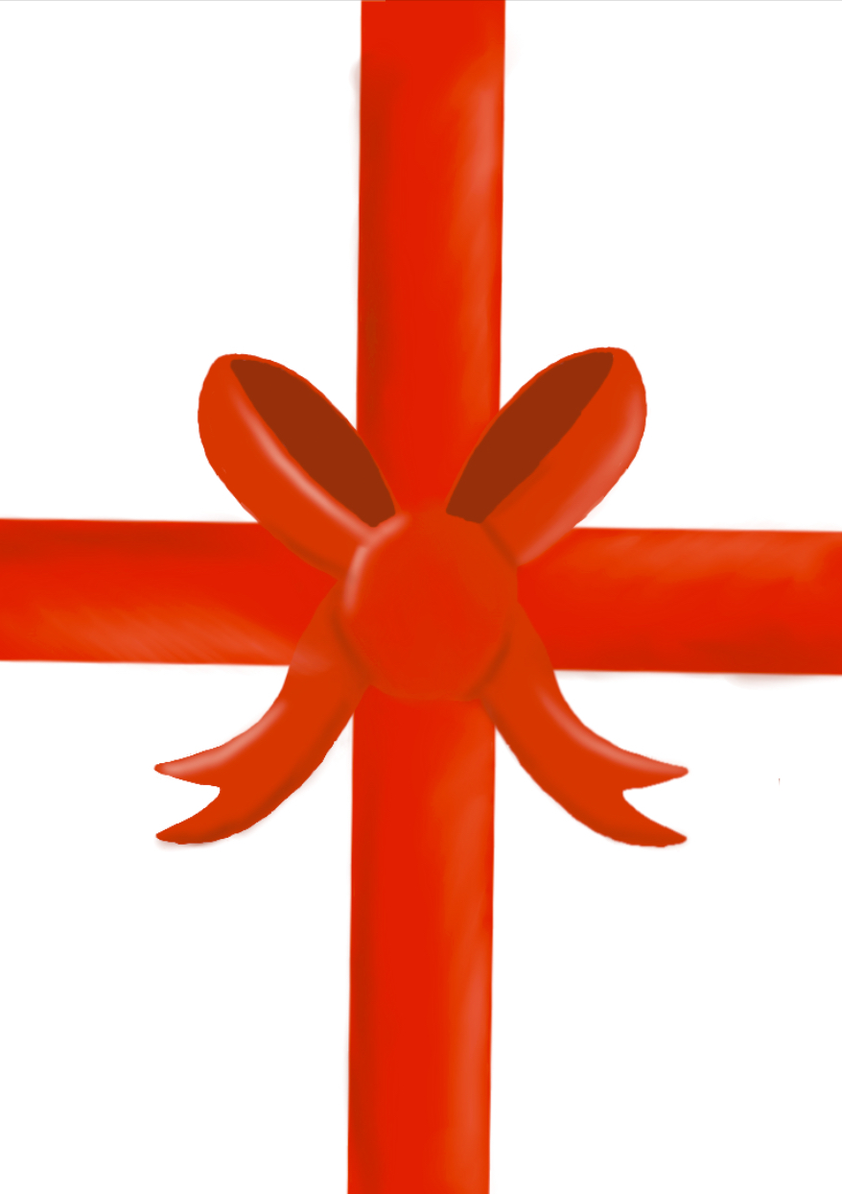
CREATIVE DECISIONS :
We didn't exactly have a particular plan as we trusted each other to make their own decisions, the design for the background was chosen to be a present to symbolize the charity that we have chosen which is Age Cymru gift box appeal; this charity supports elderly people with a Christmas box with goodies inside, we made the decision that this was a good charity as this show is aimed for children, which could teach them about gift giving and how it's important to
remember your elders.
The roles were picked
and placed by us to the
people who most suited
the job description.
OUR PROCESS AS A GROUP :
We met in the library for our first session to work on our project and every decision we made was made as a company. We assigned ourselves and each other roles listened to each other's ideas and worked creatively with one another. We all shared our designs for and ideas for our poster then Morven created it. We used power point so we could to virtually co-edit and adapt our work collectively. This was also a good way to complete the work even when we weren't in the same room as we could see what everyone else was typing and still work together.
CARW FACH
PRODUCTIONS
CONCLUDING OUR WORK :
The overall take way from this
work was we worked well
as a group and
despite members not
turning up, we still
managed to pull it
all together. This worked so well because we listened to each other's ideas, and we weren't afraid to have ideas shut down. And because of that we could improve the initial idea. We learned the importance of time management, we had clashing time, tables so we had to put the effort in to make sure we could find the time to work in person and digitally. We used some skills in design which made the poster more interesting.
BY BETSY DOWNES, MEGAN FEATHERSTONE, MORVEN
MONTGOMERY AND NINA CAMPBELL

Slide 2
BETSY DOWNES DIRECTOR/PRODUCER - EVALUATION
I found that I'm at my best working with a group of people. Especially creative people with an understanding and a deep connection to the creative industry.
My expectations for this project were high as I thought that we would be able to complete this with ease. And I was not let down as I think we worked very well within our team; we got on well and could communicate well with each other.
Director/producer was my role in this, I think that this spoke to me because I can work well with others, take criticism and I have a creative mindset.

Slide 3
MEGAN FEATHERSTONE COSTUME AND PROP DESIGNER - EVALUATION
Our group worked well as we all assigned roles for ourselves but still worked as a group. My role was costume and prop maker.
I created a mind map and we brainstormed ideas about names for our theatre company, potential shows and charities to work with. We looked at apps to create our poster and decided that power point was the best as we could co-edit and add to our ideas collaboratively.
We managed our time well when working around our different timetables. Going into this I was apprehensive about being able to do everything but the entire experience was very fruitful as we all built off each other's ideas.

Slide 4
MORVEN MONTGOMERY
STAGE MANAGER - EVALUATION
Overall, I felt our group worked well and came together with ideas early on which helped quicken our overall development process.
I opted for stage manager to be my production role as I felt I work well under pressure, whilst also providing a technical and creative mindset that is required of this job role.
Regarding the poster design itself I helped design the technical sketch before drawing it up digitally to be used for our outcome.
The shared PowerPoint also allowed for collaborating as a group to be easy and flexible, as we all had different schedules throughout the day.

Slide 5
NINA CAMPBELL
SET DESIGNER AND CREATIVE DIRECTOR - EVALUATION
I found that when working with a group I enjoy being able to merge and form new ideas based off conversations and collaboration with other people.
We were able to chat and make decisions based on how we felt the group would work best, which allowed us to remove any arguments about roles or processes that may disagree with certain people.
We chose to use PowerPoint as it allowed us all to work together on one platform all at the same time, which meant we could make in the moment decisions and then act on them straight away.

