Slide 1
Renewables
Lara Hopkinson
Building services

Slide 2
Outline
Context of decarbonisation
Differing energy types
Differing technology types
Case studies

Slide 3
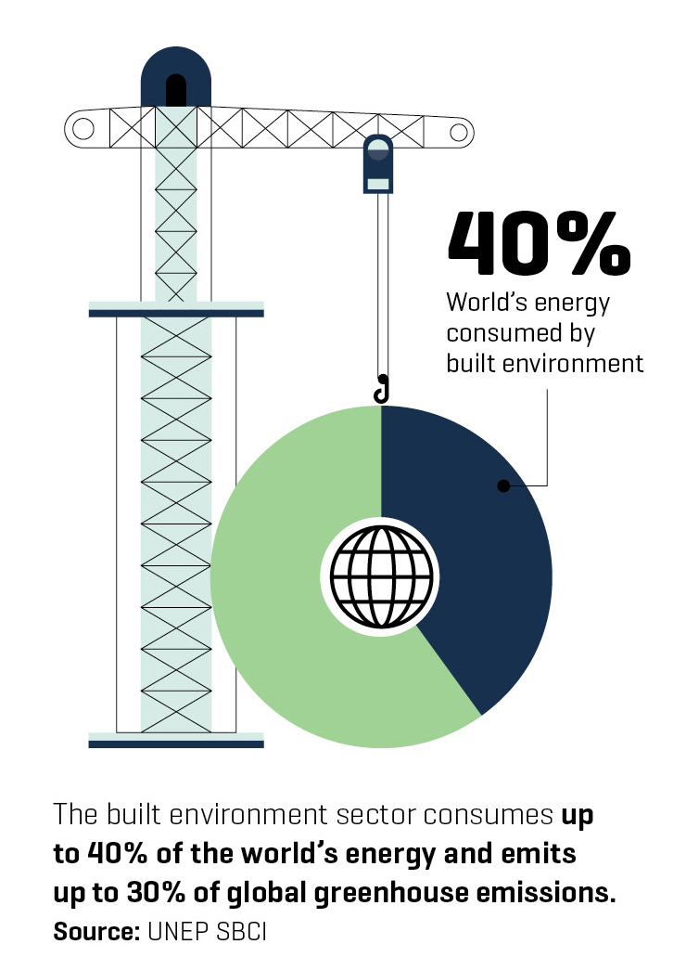
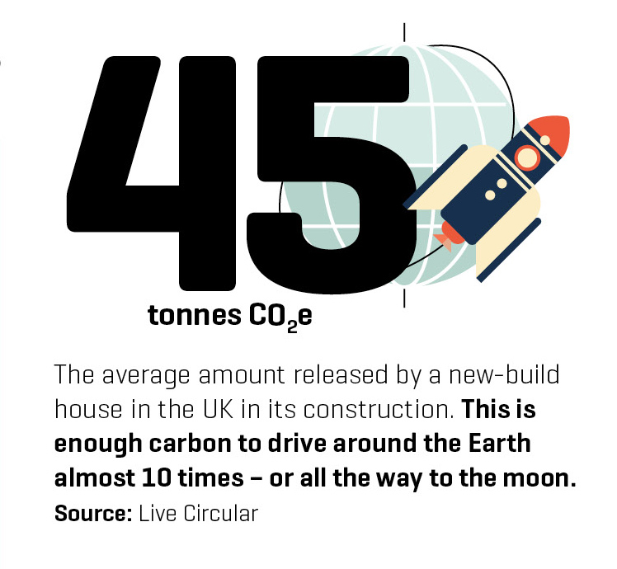
Context…

Slide 4
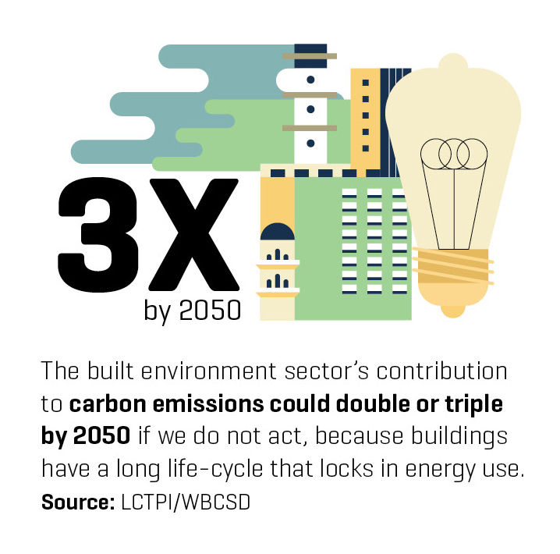
Context…

Slide 5
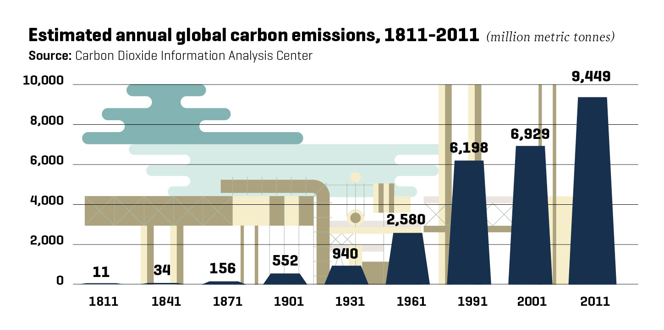
Context of carbon emissions

Slide 6
What energy source?
Solar
Biomass
Wind
Hydro
  Tidal
Geothermal

Slide 7
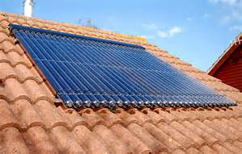
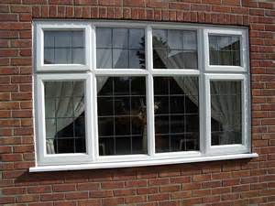
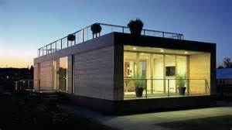
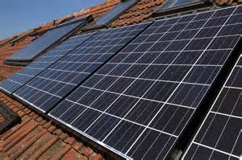
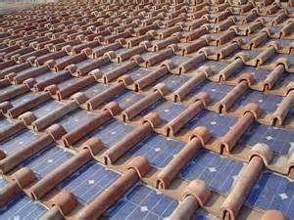
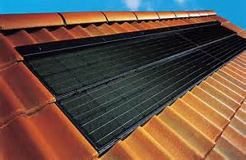
Solar energy
Two key distinctions:
  Solar thermal energy
  Solar photovoltaics
Sources: yougen.co.uk / home energy pros / Daily Mail

Slide 8
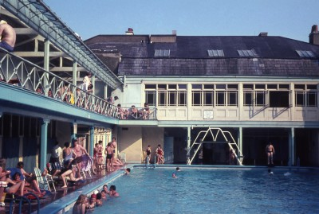
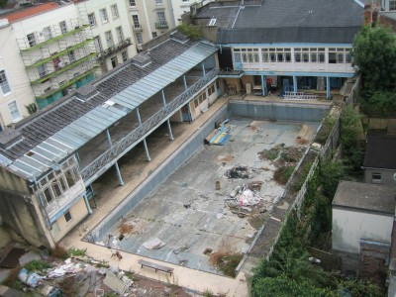
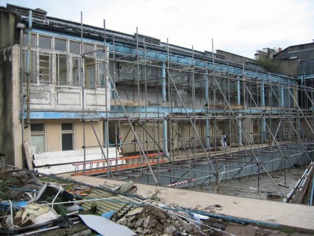

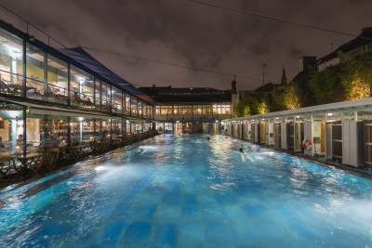
Solar thermal – case study
Clifton Lido, Bristol
Sources: The Lido Bristol / Solarsense

Slide 9
Solar Photovoltaics
Conversion of solar energy directly into electricity in a solid-state device
Technologies:
  Crystalline
    Monocrystalline cells
    Polycrystalline cells
  Thin film
Systems:
  Grid connected
  Off grid

Slide 10
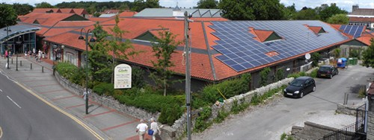
Solar PV – case study
Clarks Village outlet shopping, Somerset
Source: Solarsense

Slide 11
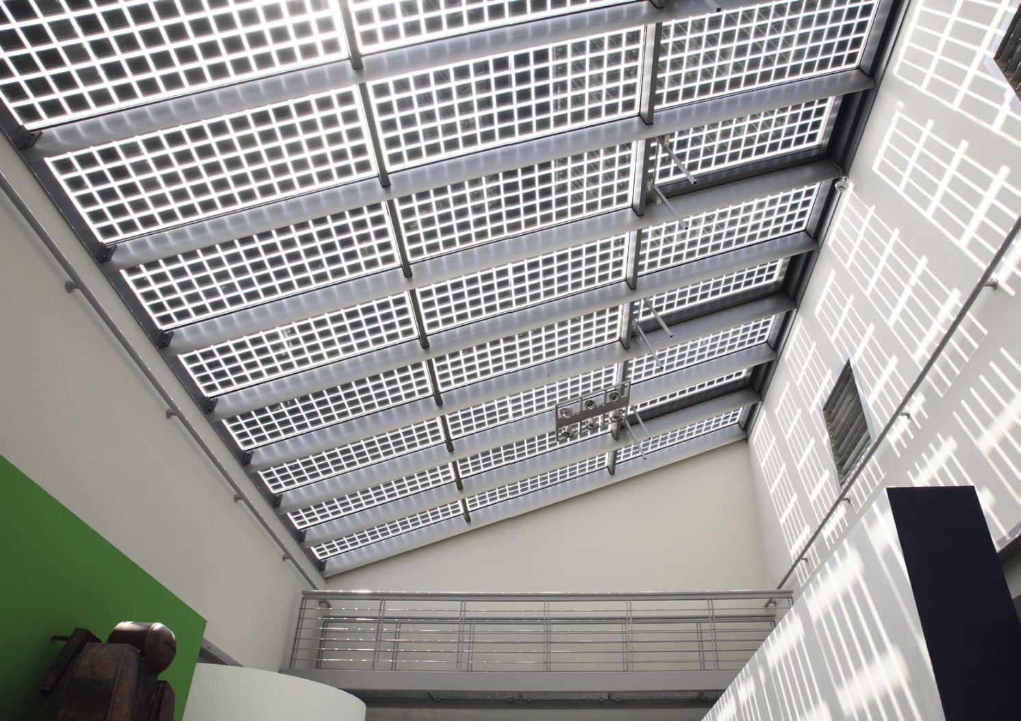
Building Integrated PV
Source: Sapa Group

Slide 12
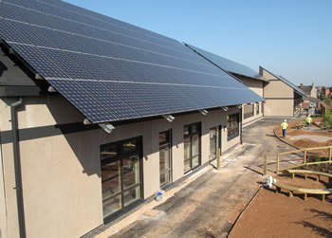
BIPV – case study
Source: Solarsense

Slide 13
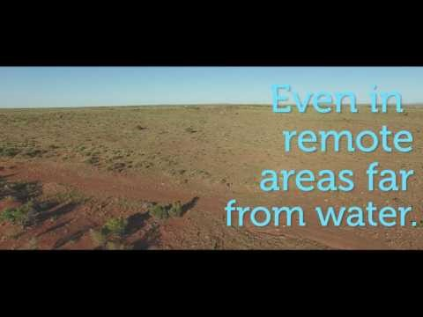
Solar paint – concept to market
https://www.rmit.edu.au/news/all-news/2017/jun/solar-paint-offers-endless-energy-from-water-vapour

Slide 14
Wind energy
“utilising the air flow through wind turbines to generate electricity”
UK has greatest capacity of wind power across Europe
Prof James Blyth – 1887
Small scale use initially
1980s – growth and greater applicability of technology

Slide 15
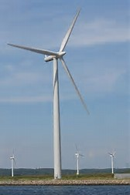
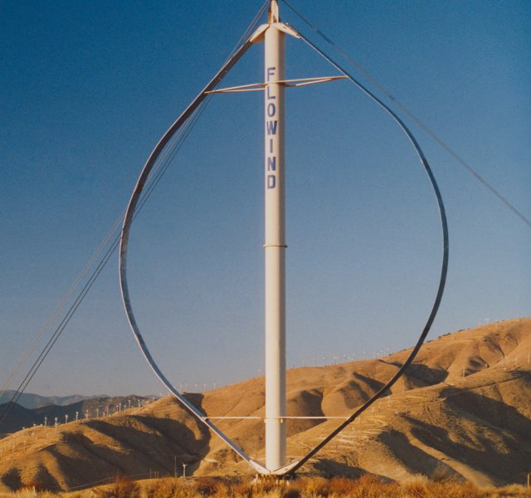
Turbine types
Horizontal axis wind turbine
Vertical axis wind turbine
Sources: New Energy Nexus / symscape

Slide 16
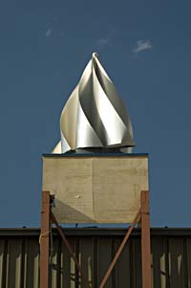
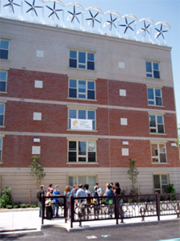
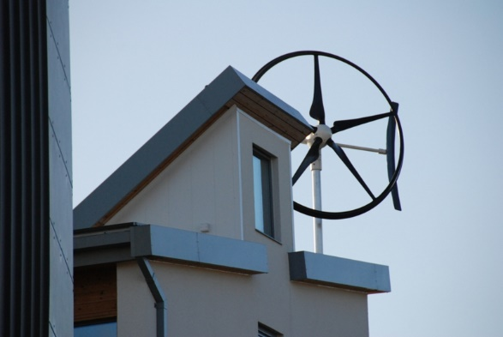
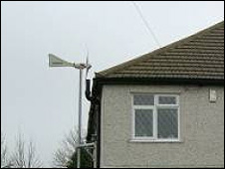
Wind energy and buildings
“Wind turbines and buildings do not generally mix”
Permitted Development Rights
Key issues to consider
Source: Microgeneration-oracle / wbdg.org / wind works / BBC

Slide 17

Wind energy – case study
Source: Bahrain World Trade Centre

Slide 18
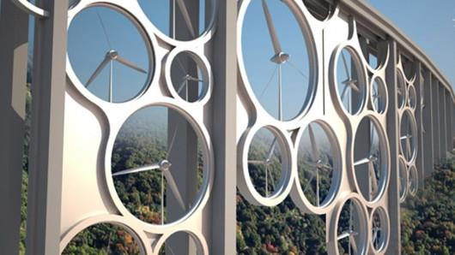
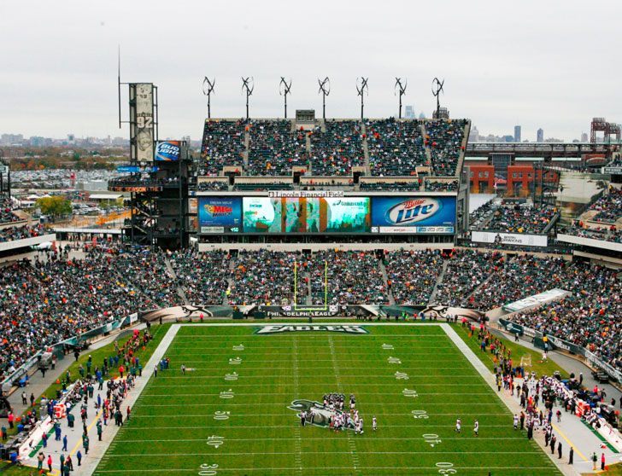
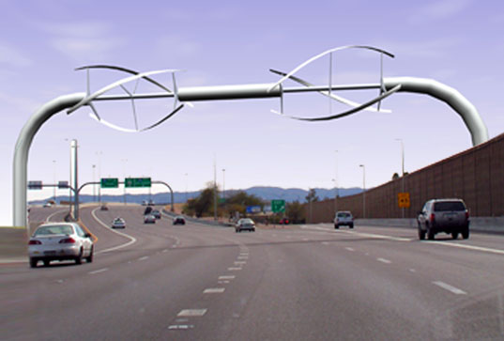
Source: Inhabitat / Research Gate

Slide 19
Bioenergy
“renewable energy made from materials derived from biological sources”
Biomass – the materials from which the energy is sourced
  E.g. wood, plants, agricultural residues, organic aspects of municipal waste, etc.
Biofuel – conversion of biomass to liquid fuel
Biopower – burning biomass directly
Bioproducts – using biomass to make chemicals

Slide 20
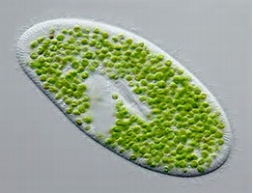
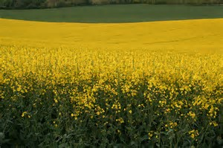
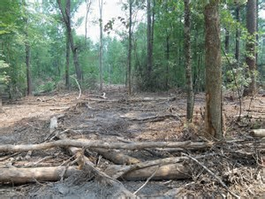
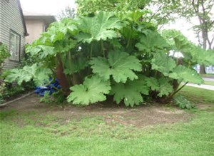
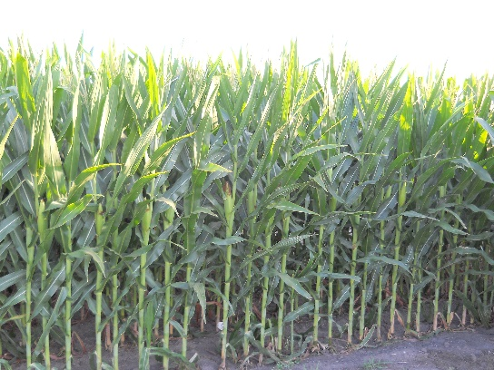
Primary biomass energy sources
Woody biomass
Cellulosic biomass
Starch / sugary biomass
Oily biomass
Microorganisms
Sources: Gardening know how / Wordpress / Flickr / Petro-online

Slide 21
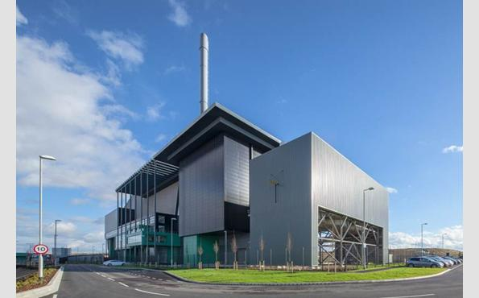
Secondary biomass energy sources
Wood residues
Temperate crop co-products
Tropical crop residues
Animals wastes
Municipal solid waste
Commercial & industrial wastes
Source: Lincolnshire Council

Slide 22
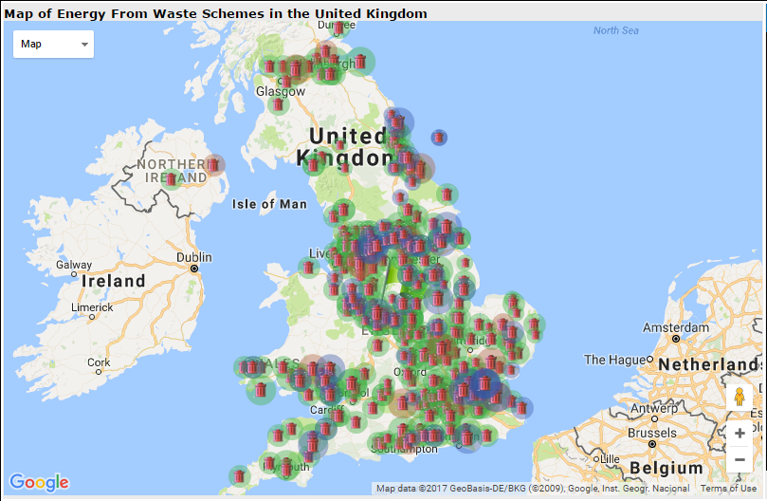
EfW uptake in the UK

Slide 23
Bioenergy – case study
The Winsford Trust, West Devon
Source: Solarsense

Slide 24
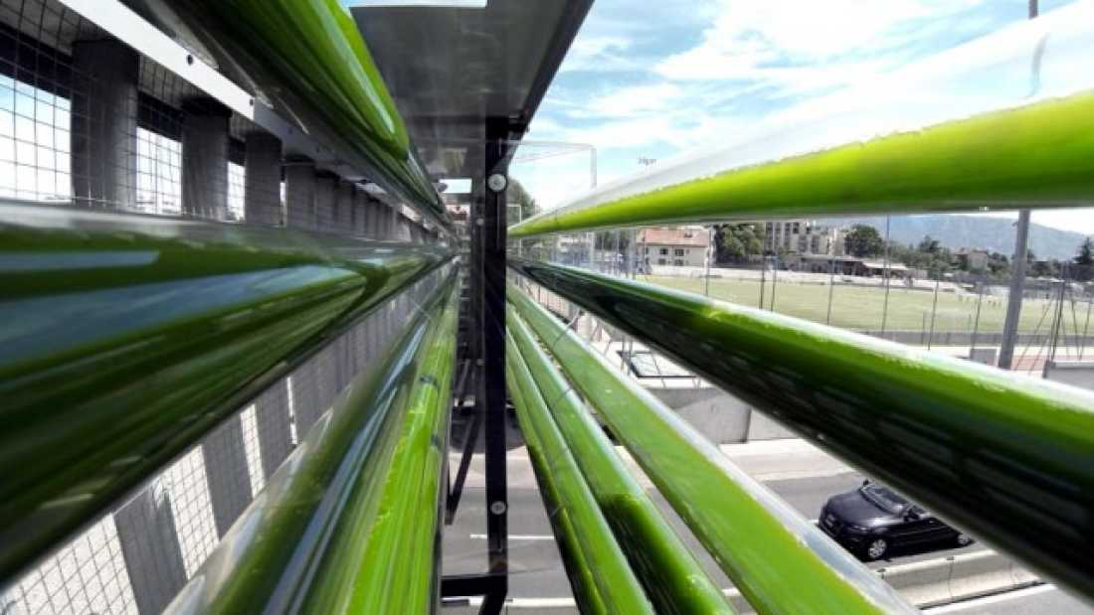
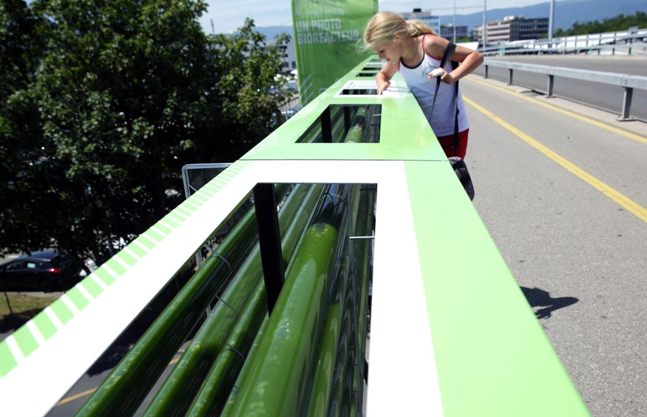

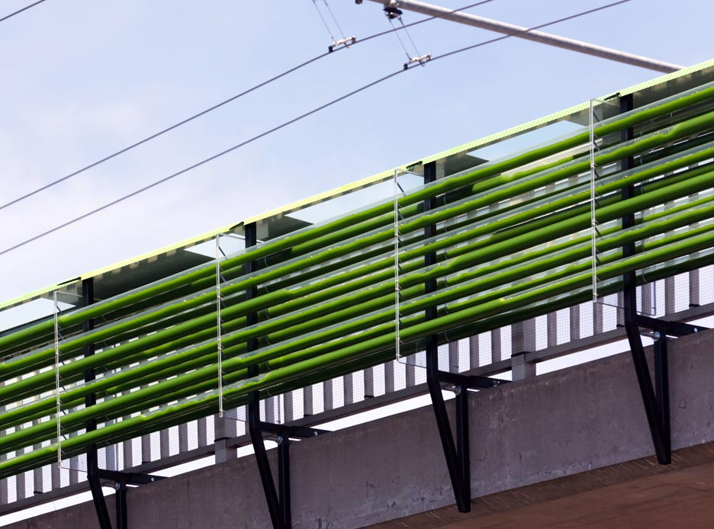
Bioenergy – algae case study
Source: Cloud Collective

Slide 25
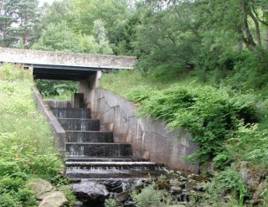
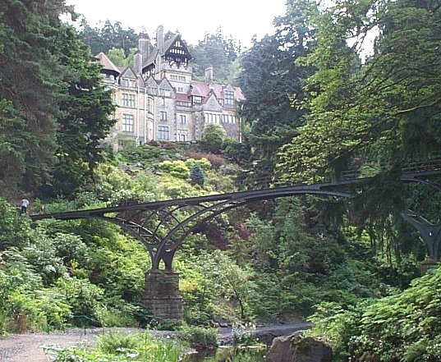
Hydroelectricity
Power harnessed from fast-flowing water or falling of water
Used since ancient times (e.g. watermills)
Used to generate electricity in late 19th century
Cragside House, Northumberland
Source: Hevac Heritage

Slide 26
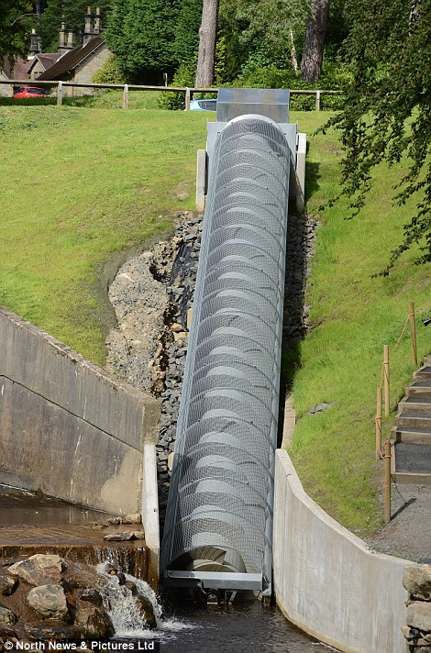
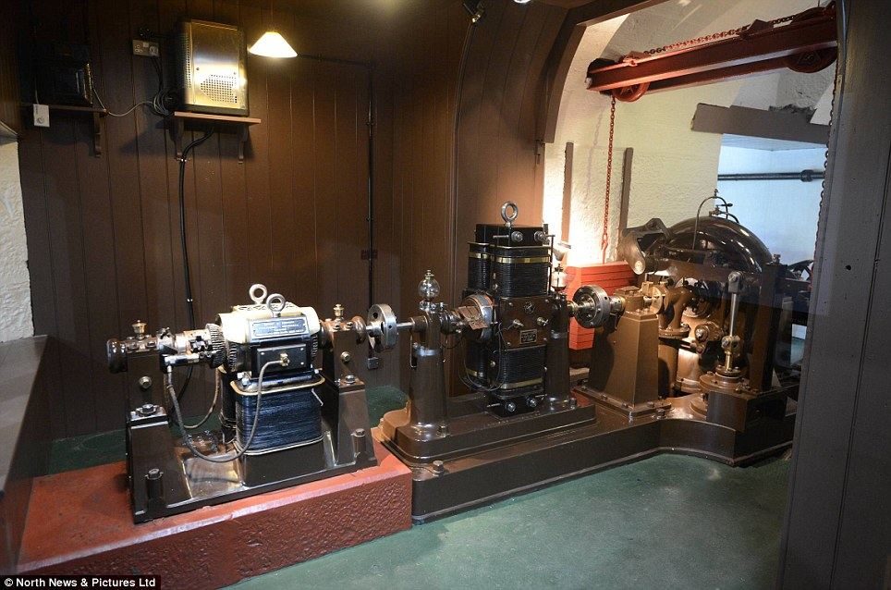
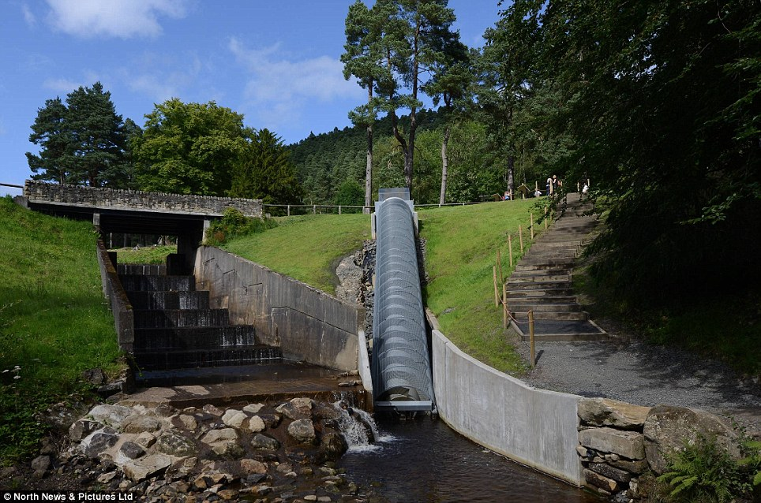

Slide 27
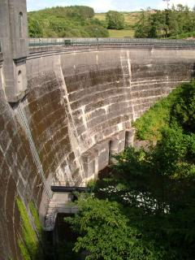
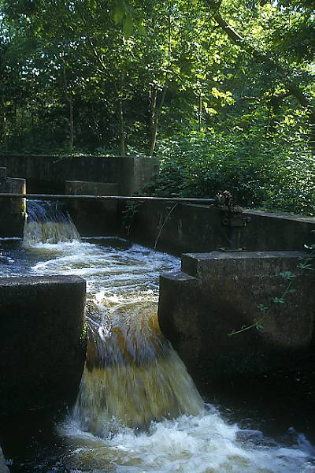
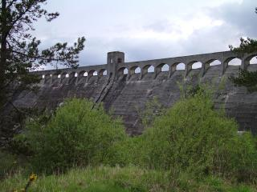
Early developments
The Galloway hydros
Source: University of Edinburgh

Slide 28
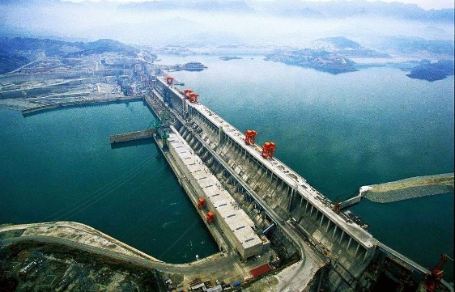
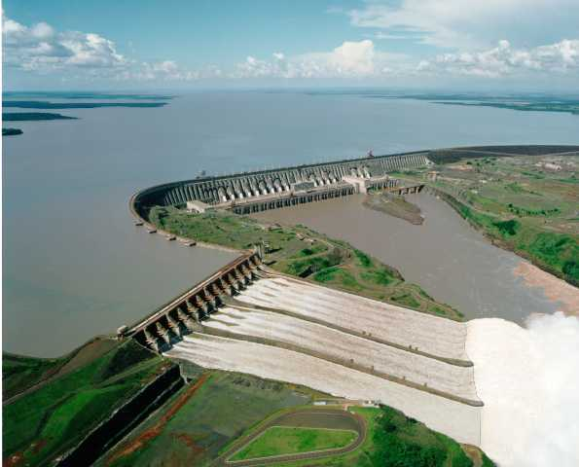
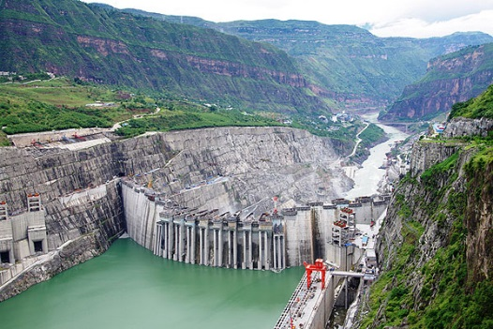
Worlds 3 largest dams
Three Gorges Dam, China
Itaipu Dam, Brazil / Paraguay
Xiluodo, China

Slide 29
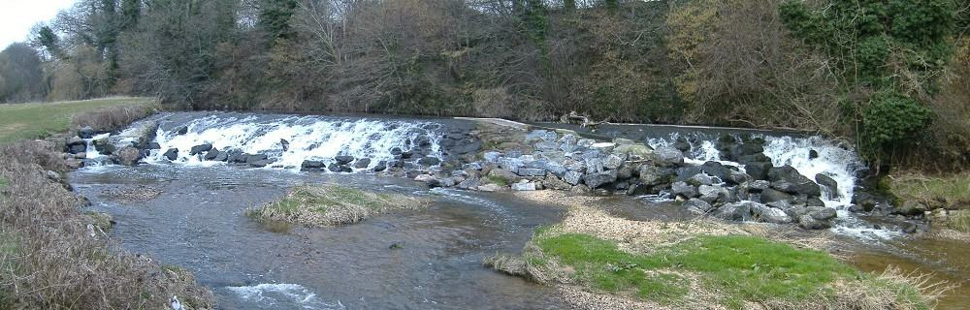
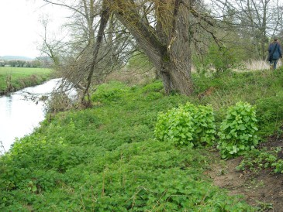





Micro hydro – case study
Source: Renewables First

Slide 30
Tidal power
“converts the energy from tides into useful power, largely electricity”
This is not widely used at present
Challenges:
  High cost
  Suitability of sites
Benefits:
  More predictable and reliable
  Does not face aesthetic issues

Slide 31
Tidal power schemes
Scheme type | Description | Advantages | Disadvantages
Tidal barrage | A dam that traps water at high tide to release it through defined channels through a turbine | High power generation Long life span Provides flood control | Requires high tidal flows Most environmental impact
Tidal lagoon | As above, except the dam is a 360˚ enclosure creating a pool | Lower impact Proven design Low maintenance | Expensive Generates less power
Tidal Stream Generator | Tide pushes a turbine as it flows | Modular Least impact | Difficult maintenance
Dynamic Tidal Power | Long walls jut out perpendicular to the shore, creating a head of water | Huge power generation Single installation | Unproven & untested Limited available sites
Source: Tidal Power

Slide 32

Tidal power – case study
Source: theearthproject.com

Slide 33



Wave energy
Harnessing the power of waves, generated by wind
Systems include:
  Float and buoy
  Oscillating water column devices
  “Tapchen” systems
Sources: Scitechdaily / science buddies

Slide 34




Wave energy – case study
Isle of Islay, Scotland
Sources: Geograph / med-etc

Slide 35

Wave energy – case study

Slide 36

Geothermal energy
Heat energy generated in the Earth
  Through formation of the planet
  Through radioactive decay of materials
Sources: British Geological Survey

Slide 37

Deep Geothermal
Source: British Geological Survey

Slide 38

Deep geothermal – case study

Slide 39



Shallow geothermal
Suitable for non-volcanic areas
  Heat trapped by solar radiation (10-15m)
  15m, temperature not influenced by seasonal variation
Ground Source Heat Pumps:
  Open-loop
  Closed-loop
  Mine water systems
Sources: British Geological Survey / ecofriend

Slide 40


Shallow geothermal – case study
Sources: British Geological Survey

Slide 41

Air Source Heat Pump

Slide 42


ASHP – case study
Source: Finn Geotherm

Slide 43

Water Source Heat Pump
Source: Green Age

Slide 44

WSHP – case study
Source: CIBSE Journal

Slide 45
Useful information
Renewable Energy: Power for a sustainable future, Godfrey Boyle
www.dictionary.com
Energy UK (www.energy-uk.org.uk)
Energy Saving Trust (www.energysavingtrust.org.uk)
Solar Trade Association (www.solar-trade.org.uk)
British Photovoltaic Association (www.bpva.org.uk)
Tidal Power (www.tidalpower.co.uk)
British Hydropower Association (www.british-hydro.org)
Ocean Energy Council (www.oceanenergycouncil.com)
British Geological Survey (www.bgs.ac.uk)
Renewable Energy Association (www.r-e-a.net)

