Slide 1

Welcome to Williams Web Design & Hosting company Analysis
By: Ricky Jenkins, Harry Hierons, Steffan Lewis, Ashleigh Steel, Paul Weaver

Slide 2
Project Development introduction
What this power point will cover:
Quality control
Cost and research
A Project Plan
PID
Benefits and risk assessment

Slide 3
Quality Management
By: Harry Hierons

Slide 4
Quality Control
To ensure quality control in our first meeting we agreed to put some blocks into place that would ensure that all of our documents looked and read the same we did this by:
Use correct syntax
Use naming conventions

Slide 5
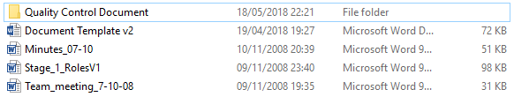
Formatting
We decided in one of the early meeting that we would use a set layout for all of our documents to make everything look the same and professional.
This folder was passed to each member of the group and they were told to base their reports and other documents from the template.

Slide 6
Version control
Checking a finished a document
V1, v2 ,v3
PowerPoint-12-05-2018_RickyJ_FINAL-DOCUMENT
Notes:
When everyone finishes a document they must email the document to the 2 people who were assigned their piece of work.
After each piece of work is checked they will either be accepted as their current version or they will be sent back to the creator to update the version and correct the errors.
Naming convention.

Slide 7
Cost
By: Steffan Lewis

Slide 8
Introduction to cost
In this section I will be covering a selected areas as mentioned below:
Research
  Research of Hardware and Software
Costs
  Cost evaluation of, Hardware, Software & staff members
Evaluation
  Evaluation of the tasks I was provided and conclude if it is worth going ahead with.

Slide 9
Research
To calculate the costs of the system I have used a verity of sites to keep the costs down. In the research stage I researched on:
Servers
  Link of Server: https://tinyurl.com/yd4jucqr
Workstations
  Link of Workstation: https://www3.lenovo.com/gb/en/workstations/p-series/ThinkStation-P320-Tiny/p/30C2CTO1WWENGB1/customize
  Link of Workstation: https://www3.lenovo.com/gb/en/workstations/p-series/ThinkStation-P320-Tiny/p/30C2CTO1WWENGB1/customize
Software for Workstations
Workstations

Slide 10
Costs
The cost of the researched hardware and software has been put into the spreadsheet which is shown below:
A breakdown of the costs is shown in the Excel document “CostsOfEquipment&Staff-28.03.2018.xlsx”.

Slide 11
Evaluation
From the research and costs I would recommend going with the equipment & software provided as this will benefit Williams Web Design. These changes will benefit Williams Web Design in the long run, initially it will be a daunting task of buying, hiring and setting up all the equipment. Even with the workstations being changed every three years I have found that the cost of the equipment still comes below the predicted profits.
Thanks
Steffan Lewis

Slide 12
Benefits and Risk Management
By: Ricky Jenkins, Harry Hierons, Steffan Lewis, Ashleigh Steel, Paul Weaver

Slide 13
Risk Assessment
This part of the PowerPoint is About the risks associated to the project.

Slide 14
Project Initiation Document (PID)
The PID is foundation of the project.
May 2018 needs to be complete.

Slide 15
Costs
There is a set budget for the implementation of the project and costs can not go above the budget.

Slide 16
Time
There is a set deadline for all parts of the project however if certain parts of the project are not completed by the deadline the project will take longer to do. This can have a knock on effect on the cost due to paying staff overtime.

Slide 17
Staff Competencies
It is important that all members of staff throughout the project have the right skill set to which they have been set otherwise the project will turn out poor and deadlines and costs will not be met.

Slide 18
Benefits
The following part of the presentation will be about the benefits of the project.

Slide 19
The Community
Should the project be successful:
.Due to the expansion it will bring more job prospects to the community.
.Reduce local unemployment rates

Slide 20
New Customers
Increase in profit
Better reputation
Advertisement

Slide 21
Reduce External Risks
Competitors
Influence Market prices

Slide 22
Reach New Markets
The expansion will allow to look into providing other services other than what they are currently providing.

Slide 23
New Technology
Expansion will allow William Web Design to have brand new technology this will improve the company’s image.

Slide 24
Project Plan
By: Ricky Jenkins

Slide 25
Project Planning
In this section, I will be explaining what was my role was and what I did with my task.
Project management and Time
  Ensuring a functional and easy to follow project plan
  Management of the Project
  Ensuring everyone was heading towards the deadline correctly.
Evaluation
  Evaluate my tasks and analysis if this project is acceptable to continue.

Slide 26
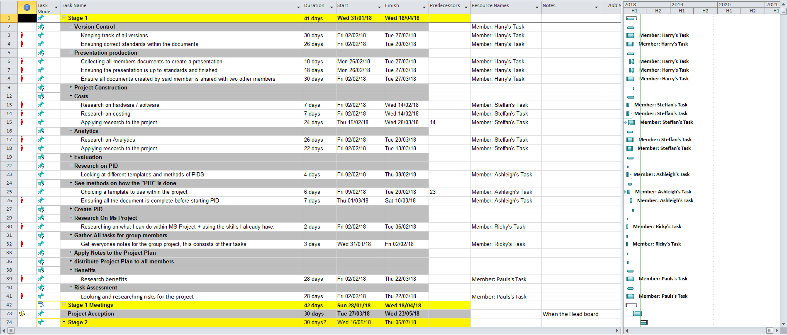
Project Plan
My main task was too build a project plan for the members. This project plan
was built too manage the deadlines and peoples tasks. This will also display all the stages from 1-7.
This allowed all members and staff to visualize the production and timeframe of the project and individual stages and tasks
Project Plan Part 1

Slide 27
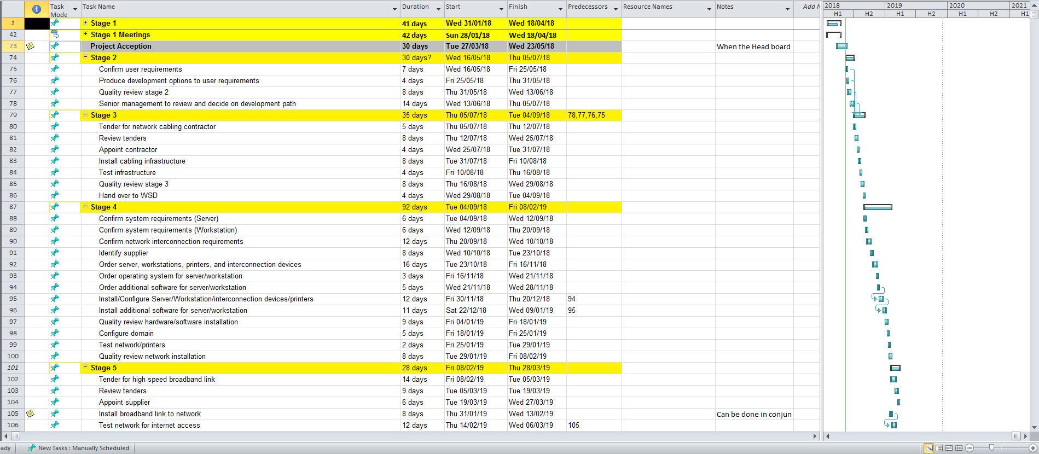
Project Plan
A Project time plan is very important for not only the members but for the company as this will be used to manage all the stages and ensure all stages go as planned. This will also allow everyone to understand the project outcome with the rest of the work put together.
Project Plan Part 2

Slide 28
Project Time Evaluation
Through my evaluation of the project I have come to a conclusion that this is more than enough time for the project to be completed and the project would be able to be produced with the outcome from the project plan.

Slide 29
PID
By: Ashley Steele

Slide 30
PID
Project Initiation Document
One of the most significant documents
Provides the foundation for the project
Bundles the information
Start of any project

Slide 31
The needs of PID
Provides
Project Goals
Scope
Project Organization
Risks
Reporting framework
PID sign OFF
Summary

Slide 32
Benefits of the PID
what it has provided
Ricky's Time management
Steff’s Cost Control
Harrys Document control
Pauls listings of Benefits

Slide 33
Thanks for listening
By: Ricky Jenkins, Harry Hierons, Steffan Lewis, Ashleigh Steel, Paul Weaver

