Slide 1
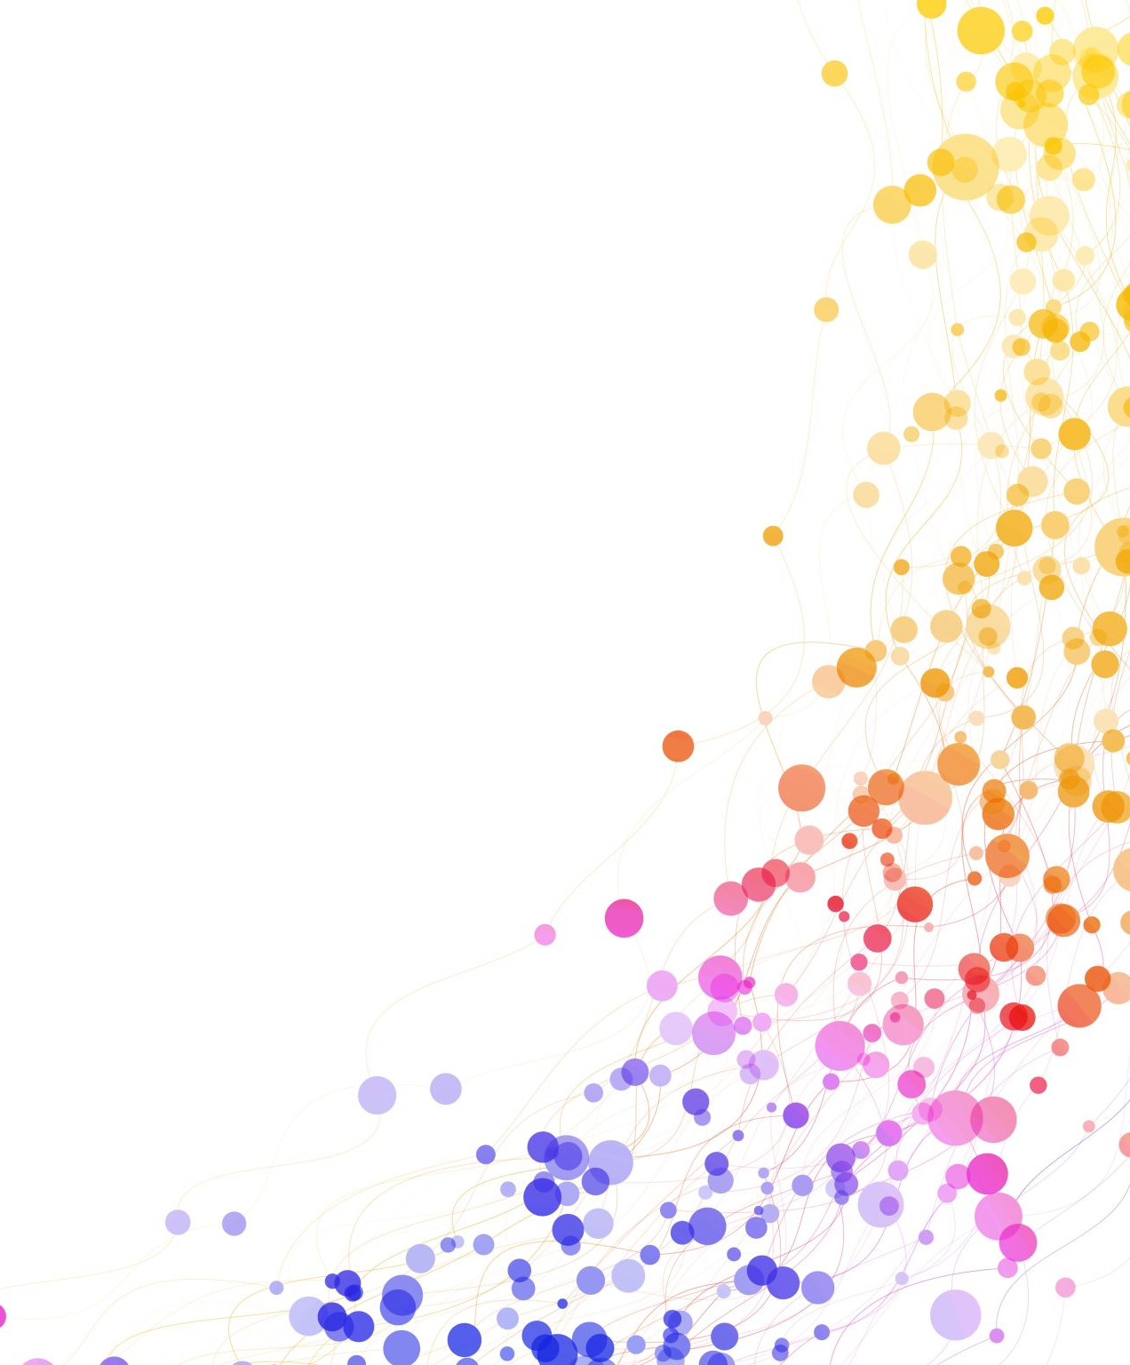
mENDLER & Curwin
2008

Slide 2
Introduction – Discipline with Dignity
Mendler & Curwin are educational theorists in classroom management and behaviour.
The model focuses on respectful interaction between students and teachers.
They developed the Discipline with Dignity model in 2008.

Slide 3
Who are they? – Allen Mendler
Education Author and educator born on October 21st 1949 in New York, New York. He received his PhD in school psychology from Union Institute, in 1980. He spent over 25 ears developing discipline with dignity classroom management methodology.
Mendler's emphasis is on developing effective frameworks and strategies for educators to manage behaviour and classrooms.
He has written 8 books to date all relating to the Discipline with Dignity model.

Slide 4
Who are they? – Richard Curwin
Richard Curwin was born on the 25th May 1944, died December 26th, 2018. Curwin was an expert in the fields of school discipline and classroom management. B.A in English, M.A in education and an Educational Doctorate from the university of Amherst. He taught 7th grade English and a class for emotionally disturbed children. Richard later served as a professor of education in multiple institutes.
Richard also developed the Discipline with Dignity framework with Allen. He presented on the subject in many different countries around the globe.
Richard wrote 28 books in his lifetime mostly relating to classroom management.

Slide 5
What is the Discipline with dignity model?
The discipline with dignity model is based upon the belief that the most effective and respected teachers express their beliefs, demands, and expectations within the context of clear values and goals that benefit learning.
The model argues that effective behaviour management should maintain the learner’s dignity while encouraging personal responsibility. Rather than relying on punishment or authoritarian control, teachers should build respectful relationships, understand the reasons behind behaviour, and use fair consequences to guide students towards better choices.

Slide 6
What is the Discipline with dignity model?
Respect and dignity: Correct behaviour without humiliating or embarrassing students.
Responsibility: Encourage learners to take ownership of their actions
Choice: Provide students with options so they feel some control over their behaviour.
Consequences over punishment: Use logical, fair consequences instead of punitive discipline.
Relationship-building: Positive teacher–student relationships reduce behavioural issues.
Behaviour as communication: Disruptive behaviour may signal unmet needs, frustration, or disengagement.

Slide 7
How can we put this into practice.
Set clear boundaries at the start and follow the structure below:
Prevention Stage – Teacher develops rules/consequences regarding student behaviour and makes them very clear to the students.
Action Stage – Warning is given for inappropriate behaviour if a rule is broken after the first warning the teacher does no discuss the reason. Does not allow the student to offer excuses. Consequence is implemented without exception
Resolution Stage – If the problem/behaviour persists and set consequences are not effective the teacher holds a conference with the student to create a mutually acceptable plan that will hep them get along better in class.

