Slide 1

BMPF7046
The Wellbeing of Future Generations (Wales) Act
Day 2

Slide 2
Recap Day 1
Discussed what you already knew about the Act
Overview of the reasons for the Act
Overview of the Well being Goals
Explored the importance of the Act to you role and your organisation
Developed a plan to tackle this module

Slide 3
Aims and Objectives
Aim
  Review the actual or potential impact of the Act
  Review the Act’s deployment in your place of work
  Develop an implementation or improvement plan for the act in your place of work
  Consider the use of the 5 ways of working and any other theories/methodologies that might help.
Objective
  Prepare you to address the needs of the assessment

Slide 4
Activity 1 (30 minutes)
Discuss what you’ve found out about the Act and it’s deployment in
  Your own department/section
  Your organisation
Discuss
  Your ideas as to how to implement/improve deployment of the Act, in your department/section.
Feedback to me

Slide 5
Role of the Act
The Wellbeing of Future Generations: A Welsh Approach - Full Session - WGS 2019 – YouTube
Lets discuss the role of the act in education.

Slide 6
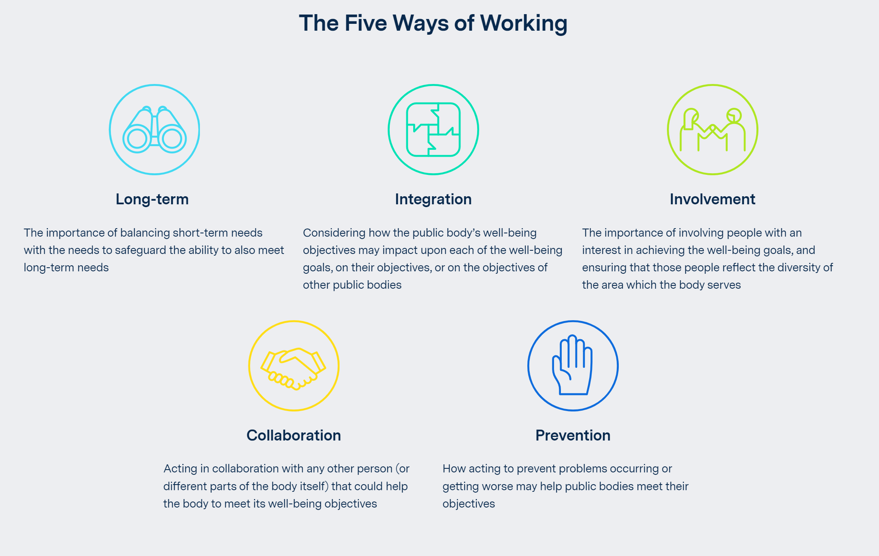

Slide 7
Activity
Can you give examples of how you see the five ways of working within your team/role?
Lets discuss…

Slide 8
Methodologies
Where are you going to start in order to collect the information you need?
Ask for the Well-being policy?
Create some interviews and perhaps interviews selected individuals within your work place.
Questionnaire or survey
Request and review the well-being act returns
Case studies
Do you think you will experience any resistance based upon any of these approaches? Which do you think will be the best use of your time and why?

Slide 9
Delivery Day 3

