Slide 1
BMHP5016
Principles of Health & Social Care

Slide 2
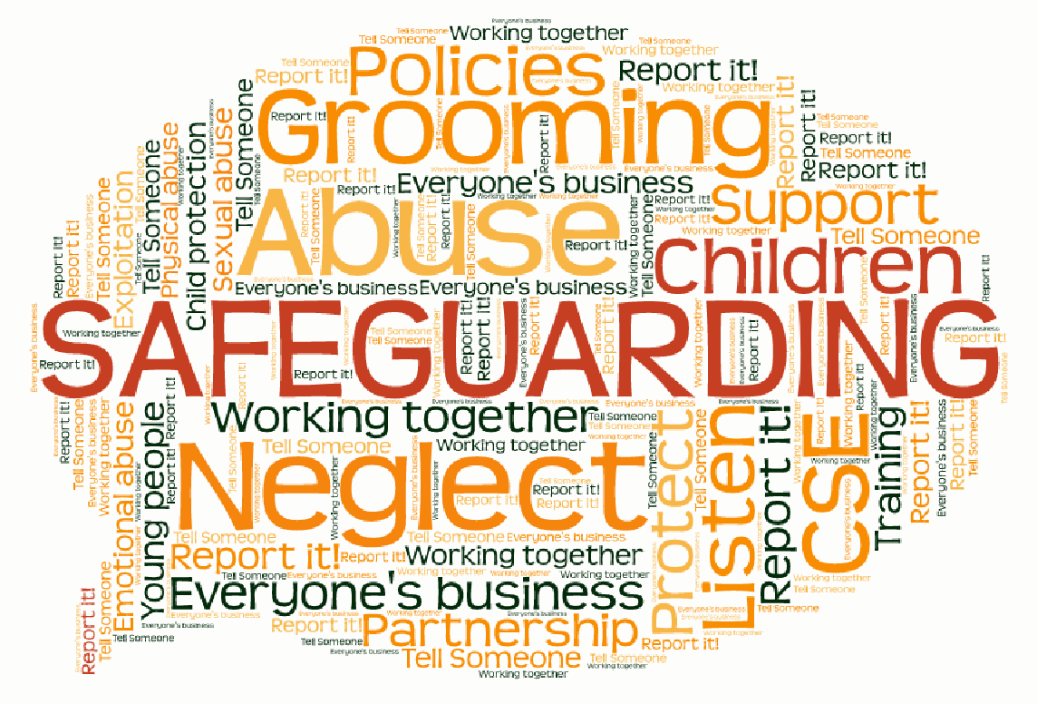
What is Safeguarding?

Slide 3
SAFEGUARDING
Safeguarding means protecting a citizen’s health, wellbeing and human rights; enabling them to live free from harm, abuse and neglect. It is an integral part of providing high-quality health care. Safeguarding children, young people and adults is a collective responsibility.
Those most in need of protection include:
Children and young people
Adults at risk, such as those receiving care in their own home, people with physical, sensory and mental impairments
Those with learning disabilities.
All staff, whether they work in a hospital, a care home, in general practice, or in providing community care, and whether they are employed by a public sector, private, or not-for-profit organisation, have a responsibility to safeguard children and adults at risk of abuse or neglect. ( CQC, 2020)

Slide 4
Children Act 1989 Children Act 2004
Framework for protection and safeguarding of children.
What is best for the child.
Care order – imposed by courts, places child under care of local council to share parental responsibility.
Builds on previous Act.
Requires local authorities to use a multi-agency approach.
Well-being: healthy, safe, able to enjoy & achieve, economic well-being, can make a positive contribution.

Slide 5
Care Act 2014 (129 chapters)
Responsibilities of Local Authority – assessing needs, providing care and support, direct payments, safeguarding, transition for children to adult services
Care standards – quality, CQC, performance ratings
Health – establishment of HEE, HRA
Integration of health and social care

Slide 6
HEE (Health Education England)
This organisation exists for one reason only: to support the delivery of excellent healthcare and health improvement to the patients and public of England by ensuring that the workforce of today and tomorrow has the right numbers, skills, values and behaviours, at the right time and in the right place.
What does HEE do? Look at website and discuss
https://www.hee.nhs.uk/about

Slide 7
HRE (Health Research England)
Our vision is for high-quality health and social care research that improves people’s health and wellbeing, and our core purpose is to protect and promote the interests of patients and the public in health and social care research
What does HEE do? Look at website and discuss
https://www.hra.nhs.uk/about-us/what-we-do/

Slide 8
Safeguarding
Principles
The Care Act 2014 encourages caregivers to take a person-centred approach when safeguarding vulnerable adults.
The principles help you directly involve the vulnerable person – and any nominated people who can help reach decisions in the vulnerable adult’s best interest – when managing safeguarding concerns and care plans.

Slide 9
Safeguarding
Principles
1. Empowerment- People being supported to make their own decisions- informed consent
2. Prevention- It is better to take action before harm occurs
3. Proportionality- The least intrusive response appropriate to the risk presented
4. Protection- Support and representation for those in greatest need
5. Partnership- Local solutions through services working with communities have a part to play in preventing, detecting and reporting neglect and abuse
6. Accountability- Accountability and transparency in safeguarding practice

Slide 10
Understanding Safeguarding Videos
Watch these real stories from Haringey Council
https://www.youtube.com/watch?v=JS33VJcaxjQ
https://www.youtube.com/watch?v=_Ki7XsezOWw
https://www.youtube.com/watch?v=8TTb_Zp43l4
https://www.youtube.com/watch?v=b-ybDjFPDRk (but bear in mind we have different phone numbers)
Do the Quiz on Moodle

Slide 11
What to do?
Contact emergency services if in danger
Report to manager / safeguarding officer
Contact social services – see council website for appropriate phone number https://www.birmingham.gov.uk/info/20019/children_young_people_and_families/602/who_to_contact_if_you_re_worried_about_a_vulnerable_adult_or_child
Make notes on what you have seen

Slide 12
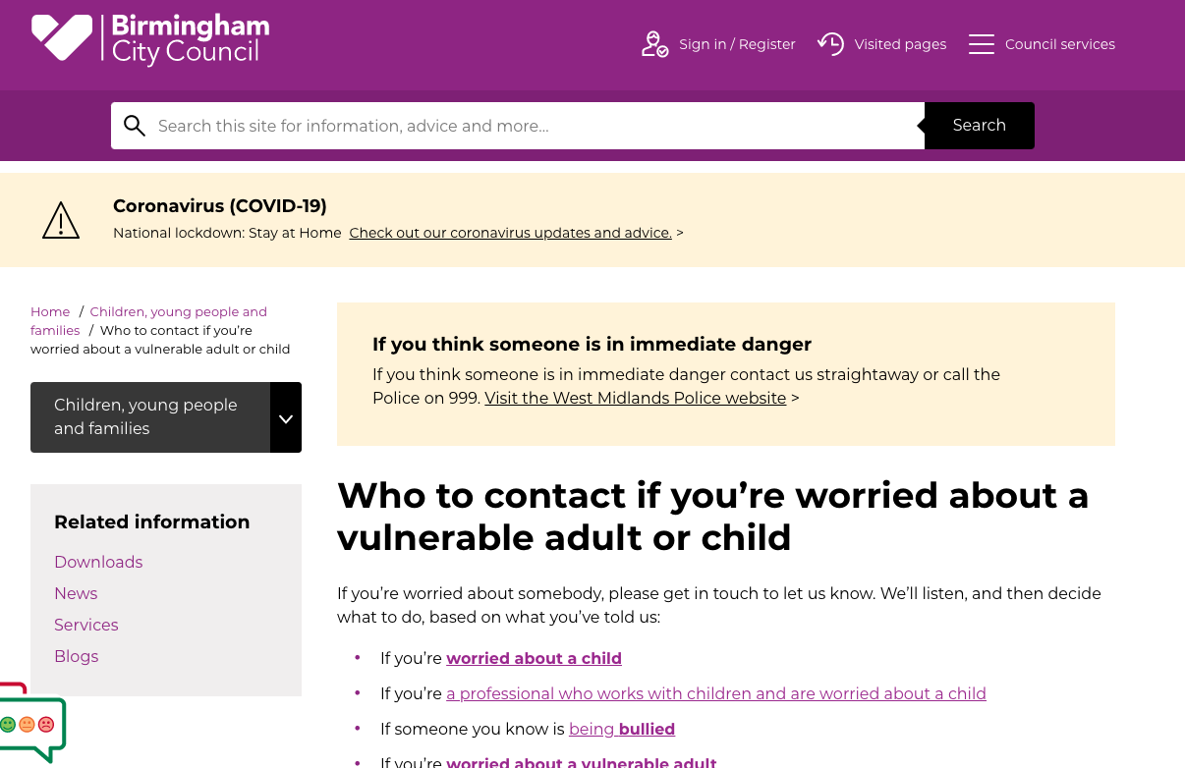

Slide 13
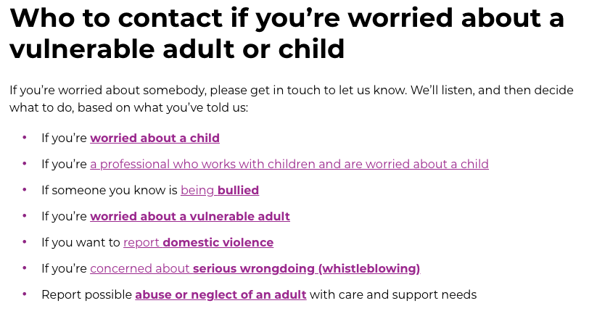
Birmingham City Council Website

Slide 14
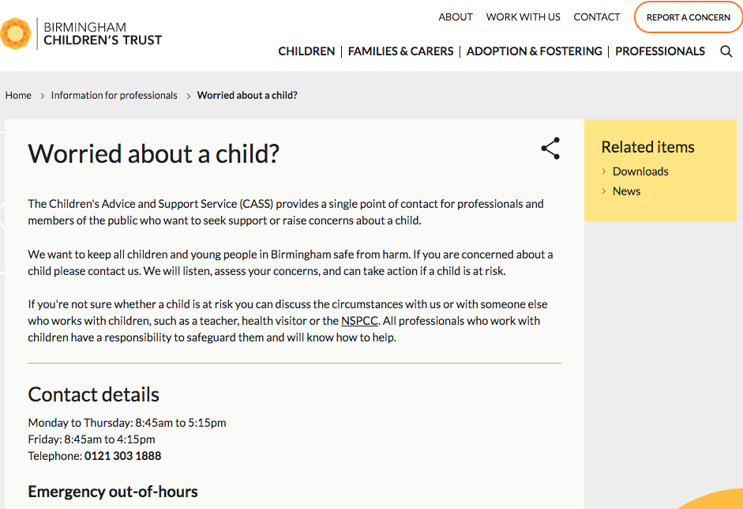

Slide 15
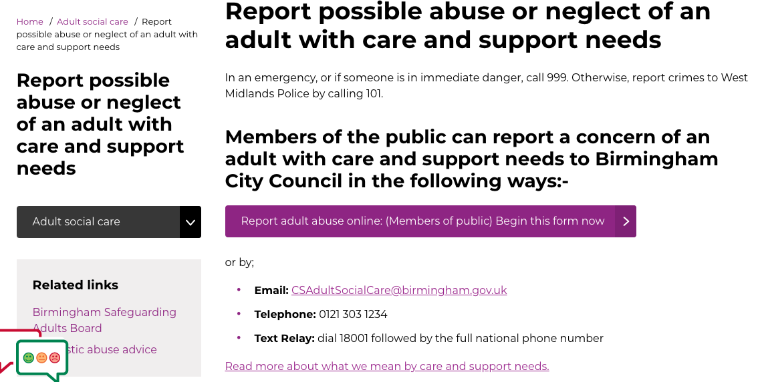

Slide 16
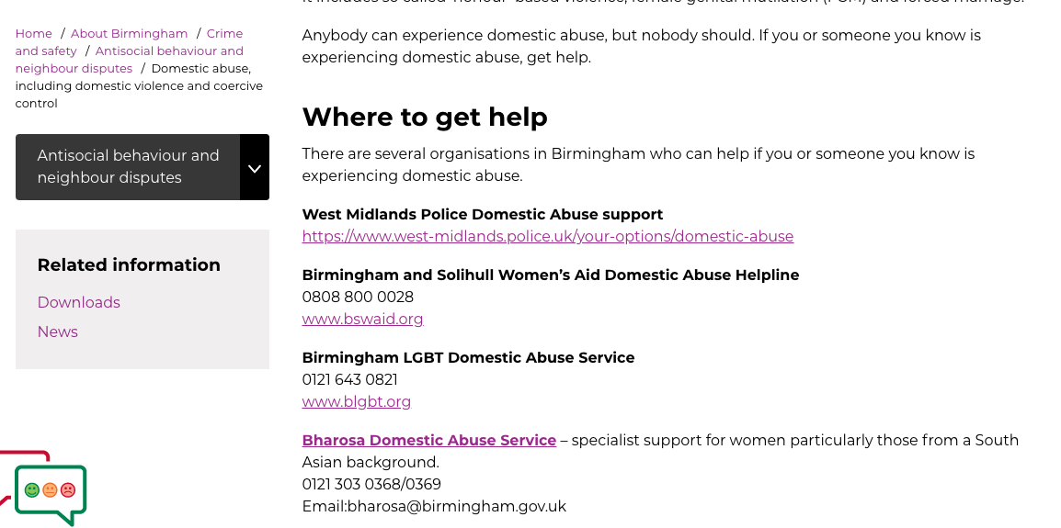

Slide 17
What to do?
Recognise
Respond
Report
Record
Refer

Slide 18
The Five R’s
Recognise- The ability to recognise behaviour that may indicate abuse is of fundamental importance
Respond- Appropriate response is vital. No report of or concern about possible abuse should ever be ignored
Report- Firstly, report your concerns to the Designated person. Should this be inappropriate for whatever reason, you should not hold back from reporting, but do so to an alternative person/ department or organisation.
Record- Record precisely what has been alleged, possibly using the words of the complainant. Records should include accurate quotation. It should also, if felt appropriate, include factual observations.
Refer- Is there an immediate risk of harm to this person? If so, ring the Police, ring the Local Authority, and do not delay. If this is not urgent, make the referral when you need to
https://ptp-training.co.uk/wp-content/uploads/2017/07/Safeguarding-Policy-1.pdf

Slide 19
REFERENCES
https://www.cqc.org.uk/what-we-do/how-we-do-our-job/fundamental-standards
www.skillsforhealth.org.uk
Principles of safeguarding
https://www.scie.org.uk/safeguarding/adults/introduction/six-principles
HM Government (2018) Working Together to Safeguard Children
https://assets.publishing.service.gov.uk/government/uploads/system/uploads/attachment_data/file/942454/Working_together_to_safeguard_children_inter_agency_guidance.pdf

