Slide 1
WEEK 7
Introduction to Data Collection
Methods

Slide 2
Today’s Objectives
To distinguish between data, information and knowledge
Explore the various types of data and data collection methods
To demonstrate how data can be presented in various formats

Slide 3
What is Data
Data is..unorganized and unprocessed facts.
It is a set of discrete facts about events
Data represents a fact or statement of event without relation to other things.
What is data
Notes:
3

Slide 4
Is there any difference between Data, Information and Knowledge?

Slide 5
Data, Information and Knowledge
Data: Unorganized and unprocessed facts; static; a set of discrete facts about events
Information: a combination of data that makes decision making easier
Knowledge is derived from information in the same way information is derived from data; it is a person’s range of information
Our focus in this lecture is on data

Slide 6
TYPES OF DATA
  Primary Data – Original data collected for a specific research goal (e.g., interviews, surveys that you conduct yourself for a specific purpose)
  Secondary Data – Data originally collected for a different purpose and reused for another research question (e.g., interviews, surveys, charts, stats already existing that you retrieve to use for your own research)
Notes:
Moodle reading Course: Academic Skills (LCBB4006_BIRM), Tile: Week 7 - Introduction to Data Collection Methods (uwtsd.ac.uk)

Slide 7
Primary Data
Original and relevant to the topic of the research study so the degree of accuracy is very high.
Good for resolving specific research issues.
Higher level of control and up-to-date information
You are the owner of the information.
But….may be expensive and time consuming

Slide 8
Secondary Data
Readily available from other sources
Likely to have been used in previous research, making it easier to carry out further research.
It is time-saving and cost-efficient
But…may not answer the researcher's specific research questions or contain specific information that the researcher would like to have.

Slide 9
Activity
In groups identify the advantages and disadvantages of using secondary and primary research.
Be prepared to report your findings to the group.
Notes:
HAVE A LOOK AT THE READING ON MOODLE 5/5

Slide 10
Advantages and Disadvantages of Secondary Research
Advantages
Inexpensive
Easily accessible
Immediately available
Will provide essential background and help to clarify or refine research problem – essential for literature review
Secondary data sources will provide research method alternatives
Will also alert the researcher to any potential difficulties

Slide 11
Advantages and Disadvantages of Secondary Research
Disadvantages
Frequently outdated – e.g. census data
Potentially unreliable – not always sure where information has come from
May not be applicable – may not totally answer your research questions
Lack of availability – i.e. no data available or very difficult to obtain

Slide 12
Advantages and Disadvantages of Primary Research
Advantages
Applicable and usable – if done right
Accurate and reliable – can answer your direct research questions
Up-to-date – as you have collected the data

Slide 13
Advantages and Disadvantages of Primary Research
Disadvantages
Expensive
Not immediately available – takes time to define problem, sampling frame, method and analysis
Not as readily accessible

Slide 14
Primary Research Methods & Techniques
Primary Research
Quantitative Data
Qualitative Data
Surveys
Personal interview (intercepts)
Mail
In-house, self-administered
Telephone, fax, e-mail, Web
Focus groups
Experiments
Individual depth
interviews
Mechanical
observation
Human
observation
Simulation
Case studies

Slide 15
Activity
Primary or Secondary Data?
1. You go to Office of National Statistics United Kingdom population mid-year estimate
2. You interview your Lecturer to find out what s/he thinks about Coca Cola’s sales performance
3. Coca Cola’s annual reports that you collected yourself from their website

Slide 16
Answer
Secondary – the data already exists, you only retrieved it
Primary – the data does not previously exist, you get from the interview
Secondary - Annual reports are prepared by the company, you merely retrieved them

Slide 17
DATA COLLECTION METHODS
Quantitative – Data that can be described numerically in terms of objects, variables and other values
Qualitative – Data involving the understanding of the complexities, details and contexts of the research subject, often consisting of texts (e.g., interview transcripts and field notes)
Mixed methods – a mix of the two above

Slide 18
Common techniques for Presenting Data
Chart - drawing that shows information in a simple way, often using lines and curves to show amounts
Graphs - a diagram showing the relation between variable quantities, typically of two variables, each measured along one of a pair of axes at right angles.
Themes/Text – thematic presentation of analysed qualitative (e.g., interview) data
Working with excel to create charts, diagrams and graphs

Slide 19
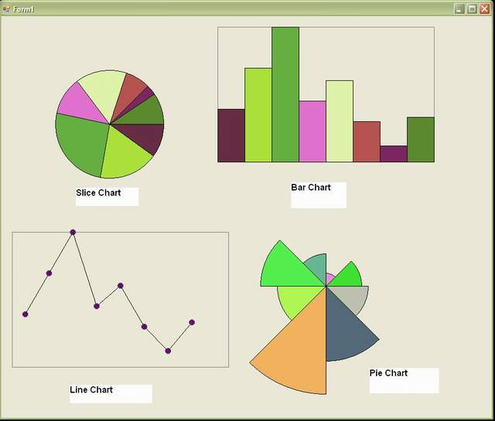

Slide 20
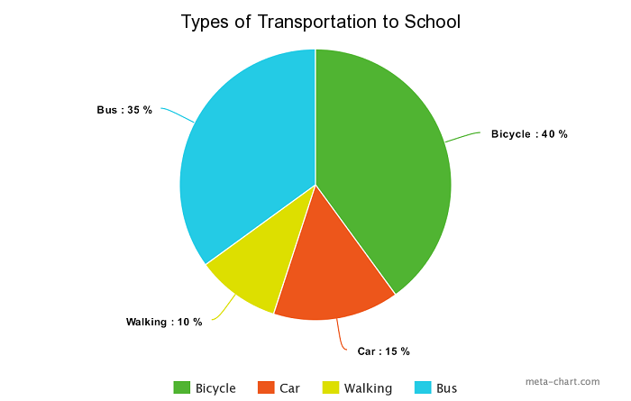
Showing percentage or proportional data.

Slide 21
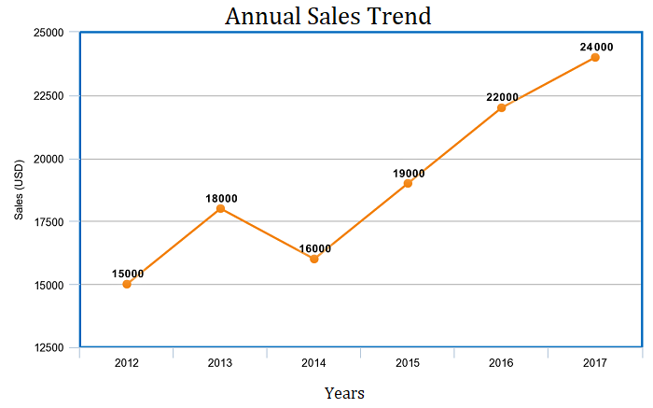
Good for showing trends

Slide 22
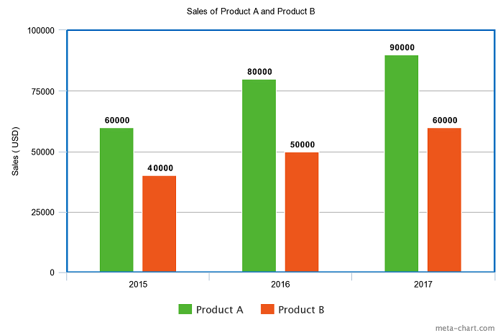
Comparing data among different categories.

Slide 23
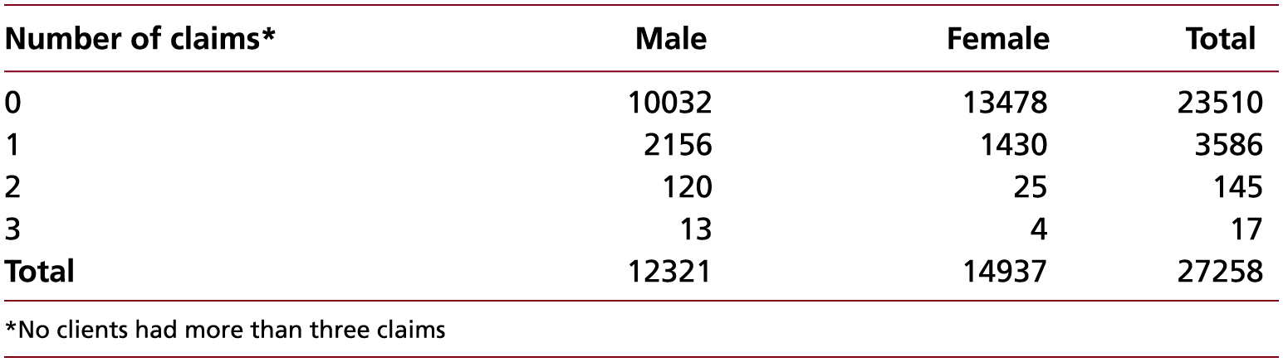
Contingency table: Number of insurance claims by gender, 2018
Source: PJ Insurance Services

Slide 24
Data collection group activity -30 minutes
You need to make a group of 3-4 people in a group
Your group is required to collect some data from any UK based commercial company of your choice.
Your group needs to compare, analyse, and present the collected data in the form of charts, graphs etc.
Your group needs to write their findings based on collected data
Notes:
Office of National Statistics

Slide 25
Video on Moodle – 20 minutes
The Beginner's Guide to Excel - Excel Basics Tutorial - YouTube

