Slide 1

Operating Systems
Introduction to MS PowerShell

Slide 2
Deck structure:
Section 1: Lecture slides
Section 2: Tutorial slides

Slide 3
Section 1:
OS Lecture

Slide 4
Lecture and tutorial
The Lecture introduces the MS PowerShell CLI, we will be using in the tutorial session.
PowerShell is taught in modules at L5/Yr2 & L6/Yr3. This module provides an overview and introduction.
This deck introduces some key commands and we will use some of these commands and the PowerShell script syntax in the tutorial.
If you have a laptop with you in the Lecture, you can start to test some of the commands.
Download the slides from Moodle: OS 7 – Introduction to PowerShell.
Notes:
Even noting the key syntax on a tablet/smartphone/notepad is initially helpful for learning. Until we can get hands on in the tutorial.

Slide 5

Introduction to PowerShell
This Photo by Unknown Author is licensed under CC BY-NC-ND
PowerShell is a CLI, an interpreter and a command scripting language.
PowerShell commands are called cmdlets pronounced ‘command-lets’. These are .NET classes that implement/perform a specific operation on the system.
We can either use the built-in commands/cmdlets or we can create our own scripts to execute tasks, administer and monitor a MS Windows system.
Released in 2006, as a Windows only tool, known as ’Windows PowerShell’.
Microsoft has started to adopt the FLOSS philosophy in recent years (Free/Libre and Open Source Software), MS made PowerShell Open source & cross platform in 2016, and you can now download ‘PowerShell’ to run on Linux & MacOS.
Notes:
MS PS is built on the .NET Framework, and PS Core on .NET (previously .NET Core).
Since Windows 10, PowerShell replaced Command Prompt (cmd.exe) and became the default command shell.
Bg. Bash is great on Linux, all output is a string, PowerShell treats all output as objects and therefore we can perform additional operations and create powerful automations using PowerShell on Linux. For more info. click-here.
Bg. PowerShell’s enables users and administrators to execute commands both locally and remotely. This is achieved due to PowerShell’s support for .NET Remoting and WS-Management & CIM (Open SOAP based remote & common Model service and SSH Secure Shell Protocol (SSH) is a secure client–server based cryptographic network protocol for secure communication over a network.)

Slide 6
Bg. Windows PowerShell v PowerShell
Windows PowerShell / Windows PowerShell 5.1 is the version preinstalled on Windows OSs (e.g. v10 & 11)and Server OS releases. It is not being developed further.
PowerShell aka PowerShell 7 / PowerShell Core is not preinstalled and is in active development. It is faster and has more commands available.
  To check the version of PowerShell you have, open PowerShell and enter $PSVersionTable. To install PowerShell click-here.
“Windows PowerShell 5.1 is built on top of the .NET Framework v4.5. With the release of PowerShell 6.0, PowerShell became an open source project built on .NET Core 2.0.
Moving from the .NET Framework to .NET Core allowed PowerShell to become a cross-platform solution.
PowerShell runs on Windows, macOS, and Linux. For a video overview please click-here (Scroll down).
  There are few differences in the PowerShell language between Windows PowerShell and PowerShell. The most notable differences are in the availability and behavior of PowerShell cmdlets between Windows and non-Windows platforms and the changes that stem from the differences between the .NET Framework and .NET Core.” [r]
For further information, please click-here.
Notes:
Why is the latest version of PS not preinstalled on new Windows OSs. One answer:
“A Windows Enterprise release is supported for up to 10 years, PowerShell versions after 5 have much shorter support lifecycles. So if they made PowerShell 7 (or 8 or whatever) a part of Windows they would have to commit to supporting a specific release version of it for 10 years with security updates just like the rest of Windows.” [r]

Slide 7
Bg. What can PowerShell be used for?
PowerShell can be used to monitor, configure and manage local, remote and cloud systems in a variety of ways. Such as:
Cloud management: PowerShell can be used to manage cloud resources. For example, you can retrieve information about cloud resources, as well as update or deploy new resources.
Continuous Integration/Continuous Deployment (CI/CD): It can be used as part of a Continuous Integration/Continuous Deployment pipeline i.e. automating the building, testing, and deployment of applications.
Automate tasks for Active Directory and Exchange. We can use PS to automate almost any task on Windows such as creating users in Active Directory and mailboxes in Exchange.
PowerShell was traditionally used by System Administrators, today however it is used by many more such as Developers, DevOps (Developers & Operations team), Cloud Ops etc…

Slide 8
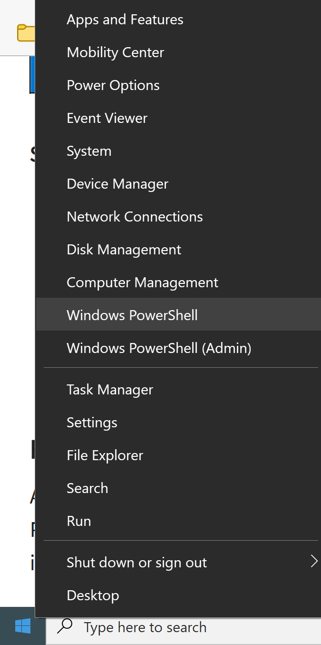
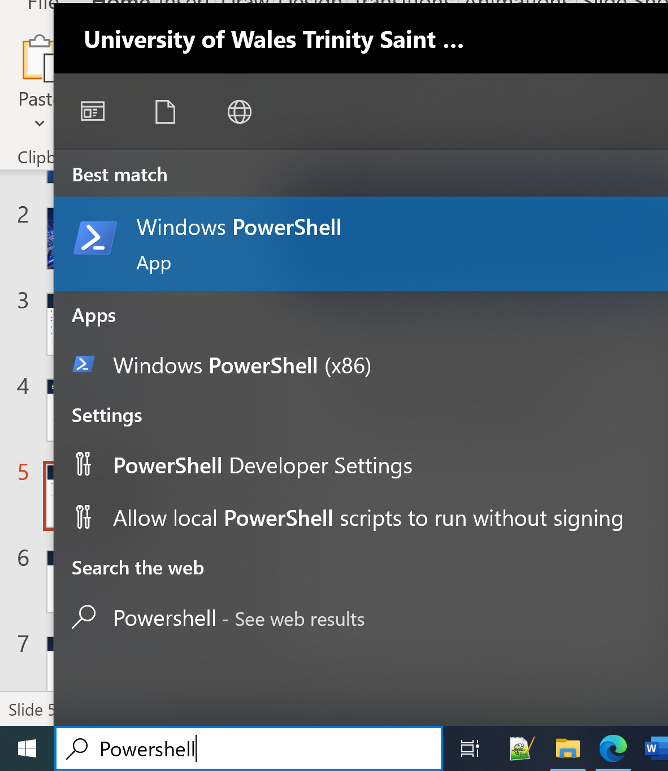
Opening PowerShell
Right click on the Window icon (bottom left corner) and click on Windows PowerShell.
Or use the search box to search for the PowerShell App.
Note: Almost everything we need to do in PowerShell we can do in normal mode. However, sometimes as need to open PowerShell (Admin) to run certain commands and scripts that require more elevated privileges.

Slide 9
PowerShell commands/cmdlets
This Photo by Unknown Author is licensed under CC BY-NC-ND
PowerShell comes with hundreds of preinstalled commands called cmdlets.
Each PowerShell command consists of a verb and a noun pair such as ‘Get-Process’.
  Bg. The ‘Verb’ part states what you're trying to do. PowerShell has a standard list of verbs which we can see/get by using the ‘Get-Verb’ command. Verb is an important concept in PowerShell. It's a naming standard we use when we write our own commands.

Slide 10
PowerShell commands
This Photo by Unknown Author is licensed under CC BY-NC-ND
Some of the common verbs used to create PowerShell commands are:
  Get — To Get something
  Start — To Run something
  Out — To Output something
  Stop — To Stop something that is running
  Set — To Set/define something
  New — To Create something

Slide 11


Show: Get-Process
This Photo by Unknown Author is licensed under CC BY-NC-ND
We can use the Get-Process command to show a list of all processes running on the system and their ids.
We can use the information to view, stop and restart a system process.
Get-Process | more – Add pipe more ‘| more’ after any command to limit the output to one screen and allows you to page (press enter) to display more output.
CTRL C to return to the prompt

Slide 12


Show: Essential PowerShell commands
The Get-Help command displays general help and information about PowerShell commands.
We can also use the Get-Help command to get help and information about specific commands, by using the Get-Help command followed by a command name.
Try: To view information about the Get-Process cmdlet, we can type: Get-Help Get-Process:

Slide 13
Bg. Get-Help COMMAND -online
To view help information about a command in Microsoft's online documentation, we can also use Get-Help with the –online command to view information online in the browser.
For example, to view the help information for the Get-Process command online, we can type:

Slide 14
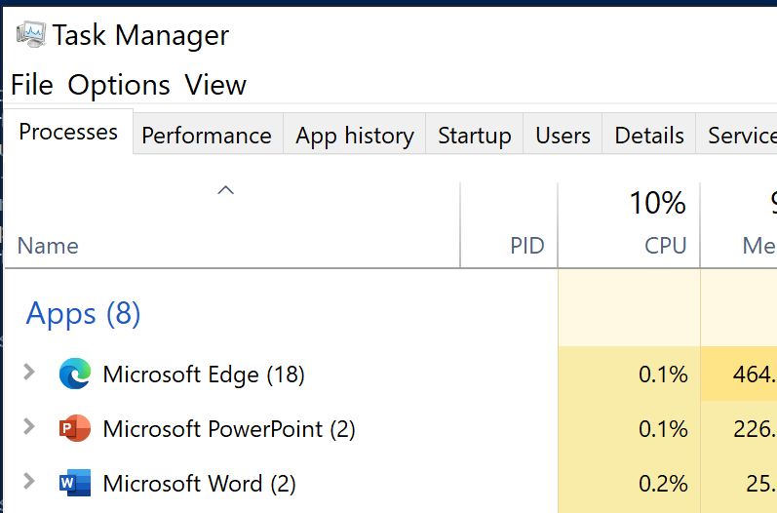
Start-Process
This Photo by Unknown Author is licensed under CC BY-NC-ND
The Start-Process command starts a program/process.
We use this command by typing Start-Process followed by the name of the program we want to start.
For example, to start Task Manager, type:

Slide 15


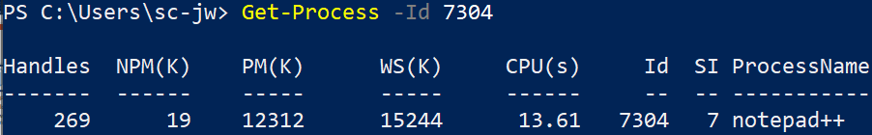
Show: Get-Process
This Photo by Unknown Author is licensed under CC BY-NC-ND
To view information about a process, we can use the Get-Process command followed by the process name or –id number.
Show: Open a program such as Notepad++, and test the Get-process command for a specific process e.g.

Slide 16

Show: Get-Process
This Photo by Unknown Author is licensed under CC BY-NC-ND
We can use the Stop-Process command to stop any process we want.
Open a program you don’t mind closing (e.g. Calculator).
Find the process id associated with the process you want to stop. Use the Get-Process command to show all processes running on the system. Or filter by a letter by using: Get-Process -Name "C*"
To stop the process, we use the Stop-Process command followed by the process id, as follows:

Slide 17
Bg. Get-Process information
NPM? PM? WS? VM? Abbreviation meanings:
Name | Description
Handles | This is the number of handle pointers (to it) a process has open in memory. E.g. other processes/threads will use handle names as pointers/smart pointers to use and handle the process.
NPM / Non-paged memory aka Non-paged pool (in kilobytes) | NPM is memory storage that is never paged or stored to the hard disk, making it more quickly accessible.
PM / Paged Memory aka Paged pool (in kilobytes) | PM can be sent to the hard disk if space is needed. This makes PM/Paged pool larger than NPM/non-paged pool. However, page reads may take longer because the data is stored on disk.
WS / Working set (in kilobytes) | WS is the pages of physical memory (not paged to the hard disk) a process is currently using.
VM / Virtual memory (in megabytes) | This is the amount of virtual memory devoted for the process's use.
CPU time (in seconds) | This is the amount of CPU/processor time the process is using (by all processors)
Process ID | Each process has a unique ID. This is the UI or Unique identifier for a process.
Process name | This is the name of the process. This is usually but does not have to be unique. (unlike Process Id).

Slide 18
Bg. Retrieve & stop high-load processes
To identify the processes that are consuming the most resources, we can request a list of working processes using the WorkingSet command.
E.g. we can use this command to identify all processes with a working set greater than 20MB:
Get-Process | where-object {$_.WorkingSet -gt 20000000}
The dollar sign creates a variable. The command finds the processes and then sends the output to the where-object. The Get-Process command displays them. For more information about the where-object’ please click-here.
Killing unnecessary processes:
Before using this command, make sure you need and want to terminate the process. If you are unsure what the process does, DO NOT kill it. First find out what the process is and what program the process belongs to.
If, it may be an unnecessary process from an unwanted program downloaded via cookies into your system after using public wifi that you simply DO NOT want/need. Fine. However you need to make sure that the process is not a system/wanted program, a critical/necessary/useful process, before killing it.
To kill a process, use the stop-process command. When run without any parameters, it will ask for the process ID. Input the PID and press Enter.
We can also stop processes by name using the –name parameter as follows: stop-process –name processname
Tip: killing processes using a unique process ID will guarantee the correct process is being killed. As process name is not unique you could potentially kill someone else's process on a multi-user shared system. Be careful.

Slide 19
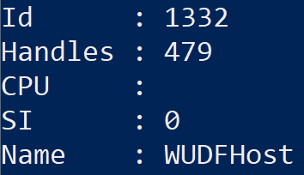
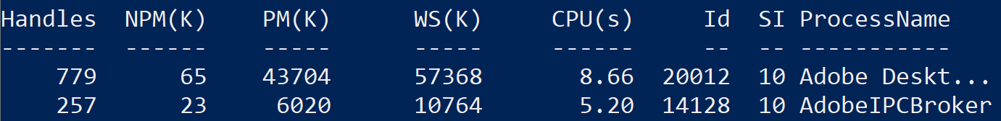
Format-List & Format-Table options
This Photo by Unknown Author is licensed under CC BY-NC-ND
To display data in a list, we use the pipe symbol | Format-List option, after a command.
To display data in a table, we use the pipe symbol | Format-Table option, after a command.

Slide 20
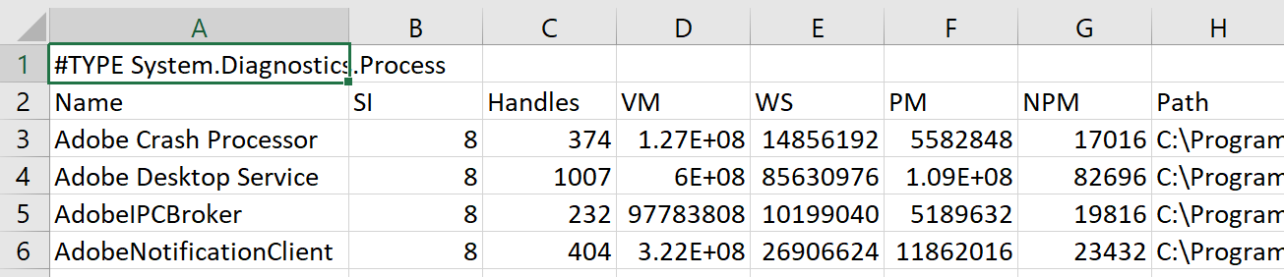
Show: Export-CSV option
This Photo by Unknown Author is licensed under CC BY-NC-ND
We can use the Export-CSV option to export PowerShell output to a CSV/Excel file.
This is useful to review system information and for reporting purposes.
Syntax : Get-Process | Export-CSV GProcess.csv
The command creates a GProcess.csv file that contains process data.
To open the file, type in:
  CMD: GProcess.csv
  PS: Invoke-item GProcess.csv

Slide 21
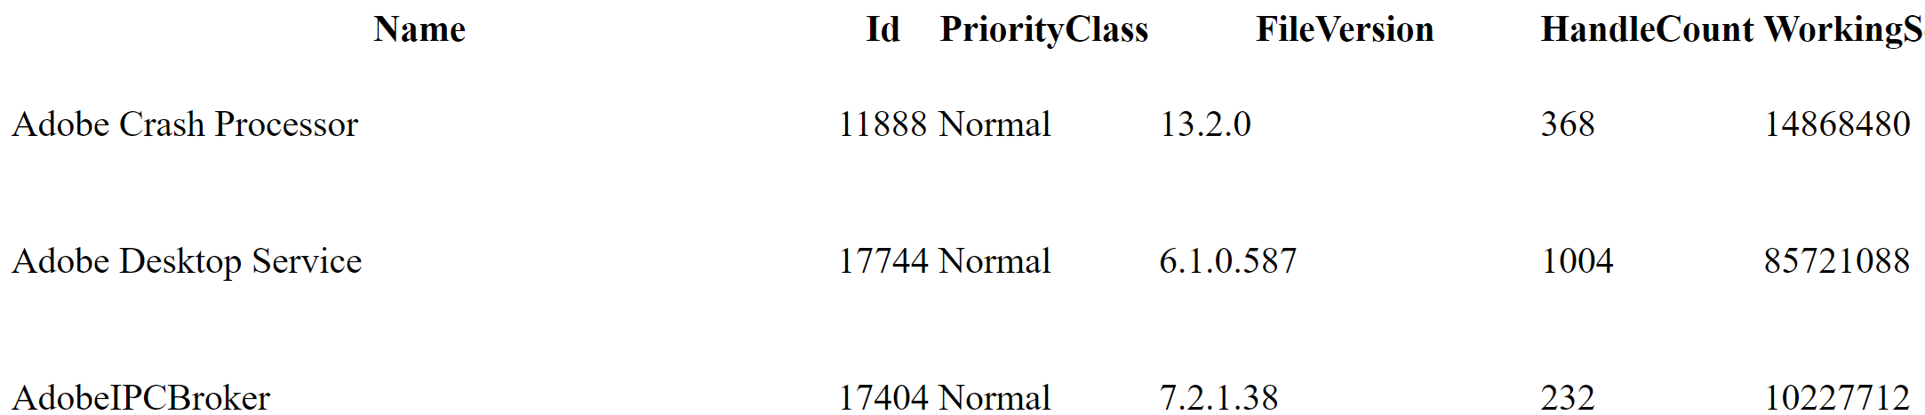
ConvertTo-HTML
This Photo by Unknown Author is licensed under CC BY-NC-ND
To create a report in HTML format, we can use the pipe symbol followed by the ConvertTo-HTML option. For example:
Syntax: Get-Process | ConvertTo-HTML > GProcess.html
A .html file will be created and saved in the current working directory: C:\Users\username.
To open the file, type in:
CMD: GProcess.html
PS: Invoke-item GProcess.html

Slide 22
Get-Childitem, Set-Location & New-Item cmdlets
The Get-Childitem command is similar to the Bat dir command that lists folders and files in the current working directory. We can still use the dir alias in PowerShell.
We can use the Set-Location command in PS to change directory, to set the current directory to a specific location, like cd in Batch. We can still use the cd alias in PowerShell.
We use the New-Item command followed by the -Path parameter and destination address to create a new item in PS. We need to append the -ItemType Directory parameter and value to create a new folder. For example:
Notes:
Get-ChildItem -Path "C:\Program Files"

Slide 23
Show 1/2: PowerShell Aliases
PowerShell alias list: click-here
PowerShell gives the option to use some shortened alias commands such as:
ls - to list files. Same as in Bash.
ps - Get-Process - Gets the processes that are running. Same as in Bash.
pwd or gl for Get-Location - Gets information about the current working directory. Bash.
clear - Clear-Host - Clears the display.
Ipconfig - Get-NetIPConfiguration & Get-NetIPAddress is used to display the computer’s IP address.
h - Get-History - Gets a list of the commands entered during the current session.
fl - Format-List - Formats the output as a list.
md - mkdir - Creates a new item/file. E.g. md text.txt.
  ni - New-Item - Also creates a new item/file.
rd - rmdir - Deletes an item. E.g. rm text.txt.
  ri - Remove-Item - Also deletes files and folders.
mi - Move-Item - Moves an item from one location to another.
ren - Rename-Item - Renames an item.
start or saps - Start-Process - Starts a process on the computer.
cd or sl - Set-Location - Sets the current working location to a specified location.
Notes:
Get-NetIPConfiguration returns networking configuration, including usable interfaces, IP addresses, and DNS servers. This command by itself will return all of the non-virtual connected interfaces on the computer. If you want to return the virtual interfaces, you will need to include the -All parameter.
Now let’s look at the cmdlet Get-NetIPAddress, which returns IPv4 and IPv6 configuration data and information about the interfaces those addresses are associated with.

Slide 24
Copy-item (Copy & paste items)
We can use the Copy-Item command to copy and paste files and folders or folders and their contents to a different folder.
To copy & paste files, we use Copy-Item command followed by the source path, -Destination parameter and destination address. For example, to copy C:\Folder1 and its contents to C:\Folder2, we type:
Tip: We use the -Recurse parameter to move ‘all’ the contents of the folder. Otherwise, PowerShell would only copy the top-level folder (Folder1) name and not the sub-folders/files inside.

Slide 25
Move-Item & Remove-item
This Photo by Unknown Author is licensed under CC BY-NC-ND
We can use the Move-item command in PS to move an item/file/folder and its contents to a specified destination. We simply type:
The Remove-Item command allows us to delete files/folders/other data from a specified directory. For example, to delete the C:\Folder1 folder:
We could also add the –Recurse parameter to avoid the console asking us for confirmation to delete all files and sub-folders within Folder1, like so:

Slide 26
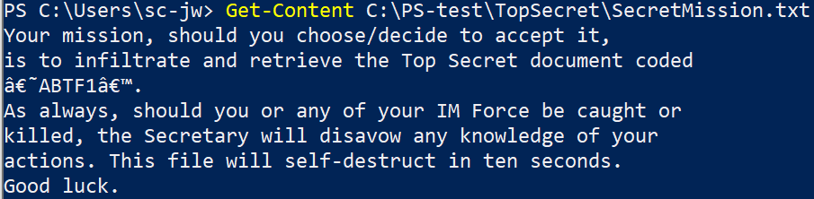
Get-Content & Clear-Content
We can use the Get-Content command to view the content of a file/item. E.g.
The Clear-Content command allows us to delete the contents of a file without deleting the file itself. E.g.

Slide 27
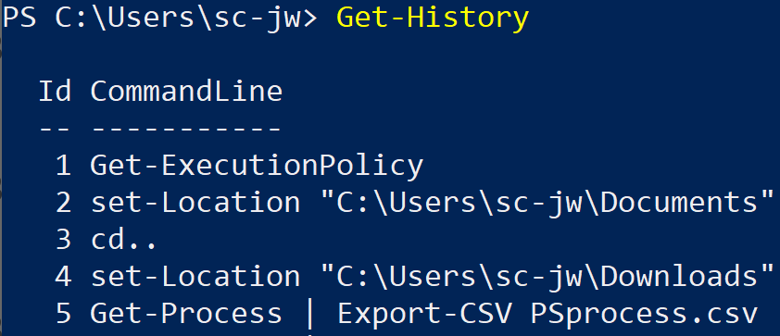

Get-History, Invoke-History & Clear-History
We can use the ’up and down’ arrow keys to scroll through recently used PowerShell commands. We use the Get-History command to view a list of all recently used commands. You can copy & paste to re-use them in PS:
We use the Invoke-History command to rerun any command from the list, by typing the command followed by the ‘Id’ number in the list.
E.g. to rerun the ‘Get-Process’ command, type Invoke-History 5.
We use the Clear-History command to clear the command history from the current session.
Notes:
Note: A CSV (comma-separated values) file is a text file that has a specific format which allows data to be saved in a table like structured format.

Slide 28

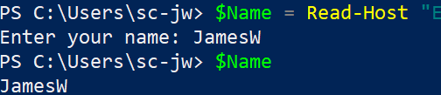
Show: User input
We use the Read-Host command to prompt a user for input, to receive user input from the terminal:
To include the value input by the user into a variable, we declare the $Name variable followed by the assignment = operator. To view the value of the $Name variable we can simply input the variable name and press enter.
We can format the colour of the text by appending pipe
| Write-Host -ForegroundColor Yellow -BackgroundColor Red after the Read-Host string:
Notes:
We also use the -Prompt parameter to specify that it is text information to be input, which also appends a colon : to the text we include after the –Prompt parameter.
In PowerShell, single and double quotation marks are used to define a string. Using single quotation marks for basic strings is a best practice e.g. ‘Hi, my name is James’. Using double quotation marks for strings that contain other objects/variables is a best practice e.g. “Hi, my name is $Name”. It is also good practice to use double quotes for both. This creates a good coding habit in PS.

Slide 29
Bg. Styling text in PowerShell v7.2+
In PowerShell v7.2 Microsoft has include support for ANSI escape sequences.
ANSI escape sequences are an industry standard for text format.
Microsoft has implemented support for ANSI escape sequences with the use of a variable named $PSStyle. Example:
$Style = “$($PSStyle.Background.BrightRed)$($PSStyle.Foreground.BrightWhite)”
Write-Host $Style”Hello World”
This way still works:
Write-Host “Hello World” -ForegroundColor White -BackgroundColor Red

Slide 30

Managing Users & Groups
Creating and managing Users and groups is beyond the scope of this module as it is specifically covered in PowerShell in another Networking module and in another module at L5.
It is covered in the following slides as Bg. Slides for those who would like an early sneak peak.

Slide 31
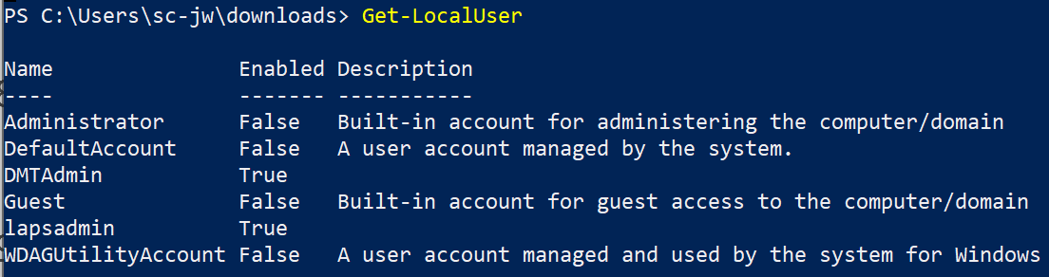
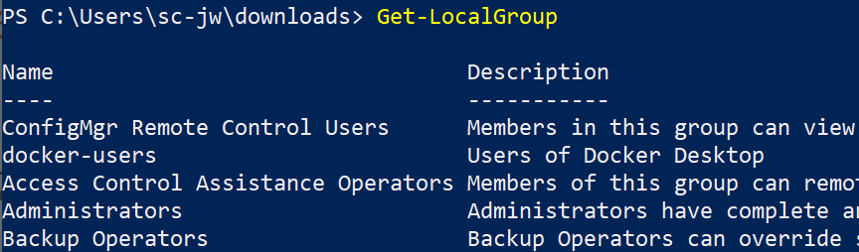
Managing Users & Groups
This Photo by Unknown Author is licensed under CC BY-NC-ND
We use the Get-LocalUser command to see all local users on a computer.
We use the Get-LocalGroup cmd to view all local groups on a computer.
We use the Get-LocalGroupMember command to view members of a specific group e.g. Get-LocalGroupMember User

Slide 32
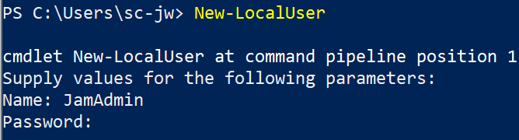
Bg. Create & Remove a User Account
To create a new user account, open PS in Admin mode, and use the
New-LocalUser command. You will be asked to set a Username and Password.
We can add a user to a group using the Add-LocalGroupMember command:
Add-LocalGroupMember -Group "Administrators" -Member “Username“
We can use the Remove-LocalUser command to remove a user account:
Remove-LocalUser -Name “Username"

Slide 33
Bg. Additional PS commands
The following useful Bat and PS commands are commonly used within the PS Terminal:
Start www.google.com - is used to open a webpage or start applications.
Get-package – is used to return a list of software installed on the computer. The parameters “-ProviderName Programs, MSI” exclude Microsoft Update packages.
Get-Package –ProviderName Programs, MSI
Get-Service – is used to list the services installed on the system. To return a more specific list such as a list of all services that begin with ‘T’, we can use Get-Service “t*”.
Gci – is used to view the files in the current working directory.
Notepad test.txt - This command is used to run and open an existing txt file in Notepad file that is saved in the current working directory.
Discover the amount of free Virtual memory on the system:
    Get-WmiObject -Class Win32_OperatingSystem –ComputerName localhost |
    Select-Object -Property CSName,FreeVirtualMemory

Slide 34

Reminder: Register.

Slide 35
Section 2:
OS Tutorial

Slide 36
Tutorial Activity: PowerShell Scripting
Download slide deck from Moodle: OS 7 - Intro to MS PowerShell
Experiment with the following PS commands and scripts.
All code located in the ‘Notes’ section of the slides.
Save your experiments with screenshots of both code and output to include in your Assignment for tasks 2 and 4.
Note: Bat or PS commands/scripts can be used to answer task 2 & 4 of the Assignment. You can stick with one either Batch or PowerShell or you could include some commands/scripts from each if you wanted to e.g. 5 Bat & 5 PS commands. It doesn’t matter from a marking perspective.

Slide 37

How to use PowerShell
On your own device PS commands can be typed directly into
PowerShell.
To safeguard your system you may want to use a safe sandboxed environment such as the Virtual Machine provided (details on next slide).
Try: PowerShell is available on campus Computers. However ‘PowerShell Admin’ is not available. Unless in IQ205 lab.
  Open PowerShell and Test the Get-Process command to view running processes.

Slide 38
Bg. Azure Cloud VM: PowerShell
An Azure Cloud VM has been created for each student. You can use the VM to run PowerShell commands scripts.
Link: https://labs.azure.com/virtualmachines
The Windows login details for every machine:
Username: soac-azure
Password: AzuR3L@85ErviCe5
and for Ubuntu (as part of WSL)
Username: l4soac
Password: 5o@cUser
Remember to ‘STOP’ the VM after to save your hours.
For additional hours email a request to Lee.Cobley@uwtsd.ac.uk.
Step by step instructions is located on the next slide.

Slide 39
Bg. Azure Cloud VM instructions
You will receive an invitation to open your Virtual Machine (VM) via your student email from the UWTSD Computing technician ‘Lee.Cobley@uwtsd.ac.uk’ from Microsoft Azure.
Click the button/link to ‘Sign in’ when you receive the email(you may need to enter your student email address and Moodle password).
You will see a splash screen with a PC, you'll notice a little slider button (bottom left) just next to a small PC icon (which at first will be greyed out). Slide the button and give it 1-3 mins while the VM powers on.
It should now show a little blue PC icon (if not, Refresh the webpage, and try again).
If you click on the little blue PC icon it should download a RDP file. If it doesn't work first time give it another go, it will put the .rdp file in the Downloads folder or, it may attempt to open it directly, at which point you'll be prompted for logon details:
Username: soac-azure
Password: AzuR3L@85ErviCe5
Linux Ubuntu (through WSL) is installed. And can be used via the CMD prompt. If it asks for the Ubuntu login, use: Username: l4soac Password: 5o@cUser
This link to access the VM will work after initial sign-in: My virtual machines - Azure Lab Services.
Usage time: VM time is limited. Remember to ‘STOP’ the VM after use. Email Lee for more hours if needed.

Slide 40
Try: Essential PowerShell commands
We can use the Get-Process command to show a list of all processes running on the system and their ids.
The Get-Help command displays general help and information about PowerShell commands.
We can also use the Get-Help command to get help and information about specific commands. To view information about the Get-Process cmdlet, we can type: Get-Help Get-Process:

Slide 41
Try: Export-CSV option
We can use the Export-CSV option to export PowerShell output to a CSV/Excel file.
This is useful to review system information and for reporting purposes.
Syntax : Get-Process | Export-CSV GProcess.csv
The command creates a GProcess.csv file that contains process data.
To open the file, type in:
  CMD: GProcess.csv
  PS: Invoke-item GProcess.csv

Slide 42
Try: PowerShell Aliases
PowerShell provides shortened alias commands such as:
ls - to list files. Same as Bash.
ps - Get-Process - Gets the processes that are running. Same as Bash.
pwd or gl for Get-Location - Gets information about the current working directory. Same as Bash.
clear - Clear-Host - Clears the display. Same as Bash.
Ipconfig - Get-NetIPConfiguration & Get-NetIPAddress is used to display the computer’s IP address.
h - Get-History - Gets a list of the commands entered during the current session.
md - mkdir - Creates a new item/file. E.g. md text.txt.
  ni - New-Item - Also creates a new item/file.
rd - rmdir - Deletes an item. E.g. rm text.txt.
  ri - Remove-Item - Also deletes files and folders.
mi - Move-Item - Moves an item from one location to another.
ren - Rename-Item - Renames an item.
start or saps - Start-Process - Starts a process on the computer.
cd or sl - Set-Location - Sets the current working location to a specified location.
fl - Format-List - Formats the output as a list.
PowerShell alias list: click-here
Note: It is good practice to use the PS commands such as Write-Host instead of echo. However PS does provide this flexibility which is useful. Especially for experienced Batch and Bash users.

Slide 43
Reminder: Peer/pair programming & AI tools
We encourage students to work together in pairs or small teams of 3 to help each other to debug and solve any code problems.
This is called Pair / Peer programming in industry, where the code of a program is written in pairs.
Each person looks at the code the other member is writing / written and they help each other debug the code.
In industry, pair / peer programming is a software development technique where two programmers work together on one device. One person who writes the code is called the driver, while the othe person is called the observer who reviews each the code being typed. Both review the code for errors after and hep each other to solve problems.
In tutorials, you can work on your own PCs independently, but you can also help each other to solve any problems and debug the code.
AI tools such as ChatGPT can be used to help debug code.

Slide 44
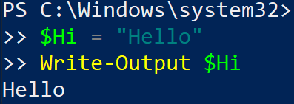
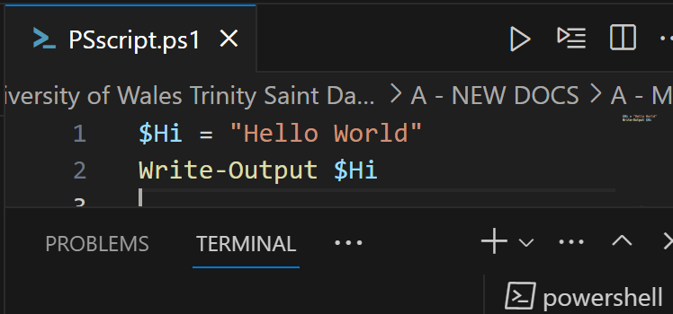
Show: PowerShell, VSC & TIO
PowerShell SHIFT + ENTER: We can type scripts inside the PS console, by typing 'SHIFT + ENTER' to continue coding on the next line.
Visual Studio Code: Create a New File e.g. PSscript.ps1. Run the program.
TIO - Try It Online: https://tio.run/#powershell
$Hi = "Hello"
Write-Output $Hi
Notes:
$Hi = "Hello"
Write-Output $Hi

Slide 45
Bg. PS scripting in the console
We can type scripts inside the PS console, by typing 'SHIFT + ENTER' to continue coding on the next line. Variable values, function names etc... Are stored in memory for us to use/call.
'SHIFT + ENTER in PS with the code below. This example creates a variable called $Hi using the $ dollar symbol and uses the Write-Output command to outputs it’s value:
Notes:
$Hi = "Hello"
Write-Output $Hi
Note: Write-output sends the string to stdout (also known as ‘standard output’ stream, others: stdin & stderr) which becomes an object and can be assigned to a variable, passed to a function or redirected to a file. Write-host outputs directly to the console for display. Both can be used to echo out / output / print to the console.
In programming, standard streams are standard input and output communication channels between a computer program and its environment when it begins execution or runs a command or script. The three input/output (I/O) connections are called standard input (stdin), standard output (stdout) and standard error (stderr).
* Write-Host (Microsoft.PowerShell.Utility) - PowerShell | Microsoft Learn
* about Output Streams - PowerShell | Microsoft Learn
R: PowerShell Write-Host v Write-Output (reddit.com)
* stdin, stdout, stderr | Microsoft Learn
* What Are stdin, stdout, and stderr on Linux? (howtogeek.com)
* What is Stdout? (computerhope.com)

Slide 46

Bg. Try It Online @ TIO.run
Try the code below with TIO.run:
https://tio.run/#powershell
* aka Windows PowerShell
Or https://tio.run/#powershell-core
* aka PS v7+. Cross platform PS.
$Hi = "Hello"
Write-Host $Hi
Notes:
Note: Write-output sends the string to stdout (also known as ‘standard output’ stream, others: stdin & stderr) which becomes an object and can be assigned to a variable, passed to a function or redirected to a file. Write-host outputs directly to the console for display. Both can be used to echo out / output / print to the console.
In programming, standard streams are standard input and output communication channels between a computer program and its environment when it begins execution or runs a command or script. The three input/output (I/O) connections are called standard input (stdin), standard output (stdout) and standard error (stderr).
* Write-Host (Microsoft.PowerShell.Utility) - PowerShell | Microsoft Learn
* about Output Streams - PowerShell | Microsoft Learn
R: PowerShell Write-Host v Write-Output (reddit.com)
* stdin, stdout, stderr | Microsoft Learn
* What Are stdin, stdout, and stderr on Linux? (howtogeek.com)

Slide 47
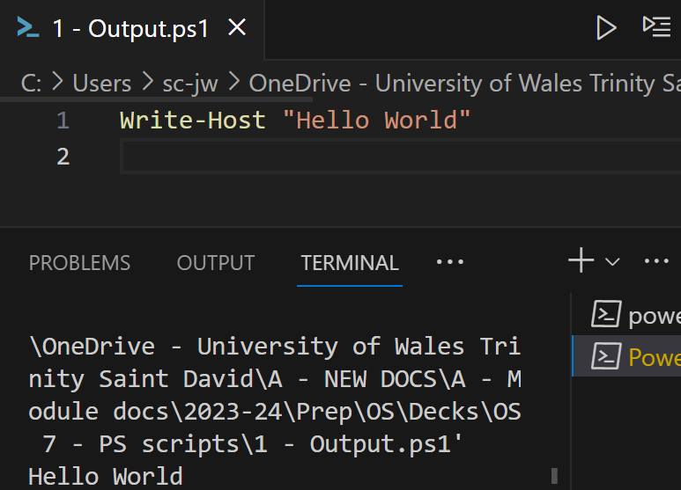
Bg. PS scripting in VSC
Open Visual Studio Code
Create a New File e.g. PSscript.ps1
  PS script files are saved with a .ps1 file extension.
Type the following command:
Write-Host “Hello World”
  Don’t copy & paste quotes “ ”, or replace them in the IDE.
Run the program.
Notes:
If you copy and paste the command / scripts you will need to check and replace certain characters such as, quotation marks “ and dash -, otherwise they will be interpreted incorrectly: For more information:
* Understanding file encoding in VS Code and PowerShell - PowerShell | Microsoft Learn
* Reddit - Dive into anything

Slide 48
Bg. PS scripting in Notepad++/VSC/other editor
PS script files are saved with a .ps1 file extension.
We can use an IDE of our choice e.g. notepad, notepad++ or Visual Studio Code.
For example, we could type the following command in our favorite editor:
Write-Host “Hello World” - Don’t copy & paste quotes “ ” or replace them.
Save the file as HelloWorld.ps1
Run the file: Navigate to the folder using ‘cd’ in PowerShell and type the file name with a preceding full stop and forward slash ./ to run the script file e.g.
Don’t forget the dot and forward slash: ./
By default, we are unable to run a script by just double-clicking a file, to protect the computer system from accidental harm.
Notes:
If you copy and paste the command / scripts you will need to check and replace certain characters such as, quotation marks “ and dash -, otherwise they will be interpreted incorrectly: For more information:
* Understanding file encoding in VS Code and PowerShell - PowerShell | Microsoft Learn
* Reddit - Dive into anything

Slide 49
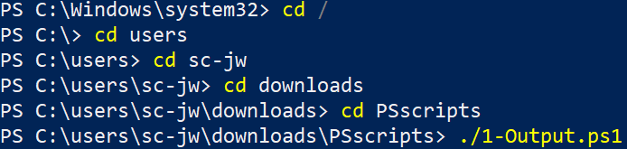
Bg. Running the Script in VSC and PS
After you open a PS script file in In VSC, there is no need to manually find the script fie to run it. We can simply press the play button (top right) to run.
If using another editor and opening the script file in the PS console, we need to use the ‘cd‘ command to navigate to the folder containing the script file in order to run it.
  Or we could copy the directory path from File Explorer and use the Set-Location command in PS to set the directory to the location of the script files. Although this command will throw an error if there is a dash - in directory path.

Slide 50
Windows PowerShell v PowerShell (Admin)
Two versions of PowerShell exist in the Power User menu:
Windows PowerShell typically runs in Restricted mode that offers access to the PowerShell console and some limited functions, and is far less potentially damaging to the system.
Windows PowerShell (Admin) typically runs in Unrestricted mode that offers full access to the PowerShell functions, and the ability to run scripts, but we need to be careful with the scripts we run in this mode.
To safeguard your primary system, when experimenting with PS scripts, you can use PS in the Azure VM provided.
Or: Try It Online: https://tio.run/#powershell
Notes:
We can change the ExecutionPolicy back to Restricted after we have finished.
You wouldn’t want a malicious PS script accidently downloaded from the internet/email running on your machine. Or a junior developer running a PS script that could harm the Organization's system/network/data.

Slide 51
PowerShell Execution modes
This Photo by Unknown Author is licensed under CC BY-NC-ND
To run and execute a PS script in the PS console, we need the execution policy to be either RemoteSigned or Unrestricted.
Whichever device/VM you are using, to see the current default policy, we use the Get-ExecutionPolicy command.
Open PowerShell: Right click on the Window start icon & click PowerShell (Admin). Type the following command in PowerShell:
Try: Get-ExecutionPolicy
  If the execution policy is set to ‘Restricted’, change the Execution Policy using the following command: Set-ExecutionPolicy RemoteSigned
  Enter Y in the prompt.
Notes:
We can change the ExecutionPolicy back to Restricted after we have finished.
You wouldn’t want a malicious PS script accidently downloaded from the internet/email running on your machine. Or a junior developer running a PS script that could harm the Organization's system/network/data.

Slide 52
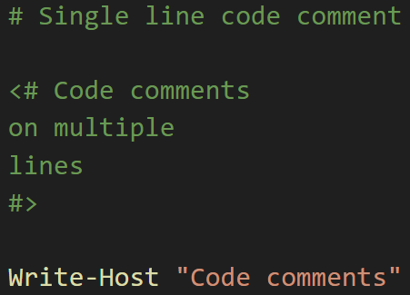
Code comments
This Photo by Unknown Author is licensed under CC BY-NC-ND
We can use the hash symbol # in PS to create a code comment on a single line.
Or we can use the less than and greater than symbols with hash like so: <# and #> to create multi-line comments / a comment block.

Slide 53

Try: Variables
In PowerShell, variables are named ‘objects’.
A variable name should start with a dollar symbol ‘$’.
Try: In either PowerShell, VSC or www.tio.run, try the following code:
Reminder: The echo command in PS is an alias to the Write-Output PS command. We can use either one.
Notes:
A variable name can contain alphanumeric characters i.e. letter and numeric characters and underscores.
Line 1: We have created a variable with the name $test and used the = assignment operator to store the string value “Hello World”.
Line 2: We use the echo command to output the variable value.

Slide 54
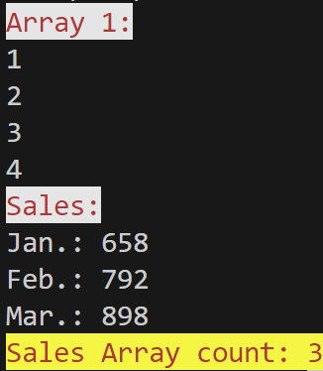
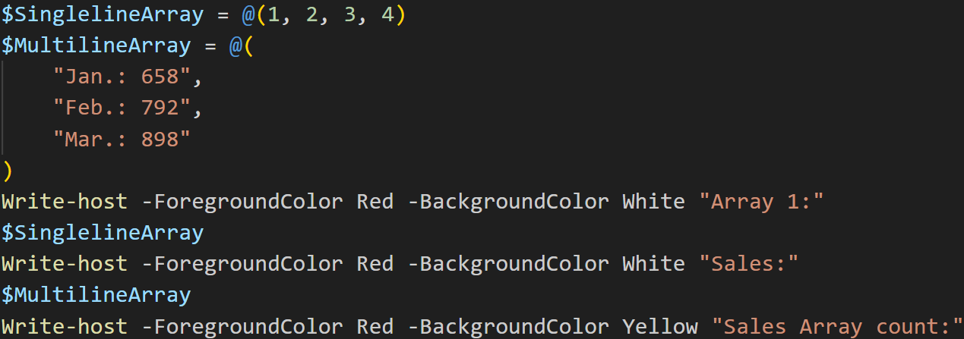
Try: Arrays
In PS, we use the @ symbol & parenthesis () to declare an array. In this example, we declare a Singleline Array and a Multiline Array, both separated by commas. To output Array values in PS we simply use the Array variable name, Write-host / echo are not needed. We also use the .count property to tell us how many items are in the array. Code & Output:
Notes:
$SinglelineArray = @(1, 2, 3, 4)
$MultilineArray = @(
"Jan.: 658",
"Feb.: 792",
"Mar.: 898"
)
Write-host -ForegroundColor Red -BackgroundColor White "Array 1:"
$SinglelineArray
Write-host -ForegroundColor Red -BackgroundColor White "Sales:"
$MultilineArray
Write-host -ForegroundColor Red -BackgroundColor Yellow "Sales Array count:"

Slide 55
Bg. Arrays
Like other programming languages, PS arrays store a collection of data values.
PS Array syntax: $MyArray @(1, 2, 3, 4)
The @ symbol in PS is used to declare an array. However, PS treats any comma-separated list as an array.
To create an array in PS, we simply declare a variable to reference the array and separate the elements with commas. Officially it is good practice to start the array list with an @ symbol and enclose the array values in parenthesis ( ).
Array elements are accessed through an index. It is important to remember that an Array index is 0-based, i.e. it starts at 0.
With an Associative array, we associate values to String keys, we then use the key to access the value e.g. ( Array[‘StringKey'] ). With a Non-associative array we store values and retrieve values using a numeric index ( Array[7] ).
  Syntax: $MyArray = @(“Steve”, “James”, “Mary”, “Paul”, “Joe”)
Notes:
For more information, click here: Everything you wanted to know about arrays - PowerShell | Microsoft Learn

Slide 56
Types of Loops in PS
This Photo by Unknown Author is licensed under CC BY-NC-ND
In programming, we use ‘a loop’ statement, to allow us to execute a block of code multiple times.
PS provides several types of loop statements, including:
for loop: Execute a sequence of statements multiple times and abbreviates the code that manages the loop variable.
foreach loop: Enhanced for loop. This is mainly used to traverse collection of elements including arrays.
while loop: Repeats a statement or group of statements while a given condition is true. It tests the condition before executing the loop body.
do...while loop: Like a while statement, except that it tests the condition at the end of the loop body.

Slide 57
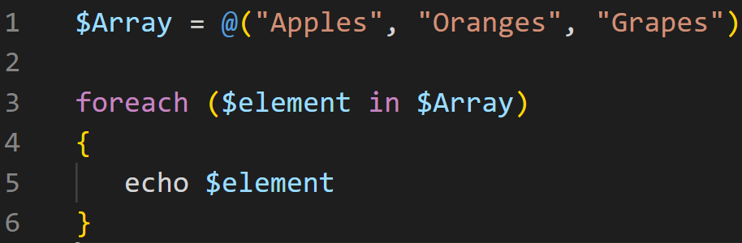
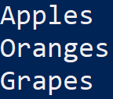
Try: for each loop
In the example, first an array $Array is created with the 3 string values.
We then create a foreach loop and use the $Array as it’s list items.
The loop assigns each value from the Array to the $element variable and the code echo’s out the value. With each iteration through the loop, the next value in the array is assigned to the $element variable and is output.
Notes:
After the Foreach loop displays the last value in the array, PowerShell terminates the loop.
For further information please click here and here.
$Array = @("Apples", "Oranges", "Grapes")
foreach ($element in $Array)
{
echo $element
}

Slide 58
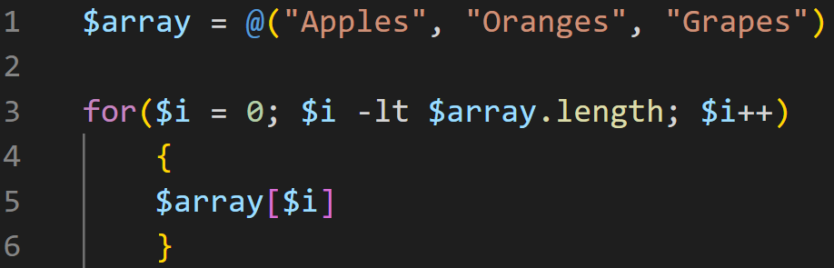
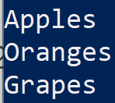
Bg. For Loop example
A for loop is used to execute a block of code statements multiple times. It is commonly used to retrieve values from an array or database query.
A for loop will execute until a condition evaluates to True.
In this example, in line 1 we create an ‘array’ variable and using the @ symbol we store all 3 values in it. In line 3, we create a for loop that will execute as long the for loop’s variable $i is less than (-lt) the length of the array (0, 1, 2). The for loop block of code statements will execute 3 times, each time it will print out a value from the $array.
Notes:
For loop syntax:
for (<Initialization>; <Condition or Test_expression>; <Repeat>)
{ code statements }
The Initialization placeholder is used to create and initialize the variable with the initial value.
The Condition placeholder in a loop gives the Boolean value True or False.
PowerShell evaluates the condition part each time when this loop executes. When it returns a True value, the statements are executed. The loop executes its block until the condition becomes false.
The Repeat placeholder in a loop, is used to modify the value of a variable which is checked inside the Condition part of the loop. [R: javatpoint.com]
For further information, please click-here.

Slide 59
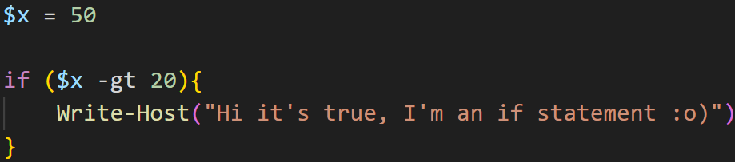
Try: if statement
This Photo by Unknown Author is licensed under CC BY-NC-ND
An if statement consists of a boolean expression followed by code statements.
  Syntax: if(Boolean_expression)
  { Statements to execute if Boolean expression is true}
If the Boolean expression evaluates to true, the code is executed. If false, the code after the if statement, after the opening curly bracket, will not be executed.
Output:
Notes:
$x = 50
if ($x -gt 20){
Write-Host("Hi it's true, I'm an if statement :o)")
}

Slide 60
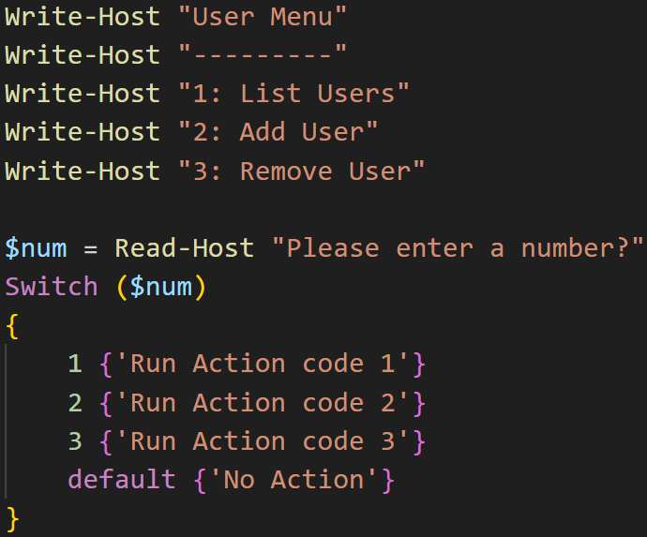
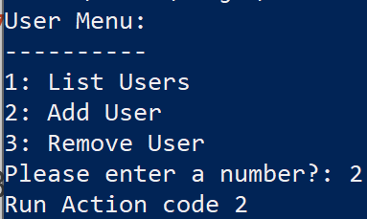
Try: Switch statement
A switch statement allows a value to be tested for equality against a list of case values.
This example asks the user to input a number using the Read-Host command.
The number entered is stored in the $num variable and the switch statement compares the number against a list of case values, and where there is match, the code is run.
If the user inputs a value where there is no match, the default action is run.
Code in notes. Larger code view on next slide.
Notes:
Write-Host "User Menu"
Write-Host "---------"
Write-Host "1: List Users"
Write-Host "2: Add User"
Write-Host "3: Remove User"
$num = Read-Host "Please enter a number?"
Switch ($num)
{
1 {'Run Action code 1'}
2 {'Run Action code 2'}
3 {'Run Action code 3'}
default {'No Action'}
}

Slide 61
Switch statement example
Notes:
Write-Host "User Menu"
Write-Host "---------"
Write-Host "1: List Users"
Write-Host "2: Add User"
Write-Host "3: Remove User"
$num = Read-Host "Please enter a number?"
Switch ($num)
{
1 {'Run Action code 1'}
2 {'Run Action code 2'}
3 {'Run Action code 3'}
default {'No Action'}
}

Slide 62
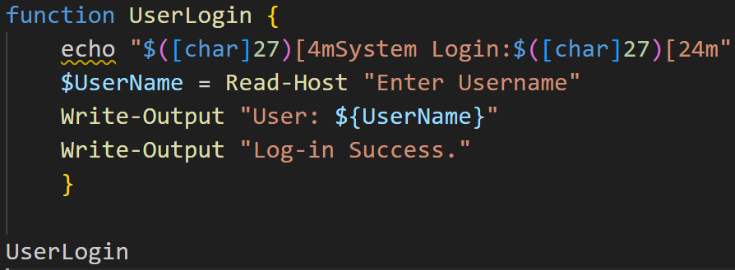
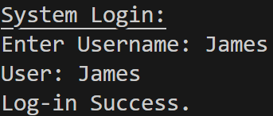
Try: Functions
In this example, we create a System Login function to request user input.
We declare the function at the top of our script using the ‘function’ keyword, followed by the name of the function ‘UserLogin’ that we create.
We call the ‘UserLogin’ function from the main script.
We use ANSII escape codes $([char]27)[4m and $([char]27)[24m to underline the System Login string.
And the Read-Host command to receive user input and store it in the ‘UserName’ variable.
Notes:
function UserLogin {
echo "$([char]27)[4mSystem Login:$([char]27)[24m"
$UserName = Read-Host "Enter Username"
Write-Output "User: ${UserName}"
Write-Output "Log-in Success."
}
UserLogin
Notes:
Write-Host ("$([char]27)[4mHello World$([char]27)[24m")
<Escape Character [char]27> [4m = "Underline on"
<Escape Character [char]27> [24m = "Underline off"

Slide 63

Bg. User input (SecureStrings)
This Photo by Unknown Author is licensed under CC BY-NC-ND
If needed, we can also use the -AsSecureString parameter with the Read-Host command that will encrypt the user’s input and display the input as asterisks **** in place of the characters the user inputs.
This is useful when prompting users for secure data, such as passwords.
For further information on how to secure passwords and encrypt credentials in PS please click here: How to encrypt credentials & secure passwords with PowerShell.

Slide 64
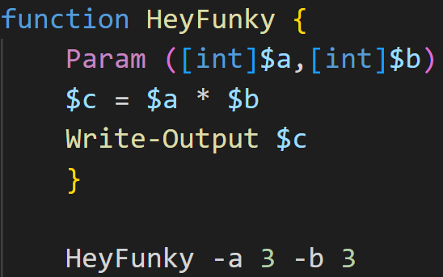
Bg. Function with Integer Parameters
In case needed, as with Batch and Bash, functions in PowerShell can also receive values/arguments. In this example we send a function 2 integer values.
The Write-Output command in the function outputs the result.
Output:
9
Notes:
Here is an example of a function with parameters. The parameters are specified so that the function can accept 2 integer/number values as arguments:
Function and parameter syntax:
param(
[Parameter()]
[string]$Parameter1
)
We can add additional parameters by separating them with a comma, for example:
param(
[Parameter()]
[string]$Parameter1,
[Parameter()]
[string]$Parameter2
)

Slide 65
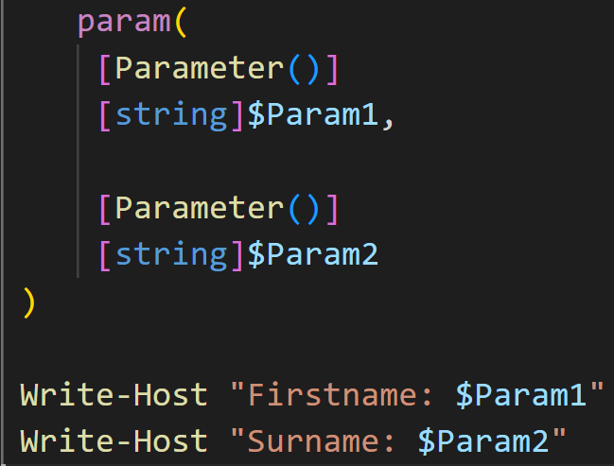

Bg. Function with String Parameters
In this example the function accepts 2 string values as parameters. This time we send the values from the terminal as follows. We could extend this example and use the Read-Host user input command to allow the user to input the values.
Output:
Notes:
Function and parameter syntax:
param(
[Parameter()]
[string]$Parameter1
)
We can add additional parameters by separating them with a comma, for example:
param(
[Parameter()]
[string]$Parameter1,
[Parameter()]
[string]$Parameter2
)

Slide 66
Bg. Functions & Parameters
Further information about Functions & Parameters here in case you are unsure would like to learn more:
When we create our functions, we also have the option to include parameters to accept data into our functions for processing. The standard Computing model of input, process, output. Data passed to a function are known as ‘arguments’.
To create parameters in a PS function, we use a param block, which holds all the parameters for a function. We create/define a param block by using the param() keyword followed by parentheses.
PowerShell best practices state that we should assign a data type to the parameter such as string or int for integer. Depending on the value being received.
We specify the data type of the parameter, by putting the parameter’s type between square brackets, such as [string] or [int] type, before the parameter variable name.
Function and parameter syntax:
  param(
  [Parameter()]
  [string]$Parameter1
  )
We can add additional parameters by separating them with a comma, for example:
  param(
  [Parameter()]
  [string]$Parameter1,
  [Parameter()]
  [string]$Parameter2
  )
Notes:
PowerShell will always try to convert any value that’s passed to the parameter into the specified data type e.g. a string, and the function will always treat that value as the specified data type.

Slide 67
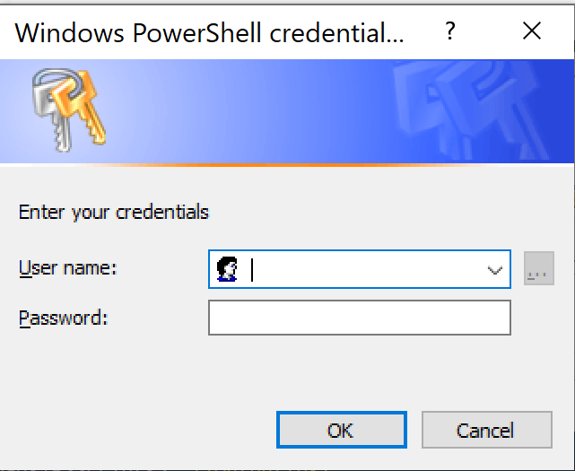

Try: Input Box
We can use the Get-Credential command in PS to create an input box.
In this example we use the Get-Credential command to prompt the user for a username and password.
We output the user input using echo and the variable name $c for credential.
$c = Get-Credential
echo $c
Bg. We can authenticate the credentials with a database/server.
Connecting PowerShell to SQL Server with Get-Credential
Connect to SQL Server with PowerShell and SQL
Bg. further information please click here:
Get-Credential (Microsoft.PowerShell.Security)
Notes:
$c = Get-Credential
echo $c

Slide 68
Bg. Customise the input Box
In this example we use the Get-Credential command to prompt the user for a username and password.
We use the -Message parameter to state a customised message for the prompt.
We access the Username and Password from the $credential variable and save them in the $username and $password variables.
We use the Write-Output command to output the credentials.
$credential = Get-Credential -Message "Enter your credentials:"
$username = $credential.UserName
$password = $credential.GetNetworkCredential().Password
Write-Output "Username: $username"
Write-Output "Password: $password"
Notes:
$credential = Get-Credential -Message "Enter your credentials"
$username = $credential.UserName
$password = $credential.GetNetworkCredential().Password
Write-Output "Username: $username"
Write-Output "Password: $password"

Slide 69
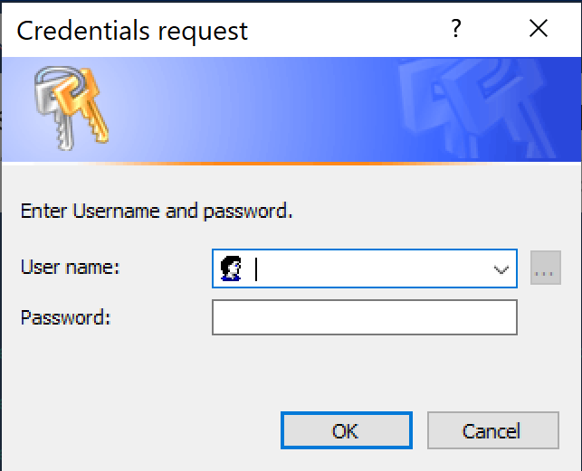
Bg. PromptForCredential method
We can also use the PromptForCredential method to ask the user for their username and password.
PromptForCredential method allows us to specify the window title and message that appear in the prompt.
We save the credentials in the $Credential variable.
The PromptForCredential method is an alternative to the Get-Credential command.
$Credential = $host.ui.PromptForCredential("Credential request", "Enter Username and password.", "", "NetBiosUserName")
Notes:
$Credential = $host.ui.PromptForCredential("Credential request", "Enter Username and password.", "", "NetBiosUserName")

Slide 70
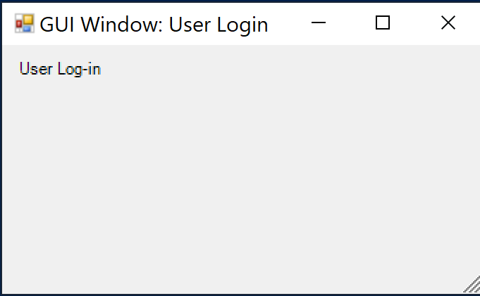
PowerShell GUIs
This Photo by Unknown Author is licensed under CC BY-NC-ND
Outside the scope of the assignment. But just to make you aware.
We can use PowerShell to create GUIs Graphical User Interfaces.
PS has access to.NET functions & features. Hence, we can create GUI front ends for users with our PS scripts. To use the .NET functionality to create forms, we use the System.Windows.Forms class to create GUIs in PowerShell:
Code example on next slide:
From here we can add form elements.
Notes:
Although using Visual Studio is easier.

Slide 71
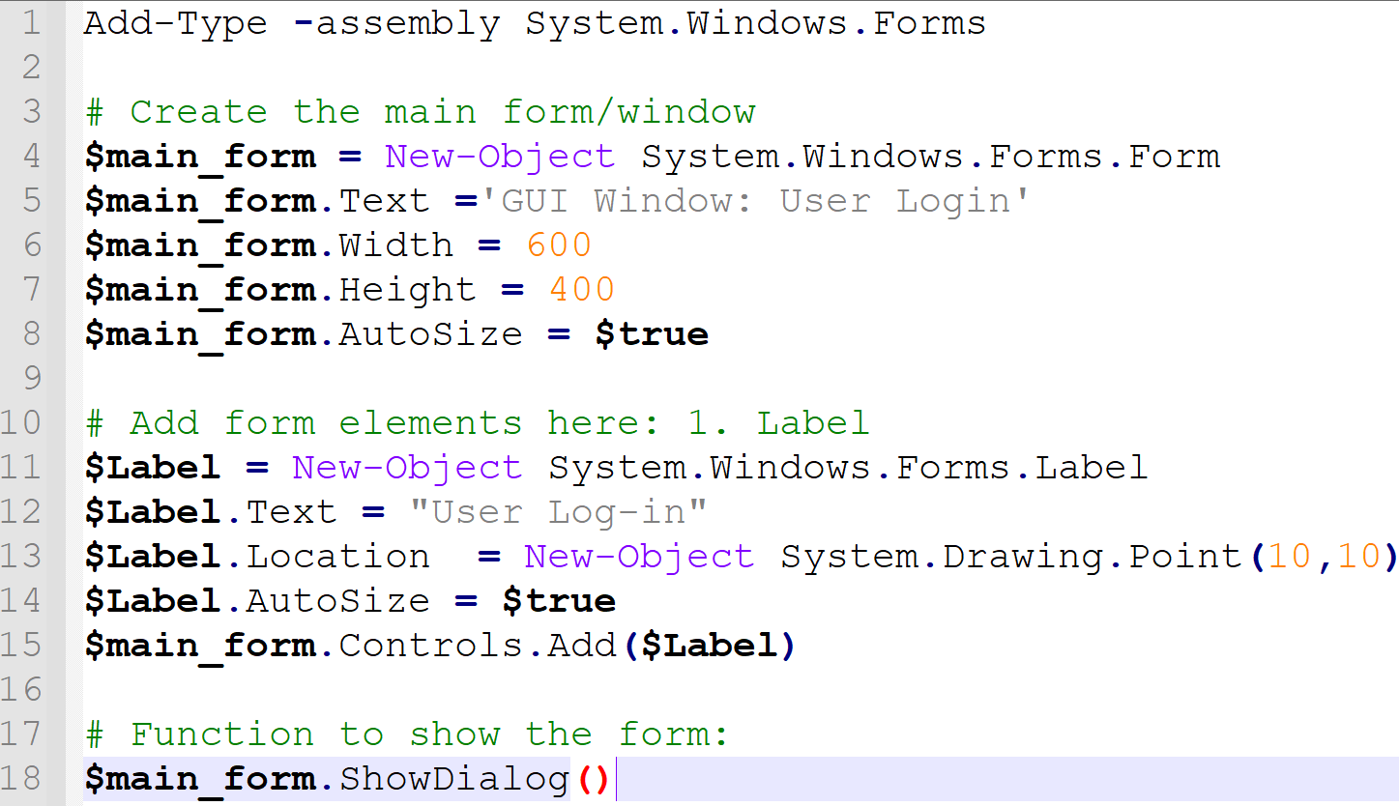
PowerShell GUIs
This Photo by Unknown Author is licensed under CC BY-NC-ND
Notes:
Although using Visual Studio is easier.

Slide 72
Bg. PowerShell GUI code description
To use this class we use the Add-Type command, as in the following code:
  Add-Type -assembly System.Windows.Forms
To create a window (aka: a Screen form), we use the New-Object command as in the following code:
  $main_form = New-Object System.Windows.Forms.Form
The following code sets the title and size of the window:
  $main_form.Text =‘GUI Window: User Login'
  $main_form.Width = 600
  $main_form.Height = 400
  We can use the AutoSize property to make the form automatically stretch: $main_form.AutoSize = $true
To display the form on the screen we use the ShowDialog() function:
  $main_form.ShowDialog()
We can now add form elements such as Labels, TextBoxs, Buttons, CheckBoxs, RadioButtons, Menu, DataGrids,Pictures/icons, Scrollbars etc….
For further information: Video: How to Create a PowerShell GUI with Winforms,
  Article: How to Create a GUI for PowerShell Scripts. Article: PowerShell GUI - How to get started

Slide 73
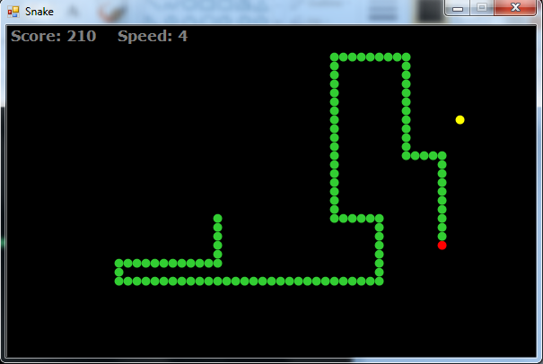
PowerShell Games
We can also create Computer Games in PowerShell.
For an example please click here.
For a basic colour guessing games using
the ‘switch‘ statement please click here.
For an example snake game click-here.

Slide 74

PowerShell Example sources:
MS PowerShell documentation
Discover PowerShell - PowerShell | Microsoft Learn
PowerShell.org – PowerShell Community
GitHub: PowerShell Beginner’s Guide
Learning PowerShell GitHub resources
How to Use PowerShell? with Examples (educba.com)
Table of Basic PowerShell Commands - (microsoft.com)
PowerShell-beginners-guide
PowerShell Tutorial for Beginners
PowerShell Tutorial (tutorialspoint.com)
For PowerShell Admin skills and commands
Microsoft Azure modules
  Using PowerShell in the Azure Portal
  Azure PowerShell Tutorial

Slide 75
Notice: Easter
  No Lectures or tutorials during Easter:
  25/03/24 - 12/04/24 (3 weeks)
  Tutorials start back Monday April 15th.
  Tutorials will be for Assignment support only. No new taught content.
  No Lecture on Monday April 15th. Please use this time to work on the Assignment.
  OS Assignment submission date: Friday 19th April 2024.

Slide 76
Reminder: Register.
This Photo by Unknown Author is licensed under CC BY

Slide 77

Q&A.

Slide 78
The End.

Slide 79
Bg. PowerShell data types & special characters
To learn about PowerShell data types and special characters click here.
This Photo by Unknown Author is licensed under CC BY-NC-ND

