Slide 1
Sustainable IT Project Management

Slide 2
IT and the Environment
Environmental Awareness
• Green House Gas Accounting (GHG)
• Kyoto
• EU Emissions Trading Scheme (EU ETS)
• Climate Change Bill
• Carbon Reduction Commitment (CRC)
• Public Pressure for ‘Sustainability’

Slide 3
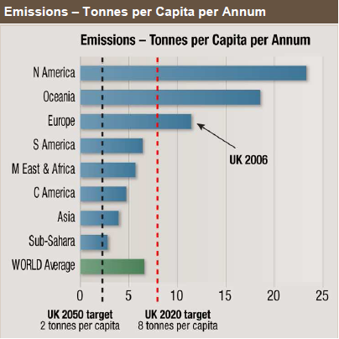

Slide 4
Our industry is not energy efficient!
• Historically equipment was selected based
only on price : performance
• Redundant Components

Slide 5
Green Data Centres
• Data Centres: ~2.5% of UK grid power
• Power Availability & Cost
• Cooling Capacity
• “90% of business will be impacted by
power issues within 5 years” EPA

Slide 6
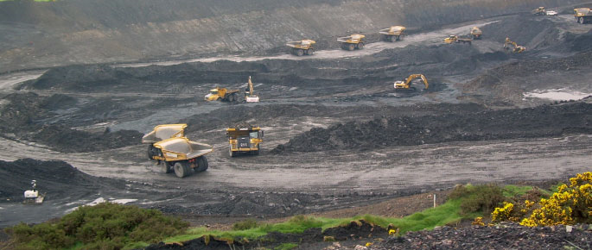
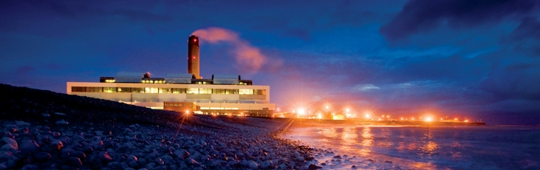
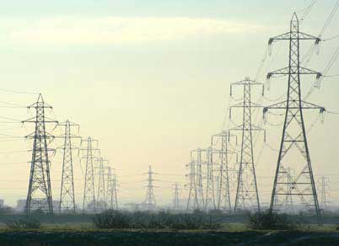
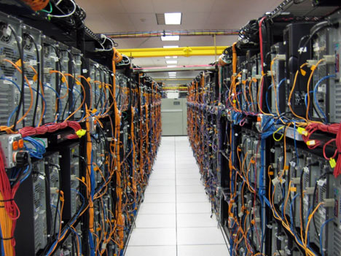

Energy Loss – Source to Destination

Slide 7
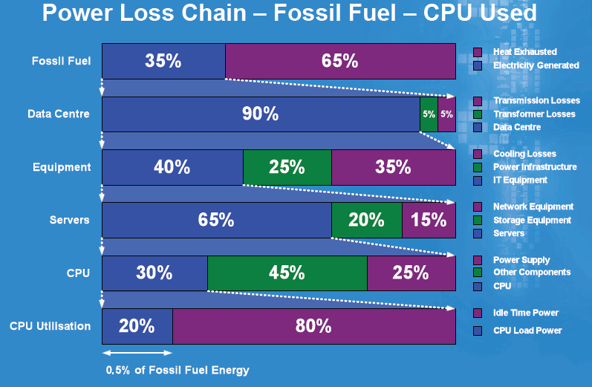

Slide 8
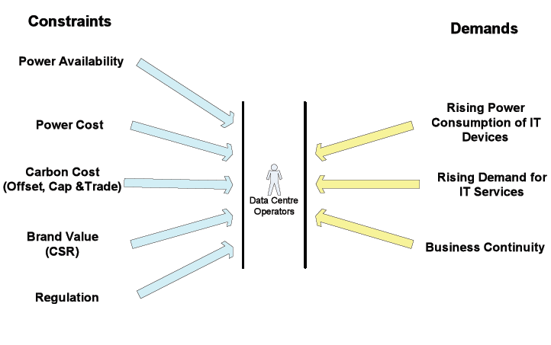

Slide 9
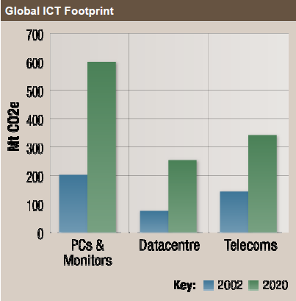
Growth in Carbon Emissions if we stick with business as usual (Carbon Trust, 2007)

Slide 10
Drivers for IT Sustainability
• UK Gov Carbon Reduction Commitment
• The Carbon Trust
• EU Code of Conduct for Data Centres
• BCS Data Centre Cost & Energy
Simulation Tool
• BCS GreenIT Specialist Group
• BCS Carbon Footprint Working Group

Slide 11
Carbon Reduction Commitment
UK Government – CRC
• CO2 emissions reduction by 80% of 1990
levels by 2050
• 2010 – Introductory phase (£12/tCO2)
• 2013 – Capped phase, auction structure,
bonus and penalty scheme as well as a
league table position
• 6,000 MWh (~685kW sustained load)
• Half-Hourly meters (sites above 100kW)

Slide 12
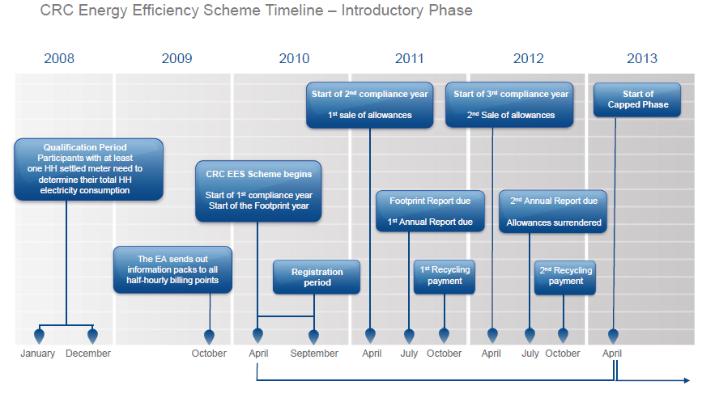
www.decc.gov.uk/en/content/cms/what_we_do/lc_uk/crc/timings/timings.aspx

Slide 13
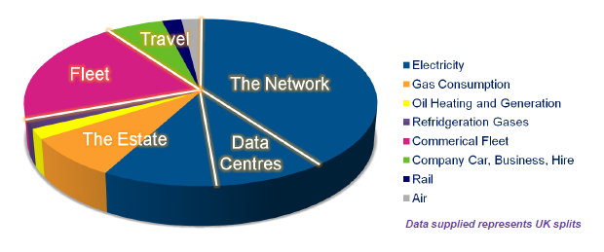
Example: BT

Slide 14
BT
•BT consumes 0.7% of the UK’s total power
•BT have reduced UK carbon footprint by 58%
•BT aims to reduce carbon emissions in UK 80% by 2016
(by comparison with 1996)

Slide 15
BT’s Procurement Principles
•To harness the capability, diversity and innovation of our supply base to add value to our business and encourage suppliers to offer solutions which have a reduced environmental impact.
•That the energy consumption and environmental impact of a product or service (from manufacture, through usage, to disposal) is a mandatory criterion in all tender adjudication.
•That the energy consumption and environmental impact of any replacement product or service (from manufacture, through usage, to disposal) is less than its predecessor.

Slide 16
Greening Data Centres
BT have reduced their 1,500-server data centre down to just over 100 servers, saving £650,000 per year.
The new servers are larger and more energy efficient

Slide 17
The role of IT in carbon emissions reduction
“While the sector plans to significantly step up the energy efficiency of its products and services, ICT’s largest influence will be by enabling energy efficiencies in other sectors, an opportunity that could deliver carbon savings five times larger than the total emissions from the entire ICT sector in 2020.”
SMART 2020: Enabling the low carbon economy in the information age
(A report by The Climate Group on behalf of the Global eSustainability Initiative (GeSI))

Slide 18
Question
The Wet Holiday Company is about to implement an online booking system. Given a 20 person operation in Swansea and 50 staff and associates spread out over the UK and the Mediterranean, what sustainability issues can be incorporated into the project and what risks are faced?

Slide 19
Relevant Industry Standards
ISO14001 Environmental Management Systems
ISO14040, 64/5 - footprinting
WEEE – waste disposals
EPEAT
Energy Star
PAS 2050 – footprinting
EU Datacentre Code of Conduct

Slide 20
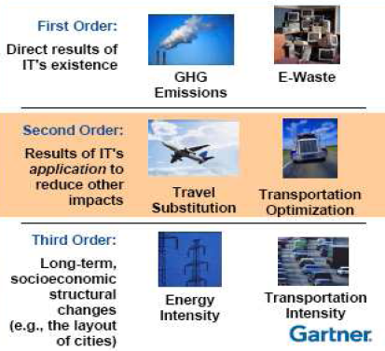
The Impact of IT
The positive benefits of IT’s second order impacts are much larger than the first order impacts.
There is still room for improvement in energy efficiency – this is becoming a standard part of IT project planning

