Slide 1
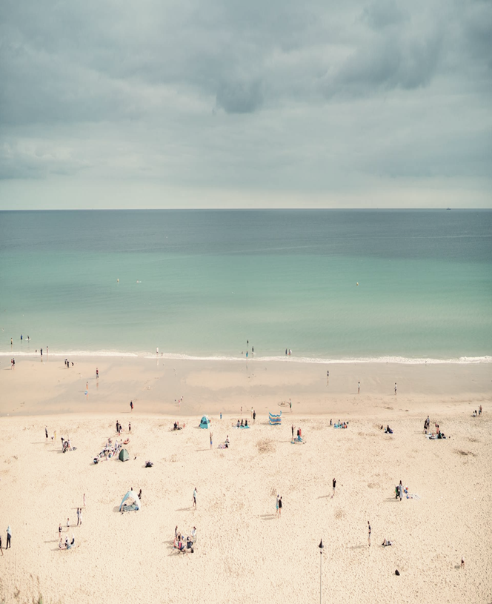
Neath Port Talbot Shoreline: Preserve, Protect, Prepare
Natalie Broadhurst

Slide 2
Agenda
What is sea level rise?
How Sea Level Rise will affect Neath Port Talbot
Tactics
Useful allies
Key stakeholders
Future Initiatives
References.

Slide 3

What is sea level rise and why is it important?

Slide 4
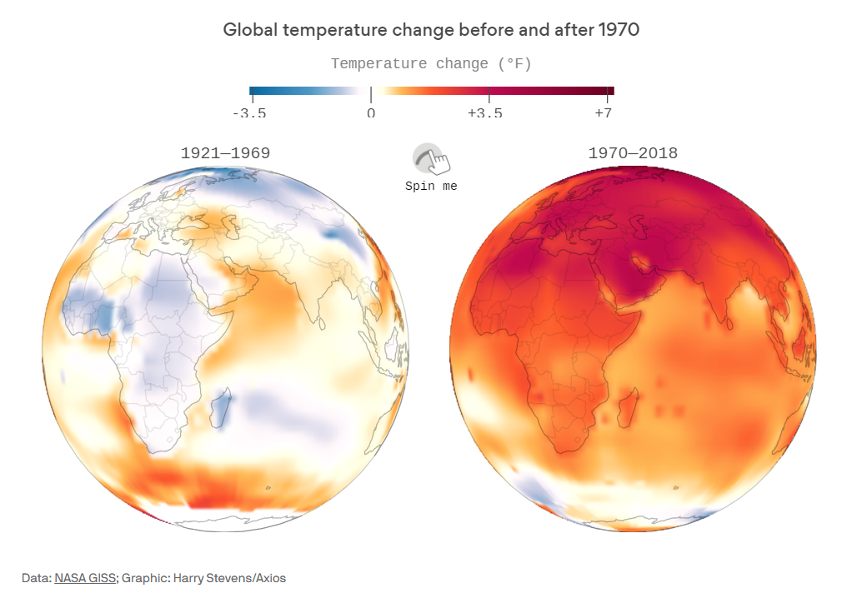
What is sea level rise?
Sea level rise refers to the increase in the average height of the world's oceans. Natural climate changes can occur due to various factors within and beyond Earth's atmosphere. Examples include El Niño, which depends on winds and ocean currents, and the 100,000-year cycles of ice ages linked to changes in Earth's axial tilt and orbital shape. Large meteorite impacts can cause climate change by sending debris into the atmosphere, blocking sunlight, and causing cooling. Plate tectonics also influence climate, as the movement of continental plates affects ocean currents and climate patterns.

Slide 5
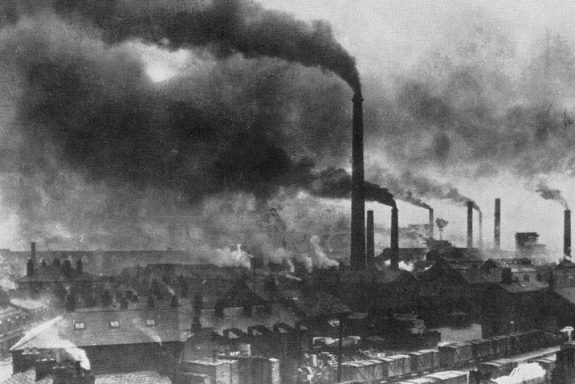
What is sea level rise?
Although our planet experiences natural warming periods, the current rapid warming is primarily driven by human activities. Since the Industrial Revolution, the release of carbon dioxide (CO2) and other greenhouse gases like methane and nitrous oxide has significantly increased. These gases trap heat, causing global warming. This warming leads to ocean expansion and additional water from melting ice sheets and glaciers, contributing to rising sea levels. The Industrial Revolution marked a significant increase in human-induced climate change due to the extensive use of fossil fuels, leading to accelerated global warming and sea level rise.
“Since the 1880s, the average global surface temperature has risen about 2°F (1°C)” Freedman 2019
Chong, A. (2020)

Slide 6

How Sea Level Rise will affect Neath Port Talbot

Slide 7
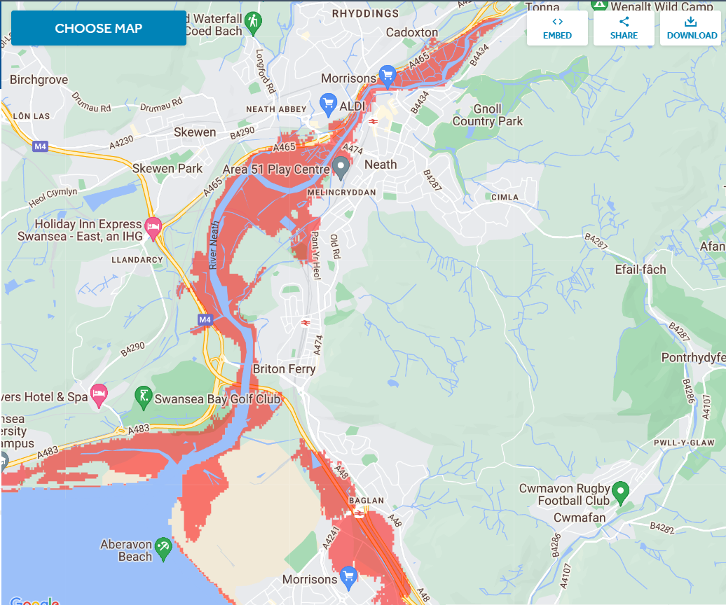
“The UK sea level has been rising by more than a millimetre on average every year since 1901, with the level around Cardiff predicted to rise by up to 28cm by 2050.” (Climate change: How rising sea levels may affect Wales, 2021)
The map by Climate Central projects that by 2050, significant portions of land will be below the annual flood level and face catastrophic flooding.
(Sea level rise map and coastal flood tool — US and global, no date)

Slide 8
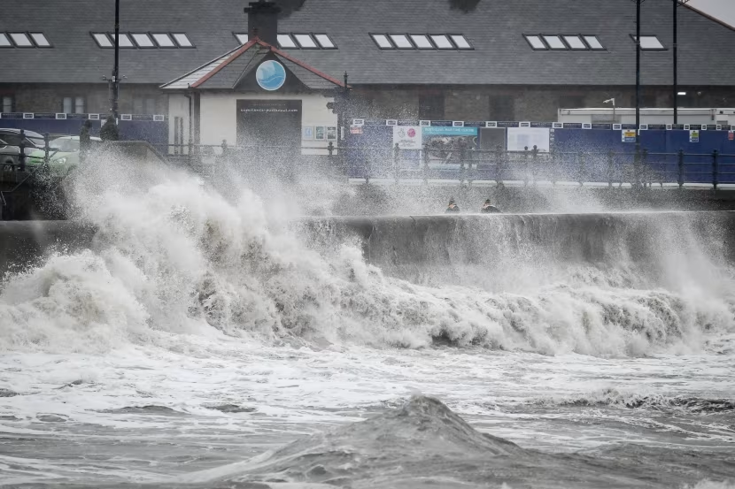
Flooding: Higher sea levels increase the risk of coastal flooding, which can damage homes, infrastructure, and ecosystems.
Erosion: Rising seas contribute to the erosion of coastlines, leading to the loss of land and habitats affecting biodiversity and the services these ecosystems provide.
Salinisation: Increased sea levels can cause saltwater to infiltrate freshwater resources, impacting drinking water supplies and agriculture.
Economic Impact: Coastal communities may face significant economic challenges due to increased costs of flood defences and damage repairs such as the 2020 flood ar canalside.
Displacement: Populations living in low-lying areas may be forced to relocate, leading to social and economic disruptions. As of the 2021 census 142,300 people reside in Neath Port Talbot. (Office for National Statistics, 2022).
(Fenton, 2022)

Slide 9
Campaign Goal
Implement effective measures to protect Neath Port Talbot from the impacts of sea level rise, such as improved coastal defences, sustainable urban planning, and community preparedness.
Neath Port Talbot Shoreline: Preserve, Protect, Prepare

Slide 10
Tactics
Public Awareness Campaign: Develop a comprehensive media strategy to raise awareness about sea level rise and its impacts on our local area. This includes drafting press releases for local newspapers and radio stations to provide information and updates about the campaign. Additionally, create informational pamphlets to distribute at community centres, libraries, and local businesses. These materials should highlight the importance of the issue, the potential impacts on our community, and ways individuals can get involved.
Create an Online Presence: Establish a robust online presence to reach a broader audience. Collaborate with local influencers and environmental advocates to amplify our message across multiple platforms. Create social media accounts on Facebook (including both groups and business pages), Instagram, X (formerly known as Twitter), and LinkedIn. Use these platforms to share updates, educational content, event information, and success stories. Engage with followers through interactive posts, live Q&A sessions, and shareable graphics and videos.
Community Events: Organise a series of community events to engage and educate the public. Plan town hall meetings where experts can speak about sea level rise and its local impacts. Host workshops that teach residents how to protect their homes and communities from flooding. Arrange beach clean ups to demonstrate the immediate benefits of coastal stewardship. Ensure all events are well coordinated by securing venues, arranging speakers, and promoting through our media channels and allies.
Petitions: Launch a petition campaign to gather signatures in support of specific actions, such as enhanced coastal defences or stricter environmental regulations. Utilise online platforms like Change.org to reach a wider audience and make it easy for people to sign and share. Additionally, set up physical petition stations at community events and local businesses to capture signatures from those who may not be online. Regularly update signatories on the progress and impact of their support.

Slide 11

Tactics
Marches and Demonstrations: Plan peaceful marches and demonstrations to visibly show public support for the cause. Organise a march along Aberavon Beach, inviting community members, local leaders, and media to participate. Use these events to raise awareness, gain media coverage, and put pressure on policymakers to take action. Ensure that these events are well organised, safe, and inclusive.
Art and Culture: Partner with local artists to create impactful art installations, murals, and performances that highlight the issue of sea level rise. Organise art exhibitions and cultural events that focus on environmental themes. Use art as a medium to communicate the emotional and social aspects of climate change, making the issue more relatable and urgent. Engage the community in creating collaborative art projects, fostering a sense of ownership and commitment to the cause.
By implementing this multifaceted campaign strategy, we can effectively raise awareness, engage the community, and drive meaningful action to address the pressing issue of sea level rise in our local area.

Slide 12
Useful allies
Create a coalition of allies to coordinate efforts and share resources.
Hold introductory meetings with each group to present my campaign and seek their support.
Regularly update allies on campaign progress and upcoming activities.
Local Schools and Universities: Engage with educational institutions for research support and outreach.
Media outlets: local newspapers and radio stations
Collaborate with local environmental groups & community associations:
Neath Port Talbot Local Nature Partnership
NPT Wildlife
Environment Centre Swansea
Sustainable Wales
Recreational and sports clubs:
Aberavon Surf lifesaving Club.

Slide 13
key stakeholders
Identify specific decision makers responsible for environmental and urban planning policies.
Arrange meetings and/or write formal letters to present my case and advocate for action.
Local Government: Target Neath Port Talbot County Borough Council and planning departments to advocate for coastal defences and sustainable development policies. Request updates on current plans
Regional Authorities: Engage with National Resources Wales to advocate for coastal plans to be implemented and ongoing plans to be completed.
National Representatives: Contact local MPs Carolyn Harris (Neath), Stephen Kinnock (Aberavon) and Welsh Assembly members Jeremy Miles (Neath) and David Rees (Aberavon) to support national policies on climate change mitigation and coastal protection.
Funding Bodies: Approach organisations and governmental bodies that can provide funding for mitigation projects. Sea defence projects are largely funded by the Welsh government.

Slide 14
Future initiatives – Coastal Partners
At present, Neath Port Talbot County Borough Council has stated in their Policy on Flood and Coastal Défense that they aim to "provide an adequate, economically, technically, and environmentally sound approach to providing the flood and coastal defence service." (Policy on flood and coastal defence - Neath Port Talbot Council, no date)
While their objectives have been set, there is no clear evidence of any forthcoming projects. However, they have contributed to the Swansea Bay Coastal Management Scheme.
I propose establishing a public-private partnership to implement these plans. Coastal Partners, working along the Solent, collaborate with five local authorities and carry out various functions to help “protect thousands of homes, businesses, wildlife and infrastructure. Our diverse work includes managing flood and erosion risk, planning and designing new coastal defence schemes, inspecting and maintaining existing defences and working towards a flood resilient future”. (About, no date)

Slide 15
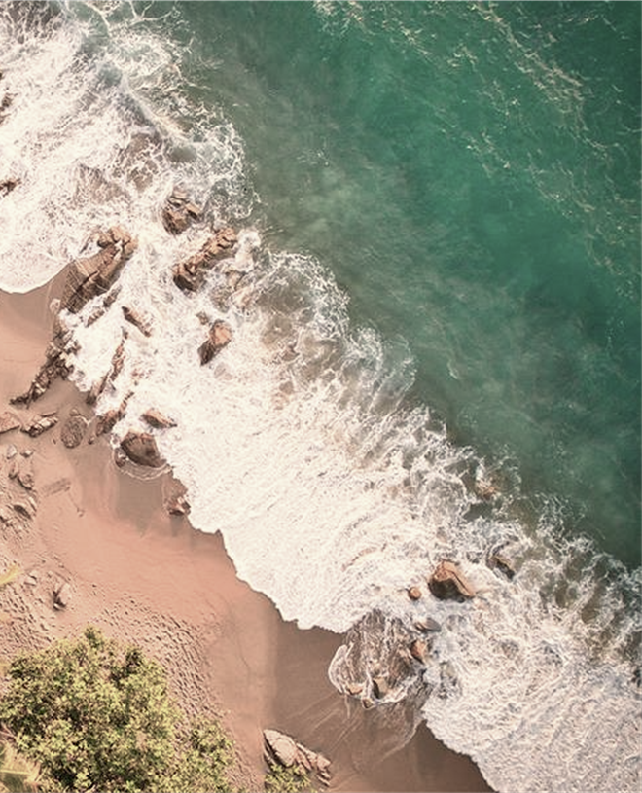
THANK
YOU
Natalie Broadhurst

Slide 16
References
About (no date). https://coastalpartners.org.uk/about/.
Chong, A. (2020) In-depth: Time consciousness and discipline in the Industrial Revolution. https://watchesbysjx.com/2020/07/time-consciousness-and-discipline-industrial-revolution.html.
Climate change: How rising sea levels may affect Wales (2021). https://www.bbc.co.uk/news/av/uk-wales-58830248.
Earth’s changing climate (no date). https://education.nationalgeographic.org/resource/earths-changing-climate/.
Data: NASA GISS; Graphic: Harry Stevens/Axios Climate change visualized: How Earth's temperature has changed since 1970 (axios.com)

Slide 17
References
Fenton, K. (2022) 'Flooding is Wales’ biggest threat from climate change, scientist warns,' ITV News, 15 February. https://www.itv.com/news/wales/2022-02-15/flooding-is-wales-biggest-threat-from-climate-change-scientist- warns.
Freedman 2019 Climate change visualized: How Earth's temperature has changed since 1970 (axios.com)
Office for National Statistics (2022) How the population changed in Neath Port Talbot: Census 2021. https://www.ons.gov.uk/visualisations/censuspopulationchange/W06000012/.
Policy on flood and coastal defence - Neath Port Talbot Council (no date). https://beta.npt.gov.uk/parking-roads-and-travel/flood-and-coastal-defence/policy-on-flood-and-coastal-defence/#contents3.
Sea level rise map and coastal flood tool — US and global (no date). https://coastal.climatecentral.org/map/13/- 3.1571/51.4749/?theme=sea_level_rise&map_type=year&basemap=roadmap&contiguous=true&elevation_model=best_av ailable&forecast_year=2050&pathway=rcp45&percentile=p50&refresh=true&return_level=return_level_1&rl_model=coas t_rp&slr_model=kopp_2014.

