Slide 1
Electromagnetic
Radiation
(ACDC5009)
Lecture - 11

Slide 2
Content
Antenna
Wire antenna
Dipole antenna
Folded Dipole Antenna
Loop Antenna
Helical antenna

Slide 3
Learning Outcome
The student upon completion of the lecture will be able to:
Define an antenna
Describe the types of antenna

Slide 4
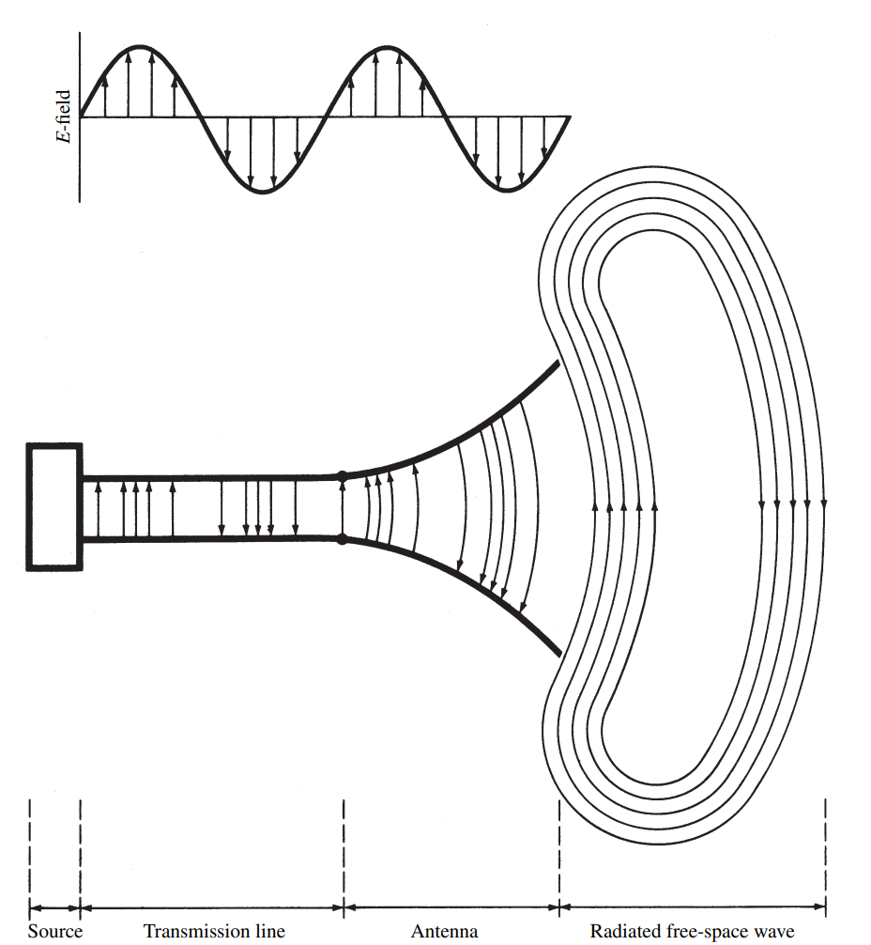
Antenna
Converts electric current into electromagnetic (EM) waves and vice versa.
Used for transmitting and receiving radio waves and microwaves.
Design of antenna varies based on application and frequency range.
Applications: Radio / TV broadcasting, wireless networks, radar, satellite communication.

Slide 5
Antenna
When the antenna and transmission line are not impedance matched, part of the signal is reflected back instead of being transmitted.
These reflected waves combine with the incoming waves, forming standing waves along the transmission line.
Standing waves cause uneven power distribution, leading to energy being stored instead of radiated.
As a result, power loss increases and system efficiency decreases.
Proper impedance matching reduces reflections and improves power transfer.

Slide 6
Types of Antenna
Antennas can be classified based on their physical structure, operating frequency, directional characteristics, polarisation, and application.
Physical Structure:
Based on the Physical structure antennas are classified as
Wire antennas
Aperture antennas
Reflector antennas
Lens antennas
Micro strip antennas
Array antennas

Slide 7
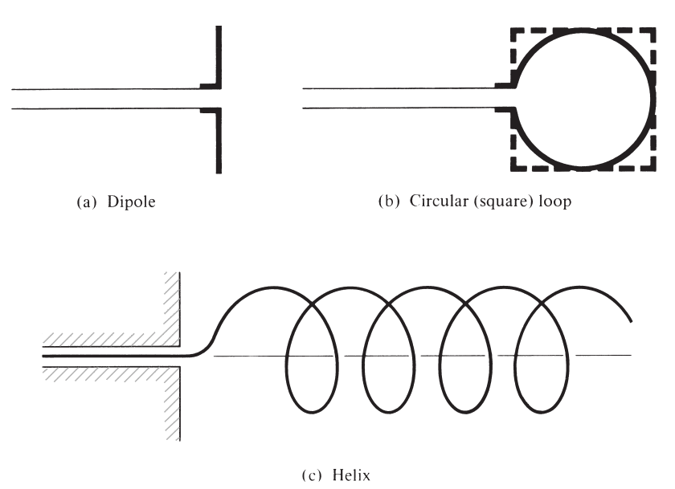
Wire Antenna
Uses conductive wires to transmit and receive RF signals
Converts electric current → electromagnetic waves
Radiation produced by electric and magnetic field interaction
Common types: Dipole, Loop, Helical
Simple, low-cost, and easy to construct

Slide 8
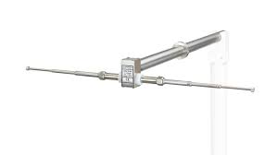
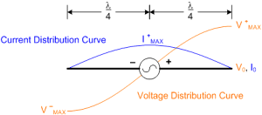
Dipole antenna
Consists of a straight conductive wire divided into two equal halves.
The two halves extend in opposite directions from the centre.
The centre is the feed point, where the antenna connects to the transmission line.
Feeding at the centre gives lower impedance and efficient power transfer.
At Resonance
Current: Maximum at centre, minimum at ends
Voltage: Minimum at centre, maximum at ends

Slide 9
Dipole antenna
Most efficient when length is λ/2 (or odd multiples of λ/2)
At resonance, provides maximum radiation efficiency.
Exhibits good impedance matching with the transmission line.
Characteristics impedance ≈ 73 Ω.
Impedance matching reduces reflections and improves power transfer.

Slide 10
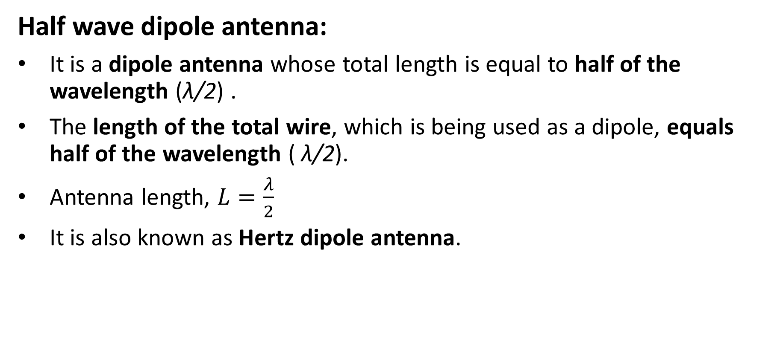
Wire Antenna – Half wave dipole Antenna
Half wave dipole antenna:
It is a dipole antenna whose total length is equal to half of the wavelength (λ/2) .
The length of the total wire, which is being used as a dipole, equals half of the wavelength ( λ/2).
Antenna length, $L=\frac{λ}{2}$
It is also known as Hertz dipole antenna.

Slide 11
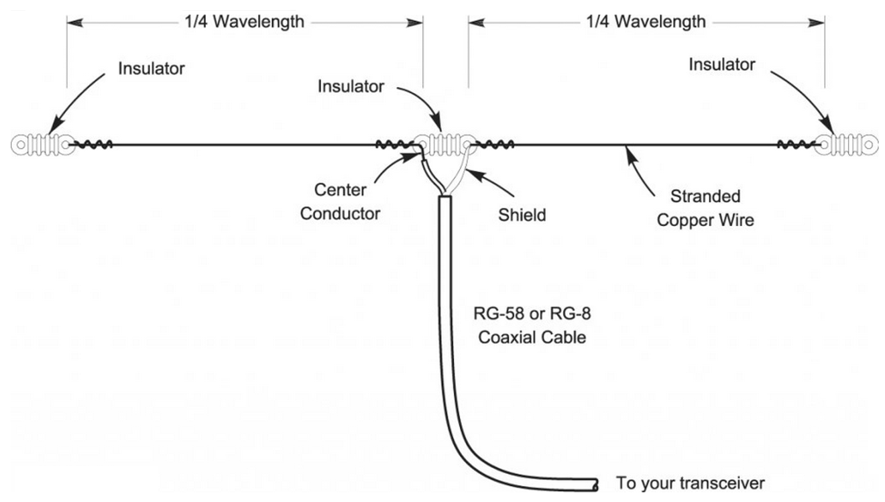
Wire Antenna – Half wave dipole Antenna
Fringing fields refer to the electric and magnetic field lines that extend beyond the physical boundaries of an antenna or conductor.
The presence of fringing fields influences the effective length and input impedance of the dipole antenna, requiring impedance matching for efficient power transfer.

Slide 12
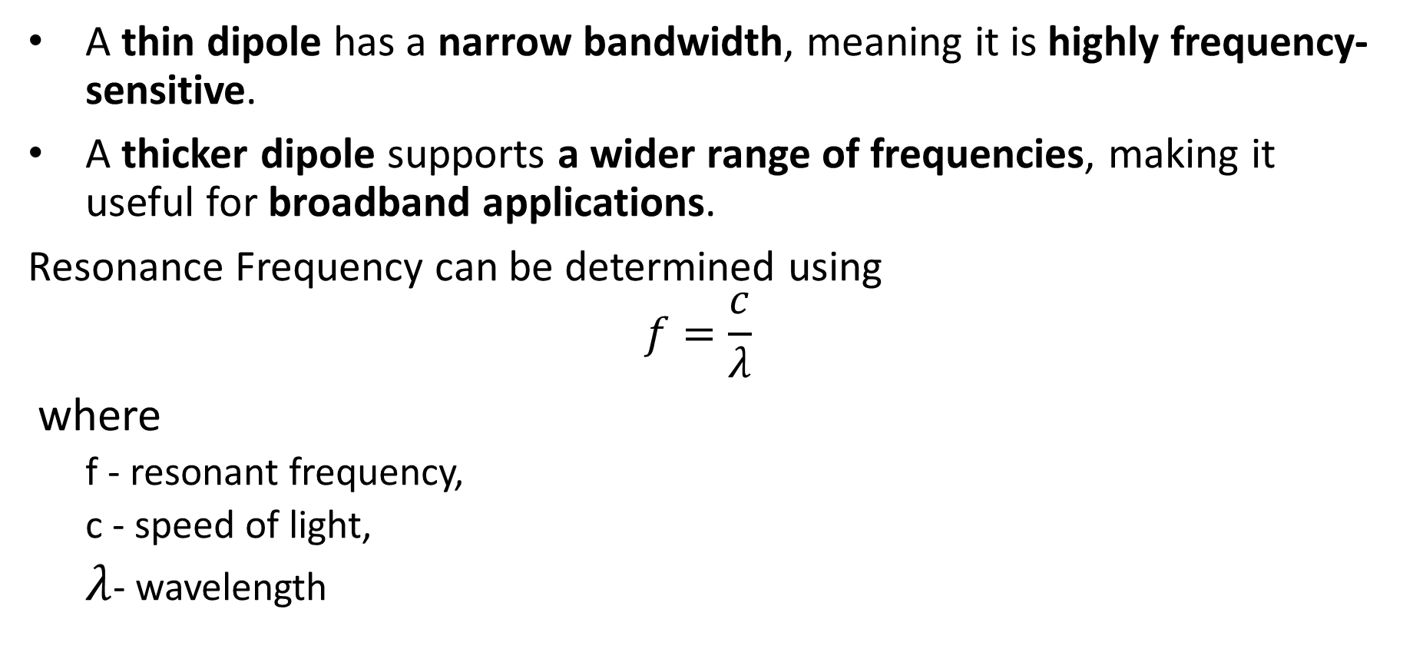
Wire Antenna – Half wave dipole Antenna
A thin dipole has a narrow bandwidth, meaning it is highly frequency-sensitive.
A thicker dipole supports a wider range of frequencies, making it useful for broadband applications.
Resonance Frequency can be determined using
$$f=\frac{c}{λ}$$
where
  f - resonant frequency,
  c - speed of light,
  $λ$- wavelength

Slide 13
Wire Antenna – Half wave dipole Antenna
The directivity of a half-wave dipole is 2.15 dBi, where "i" represents isotropic radiation.
Directivity describes the antenna's ability to concentrate radiated power in a particular direction.
Ideal for applications requiring uniform signal coverage around the antenna.
Horizontal dipole → Produces horizontally polarised waves.
Vertical dipole → Produces vertically polarised waves.

Slide 14
Join the Vevox session
Go to vevox.app
Enter the session ID: 144-109-815
Or scan the QR code

Slide 15
Radiation Pattern
Radiation Pattern:
The energy radiated by an antenna is represented by the Radiation pattern of the antenna.
Radiation Patterns are graphical representations of the distribution of radiated or received Electromagnetic energy, as a function of direction.
It provides a visual display of how an antenna distributes its radiated power in different directions and helps in understanding their performance.
It is also known as an antenna pattern.

Slide 16
Radiation pattern
A radiation pattern provides a graphical representation of how an antenna radiates electromagnetic energy in space.
The types of radiation pattern are:
Isotropic Radiation Pattern
Omnidirectional Radiation Pattern
Directional (or Beam) Radiation Pattern

Slide 17
Radiation pattern
Isotropic Radiation Pattern:
Radiates uniformly in all directions with equal intensity.
The radiation pattern is spherical with no preferred direction.
Practical isotropic radiation is impossible as all antennas exhibit some directivity.
Omnidirectional Antenna strives to mimic isotropic radiation, providing 360-degree coverage in a specific plane.
The performance of real antennas is often compared to isotropic radiation to assess their radiation pattern improvement.

Slide 18
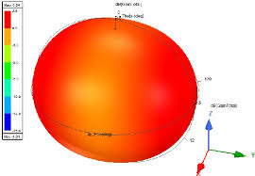
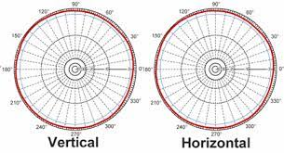
Isotropic Radiation Pattern
Isotropic radiation:

Slide 19
Omnidirectional Radiation Pattern
Omnidirectional Radiation Pattern:
These antennas Radiates or receives signals equally in all directions within a specific plane.
Radiation Pattern resembles a donut shape when viewed in 3D.
Advantage: Ideal for applications requiring signal reception or transmission from multiple directions without reorienting the antenna.

Slide 20
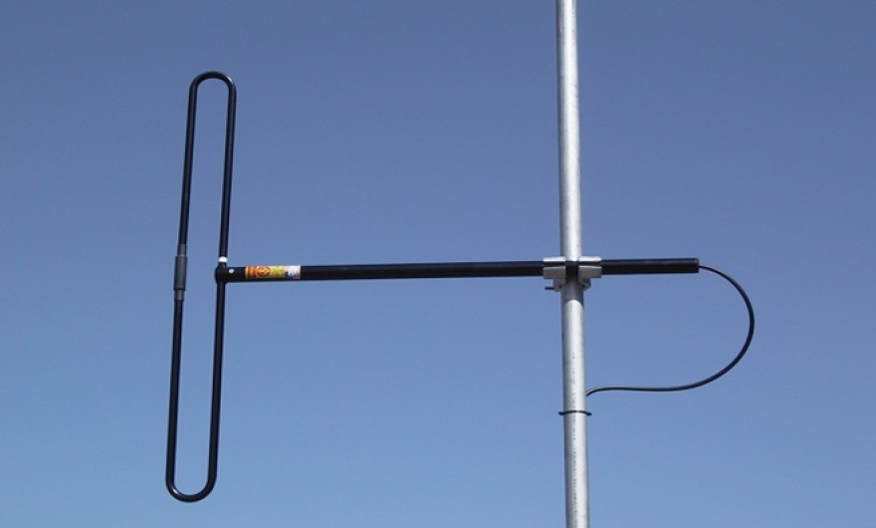
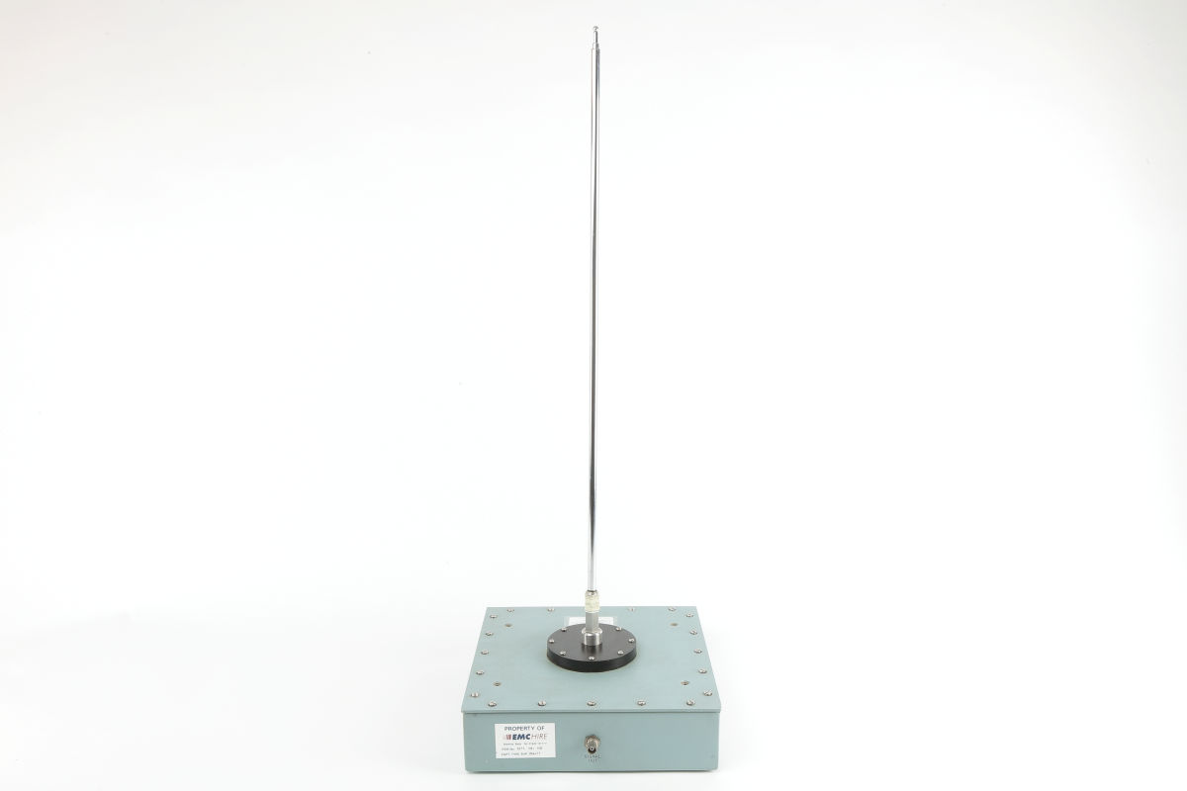
Omnidirectional Radiation Pattern
The antenna which exhibits these pattern have low gain and directivity, as gain and directivity is a measure of ability to concentrate radiation in a specific direction.
Monopole antennas, dipole antennas, etc. exhibit this radiation pattern.
Used in application like FM radio and TV broadcasting towers, where signals need to reach a wide audience in various directions

Slide 21
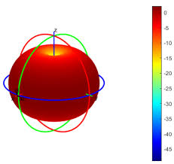
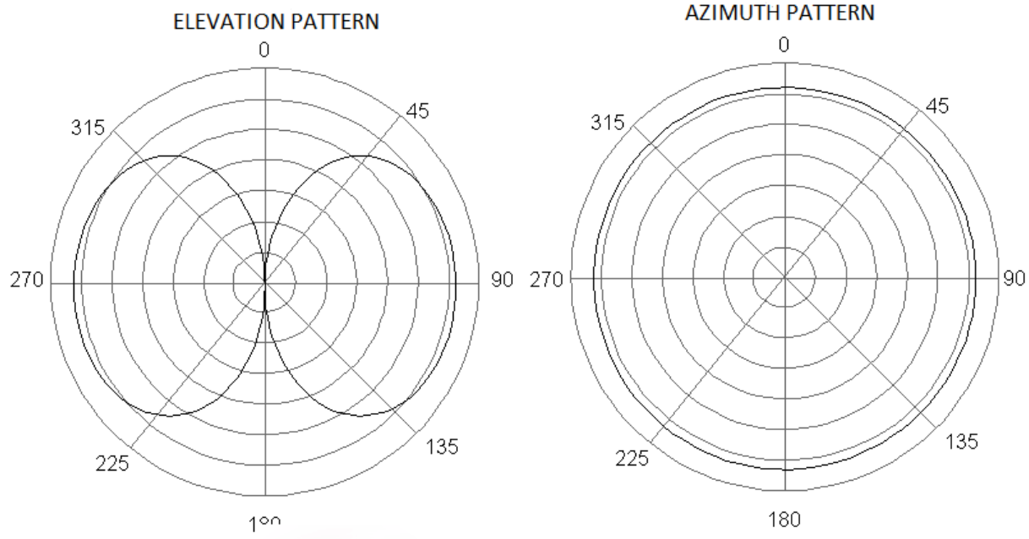
Omnidirectional Radiation Pattern

Slide 22
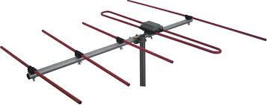
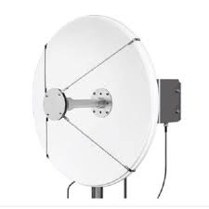
Directional (or Beam) Radiation Pattern
Directional (or Beam) Radiation Pattern:
Directionals antennas focuses energy in specific directions, enhancing signal strength in desired areas.
Provides high gain, directivity, and coverage while minimising interference.
Antennas: Yagi-Uda, Parabolic, Horn, and Log-Periodic antennas.
Used in satellite communication, radar, point-to-point links, and wireless networks.
Critical for applications needing precise coverage and controlled signal direction.

Slide 23
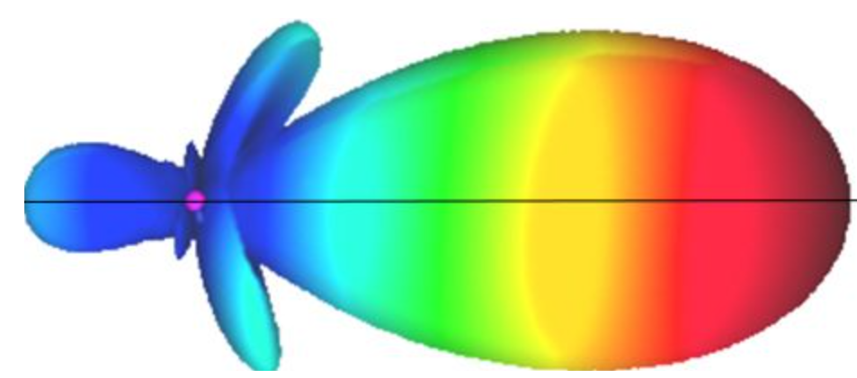
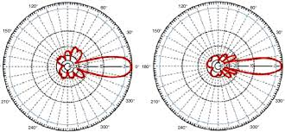
Directional (or Beam) Radiation Pattern
Directional (or Beam) Radiation Pattern:

Slide 24
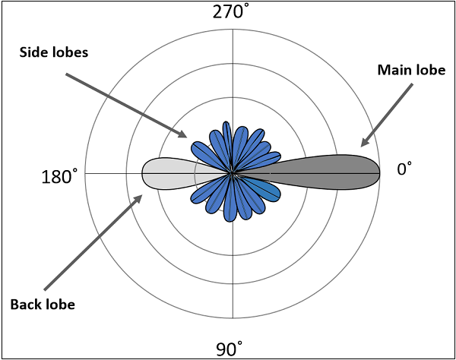
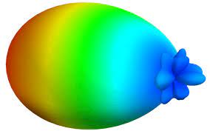
Radiation Pattern
Radiation Pattern:

Slide 25
Radiation Pattern
Main Lobe:
The main lobe is the central and the strongest lobe in the radiation pattern. It represents the primary direction in which the antenna radiates or receives energy.
Side Lobes:
Additional lobes that exist beside the main lobe.
Represent energy radiated in undesired directions.
Should be minimised to concentrate most of the energy in the main lobe.
Formed due to interference and diffraction effects caused by the physical structure and geometry of the antenna.

Slide 26
Radiation Pattern
Back Lobe:
Located in the opposite direction to the main lobe.
It represents energy radiated or received in the direction opposite to the intended radiation.
Caused by reflections, scattering, or imperfections in the antenna structure, leading to secondary radiation in the opposite direction.

Slide 27
Radiation Pattern
Nulls:
Regions in the radiation pattern where the signal strength is at a minimum.
These are areas where the antenna has poor sensitivity or does not radiate much energy.
Formed due to the wave cancellation due to destructive interference.

Slide 28
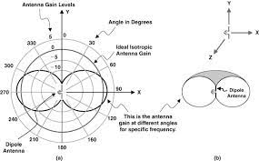
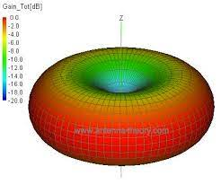
Wire Antenna – Half wave dipole Antenna
Radiation Pattern:
The radiation pattern of this half-wave dipole is Omni-directional in the H-plane.

Slide 29
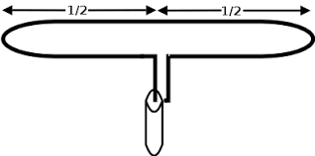
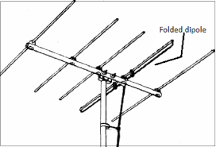
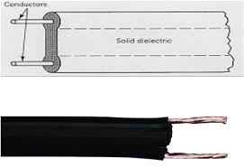
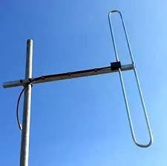
Wire Antenna –folded dipole Antenna
A folded dipole consists of two parallel conductors connected at both ends, fed at the center.
A half-wave folded dipole is commonly used in antenna arrays like Yagi-Uda.
Increases electrical length and improves impedance matching with transmission lines.
Provides a 300-ohm impedance, ideal for twin-lead transmission lines.
Maintains a radiation pattern similar to a half-wave dipole.
Offers good directivity of 2.15 dBi, making it efficient in antenna applications.

Slide 30
Wire Antenna –Loop Antenna
A loop antenna is a closed conductor (wire or metal strip) that carries radio frequency (RF) current and radiates electromagnetic waves.
Loop antennas are of two types.
  Large loop antennas
  Small loop antennas

Slide 31
Wire Antenna –Loop Antenna
Large Loop Antennas
Also known as resonant loop antennas (operates near resonance frequency).
Perimeter of the loop is approximately equal to the wavelength:L ≈ λ (L = perimeter of loop)
Higher radiation efficiency compared to small loop antennas.
Large loops have high directivity, useful for directional transmission.
Impedance is around 100 to 300 ohm

Slide 32
Wire Antenna –Loop Antenna
Small loop antennas
Also known as magnetic loop antennas.
perimeter much smaller than a wavelength (typically L ≪ λ, often ≈ λ/10)
Can be tuned to resonance using capacitors.
Has low radiation efficiency due to high resistive losses.
High reactance makes impedance matching difficult
Commonly used as receiver antennas.

Slide 33
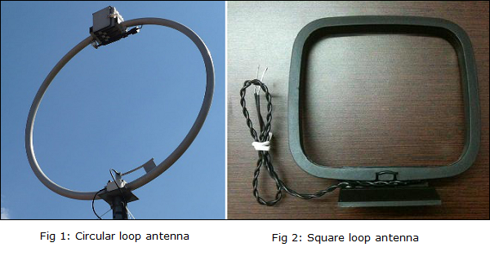
Wire Antenna –Loop Antenna
Small loop antennas are mainly of two types −
  Circular loop antennas
  Square loop antennas
These two types of loop antennas are mostly widely used. Other types (rectangular, delta, elliptical etc.) are also made according to the designer specifications.

Slide 34
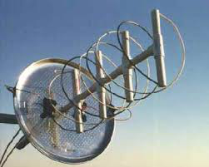
Wire Antenna –Helical Antenna
Conductive wire wound in a helical (spiral) shape.
Typically mounted on a cylindrical or conical support.
Fed using a transmission line with ground plane.
Produces circularly polarised waves.
Widely used in satellite and space communication

Slide 35
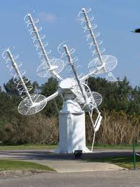
Wire Antenna –Helical Antenna
They can achieve moderate to high gain, especially when designed for directional applications.
The gain is influenced by factors such as the number of turns in the helix, the diameter of the helix, and the spacing between turns.
Helical antennas can be designed for VHF and UHF.
Multiple helical antennas can be arranged in an array to achieve higher gain and directivity, commonly used in satellite communication and tracking systems.

Slide 36
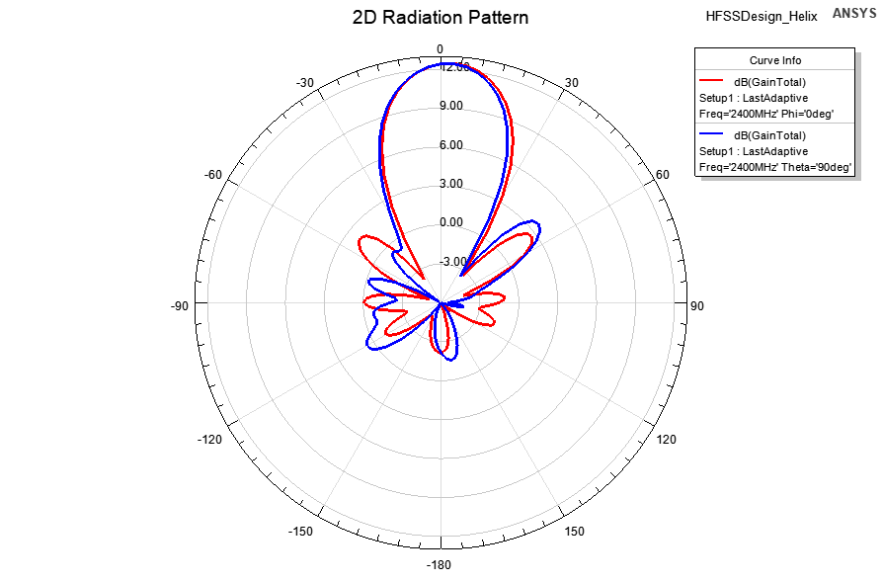
Wire Antenna –Helical Antenna

Slide 37
S-Parameters
S-parameters stands for Scattering parameters.
It says how signals are scattered, transmitted, and reflected.
S-parameters directly describe the transmission and reflection properties of a network.
S-parameters are essential for characterising and designing components like amplifiers, filters, antennas, and other RF/microwave devices.

Slide 38
Reference
[1] C. A. Balanis, Antenna Theory: Analysis and Design, 4th ed.
Hoboken, NJ, USA: John Wiley & Sons, 2016.
[2] J. D. Kraus and R. J. Marhefka, Antennas: For All Applications, 3rd ed.
New York, NY, USA: McGraw-Hill, 2002.
[3] S. R. Saunders and A. Aragón-Zavala, Antennas and Propagation for Wireless Communication Systems, 2nd ed. Chichester, UK: John Wiley & Sons, 2007.

Slide 39

Thank You
Module Descriptor

