Slide 1
Transducers and Signal Conditioning
ACDA5006
Steve Mosey

Slide 2
Signal Conditioning
Signal conditioning is the process of preparing signals from sensors to make them easier to use.
Can include
  Excitation
  Amplification / attenuation
  Level shifting
  Filtering
  Over voltage protection / Isolation

Slide 3
Excitation
Many transducers, like strain gauges and RTDs (resistance temperature devices), need a power supply.
For many transducers the supply will be low voltage DC, but for transducers based on capacitance measurement an AC supply may be required.
Excitation is commonly needed for measuring force, pressure, relative humidity, temperature, level, light level and vibration

Slide 4
Amplification / Attenuation
Amplification increases a voltage signal to a level suitable for digitisation by the DAQ equipment.
Typically a data acquisition device is calibrated for input voltages in the 0 to 10 V range.
A small voltage, such as that coming from a thermocouple or strain gauge bridge may need to be amplified 1000 times to make it between 0 and 10 V.
If your signal is larger than the maximum input range then you will have to divide the signal down using a resistor network.

Slide 5
Level shifting
Sometimes the voltage signal from a sensor will not be in the correct range for the processor
Level shifting amplifiers can correct for this
An adjustable DC voltage is added to the signal to move the signal to the correct range

Slide 6
Filtering
Filtering reduces noise and errors in the signal.
For most applications a low-pass filter is used. This allows through the lower frequency components but attenuates the higher frequencies.
The filter’s cut-off frequency must be compatible with the frequencies present in the actual signal and the sampling rate used for the A-D conversion.
A low-pass filter that's used to prevent higher frequencies, in either the signal or noise, from introducing distortion into the digitised signal is known as an anti-aliasing filter. These generally have a sharper cut-off than the normal low-pass filter used to condition a signal.
Anti-aliasing filters are specified according to the sampling rate of the system and there must be one filter per input signal.

Slide 7
Over voltage protection
There is always a chance that something could go wrong with a transducer and a high voltage is presented to your DAQ potentially damaging it.
Zener diodes can be used to clamp dangerous voltages, protecting the circuitry

Slide 8
Order
The order of signal conditioning steps will vary from system to system, not all steps are in every system.
The usual order is:
Sensor
Over voltage protection
Level Shifting
Amplification
Anti-aliasing Filter
Data Acquisition

Slide 9
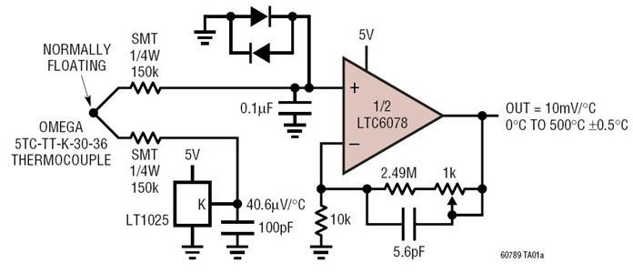
Example – Thermocouple signal conditioning
Over Voltage Protection
Amplification and
Low pass filtering
http://www.analog.com/en/design-center/reference-designs/circuit-collections/type-k-thermocouple-signal-conditioner-with-190v-protection-from-accidental-contact-and-cold.html#cc-overview

Slide 10
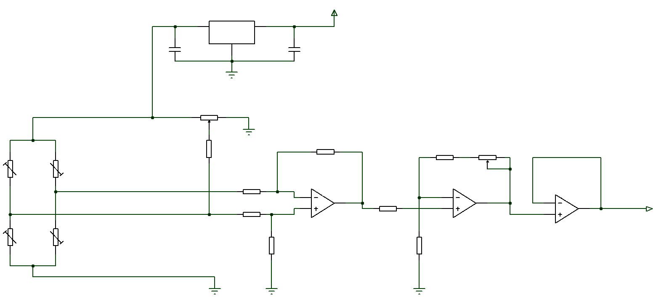
Example – Wheatstone bridge
Excitation
Wheatstone
Bridge
Level shift
Amplification

