Slide 1
Day 1
Leadership in the Third Sector
Lecturers: Julie Crossman
Steve Darnell

Slide 2
Learning Outcomes
Evaluate a range of leadership theories and relate to the workplace (4)
Critically evaluate a range of leadership theories and styles and their relevance to the workplace (7)

Slide 3


Slide 4





Leadership and management differentiation activity
Activity:
Differentiate between:
leadership
management

Slide 5

Leadership/Management

Slide 6
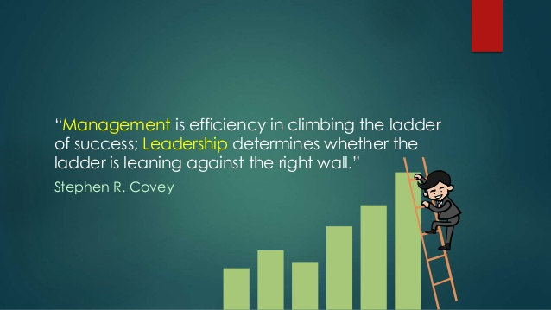

Slide 7
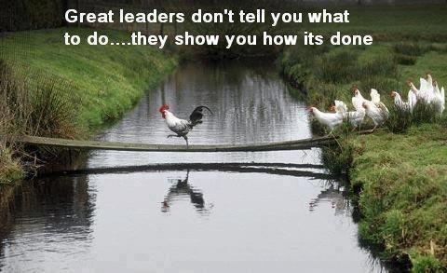
Leadership / Management

Slide 8
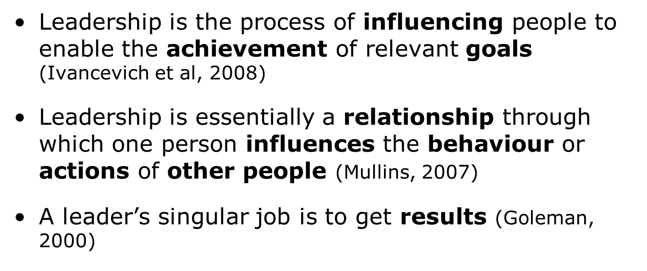
Leadership Defined

Slide 9
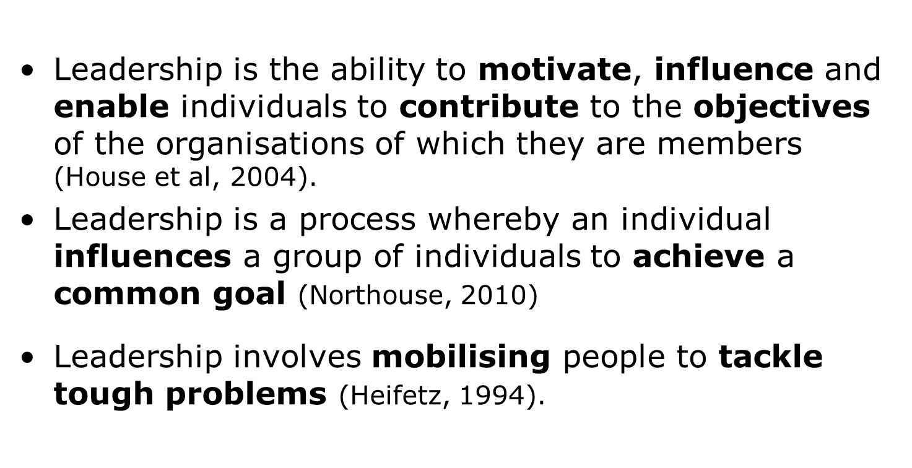
Leadership Defined

Slide 10
Leadership Defined
Leadership is not about making clever decisions and doing bigger deals, least of all for personal gain. It is about energising other people to make good decisions and do other things. In other words, it is about helping release the positive energy that exists naturally within people. Effective leadership inspires more than empowers; it connects more than controls; it demonstrates more than it decides. It does all of this by engaging, itself above all, and consequently others (Mintzberg, 2004).

Slide 11
Leadership Defined
According to Crainer (1995), there are over 400 definitions of leadership and ‘it is a veritable minefield of misunderstanding and difference through which theorists and practitioners must tread warily’.

Slide 12
Close relationship between management and leadership
‘Increasingly, management and leadership are being seen as inextricably linked. It is one thing for a leader to propound a grand vision, but this is redundant unless the vision is managed so it becomes real achievement.’
Sir John Harvey-Jones

Slide 13

Managers manage:
Resources
Information
People

Slide 14
Subject | Leader | Manager
Essence | Change | Stability
Focus | Leading people | Managing work
Have | Followers | Subordinates
Horizon | Long-term | Short-term
Seeks | Vision | Objectives
Approach | Sets direction | Plans detail
Decision | Facilitates | Makes
Power | Personal charisma | Formal authority
Appeal to | Heart | Head
Energy | Passion | Control
Dynamic | Proactive | Reactive

Slide 15
Subject | Leader | Manager
Persuasion | Sell | Tell
Style | Transformational | Transactional
Exchange | Excitement for work | Money for work
Likes | Striving | Action
Wants | Achievement | Results
Risk | Takes | Minimises
Rules | Breaks | Makes
Conflict | Uses | Avoids
Direction | New Roads | Existing roads
Truth | Seeks | Establishes
Concern | What is right | Being right
Credit | Gives | Takes
Blame | Takes | Blames

Slide 16
Are leaders born not made?
Trait theory:
Early research was based on the inherent characteristics or traits of leaders (Carlyle, 1841)
Ghiselli (1971) – researched personality traits – supervision, intelligence, decisiveness
Fiedler (1971) – studied personality and intelligence traits – perception, psychological distance
However, generally, trait theories assume that good leaders have the right combination of traits
Criticism is that a number of studies have been conducted with little agreement on a definitive list

Slide 17
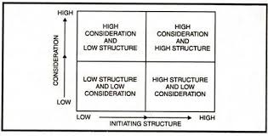
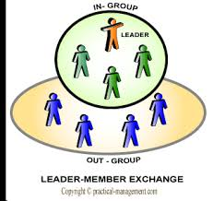
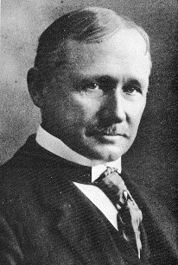
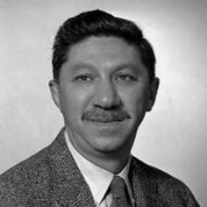

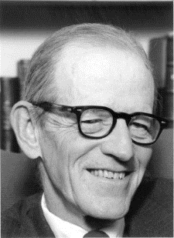
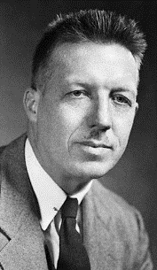
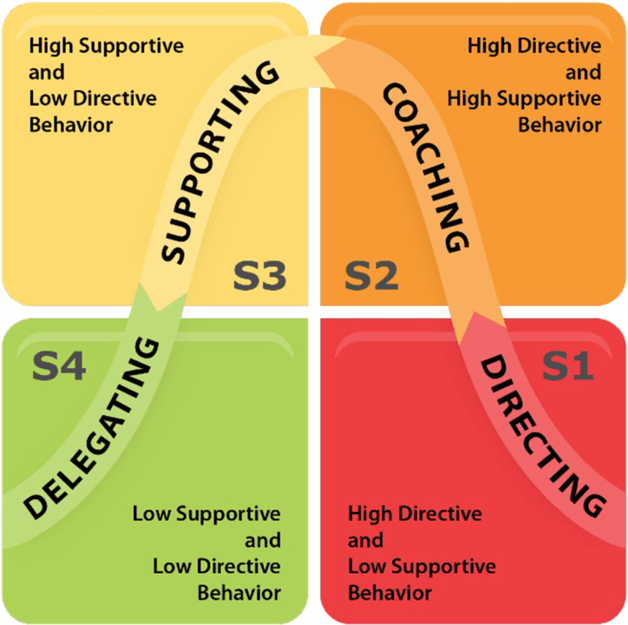

Timeline of Leadership
Taylor
Scientific management
Maslow
Human relations
Relational
Behavioural
1911
1943
1940’s-today
1990’s
1932
1960
1960’s-80’s
2000-today
Emerging
Mayo
Human relations
McGregor
Hersey & Blanchard
Situational
Human Resources

Slide 18
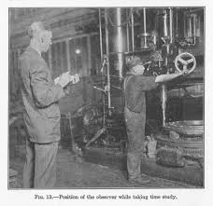
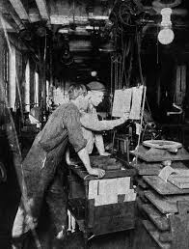
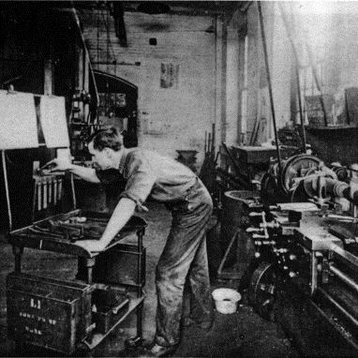
Scientific Management
Time and motion studies
Written tasks and methods
Job analysis

Slide 19
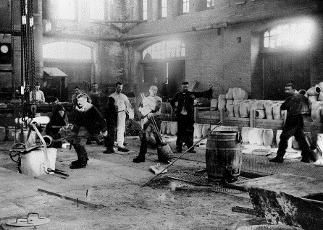
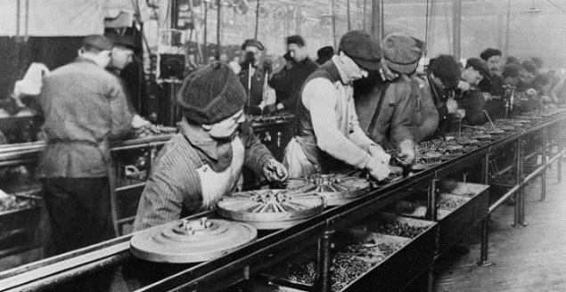
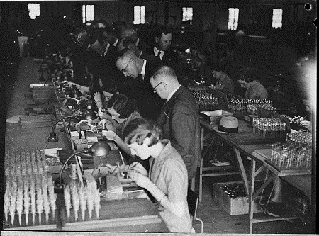
Scientific Management
Individualisation of work
Motivation through ‘high wages’
The ‘one best way’

Slide 20
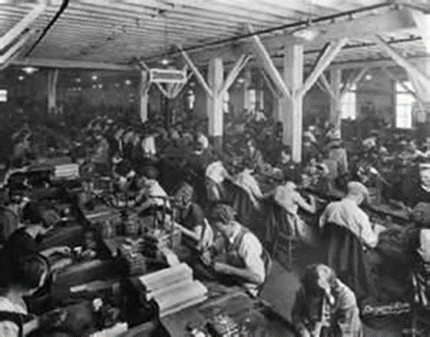
Leadership and management in context:
Human Relations approach
A focus on the needs of the workers
1920s-1930s
Notes:
Frederick Taylor´s Scientific management theory's research showed people worked purely for money. In the car assembly industry, work on a production line was based on high productivity and was repetitive. Workers were paid 'piece rate', that is, paid for every item produced. This approach of paying workers by results would be good for the business. The outcome would be greater production but gave little opportunity, encouragement or time for employees to think for themselves or be creative in what they did. This limited people's development and their use within the company.
"One of the dangers to be guarded against, when the pay of the man or woman is made in any way to depend on the quantity of the work done, is that in the effort to increase the quantity the quality is apt to deteriorate."(Taylor, 1911)
This concludes that if only pay is manipulated by workers receiving more money for higher productivity the quality of the service or product will decrease.
Frederick Taylor (1856-1915)

Slide 21

Human Relations approach
Activity
Hawthorne experiment case study
Group work

Slide 22
Human Resources approach
  Popular in the late 1950s through the 1960s
  Based on the work of Douglas McGregor (The Human Side of Enterprise, 1960), Rensis Likert (New Patterns of Management, 1961), and Chris Argyris (Personality and Organization, 1957)

Slide 23

Human Resources approach:
Douglas McGregor
  McGregor proposed that managers come in two types:
  Theory X managers who believe that workers are generally lazy and must be forced to be productive
  The Theory Y manager believes that staff want to better themselves, to develop new skills and gain knowledge.
  This, of course, was the example of the ‘one best way’ to lead

Slide 24
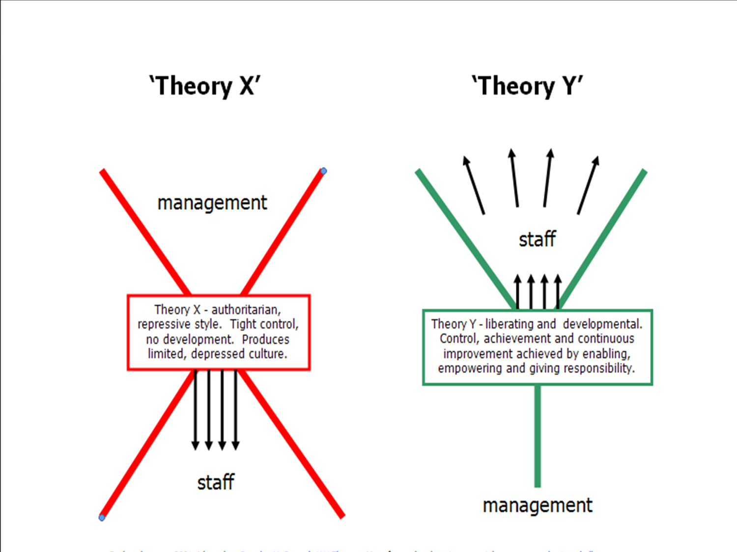
McGregor’s Theory X Theory Y (1960)

Slide 25
Comparison between Human Relations and Human Resources approach
  Human relations approach - Improve the worker-manager relationship. This will lead to a satisfied worker. A satisfied worker will be a more productive worker.
  Human resources approach - When managers treat their workers as valuable resources and help them improve their skills and knowledge, this helps the worker perform better. This in turn increases worker job satisfaction.

Slide 26
Ohio State University Research
A series of studies at the University indicated that two behavioural dimensions play a significant role in successful leadership. Those dimensions are:
Consideration – (friendship, mutual trust, respect and warmth)
Initiating Structure – (organises and defines relationships or roles, establishes well-defined patterns of organisation, channels of communication, and ways of getting jobs done.)
www.stewart-associates.co.uk/leadership-models.aspx

Slide 27
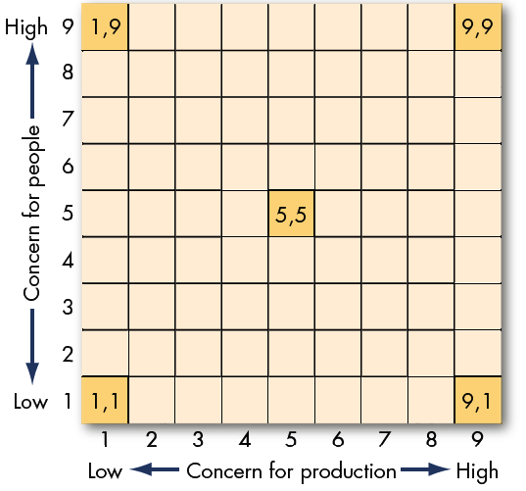
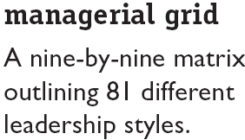
The Managerial Grid
(Blake and Mouton)

Slide 28

Activity
Identify your Leadership/Management Style by completing the questionnaire(s)

