Slide 1
Running Order
15th January 2026
ALL TIMINGS APPROXIMATE
1-2pm SR/meta-analysis and discussion of
automating evidence synthesis - Prof Philip Scott
2-2:15 Break
2:15-3 Clinical Decision Support (CDS) – An Overview - Dr Edward Conley
3-3:20 CDS Exercise
3:20-3:30 Q&A on "Critical analysis of decision support” assignment

Slide 2

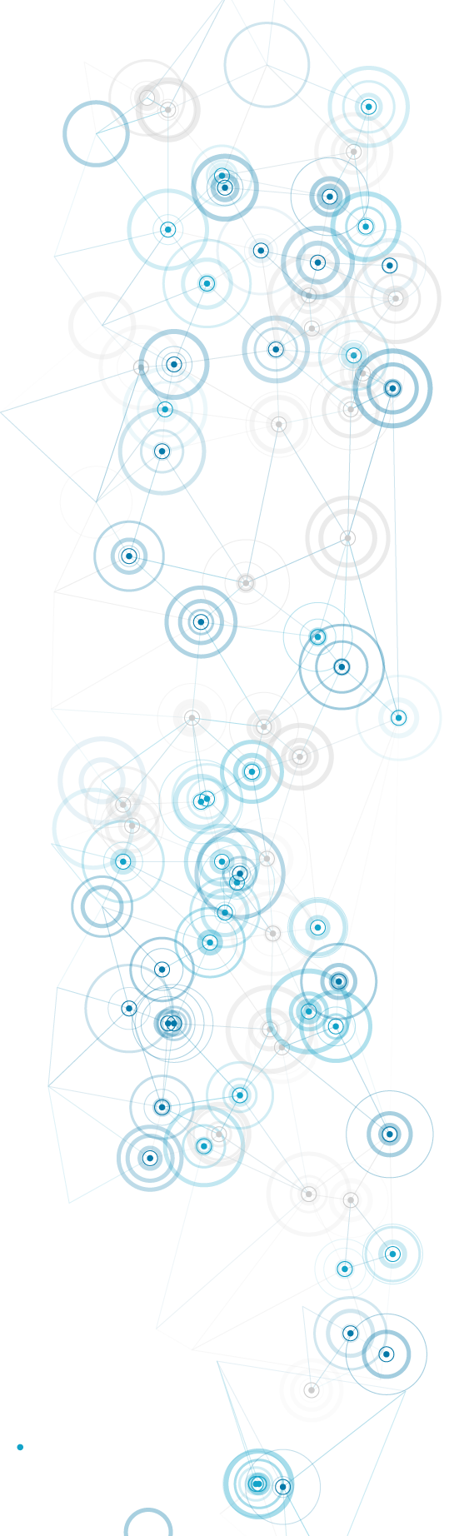


The Digital Professional for Health and Care
BMDS7003
Clinical Decision Support (CDS) –
An Overview
Dr Ed Conley BSc PhD

Slide 3
Learning Objectives
1 - Understand what clinical decision support (CDS) is (interchangeably used with healthcare decision support).
2 - Comprehend the range of healthcare scenarios where CDS has been attempted/implemented.
3 - Know about some key developments in the history of CDS.
4 - Know about the “six grand challenges” still facing CDS.
5 - Be able to outline the potential for cost-savings and quality improvements that CDS could enable.

Slide 4
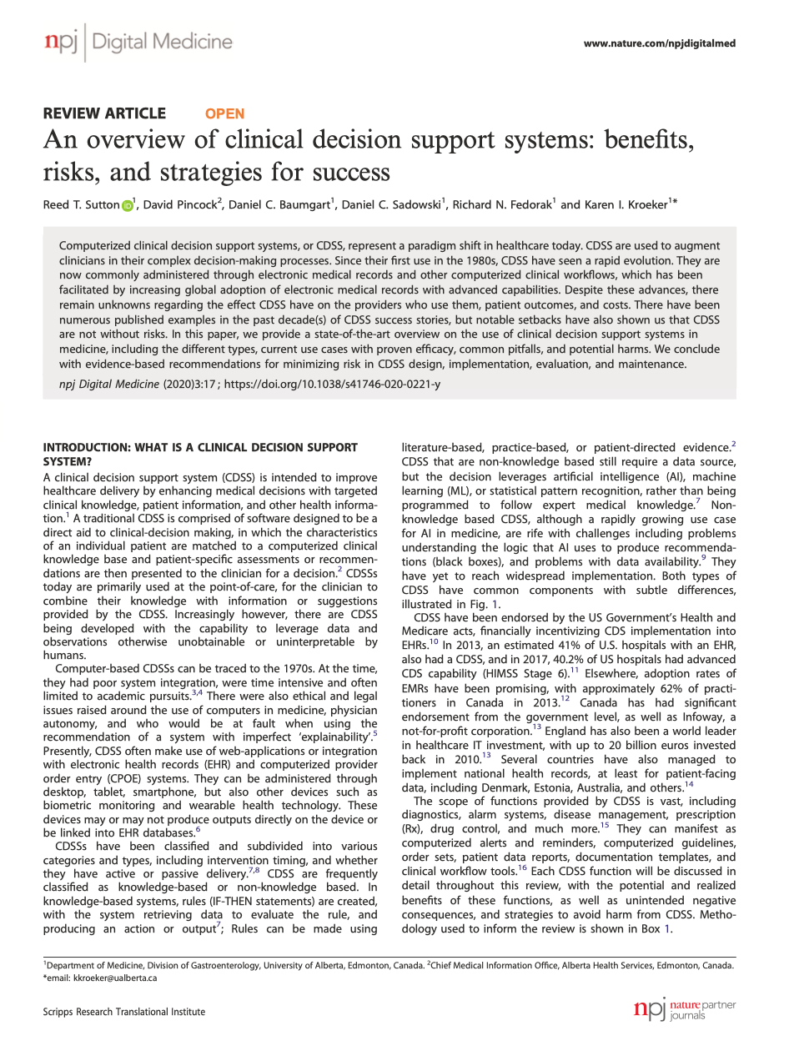
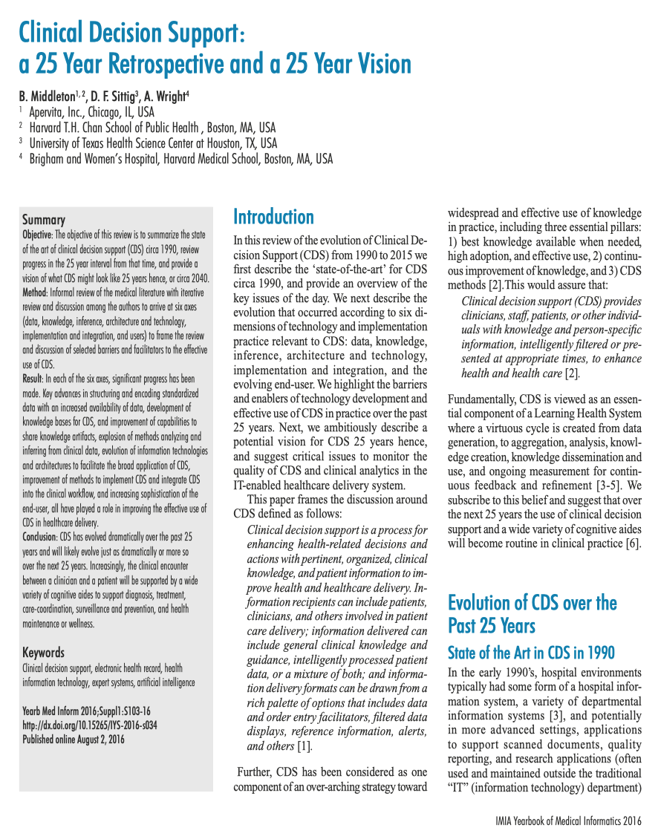
What is Clinical Decision Support (CDS)?
You should be aware of these two broad perspective papers
Sutton et al (2022)
Middleton et al (2014)

Slide 5


What is CDS?
A simple
overview
A DEFINITION
“A process for enhancing health-related decisions and actions with pertinent, organized, clinical knowledge, and patient information to improve health and healthcare delivery”.
WHO CAN USE IT?
- patients, clinicians, and others involved in patient care delivery
WHAT DOES IT DELIVER?
- general clinical knowledge and guidance
- intelligently processed patient data (or both)
SOME SIMPLE EXAMPLES
- filtered data displays
- reference information
- alerts
- domain specialist apps

Slide 6
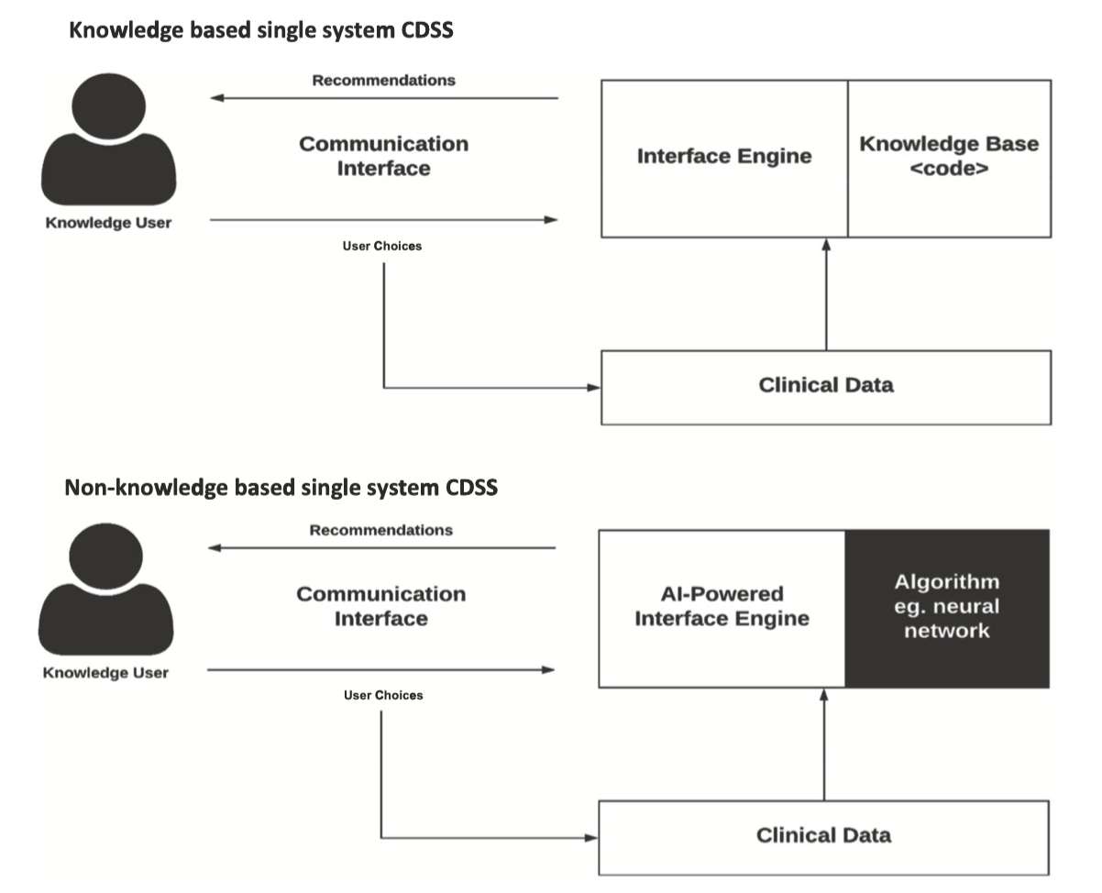
Knowledge-based versus
non-knowledge based
Clinical Decision Support
Recommendations
Knowledge
Base <code>
Interface
Engine
User
User Choices
NB Mention - the definition of “knowledge “
can vary amongst experts
Clinical data
Recommendations
AI-Powered Interface
Engine
Algorithm
e.g. Neural network
User
User Choices
Clinical data
Notes:
COMMENT AI enthusiasts do think their output is ‘knowledge’ whereas rational humans see the distinction (evidence pyramid) between gold standard meta-analysis of SRs of RCTs [NICE-type output] versus ‘mere’ retrospective studies.

Slide 7

The “3 pillars” of CDS
Supports knowledge and person-specific information,
intelligently filtered or presented at appropriate times
to enhance health and health care
Best knowledge available when needed, high adoption,
effective use
Continuous improvement
of
knowledge
Development
of
CDS methods
per se
CDS is best understood as a Learning Health System

Slide 8
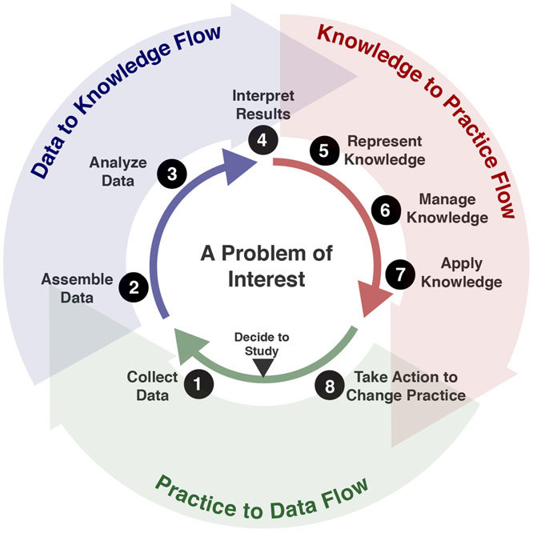
CDS as a virtuous circle
(Learning Health System)
1 from data generation…
2 to aggregation…
3 through analysis…
4, 5 knowledge creation…
6, 7 knowledge dissemination and use…
8 ongoing measurement, continuous
. feedback and refinement

Slide 9



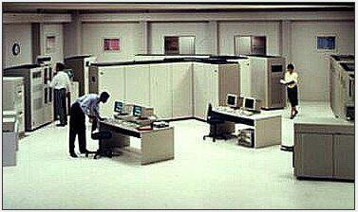
A rapid history of CDS
evolutionary forces
State-of-the-Art CDS in 1990
Hospital Information System (HIS)
Departmental Information System (DIS)
Document Scanners
Quality Reporting Systems
Standalone Specialist Systems
Supportive trends since then
Improved data structure & encoding of standardized data
Increased availability of data and knowledge bases for CDS
Improvement of data sharing capabilities
Explosion of analytical and inference methods - AI/ML/modelling
Architectures for CDS in clinical workflow web / mobile
Increase user sophistication/expectations
The 1990s

Slide 10
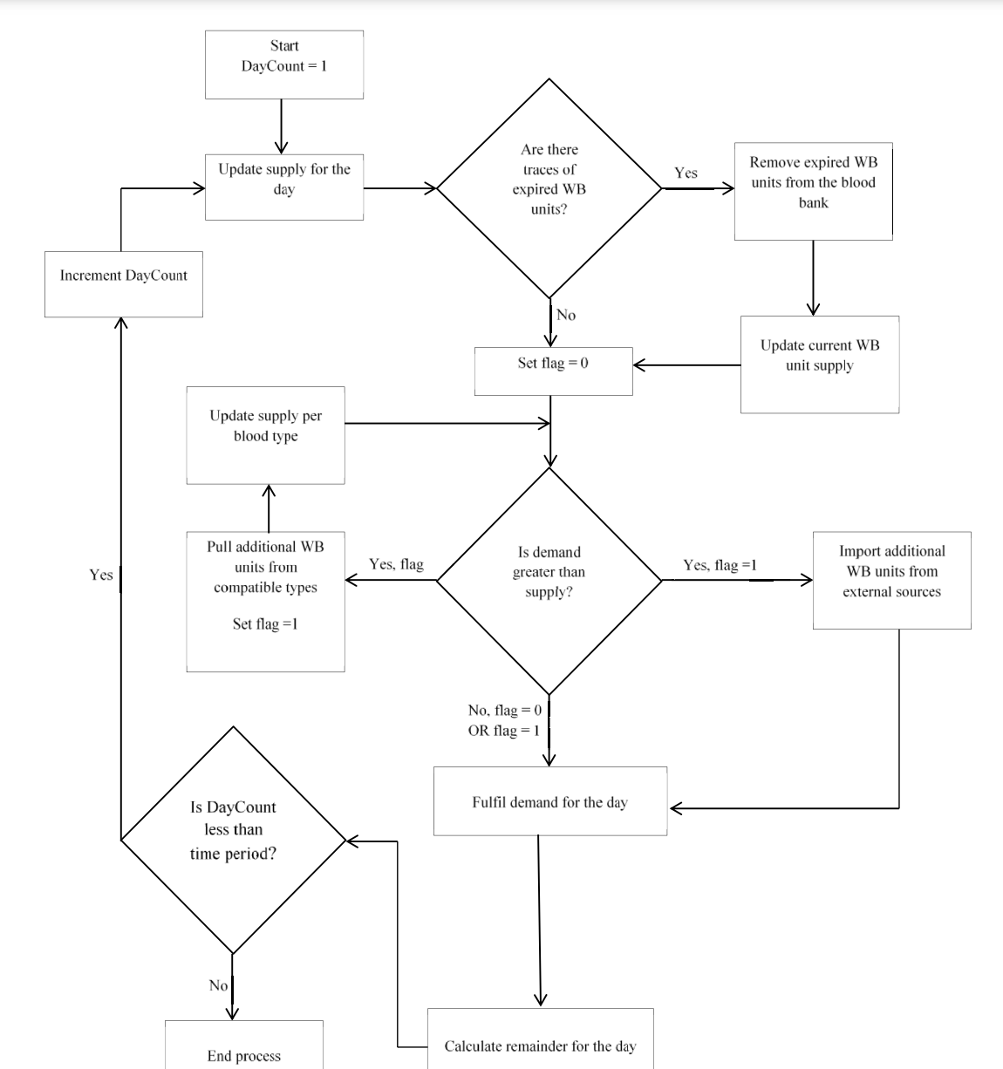
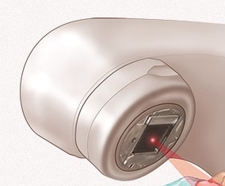
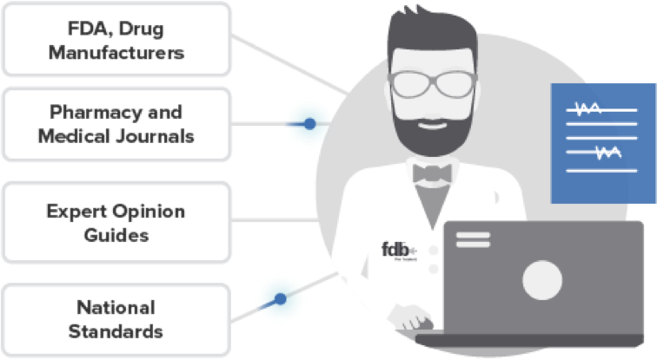
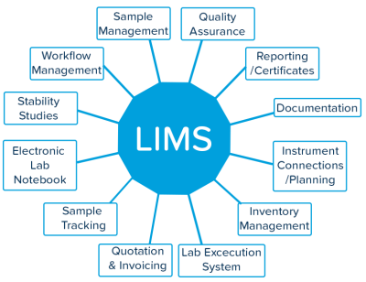
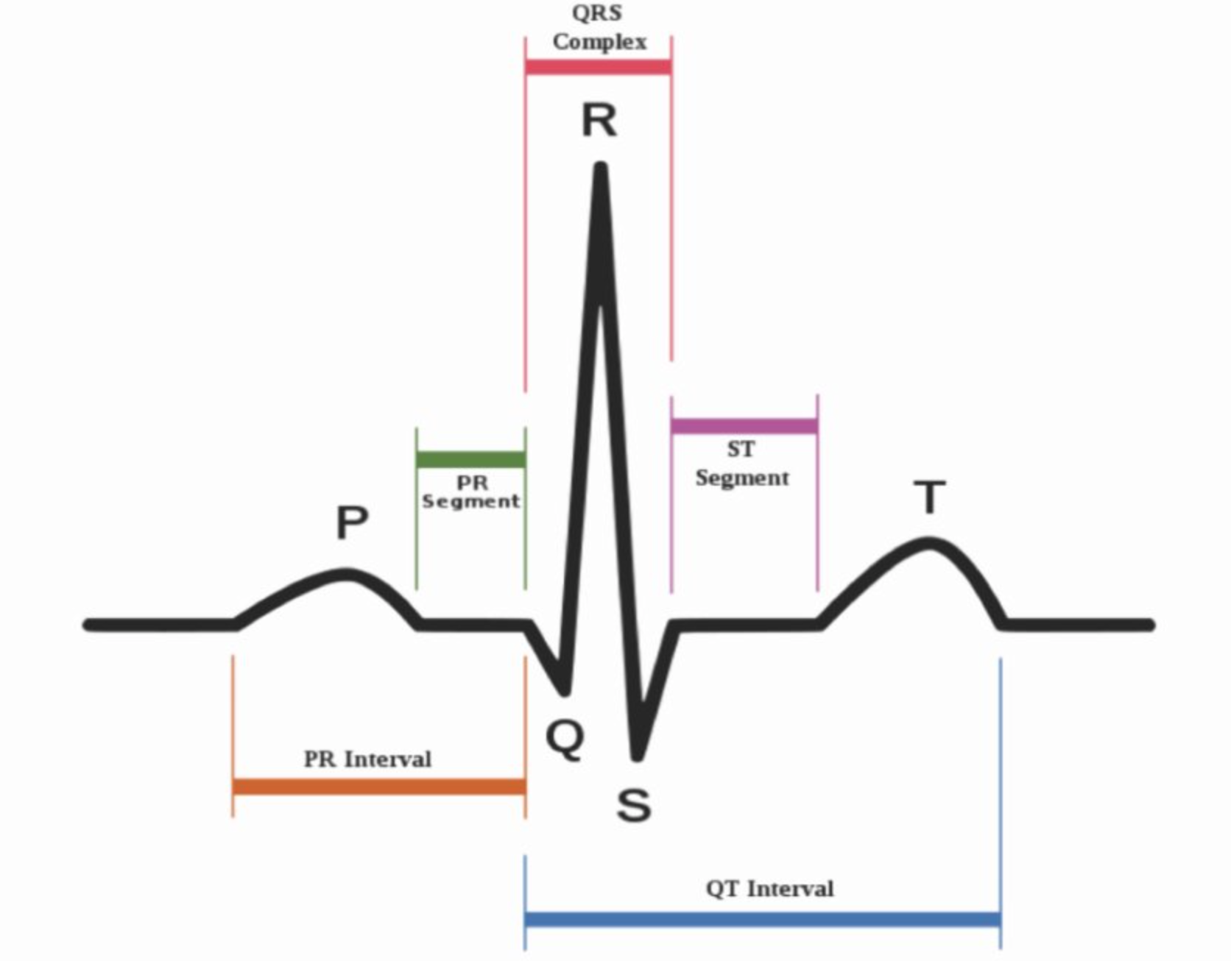
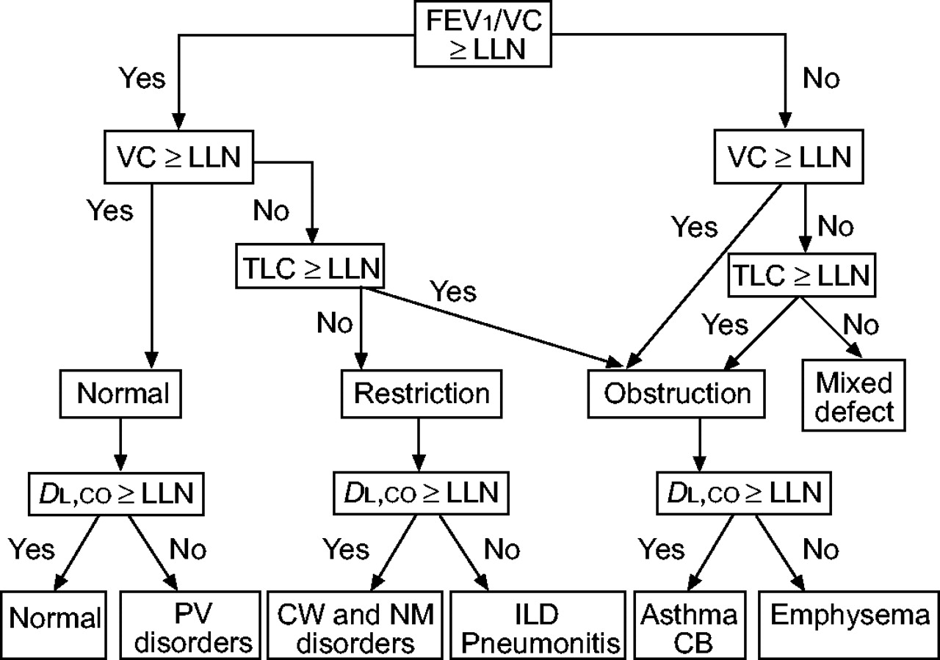
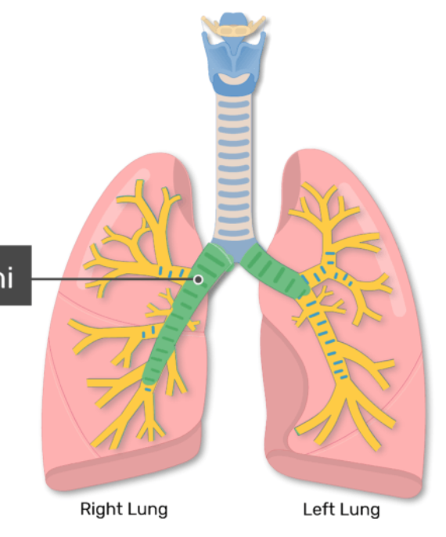
Early standalone applications
mainly at departmental level
Prescribing
Decision
Support
(FDB – 1980s)
Blood
Banking
Systems
Radiation Therapy
Dosimetry Systems
Laboratory
Information
Systems
(LIMS)
ECG
Interpretation
Pulmonary
function interpretation

Slide 11
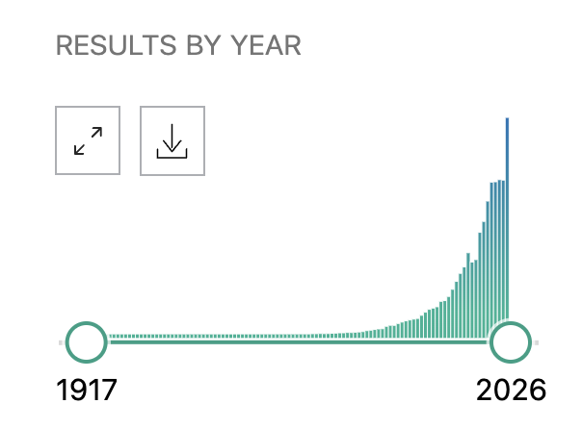
Subsequent Evolution
towards system integration and interoperable
Filters applied: Review, Systematic Review →
491 results
2500 results
Filters applied: in the last 1 year →
“clinical decision support”
CDS TOPIC BREADTH ILLUSTRATION BY RANDOM LITERATURE SAMPLES – many applications in patient safety, clinical management, cost containment, administrative function/automation, diagnostics support, better documentation workﬂow improvement including specialist adverse drug event monitoring, drug and parenteral nutrition dosing, antibiotic prescribing, ventilator management, report formatting, laboratory result alerting, blood product ordering, infusion pump monitoring, isolation bed management, diagnostic services, medical imaging, test ordering, patient apps, social care, paediatric elbow, anticoagulant prescribing, allergy, pharmacogenetics, atherosclerosis, family maltreatment severity. asthma management, renal function, pneumonia, ulcerative colitis, depression, diabetes, oncology, appendicitis, coronavirus, antimicrobials, lung disease, inflammatory bowel disease, neuroblastoma, hepatitis B, head and neck surgery, suicide risk, orthodontics, retinopathy, naloxone co-prescription, autism, dentistry, interleukin-6 assay, preeclampsia, platelet transfusions, C. difficile testing, stroke chlamydial infections, colorectal screening, thyroid malignancies, psychological therapy, lactate levels, traumatic brain injury, triage, dementia, cancer predisposition, paediatric gastroenterology, chest radiography, lung cancer, blood stream infection, neonatal sepsis, computed tomography, knee pain… etc. (this was covering just c 20% of CDS papers from 2021-2026).
9,259 hits
16,880 hits
on 13 Jan 2026
NB query was in quotes
for exact string

Slide 12


Notable steps forward
“and backward”
USA, 2009 - use of EHRs incentivised by the HITECH Act
= financial incentives for the “meaningful use” of electronic medical record systems.
An key component of “Meaningful Use” legislation was the integration of CDS into the computerized record, providing up-to-date medical knowledge and evidence-based guidance to the physician at the point of care. Incentivisation did not last forever, but it broke the mould.
UK, 2002 - NPfIT
= huge promise and investment by the Blair government to modernise NHS IT and “bring it into the 21st Century”. Huge step changes, non-native culturally mismatched (US-based) IT systems, impossible timelines, technically challenging and bloated structured data – e.g. verbose XML messages → Failure… Would have been a new dawn for CDS if it was approached differently (e.g. applying digital maturity evolution methods).

Slide 13
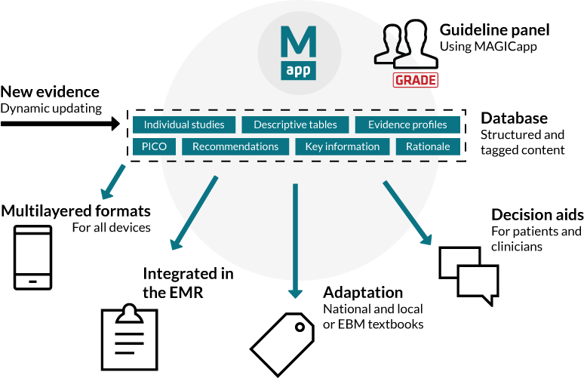
More Notable Projects & Trends
Norway, 2009 - The MAGIC programme –creation, disseminate and dynamically update clinical practice guidelines, evidence summaries and decision aids. Uses a content management system addressable registry of guidelines so distributed users can develop,
The project motto is “guidelines that we can all share”

Slide 14
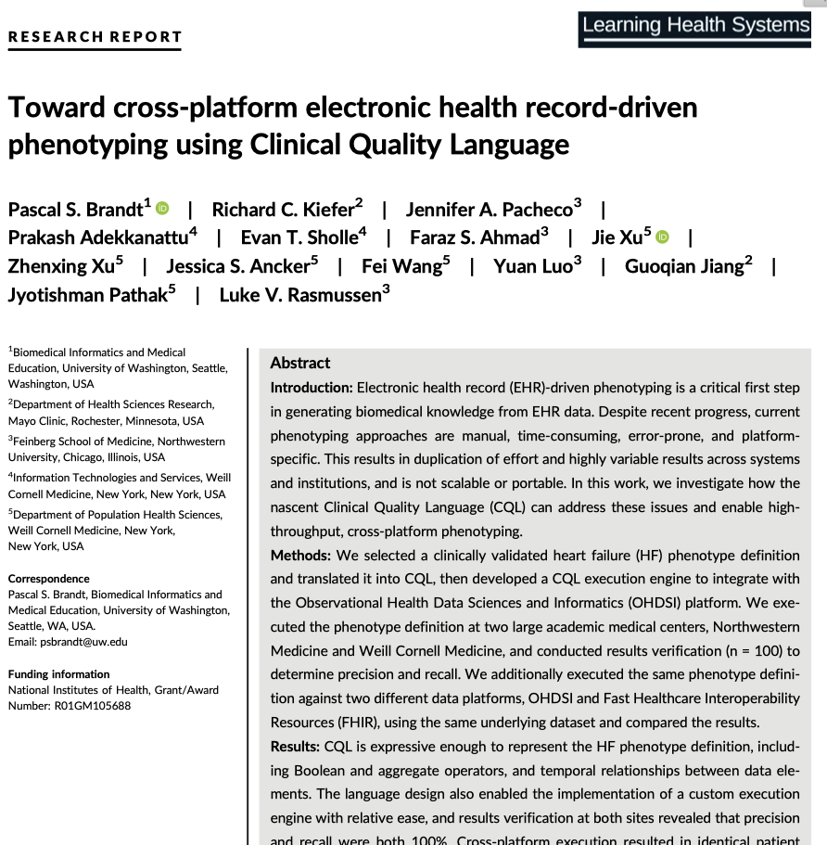
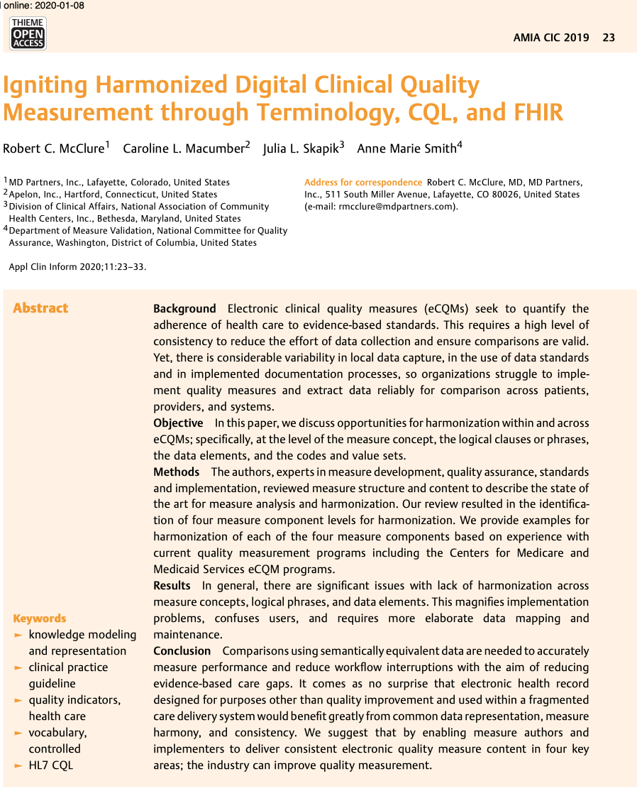
Use of the CQL standard in CDS
Brandt et al 2020
McClure et al 2019
Electronic clinical quality measures variability in local data capture - useless for comparisons.
This paper standardises measure concept, the logical clauses or phrases, the data elements, and the codes and value sets.
Clinical Quality Language (CQL) applied to representation of arbitrarily complex phenotype definitions - addresses portability
CQL now developed within HL7

Slide 15
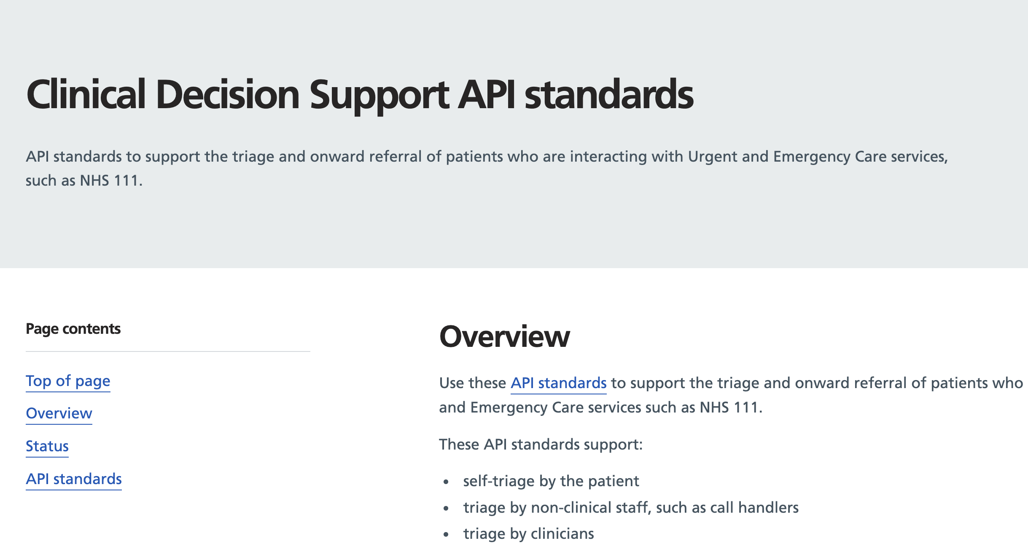
Currently: CDS via APIs
A patient record or live observation to be sent in real time to an external rules engine or AI model, which returns risk scores, alerts, or treatment recommendations directly into the clinician’s workflow at the point of care.
https://digital.nhs.uk/developer/api-catalogue/clinical-decision-support-standards
e.g. Triage through a series of questions and responses to determine the correct outcome or onward referral for the patient
SOON TO BE IMPLEMENTED IN FHIR CDS APIs
FHIR ~ The HL7 standard describing data formats and elements with an API for exchanging information in EHRs

Slide 16
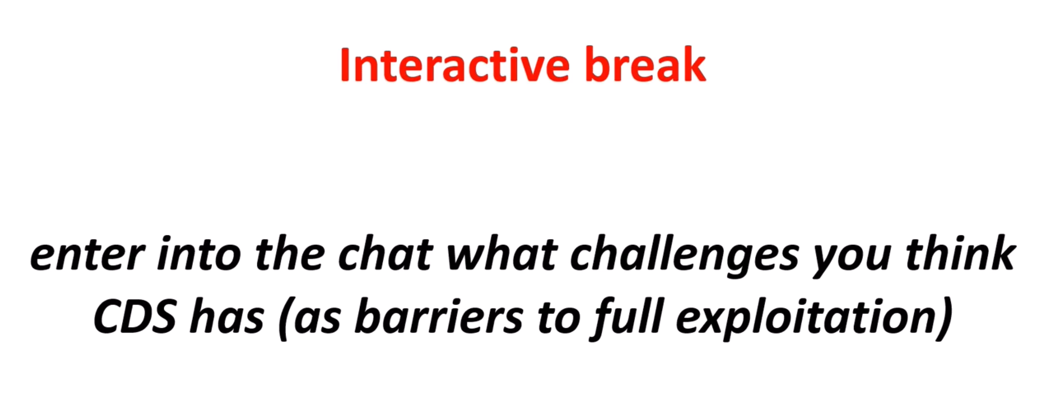

Slide 17
The Six Grand Challenges
“still faced by CDS”
Middleton’s review arrived at “six axes of CDS” to discuss the barriers and facilitators to effective use in the real world:
1. Data
2. Knowledge
3. Inference
4. Architecture and technology
5. Implementation and integration
6. Users

Slide 18



CDS Grand Challenge 1 - Data
Data volume
Variable quality
Introduction and propagation of errors
Huge scope of patient journey
IoT
Privacy risks
Self-monitoring
Interoperability (is hard)
Non-standardised search
Proprietary data
Poor ontologies
Linkage error

Slide 19

CDS Grand Challenge 1 – Data
continued
Barrier – there is often no business case to bring legacy data to a common standard
Barrier – commercial fees for
proprietary software or restrictive licences
Barrier – dataset A to B mappings may not exist
Comparing apples to apples = comparing things that can reasonably be compared, apples to oranges = a comparison that is unreasonable or perhaps impossible.
Barrier – large scale data aggregation is error prone

Slide 20
CDS Grand Challenge 2 – Knowledge (Exchange)
where it came from
Early 1990’s CDS systems:
HELP
BICS
RMRS
CPRS
could not share
knowledge artifacts
between systems
The Arden Syntax
represented rule-based knowledge and could exchange
“Medical Logic Modules”
BUT
it lacked standardized terminology for clinical concepts (clinical findings, laboratory names, diseases, drugs, etc.).
Progress required robust standards for example:
Laboratory terms - LOINC - Logical Observation Identifiers Names and Codes for diseases – the International Classification of Diseases (ICD-9-CM/10) and Systematized Nomenclature of Medicine (SNOMED)
Procedures - Current Procedural Terminology (CPT)
Drug names (RxNorm)
Permitted development of…
GuideLine Interchange Format SEBASTIAN
CDS Consortium OpenClinical.org

Slide 21
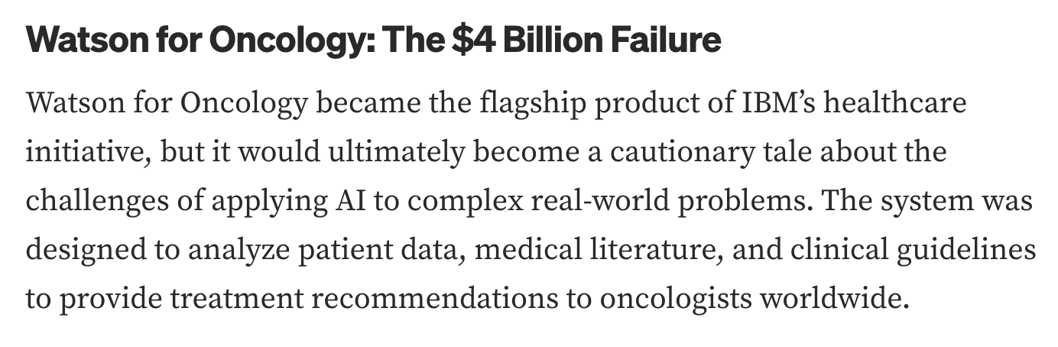

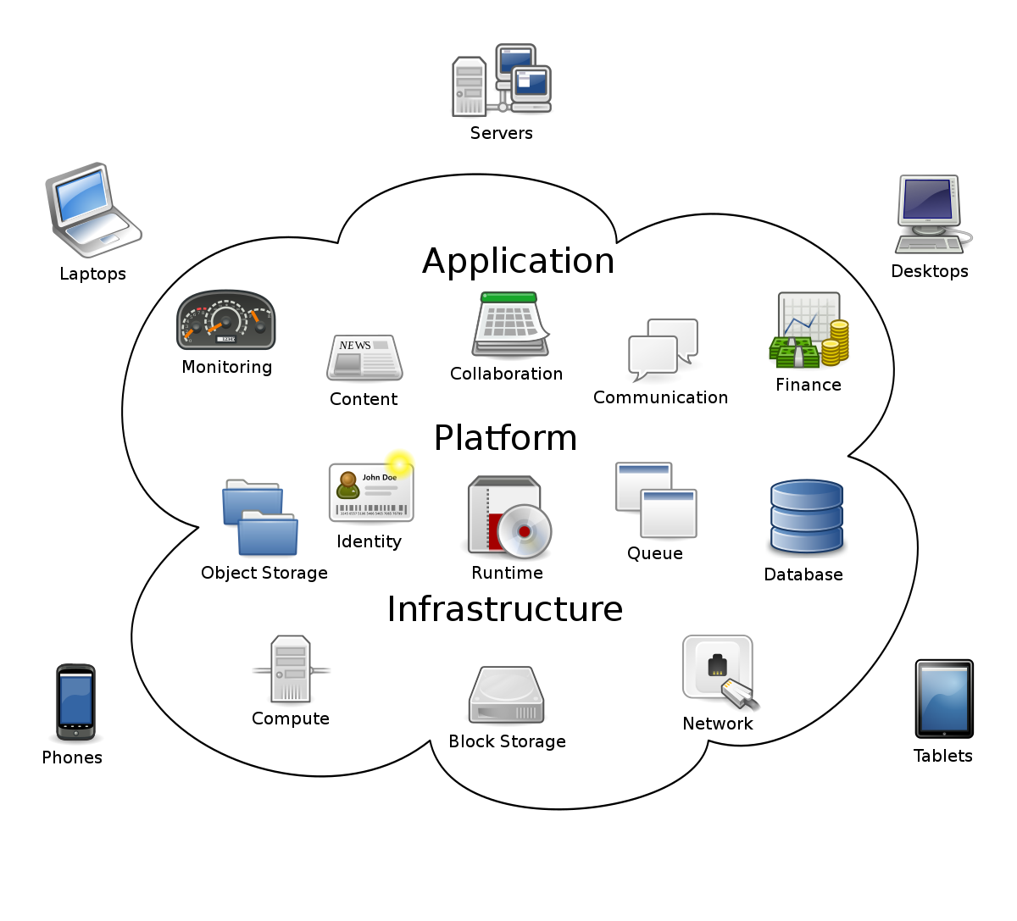
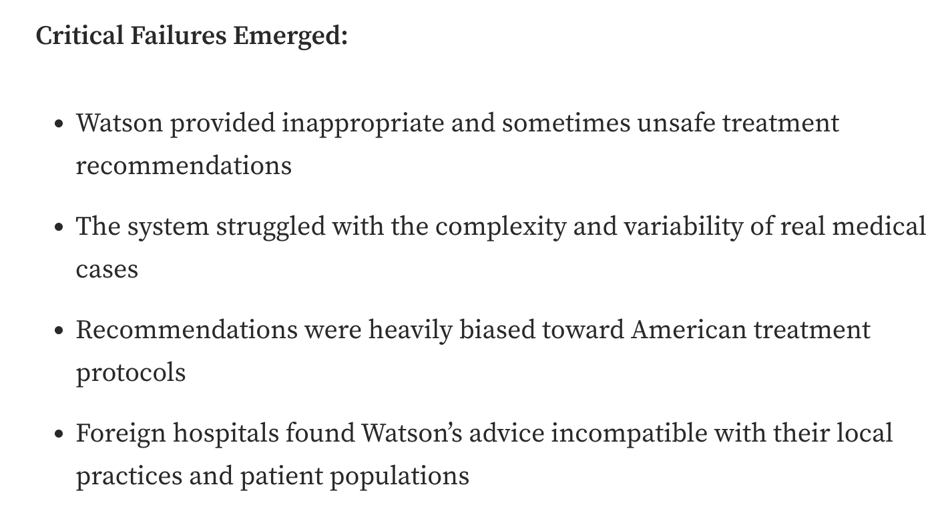
CDS Grand Challenge 2 – Knowledge
Key trends
Rule-based knowledge → Direct data mining
Domain expertise → Discovery algorithms
Consensus opinion → Data driven
Text mining → Knowledge bases (e.g. IBM Watson)
All are exciting and have great promise, but…
THEY MUST be able to explain their reasoning
THEY MUST show knowledge and data sources transparently and
THEY MUST update as new knowledge (or performance and impact data)

Slide 22
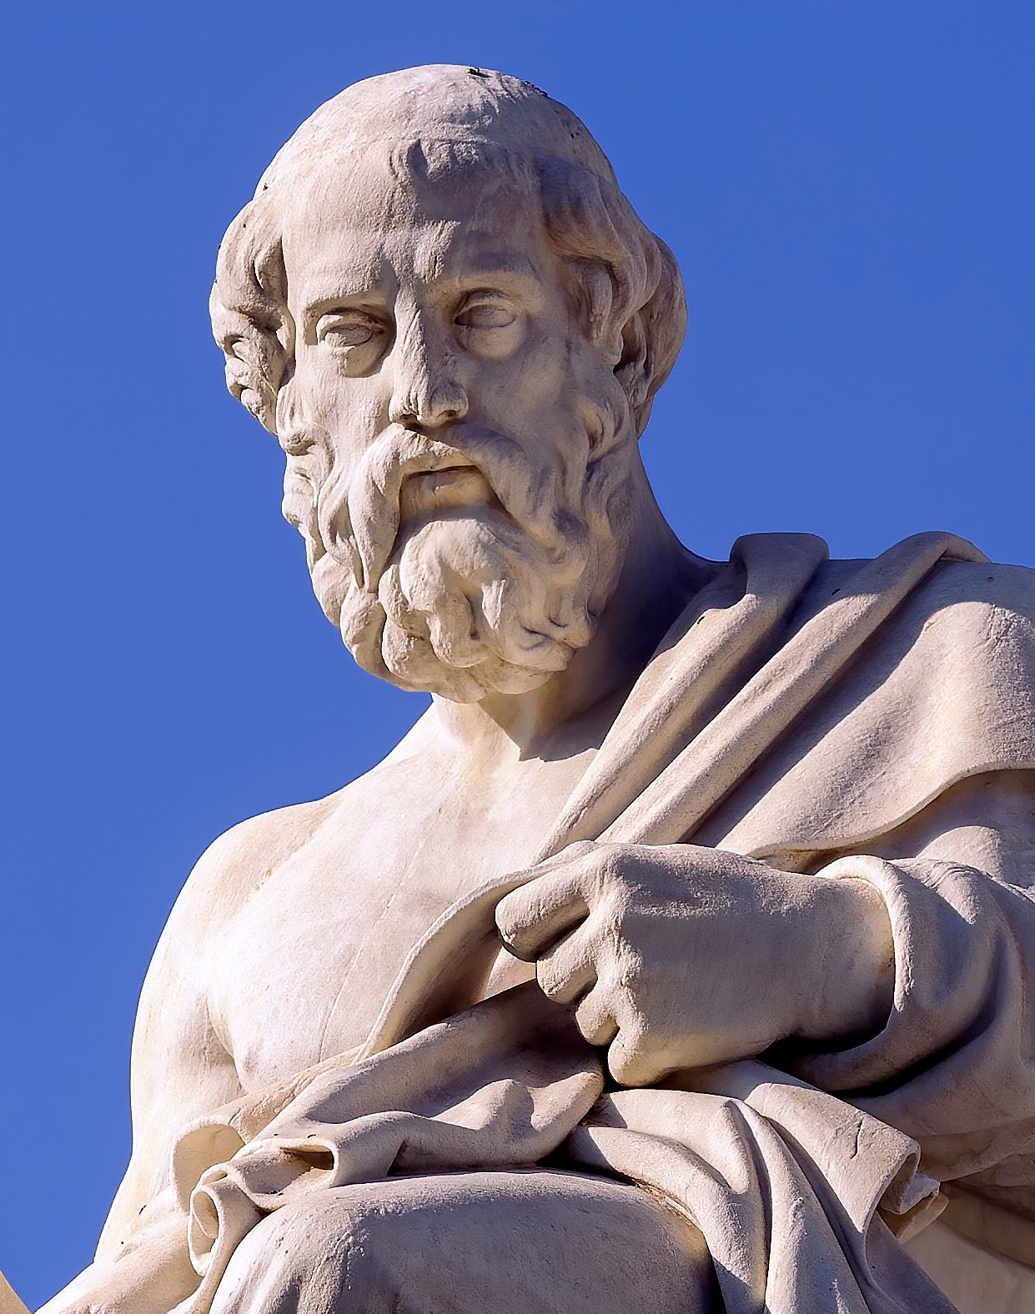

CDS Grand Challenge 3 – Inference
Aristotle
Inference - "A conclusion reached from evidence and reasoning"
Classically inductive – a general principle from many observations
Classically deductive – a logical conclusion from the premises
A key problem for simple rule-based inferences is…
maintaining the rule (knowledge) base in an up-to-date format
and from potential conflicts between rules.
Underlying Cause : poor semantics to manage the different types of knowledge to accurately represent a guideline
leads to → ambiguity in understanding and action
leads to → potential safety issues.

Slide 23
CDS Grand Challenge 3 – Inference
Now* is the advent of AI = explodes knowledge discovery
*actually it started in 1940-1960
Prior to now:
1 – The rule-based approach (heuristic - "enabling to learn for oneself”)
2 – The probabilistic or Bayesian reasoning approach (suffer from linkage weightings that have to be applied by experts - the conditional probabilities)
=====
Notable current examples
New numeric-based approaches (ML) incl. artificial neural networks for deep learning – combined with the availability of increasingly large clinical databases.
- Associations between gene variants and disease states (GWAS)
- Drug to gene variant dependencies (pharmacogenomics)
- Genome-specific drug selection and dosing advice
- Patient state, genomics, behaviour, and the environment → ‘precision medicine’
- Inference of all known protein tertiary structures from primary amino acid sequences

Slide 24
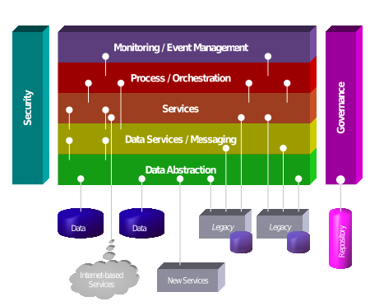

CDS Grand Challenge 4
Architecture and Technology
Clunky
mainframe
architecture
Cloud-based
service oriented
architecture
No mobile
devices/Internet
Abundant mobile
devices / Internet
Progress over time
Bespoke architecture
Monolithic
Irreplaceable
Re-applicable architecture
Modular
Interchangeable
interoperable
decision support systems
standalone decision support systems
→ “Separation of concerns”
separation of knowledge and inference from the presenting EHR

Slide 25
CDS Grand Challenge 5
Implementation and Integration
Problem: clinical practice patterns are hyper-variable
Result: "it doesn't fit into my workflow; there are too many alerts!"
Software: data element missing, please recheck!
User – “why won't this damn thing send?”
CDS recommendations have unacceptably high override rates - the reasons include:
outdated patient data
missing patient data
CDS logic not precisely fitting the patient
clinically irrelevant alerts such as drug-food alerts
or CDS is active after decision already made
There remains a myth that care pathways are perfectly linear and predictable; in reality
local idiosyncrasies arise with the care of individual patients…

Slide 26

CDS Grand Challenge 6
Real-world users
Overheard on the ward
CDS user design points
“Can’t see why
you need that app -
what’s the problem?”
CDS users do need to “see the problem” before applying any solution
“I’ve no idea
what this app
does”
CDS systems must provide their guidance in a consistent manner coherent with context
Bring prospective users
digital literacy to a
defined competence level
“IT is my
weak point”

Slide 27
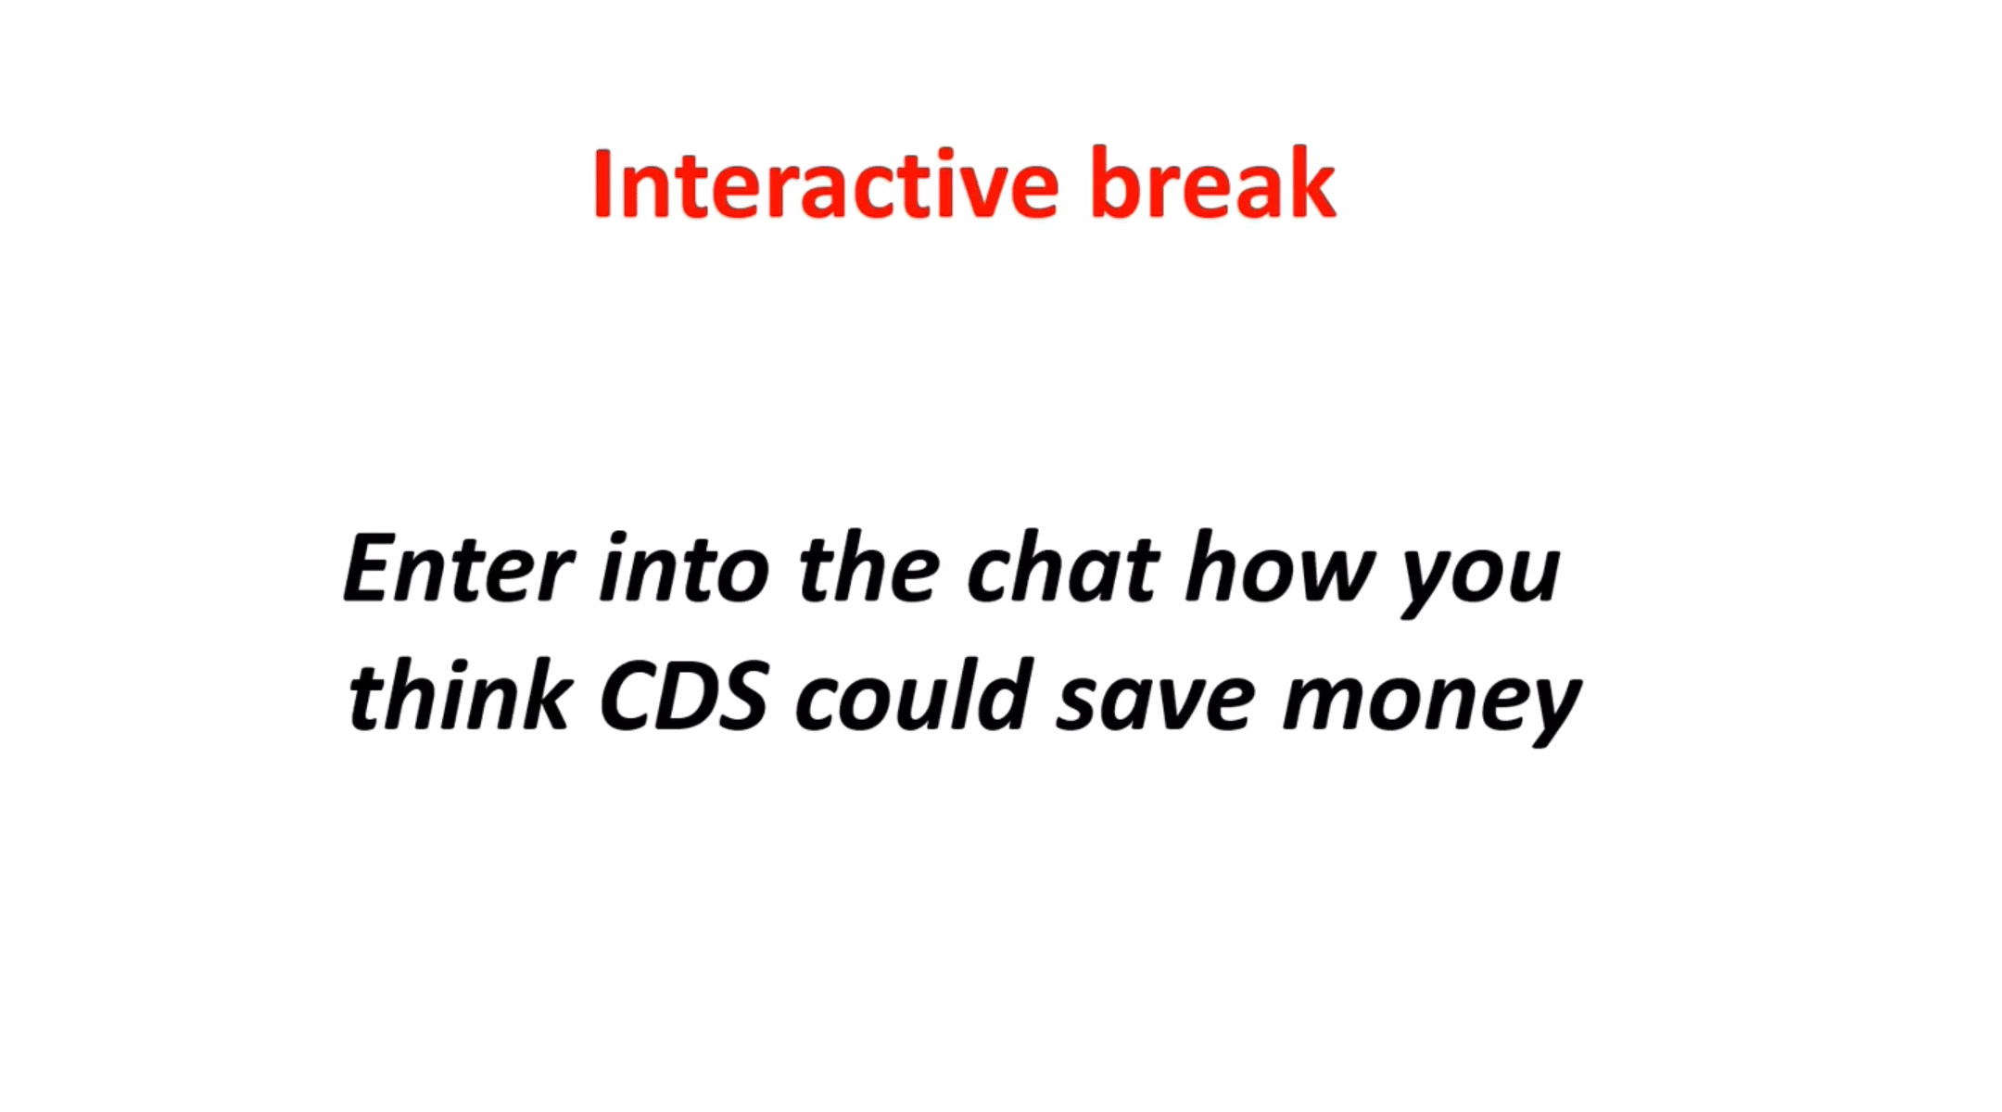

Slide 28

CDS - potential for cost-savings (and quality improvements)
CDS is cost-effective in many use cases, notably:
Clinical intervention statistics
Decreasing inpatient length-of-stay
Cheaper medication alternatives
Reducing test duplications
Limiting of scheduled tests
Cost effectiveness through efficiency gain –
Think of an analogy in Facebook - AI agents make certain tasks cheaper
and faster at scale. They help classify posts, rank feeds, translate languages,
and detect patterns that would otherwise require vast numbers of staff.
They reduce operational friction.

Slide 29


Summary of potential pitfalls with CDS
CDS can disrupt clinician workﬂow
Unstandardised data - corrupt data = incorrect CDS inferences
Given a forbidden box by the gods, Pandora opens it and releases every human sorrow into the world, leaving only hope behind.
CDS can increase time required to complete tasks
CDS can increase cognitive effort
GDPR personal data transportability can be difficult from CDS
Pandora’s Box
CDS can create face-to-face "disconnect" with patients
CDS can create dependency
CDS can de-skill (compare pocket calculators with manual calculation)
CDS needs expensive specialist maintenance
Substantial upfront CDS costs
Up to 95% of CDS alerts are inconsequential
CDS can give alert fatigue
Many CDS systems have interoperability issues

Slide 30

To follow in next Sync Session
Collaboration between NICE and MCBK*
*Mobilising Computable Biomedical Knowledge (MCBK)
Objective is to guide CDS/software developers to increase traceability, fidelity and consistency in supporting clinical use of NICE recommendations.
Standards Used
1. Clinical terminology and value sets: SNOMED CT, dm+d, BNF
2. NHS Data Dictionary
3. Machine-readable format (tbc: xml, JSON, Oxford metadata…)
4. PRSB information models
5. Data API: FHIR
“Developing computable implementation guidance”

Slide 31
CDS mini-bibliography
(selected papers: not required reading)
Kline A, Wang H, Li Y, Dennis S, Hutch M, Xu Z, Wang F, Cheng F, Luo Y. Multimodal machine learning in precision health: A scoping review. NPJ Digit Med. 2022 Nov 7;5(1):171. doi: 10.1038/s41746-022-00712-8. PMID: 36344814; PMCID: PMC9640667.
Swift CG. Personalised future prescribing using pharmacogenomics: A resumé of a joint Royal College of Physicians / British Pharmacological Society working party report. Future Healthc J. 2022 Jul;9(2):174-178. doi: 10.7861/fhj.rev-9.2.1. PMID: 35928194; PMCID: PMC9345247.
Rodriguez JPM, Rodriguez R, Silva VWK, Kitamura FC, Corradi GCA, de Marchi ACB, Rieder R. Artificial intelligence as a tool for diagnosis in digital pathology whole slide images: A systematic review. J Pathol Inform. 2022 Sep 8;13:100138. doi: 10.1016/j.jpi.2022.100138. PMID: 36268059; PMCID: PMC9577128.
Chen W, O'Bryan CM, Gorham G, Howard K, Balasubramanya B, Coffey P, Abeyaratne A, Cass A. Barriers and enablers to implementing and using clinical decision support systems for chronic diseases: a qualitative systematic review and meta-aggregation. Implement Sci Commun. 2022 Jul 28;3(1):81. doi: 10.1186/s43058-022-00326-x. PMID: 35902894; PMCID: PMC9330991.
Rodriguez JPM, Rodriguez R, Silva VWK, Kitamura FC, Corradi GCA, de Marchi ACB, Rieder R. Artificial intelligence as a tool for diagnosis in digital pathology whole slide images: A systematic review. J Pathol Inform. 2022 Sep 8;13:100138. doi: 10.1016/j.jpi.2022.100138. PMID: 36268059; PMCID: PMC9577128.

Slide 32
CDS mini-bibliography
(selected papers: not required reading)
Koulaouzidis G, Jadczyk T, Iakovidis DK, Koulaouzidis A, Bisnaire M, Charisopoulou D. Artificial Intelligence in Cardiology-A Narrative Review of Current Status. J Clin Med. 2022 Jul 5;11(13):3910. doi: 10.3390/jcm11133910. PMID: 35807195; PMCID: PMC9267740.
Mouazer A, Tsopra R, Sedki K, Letord C, Lamy JB. Decision-support systems for managing polypharmacy in the elderly: A scoping review. J Biomed Inform. 2022 Jun;130:104074. doi: 10.1016/j.jbi.2022.104074. Epub 2022 Apr 22. PMID: 35470079.
Ackermann K, Baker J, Festa M, McMullan B, Westbrook J, Li L. Computerized Clinical Decision Support Systems for the Early Detection of Sepsis Among Pediatric, Neonatal, and Maternal Inpatients: Scoping Review. JMIR Med Inform. 2022 May 6;10(5):e35061. doi: 10.2196/35061. PMID: 35522467; PMCID: PMC9123549.
Tuppad A, Patil SD. Machine learning for diabetes clinical decision support: a review. Adv Comput Intell. 2022;2(2):22.
doi: 10.1007/s43674-022-00034-y. Epub 2022 Apr 13. PMID: 35434723; PMCID: PMC9006199.
Singh M, Nath G. Artificial intelligence and anesthesia: A narrative review. Saudi J Anaesth. 2022 Jan-Mar;16(1):86-93.
doi: 10.4103/sja.sja_669_21. Epub 2022 Jan 4. PMID:
35261595; PMCID: PMC8846233.
Honkoop P, Usmani O, Bonini M. The Current and Future Role of Technology in Respiratory Care. Pulm Ther. 2022 Jun;8(2):167-179. doi: 10.1007/s41030-022-00191-y. Epub 2022 Apr 26. PMID: 35471689; PMCID: PMC9039604.

Slide 33
CDS mini-bibliography
(selected papers: not required reading)
Singh M, Nath G. Artificial intelligence and anesthesia: A narrative review. Saudi J Anaesth. 2022 Jan-Mar;16(1):86-93. doi: 10.4103/sja.sja_669_21. Epub 2022 Jan 4. PMID: 35261595; PMCID: PMC8846233.
Teufel A, Binder H. Clinical Decision Support Systems. Visc Med. 2021 Dec;37(6):491-498. doi: 10.1159/000519420. Epub 2021 Sep 28. PMID: 35087899; PMCID: PMC8738909.
Luri M, Leache L, Gastaminza G, Idoate A, Ortega A. A systematic review of drug allergy alert systems. Int J Med Inform. 2022 Mar;159:104673. doi: 10.1016/j.ijmedinf.2021.104673. Epub 2021 Dec 26. PMID: 34990941.
Wake DT, Smith DM, Kazi S, Dunnenberger HM. Pharmacogenomic Clinical Decision Support: A Review, How-to Guide, and Future Vision. Clin Pharmacol Ther. 2022 Jul;112(1):44-57. doi: 10.1002/cpt.2387. Epub 2021 Aug 29. PMID: 34365648; PMCID: PMC9291515.

Slide 34
Review of Learning Objectives
1 - Understand what clinical decision support (CDS) is (interchangeably used with healthcare decision support).
2 - Comprehend the range of healthcare scenarios where CDS has been attempted/implemented.
3 - Know about some key developments in the history of CDS.
4 - Know about the “six grand challenges” still facing CDS.
5 - Be able to outline the potential for cost-savings and quality improvements that CDS could enable.

Slide 35
Running Order
15th January 2026
ALL TIMINGS APPROXIMATE
1-2pm SR/meta-analysis and discussion of
automating evidence synthesis - Prof Philip Scott
2-2:15 Break
2:15-3 Clinical Decision Support (CDS) – An Overview - Dr Edward Conley
3-3:20 CDS Exercise
3:20-3:30 Q&A on "Critical analysis of decision support” assignment

Slide 36
CDS EXERCISE on Moodle
EXERCISE – CDS
approx. 10 min + 10 min summary
In each group Identify THREE decision support tools used in your work area (any area).
Analyse
  Type of support? (clinical, admin, etc.)
  Data & info needed?
  What data content and standards are needed - how does this tool use them?
  What impact is there on workflow, efficiency and outcomes?
  What could be potential biases or limitations?
Summarise
Informally share your findings with the whole group.

Slide 37
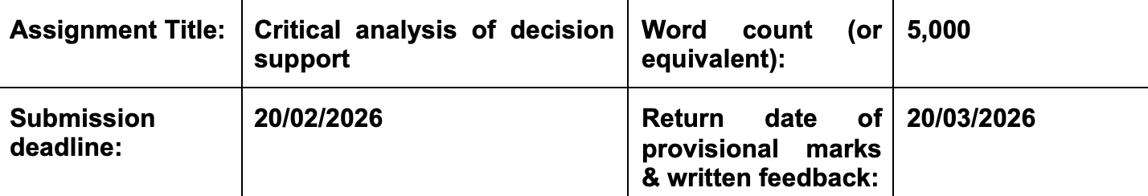
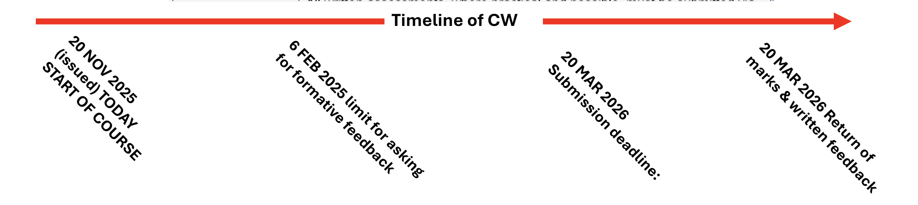
Q & A
On BMDS7003 Assignment

