Slide 1
Digital Skills Support Session
Essential Skills Week 3: Getting Started with Digital Tools at University

Slide 2
Lesson Aims
In this session you will:
Learn how to navigate Moodle confidently
Communicate effectively using Teams and email
Use OneDrive to store, create, and edit documents
Build confidence using essential digital tools

Slide 3

Discussion Points
Before we begin…
In pairs, discuss:
What digital tools have you used before starting university?
What do you find most confusing at university so far?
Have you ever missed something on Moodle?

Slide 4

Why digital tools matter at Level 4
Digital tools are central to learning at university
Most communication happens online
Knowing where things are reduces stress
Confidence with tools helps you focus on learning

Slide 5
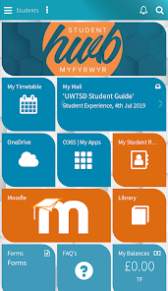
Activity 1: Making friends with Moodle
In pairs:
Log into Moodle and Find:
  module page
  announcements
  assignment submission area
Identify:
where to find deadlines
where to find feedback

Slide 6
Activity 1: Making friends with Moodle (Cont’d)
Moodle Checklist
After the activity, ask:
Did you find your assessments?
Do you know your deadlines?
Do you know where feedback appears?
Were there any challenges?

Slide 7

Activity 2: Communicating via Email
Part A: Email
In pairs or small groups, discuss:
Which email is more effective and why?
What problems can you spot in Email A?
What does Email B do well?
How might Email A be improved?

Slide 8
Activity 2: Communicating via Email (Cont’d)
Part A: Email
Activity: Write your own professional email
Scenario examples:
You missed the time of a 1:1 meeting.
You want to book a digital skills appointment.
Students:
Draft an email for each scenario
Exchange in pairs
Provide feedback

Slide 9

Activity 3: Communicating via Microsoft Teams
What is Teams used for?
Quick messages
Informal academic communication
Group chats
Not formal requests

Slide 10
Activity 3: Communicating via Microsoft Teams (Cont’d)
Part B: Teams
Scenario:
You need help with an assignment and want to contact your lecturer or classmates using Microsoft Teams.
In pairs, discuss:
When is it appropriate to use Teams instead of email?
What information should you include in a Teams message?
How should your tone differ when messaging a lecturer vs a classmate?

Slide 11
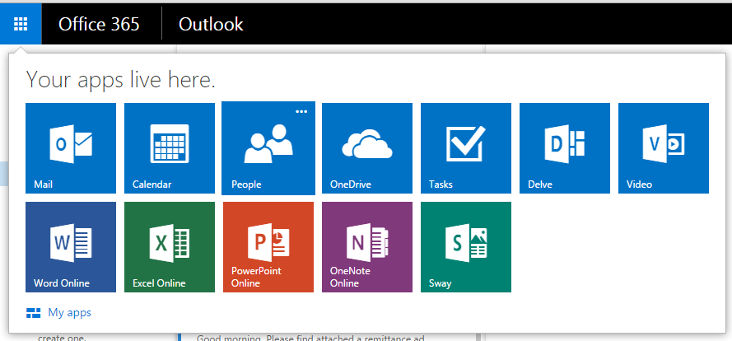
Using OneDrive like a professional
Accessing OneDrive (Step-by-step)
Finding OneDrive
Log into your university account
Click the app launcher (top left)
Select OneDrive
Check that you can see your files

Slide 12
Using OneDrive like a professional
Creating a Folder Structure
Organising Your Work
Click “Create or Upload”
Select “Folder”
Create a folder called:
  L4 Essential Skills
Inside that folder create:
  Assessments
  Notes
  Research
Add example file names:
❌ document1.docx
❌ finalversion2.docx
✔L4_EssentialSkills_Assignment1_Draft1.docx

Slide 13
Using OneDrive like a professional
Uploading & Renaming Files
Click Upload
Select file from computer
Rename file clearly
Check location

Slide 14
Using OneDrive like a professional
Editing & Version History
Now introduce:
Open file in Word Online
Make small edit
Check AutoSave
View Version History

Slide 15

Activity 4: Creating & editing a document in OneDrive
Task:
Open a Word document via OneDrive
Make a simple edit
Save changes
Check version history

Slide 16
Activity 5: Using OneDrive like a professional
In pairs:
Create a folder structure in OneDrive
Upload a document
Rename files clearly
Share a file with editing access
Discussion:
Why might poor file organisation cause problems later?

Slide 17

Remember
Digital tools support your learning
You do not need to be an expert; confidence grows with use
Organised files and clear communication save time and stress
Ask for help early if something is unclear

Slide 18
Development Diary: Record Your Learning
After today’s session:
What digital skills you practised today
What you found challenging or new
One action you will take to improve
How these skills will support your assessments

Slide 19

Any Questions?

