Slide 1
Jacob the Patriarch: Prophecy, Ethics, and Leadership
Dr Jessica Keady
Week 6

Slide 2
Jacob’s Prophetic Identity
Genesis portrays Jacob as chosen by God (Gen 28:13–15;
35:9–12).
His prophetic dimension: encounters with God in visions, renaming (Israel – “he who wrestles with God” Genesis 32)
Contrast: prophetic insight vs. moral indecision – Jacob’s ladder
(Genesis 28: 10-22)
Secondary Sources: von Rad (1962), Alter (2004),
Wenham (1994).

Slide 3
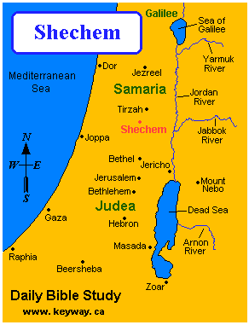
Context of Genesis 34
Narrative setting: After reconciliation with Esau, Jacob settles near Shechem.
The story omits Dinah’s voice.
The story omits God’s voice—divine silence as a narrative device.

Slide 4
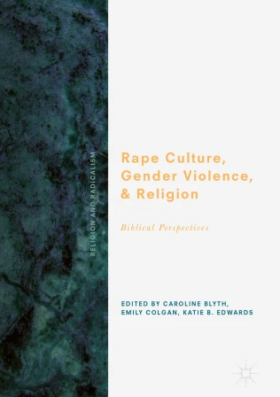
A closer look at Genesis 34
Genesis 34 NRSVUE - The Rape of Dinah - Now Dinah the - Bible Gateway
Rape Culture Chapter JKeady.pdf

Slide 5
Jacob’s Silence
Jacob “held his peace” (Gen 34:5) → prophetic restraint or moral paralysis?
His sons’ anger contrasts with Jacob’s quiet diplomacy.
Phyllis Trible (Texts of Terror) – Jacob’s silence mirrors patriarchal complicity.
Robert Alter – silence invites reader judgment and moral complexity.
Jacob’s passivity undermines his prophetic authority.

Slide 6
Theological and Ethical Reflections
Absence of God → test of prophetic judgement
Jacob’s concern for reputation (“You’ve made me a odious” Gen. 34: 31) contrasts with covenantal ethics.
Feminist reading: Dinah as a voiceless victim exposes the limits of patriarchal prophecy.

Slide 7

Reception History of Jacob and Dinah
The Red Tent (TV Mini Series 2014) – IMDb
The Rape of Dinah - Sebastiano Ricci — Google Arts & Culture

Slide 8
Jacob and Genesis 34
Genesis 34 reveals a paradoxical prophet: chosen by God but morally hesitant.
Prophetic vocation entails not only divine encounter but ethical responsibility.
Jacob’s story invites reflection on the limits of patriarchal authority and the necessity of divine speech in moral crises.

Slide 9

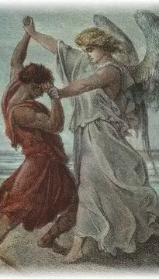
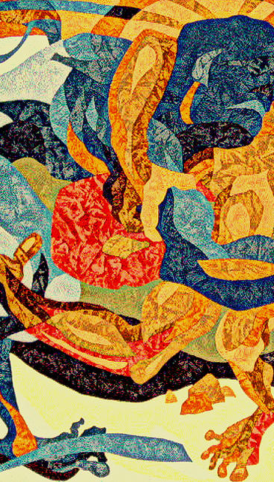
Wrestling of Jacob with God/Angel
(Gen.32:22-32) - Search | VCS

Slide 10
Database Search
Assessment Two (Patriarch Focus)
3000 words essay on the characteristics and reception of either Abraham, Isaac OR Jacob. As well as engaging with primary and secondary sources, you are also encouraged to evaluate and critique other material relating to the reception of the patriarchs in culture (this may include taking a gendered perspective, reviewing paintings, looking at poems, analysing films, etc).
Due: 5th December (11:59pm UK time)

