Slide 1
MODULE NAME Problem solving and decision making
MODULE CODE LCLM4004
STUDENT NAME Oksana Bielova
STUDENT ID 2526746
LECTURER Toyin Adisa
Assignment 1: Presentation

Slide 2
OVERVIEW
Introduction
Company background
Problem: nature and scope
PESTLE ANALYSIS: Basil’s Bakery
SWOT analyses
Cause and effect analysis: Fishbone diagram
Conclusion
References

Slide 3
Basil's Bakery: Business Problem Analysis
Case Study
Independent artisan bakery
Strong reputation for quality products
Location- in a retail park
Sales have continued to decline
Presentation Aim
Identify the causes of declining sales
Analyse the business using management tools
Evaluate possible solutions
Recommend the most appropriate strategy

Slide 4
Company background
Business Profile | Current Situation
Independ Artisan bakery | Sales remain below previous levels
Located in a retail park | Customer footfall became lower
Organic, high-quality products | Rising operating costs
Experienced owner | No online ordering or delivery
Strong local reputation | Increased market competition
The bakery's products remain highly valued, but the business model has not adapted to changes in customer behaviour.
Notes:
Competitive Advantage:
High product quality
Strong local reputation
Loyal customer base
Current Challenge:
Declining sales despite a positive reputation

Slide 5
Problem: Nature and Scope
Nature of the Problem
Declining sales despite high-quality products
Fewer customers visiting the retail park
Rising operating costs reducing profitability
Lack of online ordering and delivery services
Scope of the Problem
Lower revenue and profitability
Reduced business growth
Greater competitive pressure
Risk to long-term sustainability
Notes:
The problem is not product quality. Instead, the evidence suggests that changing customer behaviour and limited digital adaptation are the main drivers of declining sales.

Slide 6
Problem: nature and scope 1
5W2H Analysis
What:
Basil’s Bakery is experiencing a decline in sales and customer footfall, resulting in lower revenue and increasing financial pressure.
Who:
The problem affects the bakery owner, employees, existing customers, suppliers and other stakeholders connected to the business.
Where:
The problem occurs at Basil’s Bakery, located in a retail park where overall customer footfall has also decreased.
When:
The decline has developed gradually over recent months and is becoming more serious as operating costs continue to rise.
Notes:
"Using the 5W2H framework helps us clearly define the problem:
What: Sales stagnation at 25% below 2019 levels.
Where: Shopping retail park in Coventry.
When: Particularly from 2023 to 2025.
Who: Affects Basil and his customer base of local shoppers and workers.

Slide 7
Problem: nature and scope 2
5W2H Analysis
Why:
The main causes include reduced retail park footfall, lack of online ordering and delivery, strong competition and changing customer buying habits.
How:
Sales are falling because the bakery relies mainly on walk-in customers and has limited digital marketing, delivery and promotional activities.
How Much:
The problem affects the bakery’s revenue, profitability and ability to cover fixed costs such as rent, utilities, wages and ingredients.
Notes:
Why: Failure to adapt to post-COVID changes.
How: Combination of reduced footfall and lack of digital services.
How much: A sustained 25% drop in annual sales.
This framework gives us a clear picture of the current situation."

Slide 8
SWOT Analysis – Basil's Bakery 1
🟢 Strengths
• High-quality organic products
• Strong local reputation and loyal customers
• Prime location in a busy retail park
• Experienced and skilled owner-baker
🔴 Weaknesses
• No delivery or online ordering service
• Heavy reliance on walk-in customers
• High fixed operating costs
• Limited staffing; owner often works alone (no delegation)
Notes:
Basil's Bakery has several competitive strengths, including its high-quality artisan products, loyal local customer base, experienced owner and attractive location. However, the business relies heavily on in-store customers and lacks digital sales channels.

Slide 9
SWOT Analysis – Basil's Bakery 2
🔵 Opportunities
• Launch delivery and pre-order
• Digital transformation
🟠 Threats
•Declining retail park traffic
• Rising costs of rent, utilities and ingredients
• Competition from supermarkets and chain bakeries
Notes:
In my view, the biggest opportunity is online ordering because it could increase sales without changing the bakery's products.

Slide 10
PESTLE ANALYSIS: Basil’s Bakery
POLITICAL
🔴 COVID-19 restrictions negatively affected the bakery’s operations and customer footfall..
🔴 After the restrictions were lifted, customer footfall did not return to its pre-pandemic level.
ECONOMIC
🔴Between 2023 and 2025, sales remained approximately 25% below the 2019 level.
🔴Reduced customer footfall has resulted in lower sales revenue for the bakery.
SOCIAL
🔴 Customer behaviour has changed since the pandemic, with fewer shoppers visiting the retail park.
🔴More people working remotely has reduced the number of nearby office workers visiting the bakery.
Notes:
PESTEL analysis shows the broader external environment:
Economic pressures include rising costs and inflation.
Social factors are very strong – remote working has changed customer behaviour.

Slide 11
PESTLE ANALYSIS: Basil’s Bakery
TECHNOLOGICAL
🔴 The bakery does not provide an online ordering service..
🔴 The bakery does not offer a delivery service.
LEGAL
🔴 No specific legal factors are identified in the case study.
🔴The case does not mention any legal issues affecting the bakery’s sales.
ENVIRONMENTAL
🔴 The bakery uses high-quality organic ingredients.
🔴No other specific environmental factors are identified in the case study.
Notes:
Technological – the business is behind in digital services.
Environmental – commitment to organic ingredients creates cost volatility.
From my analysis, social changes appear to have had the greatest impact because customer behaviour has changed since the pandemic.
Strong Social + Economic + Technological factors are negatively impacting the business.

Slide 12
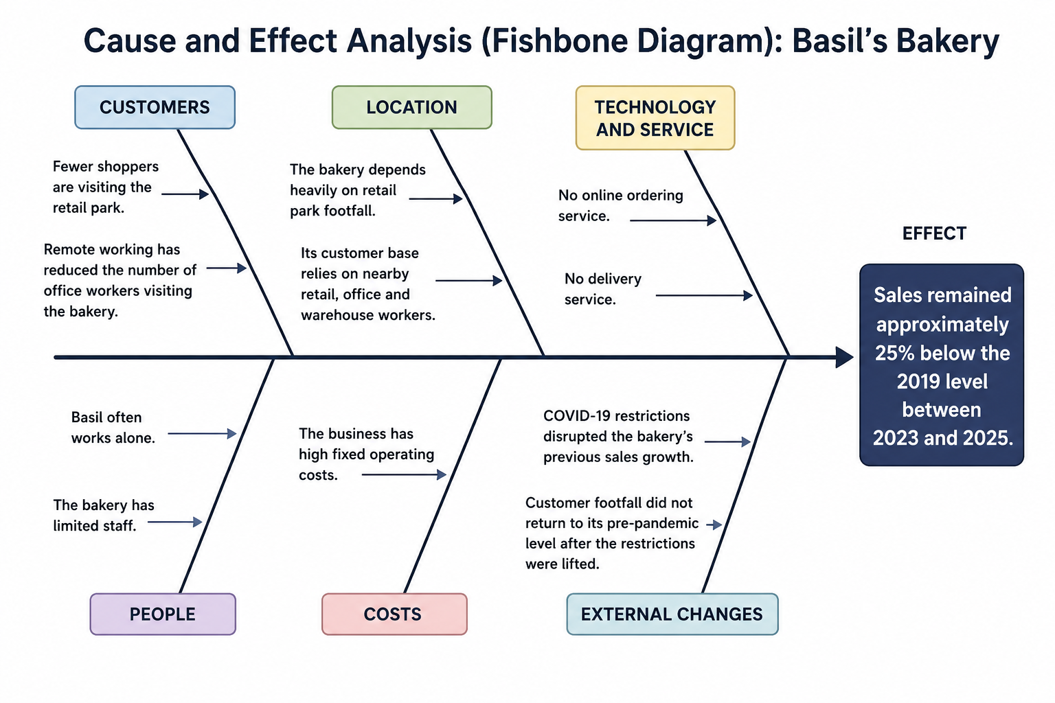
Notes:
As we can observe, none of the root causes relate to product quality, suggesting that the problem lies in the business model rather than the product itself.

Slide 13
Key Findings & Recommendations 1
Key Findings
Sales decline is caused by both internal and external factors.
The main weakness is the lack of digital sales channels.
Rising operating costs and lower customer footfall have reduced profitability.
The bakery's strong reputation and product quality provide a solid competitive advantage.

Slide 14
Key Findings & Recommendations 2
Recommendations
Launch online ordering.
Introduce click-and-collect before full delivery.
Use social media to promote daily fresh products.
Evaluate customer demand before investing in delivery.
Notes:
I think that Basil's Bakery has a strong product and customer reputation but has not adapted
to changing consumer behaviour.
Digital transformation, together with improved marketing and product diversification,
would help the bakery attract new customers, retain existing ones and improve long-term competitiveness.

Slide 15
Key Findings & Recommendations 3
Recommendations
Alternative strategy
Relocate to a more affluent area if the owner wishes to maintain a traditional artisan business model without digital transformation.
Target customers who value premium quality over price.
Accept lower growth potential in exchange for preserving the existing business model.
Notes:
If Basil prefers to maintain his traditional business model and does not wish to invest in digital transformation or additional staff, he could consider relocating the bakery to a more affluent area.
This strategy would better align the bakery's premium artisan products with customers
who place greater value on quality, freshness and organic ingredients, and who may be less price-sensitive.
However, relocation would involve significant costs and risks,
including uncertainty about customer demand and continued dependence on local footfall.
While this option may provide a more stable niche market,
it could also limit future business growth compared with adopting digital sales channels.

Slide 16
Conclusion
🟢 Sales decline is driven by internal and external factors.
🟢 Strong product quality and local reputation remain key strengths.
🟢 Limited digital presence restricts business growth.
🟢 Digital transformation offers the greatest growth opportunity.
🟢 Relocation could be an alternative for a traditional business model.
Notes:
The analysis shows that declining sales are caused by both internal and external factors.
I believe digital transformation should be the first priority because it addresses several root causes at the same time.
Although Basil's Bakery has an excellent reputation and high-quality products, the lack of digital channels limits its growth.
However,
if Basil wants to preserve his traditional artisan business model,
relocating to a more affluent area could also be considered as an alternative strategy.

Slide 17
References
Basil's Bakery Case Study (2026) Module materials. University of Wales Trinity Saint David. (Unpublished teaching case).
Cadle, J., Paul, D., Hunsley, J., Reed, A., Beckham, D. and Turner, P. (2021) Business Analysis Techniques: 123 Essential Tools for Success. Swindon: BCS, The Chartered Institute for IT.
Hill, T. and Westbrook, R. (1997) 'SWOT Analysis: It's Time for a Product Recall', Long Range Planning, 30(1), pp. 46–52. https://doi.org/10.1016/S0024-6301(96)00095-7
Ishikawa, K. (1986) Guide to Quality Control. Tokyo: Asian Productivity Organization.
Kotler, P. and Keller, K.L. (2022) Marketing Management. 16th edn. Harlow: Pearson.
Porter, M.E. (1980) Competitive Strategy: Techniques for Analyzing Industries and Competitors. New York: Free Press.

Slide 18

Questions

