Slide 1
LCDB7008 Visions for the Future : Theoretical Perspectives on Management
Students' work

Slide 2
In-class activity
You are the CEO of café downstairs .
1. Please suggest ONE way of increasing the revenue stream. Reason
2. Please suggest ONE change on their existing business operation. Why?

Slide 3
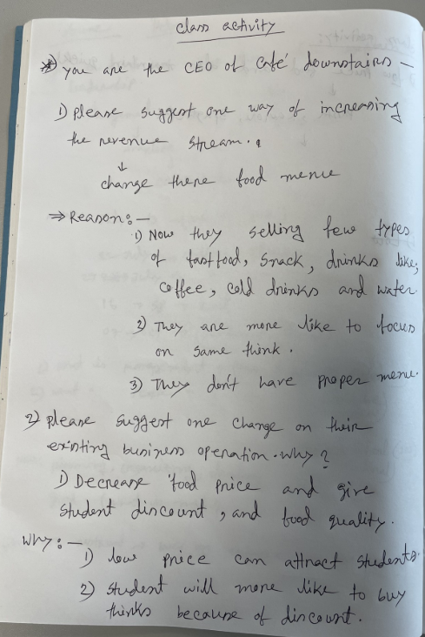
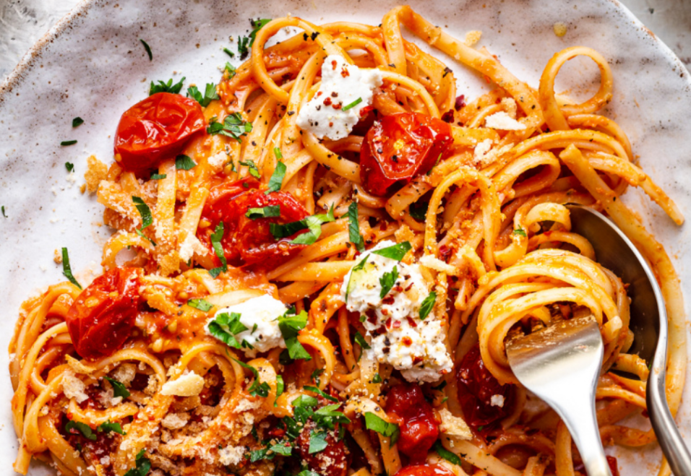
Ummay Huney

Slide 4
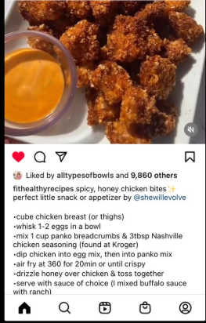
Krishnaveni Balakrishnan
Chicken nuggets
Chicken nuggets are very healthy than fast food, and it's most popular food among the students. This is a pre cooked food, so it required minimum preparation, just add to the hot oil and serve it. Adding chicken nuggets to a cafe menu can attract more students, and it automatically increase the revenue.

Slide 5
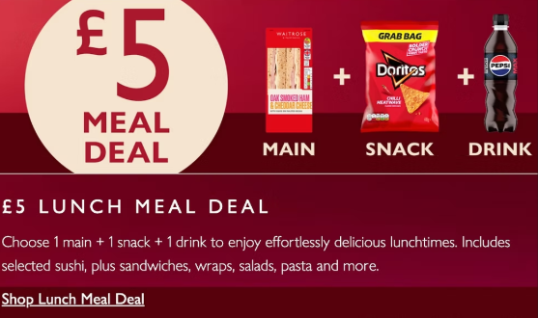
Natalie Brailsford

Slide 6
Cost effective meal deals
“
Office delivery now also available!

Slide 7
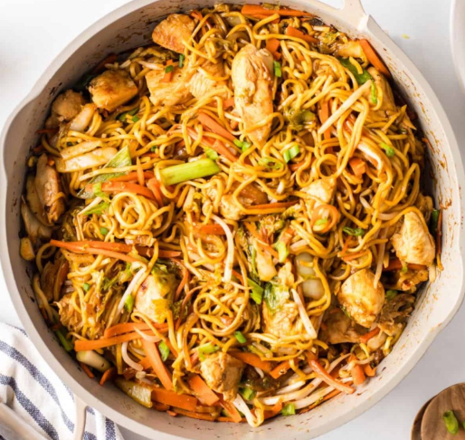
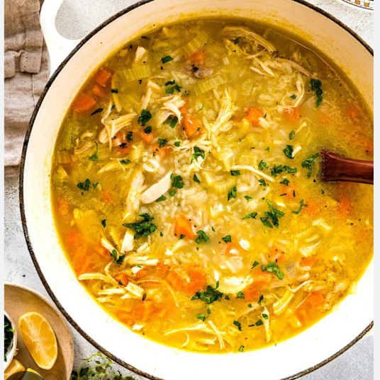
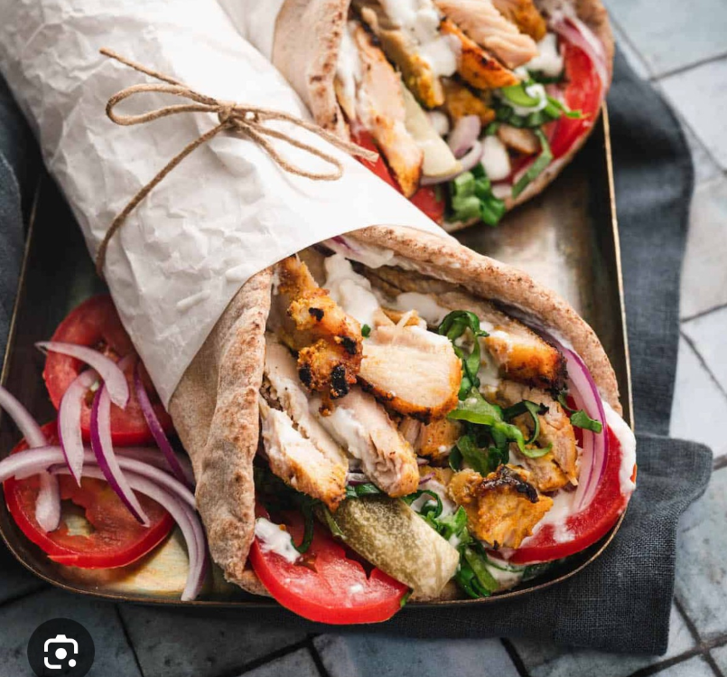
Especially for the university cafe, to attract and attach students from diverse countries and backgrounds, the first focus is the food menu. It must be keeping some items that are very recognised and neutral foods and must be in a student-budget-friendly price. For example: Different types of soup, wraps or burgers, chawmein and any kind of combo meals. When food is both familiar and cheap then students will not eat outside. They will buy from the university cafe every single day and enjoy foods with friends. Because of the high sales, the cafe day by day get more profitable and it increases their cafe revenue also. Because good service, good food in resonable price and a cozy and peaceful environment are all keys to the success of a business.
Sumaiya Minnat

