Slide 1

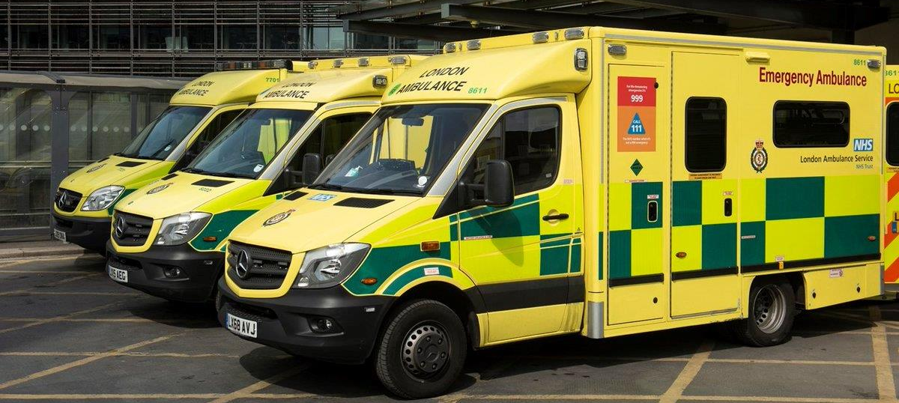
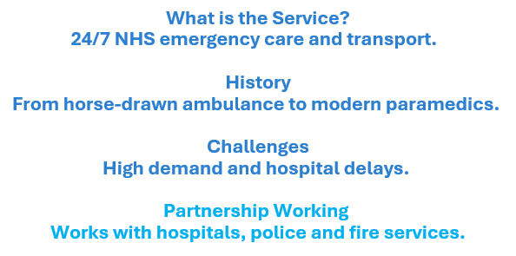
Introduction to Health and Social Care
2522889@student.uwtsd.ac.uk
Module code:
LCHS4003
Keeran Wahid

Slide 2

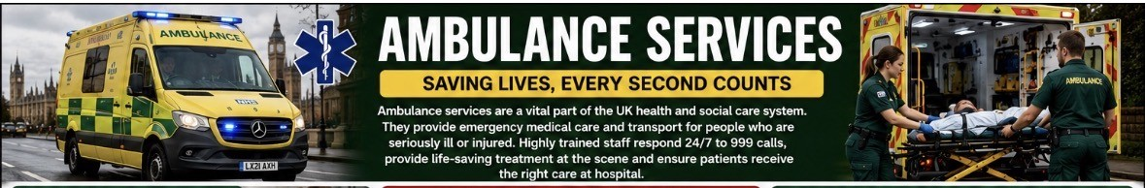
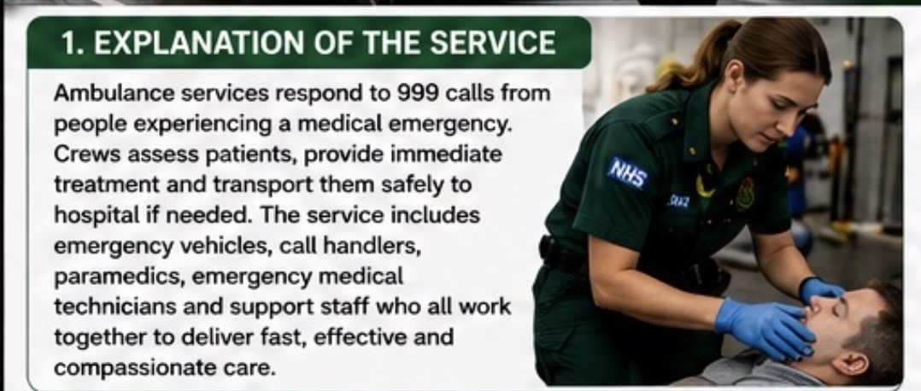
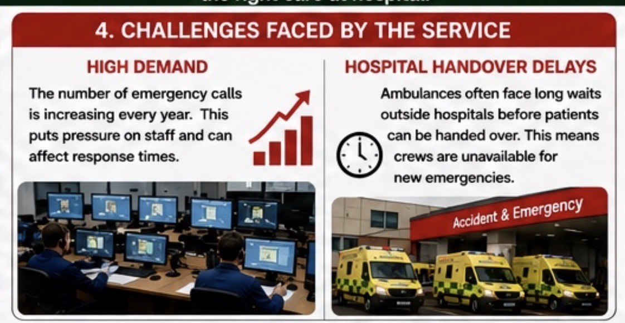
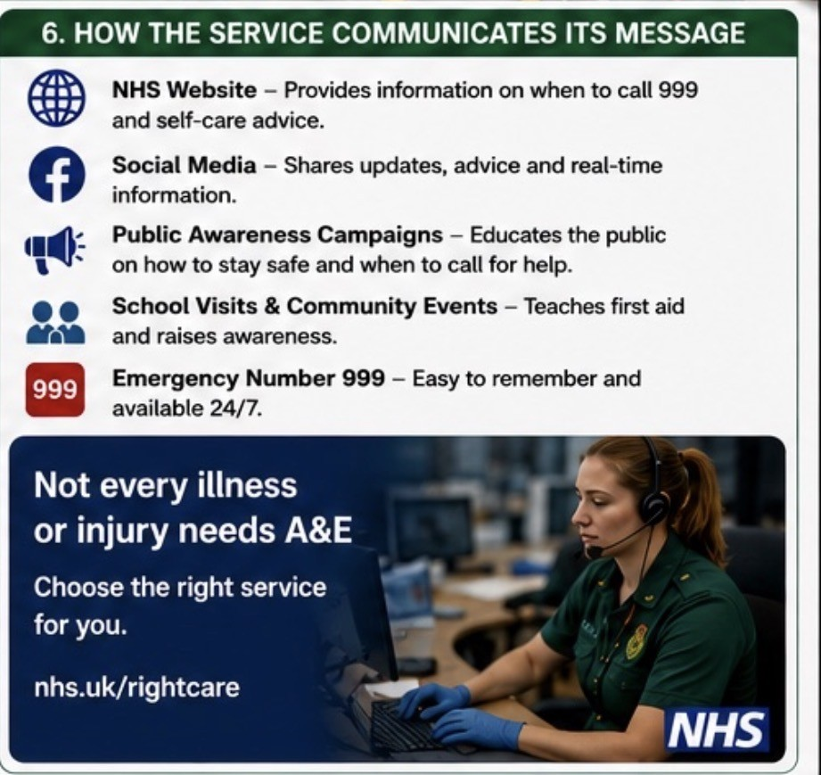
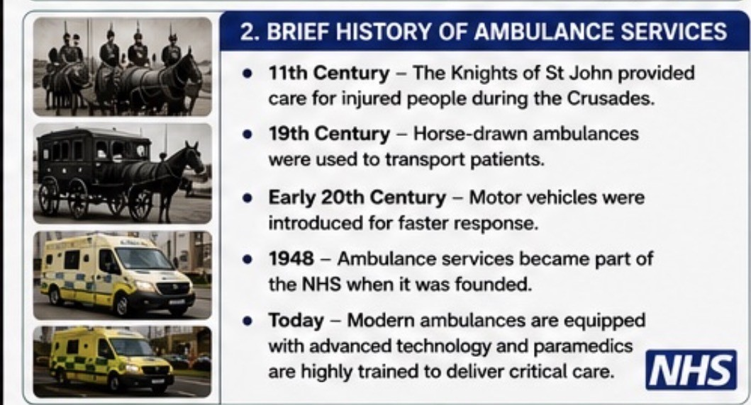
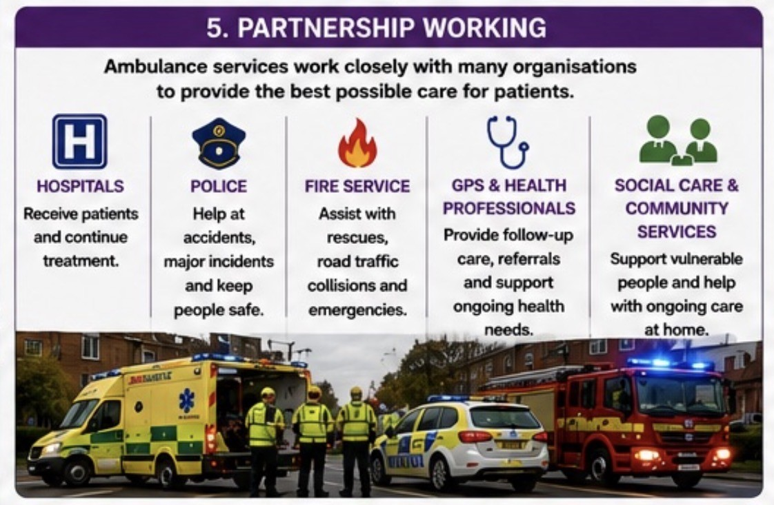
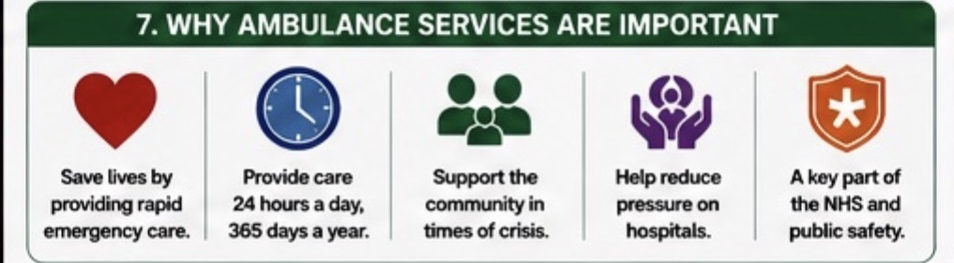
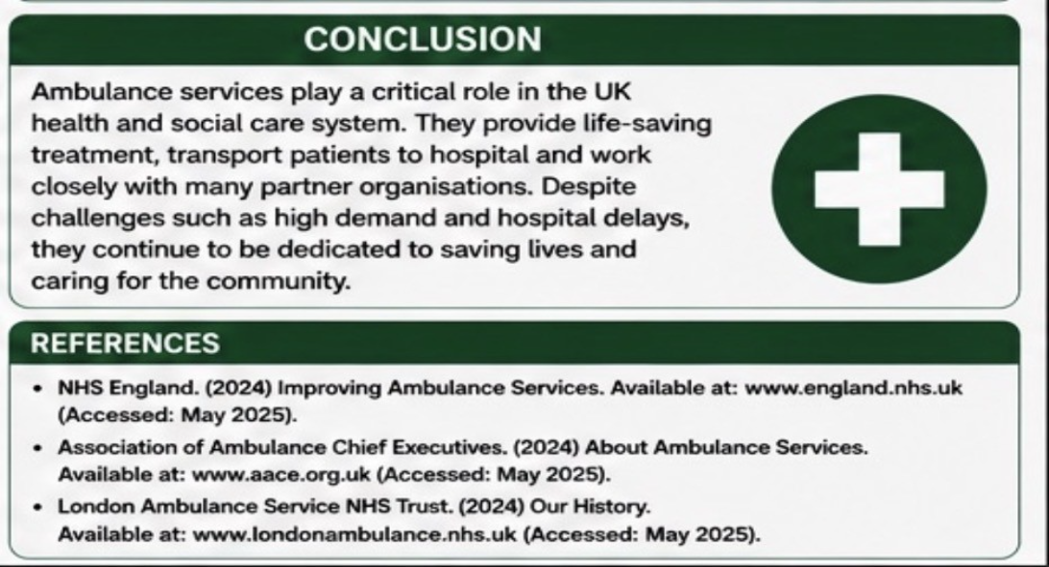
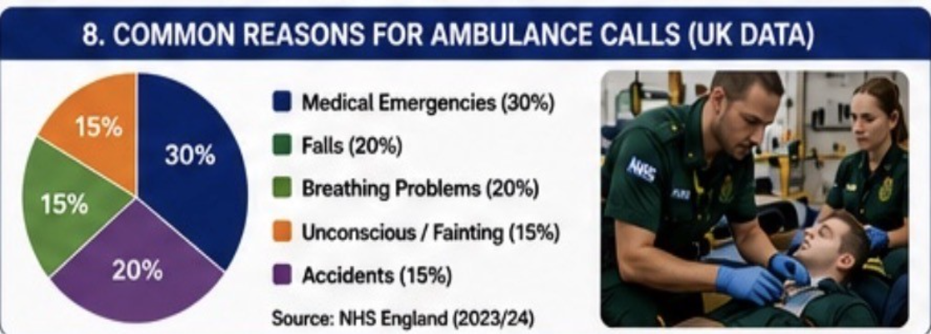
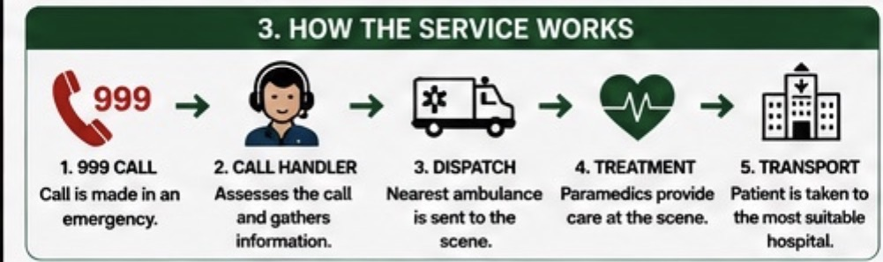
INSERT IMAGE
AMBULANCE SERVICES
INSERT IMAGE
SAVING LIVES, EVERY SECOND COUNTS
1. EXPLANATION OF THE SERVICE
Click to this section.
INSERT IMAGE
4. CHALLENGES FACED BY THE SERVICE
Click to edit this section.
6. HOW THE SERVICE COMMUNICATES ITS MESSAGE
Click to edit this section.
2. BRIEF HISTORY OF AMBULANCE SERVICES
Click to edit this section.
5. PARTNERSHIP WORKING
Click to edit this section.
3. HOW THE SERVICE WORKS
Click to edit this section.
INSERT IMAGE
CONCLUSION
Click to edit this section.
7. WHY AMBULANCE SERVICES ARE IMPORTANT
Click to edit this section.
8. COMMON REASONS FOR AMBULANCE CALLS
Click to edit this section.
REFERENCES
Click to edit this section.
Notes:
What is the Service?
24/7 NHS emergency care and transport.
History
From horse-drawn ambulance to modern paramedics.
Challenges
High demand and hospital delays.
Partnership Working
Works with hospitals, police and fire services.
Introduction to Health and Social Care
2522889@student.uwtsd.ac.uk
Module code:
LCHS4003

