Slide 1
The Shock Tube Problem
Initial configuration at t=0 : p₄ > 1
p₄ T₄ ρ₄ and U_{L}=0
p₁ T₁ ρ₁ and U_{R}=0
Driven section
Working section
diaphragm
At t>0:
(4) (E)
(2) (1)
(2’)
Contact discontinuity
Shock wave

Slide 2
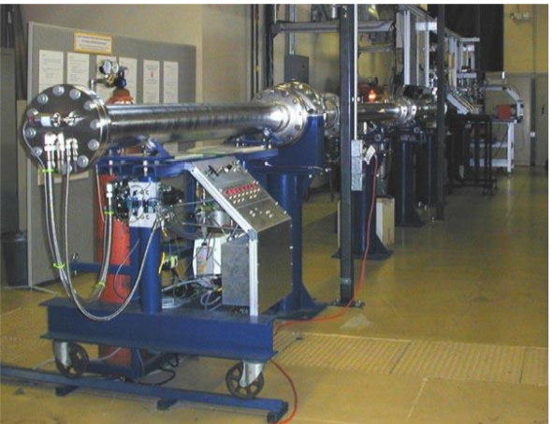

Slide 3
The shock tube is useful for laboratory testing of a range of problems, including supersonic aerodynamic investigations.
There exists an analytic solution for this problem- i.e. solving Euler equations. We can apply these equations across the shock and get the Rankine - Hugoniot equations. There are various forms of these equations. They express the conservation of mass, momentum and energy across the discontinuity/shock.

Slide 4
Sudden breakdown of diaphragm causes a high speed flow which propagates into working section.
Gas at high pressure expands and flows into working section. This expansion fan propagates left and grows with time.
The compression of the low pressure gas generates a shock wave and this moves to the right. The expanded gas is separated from the compressed gas by a contact discontinuity, which can be regarded as a fictitious membrane moving to the right at constant speed.
Note that some of the physical properties such as density are discontinuous across the shock wave.
Plotting these zones on an x – t graph :

Slide 5
t
Contact disc.
shock
Exp fan
(4)
(3)
(2’)
(2)
(1)
x
Initial diaphragm

Slide 6
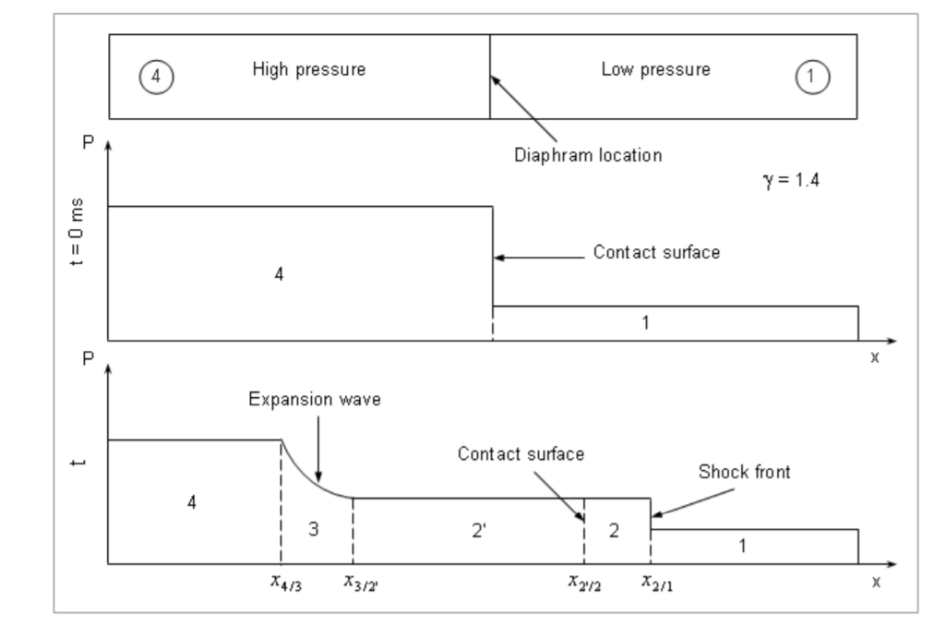
When diaphragm bursts, the discontinuity between the two initial states breaks into leftward and rightward moving waves, separated by a contact surface. A shock wave moves at supersonic speed into the low pressure side. A rarefaction (expansion) wave moves to the left.

Slide 7
There are two types of discontinuities present:
  Contact surface: no flow between regions separated by a contact surface. A contact surface moves with the fluid and separates two zones (2 and 2’ in the figure) of different density and temperature, but the same pressure. The flow velocity is the same on both sides of the contact discontinuity- therefore no net mass flow across it.
  Shock front: fluid mass does flow across a shock front. If we move with the shock then we could think of the upstream fluid (region 1) as being supersonic and the downstream fluid (region 2) as being subsonic.
  There are two types of shock wave we can consider:
    With and without exothermic chemical reaction - that might be triggered by the step change in pressure and temperature induced by the shock/detonation wave.

Slide 8
At some arbitrary time shortly after diaphragm rupture, the pressure, density and velocity profiles are:
P
4
1
3
2’
2
ρ
v
Exp wave
contact
shock

Slide 9
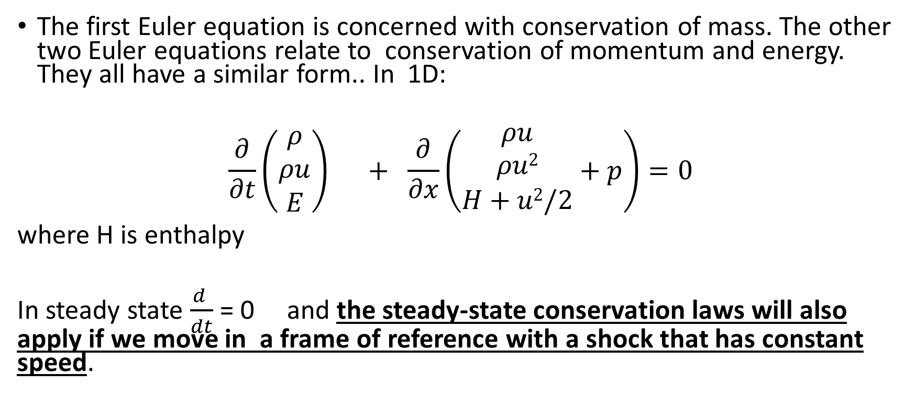
The Euler equations of gas dynamics
The first Euler equation is concerned with conservation of mass. The other two Euler equations relate to conservation of momentum and energy. They all have a similar form.. In 1D:
$$\frac{∂}{∂t}{\left(\begin{matrix}ρ \\ ρu \\ E\end{matrix}\right)}_{}^{} + \frac{∂}{∂x}\left(\begin{matrix}\begin{matrix}ρu \\ ρu2\end{matrix} \\ H+u2/2\end{matrix}+p\right)=0$$
where H is enthalpy
In steady state $\frac{d }{dt}$ = 0 and the steady-state conservation laws will also apply if we move in a frame of reference with a shock that has constant speed.

Slide 10
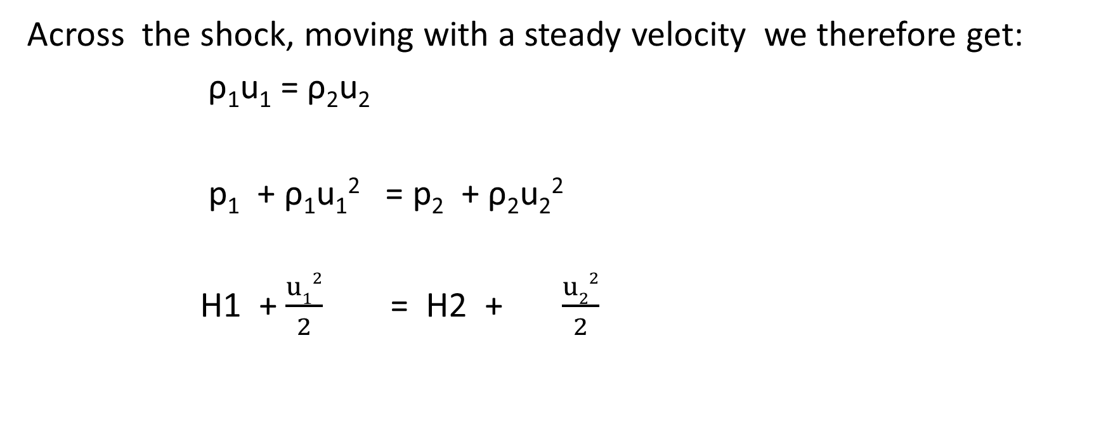
P2
ρ2
U2
H2
P1
ρ1
U1
H1
Across the shock, moving with a steady velocity we therefore get:
ρ₁u₁ = ρ₂u₂
p₁ + ρ₁u₁² = p₂ + ρ₂u₂²
H1 + $\frac{u12}{2}$ = H2 + $\frac{u22}{2}$
These are the Hugoniot equations across a shock

Slide 11
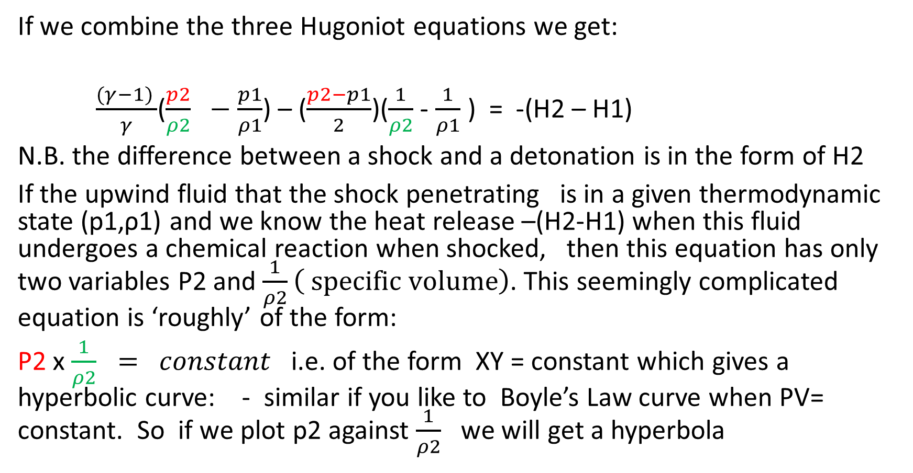
Rankine- Hugoniot equation for detonation/deflagration wave
If we combine the three Hugoniot equations we get:
$\frac{(γ−1) }{γ}$($\frac{p2}{ρ2} −\frac{p1}{ρ1}$) – ($\frac{p2−p1}{2}$)($\frac{1}{ρ2}$- $\frac{1}{ρ1}$ ) = -(H2 – H1)
N.B. the difference between a shock and a detonation is in the form of H2
If the upwind fluid that the shock penetrating is in a given thermodynamic state (p1,ρ1) and we know the heat release –(H2-H1) when this fluid undergoes a chemical reaction when shocked, then this equation has only two variables P2 and $\frac{1}{ρ2}\left( specific volume\right)$. This seemingly complicated equation is ‘roughly’ of the form:
P2 x $\frac{1}{ρ2} = constant$ i.e. of the form XY = constant which gives a hyperbolic curve: - similar if you like to Boyle’s Law curve when PV= constant. So if we plot p2 against $\frac{1}{ρ2}$ we will get a hyperbola

Slide 12
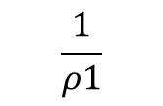

The Hugoniot Curve - it’s a plot of p2 versus $\frac{1}{ρ2}$ for a given value of (p1 , $\frac{1}{ρ1}$ ) and heat release (-H2-H1)
Possible solutions (p2, ρ2) to the Hugionot equation lie on this curve.
p
p1
(p1,$\frac{1}{ρ1}$)
$$\frac{1}{ρ1}$$

Slide 13
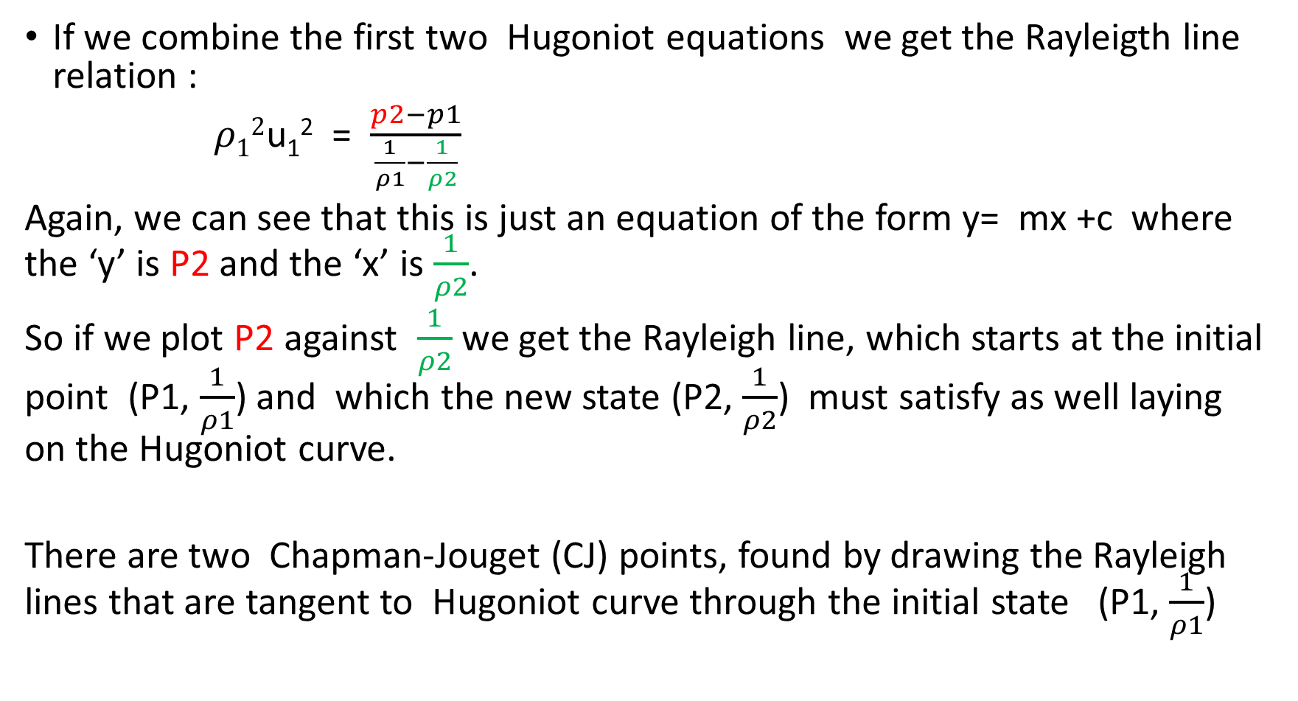
If we combine the first two Hugoniot equations we get the Rayleigth line relation :
$ρ12$u₁² = $\frac{p2−p1}{\frac{1}{ρ1}−\frac{1}{ρ2}}$
Again, we can see that this is just an equation of the form y= mx +c where the ‘y’ is P2 and the ‘x’ is $\frac{1}{ρ2}$.
So if we plot P2 against $\frac{1}{ρ2}$ we get the Rayleigh line, which starts at the initial point (P1, $\frac{1}{ρ1}$) and which the new state (P2, $\frac{1}{ρ2}$) must satisfy as well laying on the Hugoniot curve.
There are two Chapman-Jouget (CJ) points, found by drawing the Rayleigh lines that are tangent to Hugoniot curve through the initial state (P1, $\frac{1}{ρ1}$)

Slide 14
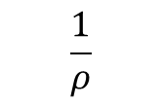
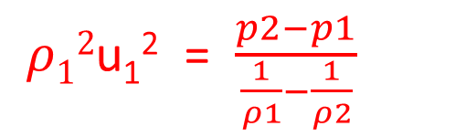
The Rayleigh line relation is a criterion to identify regimes on the Hugoniot curve where detonation and deflagration are possible
Possible solutions (p2, ρ2) to the Hugoniot equation lie on this curve.
p
Region I
Strong Detonation
Upper CJ Point
$ρ12$u₁² = $\frac{p2−p1}{\frac{1}{ρ1}−\frac{1}{ρ2}}$
Region II
Weak Detonation
Region V
Impossible
p1
Region III
Weak Deflagration
(p1,$\frac{1}{ρ1}$)
Region IV
Strong Deflagration
Lower CJ point
$$\frac{1}{ρ}$$
$$\frac{1}{ρ1}$$

Slide 15
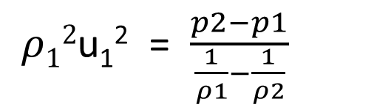
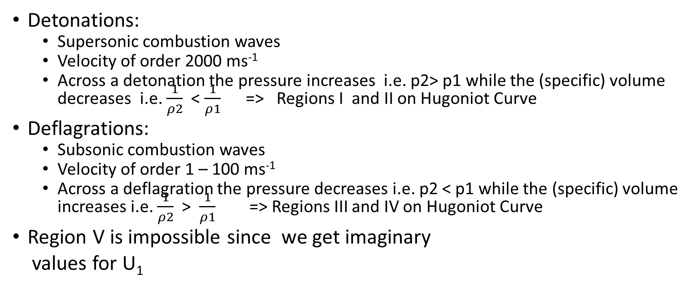
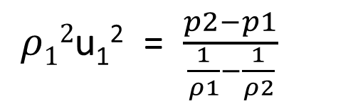
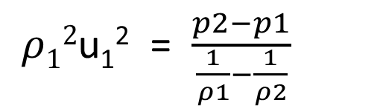
The Rayleigh line relation is a criterion to identify regimes on the Hugoniot curve where detonation and deflagration are possible
$ρ12$u₁² = $\frac{p2−p1}{\frac{1}{ρ1}−\frac{1}{ρ2}}$
Detonations:
  Supersonic combustion waves
  Velocity of order 2000 ms⁻¹
  Across a detonation the pressure increases i.e. p2> p1 while the (specific) volume decreases i.e. $\frac{1}{ρ2}$ < $\frac{1}{ρ1}$ => Regions I and II on Hugoniot Curve
Deflagrations:
  Subsonic combustion waves
  Velocity of order 1 – 100 ms⁻¹
  Across a deflagration the pressure decreases i.e. p2 < p1 while the (specific) volume increases i.e. $\frac{1}{ρ2}$ > $\frac{1}{ρ1}$ => Regions III and IV on Hugoniot Curve
Region V is impossible since we get imaginary
values for U₁
$ρ12$u₁² = $\frac{p2−p1}{\frac{1}{ρ1}−\frac{1}{ρ2}}$
$ρ12$u₁² = $\frac{p2−p1}{\frac{1}{ρ1}−\frac{1}{ρ2}}$

Slide 16
From a stationary frame of reference
Conservation of mass:
ρ₁D = ρ₂(D-u₂ ) because:
Mass into shock wave from undisturbed fluid is ρ₁D .Δt. A = Δm₁
Mass out of shock wave into disturbed fluid is ρ₂(D-u₂ ) .Δt. A = Δm₂
Conservation of mass means Δm₁ = Δm₂ = Δm
Conservation of momentum: (note momentum of undisturbed fluid is zero)
change in momentum for the mass Δm is Δm. u₂ ₌ ρ₁D .Δt. A .u₂
But Newton’s 2nd Law says change in momentum = F. Δt = (P₂ – P₁)A Δt
Therefore: (P₂ – P₁) A Δt = ρ₁D .Δt. A .u₂
Hence (P₂ – P₁)= ρ₁D .u₂

Slide 17
The Water shock Hugoniot
For many materials the shock velocity D is linearly related to the particle velocity, u ( fluid velocity just after shock has passed)
D = a + bu where a and b are constants obtained from experiment.
Typical values for these constants for water are
  a = 1.45 kms⁻¹ and
  b =1.99
Example: Calculate the specific volume and pressure when the particle velocity is 0.5 kms⁻¹ and the initial water pressure is zero and initial density is 1000 kgm^{-3 .}
Solution: Determine D from linear relationship for water; then use Hugoniot equation for momentum to determine P. The use Hugoniot equation for mass conservation to determine ρ₂ and hence specific volume.

Slide 18
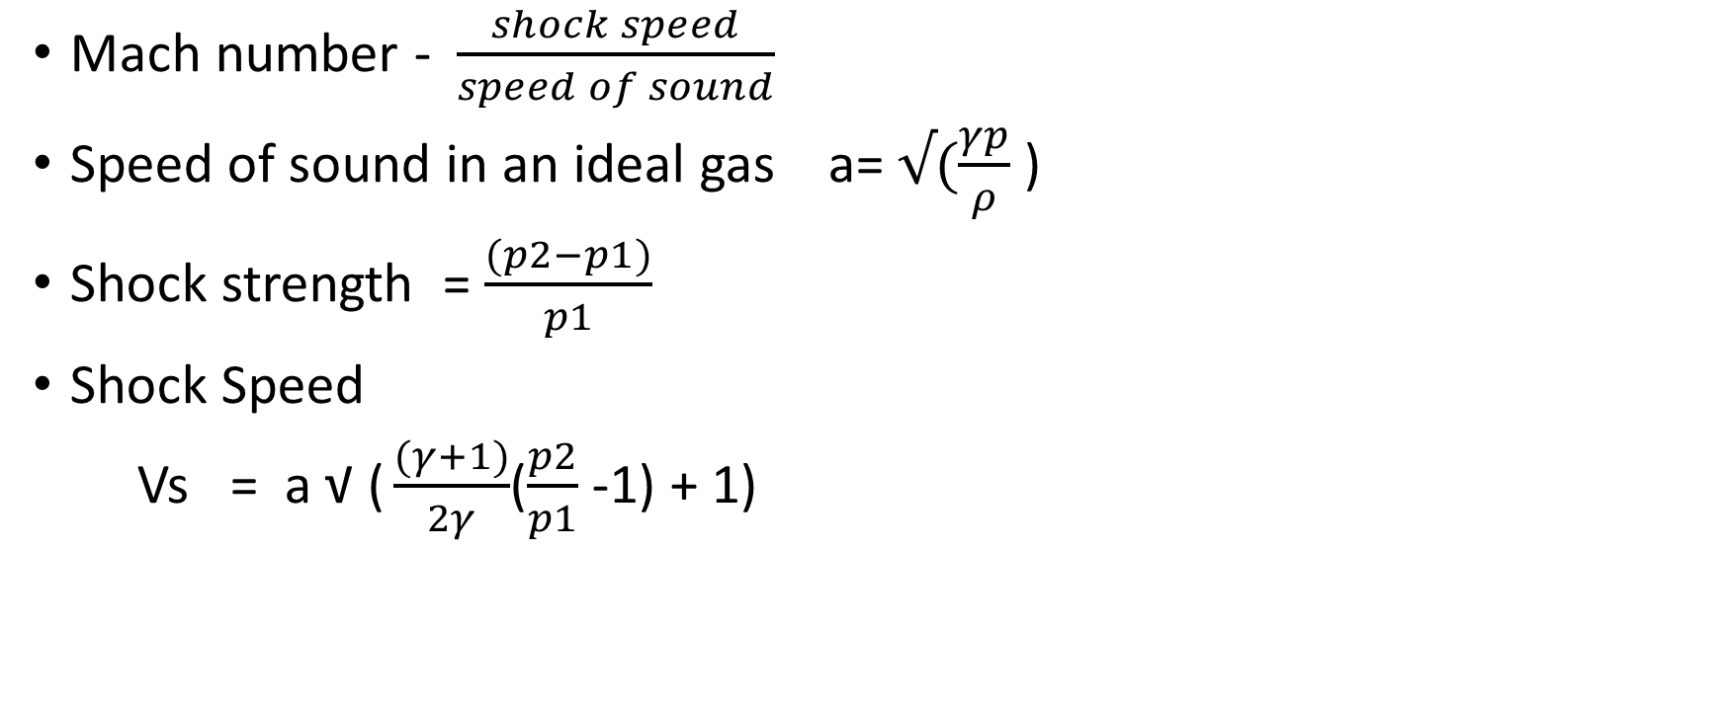
Some well-known terms
Mach number - $\frac{shock speed}{speed of sound}$
Speed of sound in an ideal gas a= $√(\frac{γp}{ρ}$ )
Shock strength = $\frac{(p2−p1)}{p1}$
Shock Speed
Vs = a $\text{√}\text{ (}\frac{(γ+1)}{2γ}$($\frac{p2}{p1}$ -1) + 1)

