Slide 1
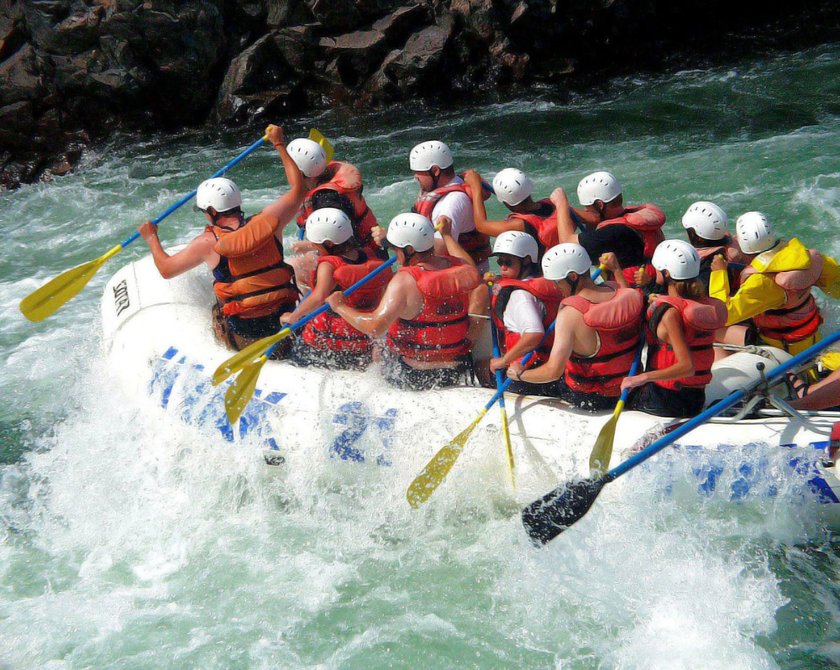
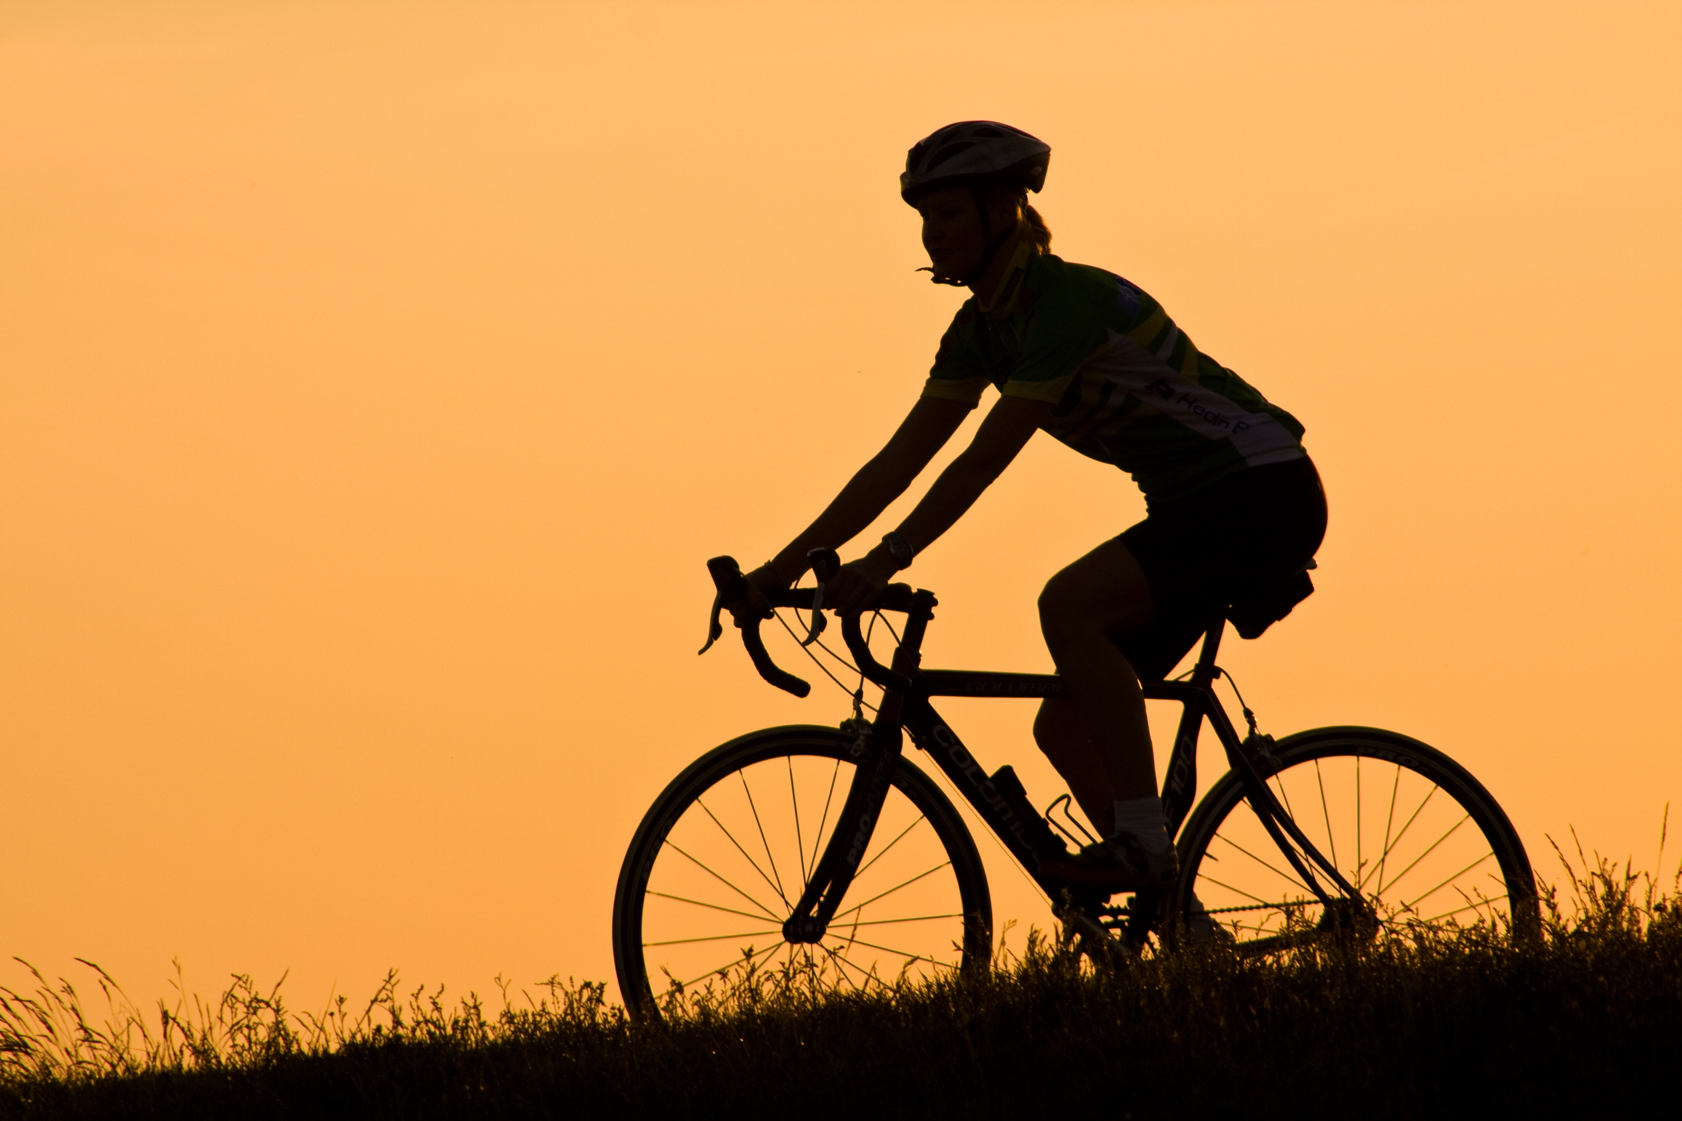

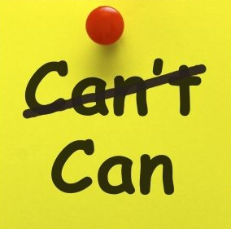
Outdoor learning and adventurous activities
Physical literacy – described as the motivation, confidence, physical competence, knowledge and understanding about taking part in physical activity for life (Whitehead, 2016).
A person that is physically literate has good self-esteem. It has been argued that compulsory and regular outdoor education can improve self-esteem and self-confidence (Becker, 2017).
Fairclough (2002) states that children should have a variety of opportunities in outdoor education and that team games restrict success and affects confidence whereas outdoor education does the opposite.
Fjortoft (2001) explains how the unpredictable nature of the outdoors can develop physical skills such as balance and coordination.

Slide 2
Reference list
Becker, C., Lauterbach, G., Spengler, S., Dettweiler, U. and Mess, F. (2017). Effects of regular classes in outdoor education settings: a systematic review on pupils learning, social and health dimensions. International journal of environmental research and public health, 14 (5).
Fairclough, S., Stratton, G. and Baldwin, G. (2002). The contribution of secondary school physical education to lifetime physical activity. European physical education review. 8 (1), pp.69-84.
Fjortoft, I. (2001). The natural environment as a playground for children: The impact of outdoor play activities in pre-primary school children. Early childhood education journal, 29 (2), pp.111-117.
Maynard, T., Waters, J. and Clement, J. (2013). Child-initiated learning, the outdoor environment and the “underachieving” child. Early years: An international research journal, 33 (3), pp.212-225.
Mygind, E. (2009). A comparison of children statements about social relations and teaching in the classroom and in the outdoor environment. Journal of adventure education & outdoor learning, 9 (2), pp.151-169.
Sharples, G. (2017). Teachers Teaching OAA: take the challenge. PE matters, 12 (2), pp.22-25.
Slade, M., Lowery, C. and Bland, K. (2013). Evaluating the impact of forest schools: A collaboration between a university and a primary school. Support for Learning: British Journal of Learning Support, 28 (2), pp.66-72.
Wainwright, N. (2013). Physical Literacy in the foundation phase in Wales. ICSSPE Bulletin, 65 (1.2).
Whitehead, M. (2013). Definition of physical literacy and clarification of related issues. ICSSPE Bulletin, 65 (1.2).
Williams, A. and Wainwright, N. (2016). A new pedagogical model for adventure in the curriculum: part one – advocating for the model. Physical Education and Sport Pedagogy, 21(5), pp.481-500.
Williams, A. and Wainwright, N. (2016). A new pedagogical model for adventure in the curriculum: part two – outlining the model. Physical Education and Sport Pedagogy, 21(6), pp.589-602.

