Slide 1
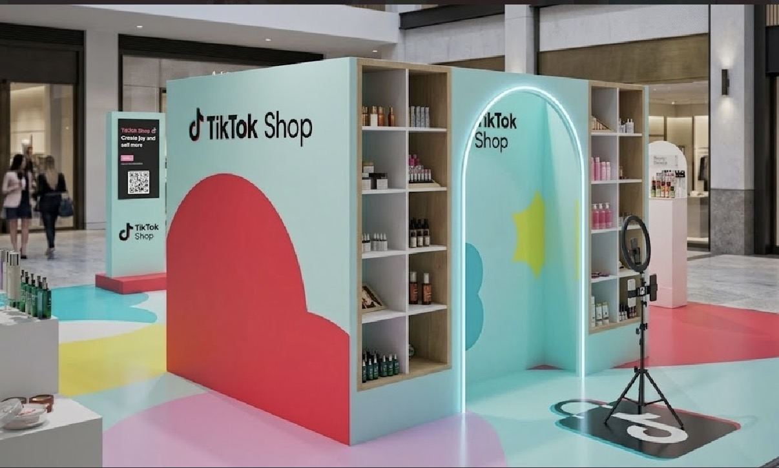
Business Plan – TikTok Clothing Store
Presented by: Mutwakil Muhamado
Student ID: 2024521
Module name: Enterprise and Entrepreneurship
Model code: LCLM4006
Lecturer: Andy Rakotovololona
Programme: Level 4 Certificate in Higher Education – Business Skills for the Workplace
https://london-post.co.uk/tiktok-shop-launches-westfield-stratford-pop-up-with-up-to-50-off-for-spring-sale-2026/

Slide 2

Presentation overview
Overview of the Business Idea
Important Pestel Factors
Marketing Strategy 1
Marketing Strategy 2
Funding Requirements
Budget & Sustainability
Project sales for the first month
Conclusion
References list
https://marketing.org.nz/hubfs/Overviewe%20hero%20image.png

Slide 3
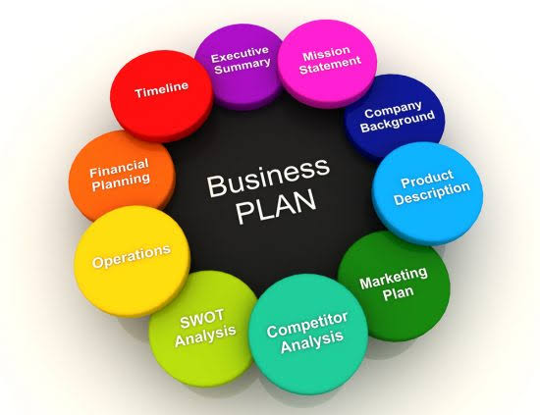
Overview of the Business Idea
Online start-up selling affordable clothing through TikTok Shop.
Offers hoodies, T-shirts, jeans, jackets, tracksuits and accessories.
Targets men and women aged 18–35 across the UK.
Unique Selling Points (USP)
Affordable prices.
Good-quality clothing.
Fast UK delivery.
Excellent customer service.
Easy shopping through TikTok Shop.
Business Structure
Legal Structure: Sole Trader.
Managed by the owner.
https://encrypted-tbn0.gstatic.com/images?q=tbn:ANd9GcS2JVcbCxq-95hPTUe0Pj_dzWJVJJcbhQrXB1NCtVWaWQ&s=10

Slide 4
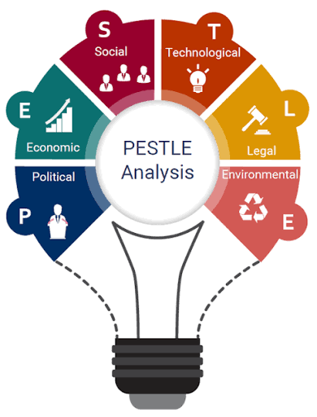
Important Pestel Factors
Political
  UK trade policies may affect clothing imports.
  Import taxes and customs duties can increase costs.
  Government support for small businesses may provide funding opportunities.
Economic
  Inflation can increase the cost of stock and shipping.
  The cost of living affects customers’ spending on clothing.
  Competition from other online retailers may influence pricing.
Social
  Young consumers are highly influenced by TikTok trends.
  Influencer marketing increases brand awareness and sales.
  Customers prefer fashionable, affordable, and high-quality clothing.
Technological
  TikTok’s algorithm helps businesses reach a larger audience.
  TikTok Shop allows customers to purchase products directly through the app.
  Secure online payment systems improve the shopping experience.
Legal
  The business must comply with UK consumer protection laws.
  Customer data must be protected under GDPR.
  Clothing products must meet UK product safety and labelling requirements.
https://encrypted-tbn0.gstatic.com/images?q=tbn:ANd9GcTWgxiAMHtC4zuxTJopfYQxqbgc3XBwMVwP9pLQH53yPg&s=10

Slide 5

Marketing Strategy 1
TikTok Marketing
> Post daily fashion videos.
> Host weekly livestreams.
> Show new products.
> Share styling ideas.
> Answer customer questions live.
> Offer exclusive livestream discounts.
Benefits
> Builds customer trust.
> Increases followers.
> Creates higher engagement.
> Generates more sales.
https://encrypted-tbn0.gstatic.com/images?q=tbn:ANd9GcT2cHtKbB89z_n3Yu36XiQ6ZZ4p9b_3N_JV7C9_2po3uA&s=10

Slide 6
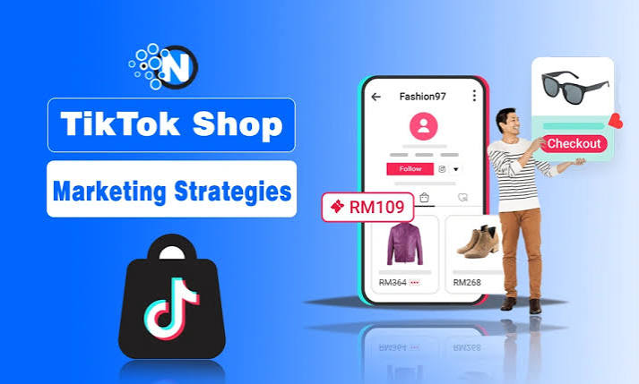
Marketing Strategy 2
Social Media & Influencers
Promote products on Instagram.
Advertise on Facebook.
Work with fashion influencers.
Share customer reviews.
Offer discount codes.
Run giveaways.
Reward customer referrals.
Benefits
Increases brand awareness.
Reaches more customers.
Encourages repeat purchases.
Builds customer loyalty.
https://encrypted-tbn0.gstatic.com/images?q=tbn:ANd9GcT-n8tZqzN0R4ZBSS_Z8IGBh7dci8YsOKCxvIQDcEojng&s=10

Slide 7
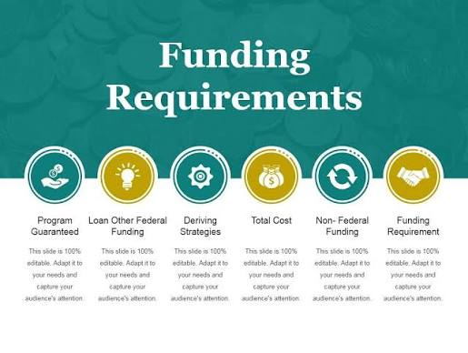
Funding Requirements
Total Funding Required
£5,000
Funding Sources
Personal savings.
Why Funding Is Needed
Purchase clothing stock.
Marketing and advertising.
Packaging materials.
TikTok Shop setup.
Delivery costs.
Business operating expenses.
https://encrypted-tbn0.gstatic.com/images?q=tbn:ANd9GcRaM-1qSgkTf5mycBlSThyB6gaaySJE563b-AET9Gh84Q&s=10

Slide 8

Budget & Sustainability
First Month Budget
Stock – £2,500
Marketing – £500
Packaging – £300
TikTok Shop setup – £200
Delivery & other costs – £1,500
Sustainability
Use recyclable packaging.
Reduce plastic waste.
Donate selected unsold clothing.
Support local charities.
Encourage responsible shopping.
https://encrypted-tbn0.gstatic.com/images?q=tbn:ANd9GcQLD1gj6Wqr39mkEa6JSe0kUCiOeCJ0tsBzVb6CSden3w&s=10

Slide 9
Project sales for the first month
Product | Units sold | Selling price | Total sales
T shirts | 40 | £20 | £800
Hoodies | 25 | £35 | £875
Jeans | 20 | £30 | £600
Jackets | 10 | £50 | £500
Tracksuits | 15 | £45 | £675
Total sales revenue 110
£3,450

Slide 10

Conclusion
Why My Business Will Succeed
Growing demand for online fashion.
Popularity of TikTok Shop.
Affordable products.
Strong social media marketing.
Excellent customer service.
Sustainable business practices.
Future Goals
Increase monthly sales.
Expand the product range.
Build a loyal customer base.
Grow into a recognized UK online fashion brand.
https://encrypted-tbn0.gstatic.com/imagesq=tbn:ANd9GcQV7LIMEE5k3J-pDuitppTuUcUKxqUWHMLJXYs89ThIzA&s=10?

Slide 11
References list
> Burns,P. (2023).Entrepreneurship and Small Business.
> Kotler, P. & Keller, K. (2022). Marketing Management.
> TikTok Shop. (2025) TikTok Shop UK. Available at: https://seller-uk.tiktok.com/ (Accessed: 5 August 2026).
> UK Government (2025) Set up as a Sole Trader. Available at: https://www.gov.uk/set-up-sole-trader (Accessed: 5 August 2026).
> Statista (2025) UK Online Fashion Market Statistics. Available at: https://www.statista.com (Accessed: 5 August 2026).
> TikTok Shop UK.
> UK Government.

