Slide 1
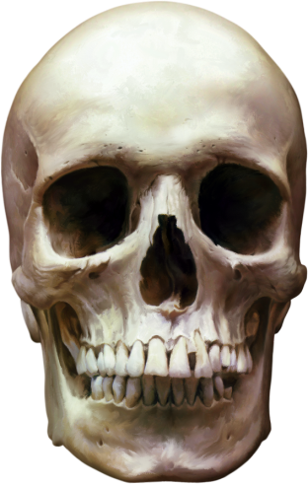
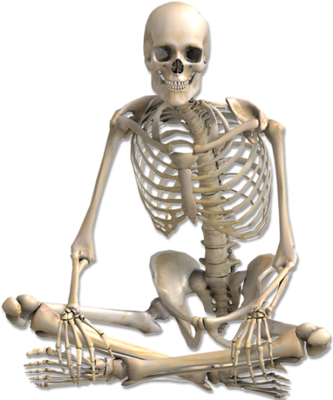

skeletal system samina bashir 1816450 BMHP5003 Introduction to physiology Mumtaz goolam Individual poster

Slide 2

Skeletal System
The core structure of your body is provided by the skeletal system. Connective tissue such as cartilage and tendons and ligaments are found in this structure. The musculoskeletal system is another name for it. Everything that makes up the human body's skeleton is found inside its skeletal system. The skeleton accounts for around 20% of the human body. A reliable source for determining a person's weight (Chen, 2021).
206 bones make up the skeleton of an adult. Some bones in children's skeletons, such as those in the skull, fuse together as they grow older. The male and female skeletons vary in certain respects as well. The skeleton of a man is typically larger and more densely boned than that of a woman. Women have larger pelvises to enable pregnancy and childbirth, whereas men have smaller ones. The axial skeleton and appendicular skeleton are two distinct elements of the skeletal system, regardless of gender or age (Dahdu, 2012).
There are three main functions of the skeleton: support, protection, and motion, which can be explained by looking at how the skeleton is connected to the body's soft tissues, such as the nervous system, digestive system, respiratory system, cardiovascular system, and the muscles of the skeletal system. Support is the most rudimentary and earliest of these tasks, just as the axial skeleton was the first to emerge. There is a strong connection between the vertebral column (the notochord in lower creatures) and the trunk (Dong, 2022).

Slide 3
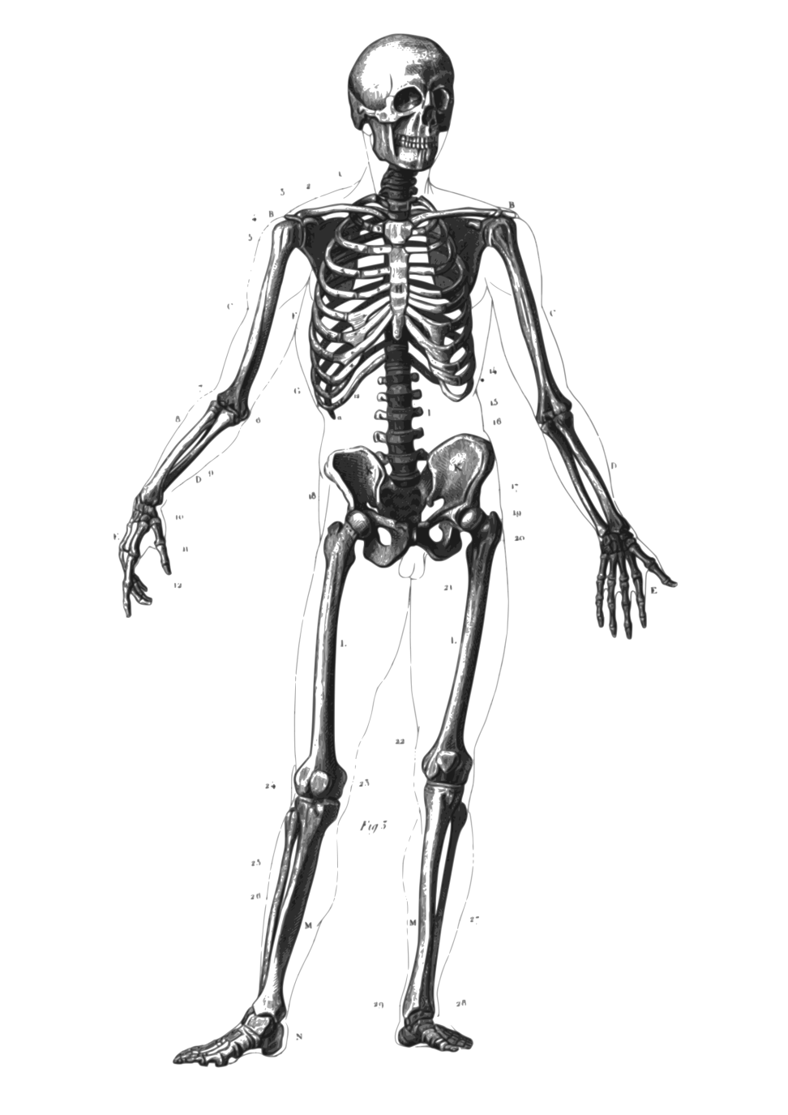
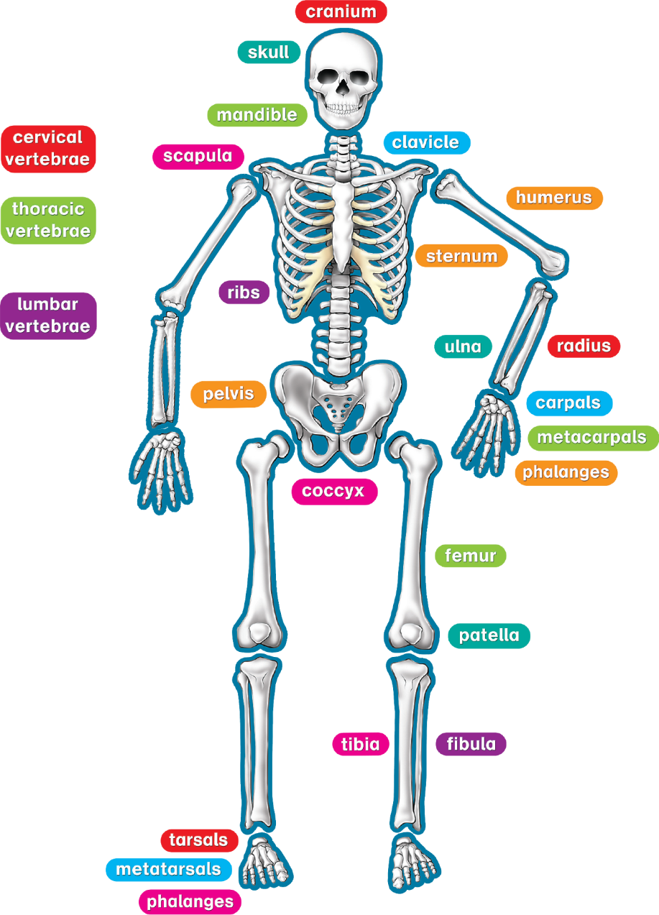

Slide 4
Types of bones
Long, short, flat, uneven, and sesamoid bones make up the human skeleton.
To aid in mobility and to sustain one's weight, a long bone is essential. Long bones have a tubular shaft and an articular surface at either end, where ligaments and tendons connect, making them more flexible. Some of these bone include humerus, femur, tibia and fibula, radius, as well as the ulna and ulna.
Ankle and wrist joints are supported by a short bone that aids in stability and mobility. They provide very little in the way of motion. Short bones have a cube-like form and are about the same width and length as a human fist. Carpals and metacarpals in the wrists and ankles are examples of this kind of bone (Jerome, 2018).
The major function of flat bone is to protect vital internal organs including the brain, heart, and lungs from injury. A vast surface area for muscles to adhere to is also provided by this material. The cranium (head), the thoracic cage (sternum and ribs), and the ilium are examples of this kind of bone (pelvis).
Variations in the structure and size of the irradiated bone are typical of this kind of bone. Depending on where they are found, irregular bones serve a variety of purposes. The spinal column is made up of vertebrae, which protect the spinal cord. Hyoid bones, which support the trachea and pharynx, are another good example (Seo, 2017).
Protecting tendons and reducing friction and wear on joint surfaces are the primary functions of the sesamoid bone. The hands, feet, and knees are the most common places to find this kind of bone. When it comes to sesamoids, patella is the most well-known example (kneecap) (Stiassny, 2000).

Slide 5
the skeletal system do
Bones serve a variety of purposes. We get our human form and traits from it in addition to that.
Your skeleton helps you stand and move by supporting your weight. Your joints, muscles, and connective tissue all work together to allow you to move.
Contains bone marrow: Bones produce blood cells. The bone marrow produces both red and white blood cells.
Ensures organ health and well-being: Your brain is protected by your skull, your heart and lungs are protected by your ribs, and your spine is protected by your backbone.
For minerals such as calcium and vitamin D: Bones store your body's mineral supply in them (Troy, 2018).

Slide 6
Components
There are several components in the skeletal system that work together to allow you to move freely. Hard components that make up your body's framework—the skeleton—are the most important aspect of your skeleton system. Skeletons of adults have 206 bones. Bones are made up of three distinct layers:
This strong membrane, the periosteum, covers and protects the bone's outside.
White, firm, and smooth, compact bone is found below the periosteum. It serves as a structural stabiliser and a protective barrier.
Compact bone, on the other hand, has a spongier core. Marrow may be stored in the pores of the bone (Dong, 2022).
Cartilage protects the ends of your bones where they connect with a smooth and flexible material called cartilage. It allows the bones to move freely without friction (rubbing against each other). Arthritis, which occurs when the cartilage in the joints wears away, may be uncomfortable and impair mobility (Seo, 2017).
A joint is a place in the body where two or more bones meet. Three kinds of joints exist. Among the several joints are:
Joints that can't be moved: The joints between the bones of your skull are examples of immovable joints that prevent the bones from moving at all.
This kind of joint is only partially moveable. There are several rib cage joints that can be partially flexed.
Movable joints provide for a large range of motion. Shoulder and knee joint are moveable.
Ligaments: Bones are held together by bands of strong connective tissue known as ligaments.
It is via the tendons that a muscle is attached to a bone (Stiassny, 2000).

Slide 7
Conditions that can affect the skeletal system
The skeletal system, which includes bones, joints, and tissues, may be affected by a wide range of disorders. Disease or injury may be to blame for some. Others come about as you grow older because to the wear and strain on your body. These include, but are not limited to, the following:
Inflammation in the joints due to arthritis may be caused by a variety of factors, including old age and medical disorders such as Lyme disease.
Fracture: Bones may be fractured by disease, tumours, or trauma.
osteosarcoma: Bone cancer may lead to tumours that weaken and shatter bones if they are not treated.
A condition known as osteoporosis is caused by a lack of calcium in the diet, which results in weak and brittle bones.
Overstretching and tearing of connective tissue may be caused by a variety of factors, including old age, illness, and trauma (Dahdu, 2012).

Slide 8
healthy skeletal system
Skeletal systems support all of the body's motions, as well as a variety of vital activities. These guidelines will help maintain it in excellent condition:
Consume a lot of calcium. Leafy greens, broccoli, tofu, and seafood, such as salmon, are all high in calcium.
Don't forget to take your daily dose of vitamin D. A vitamin D pill may enable folks who don't receive enough sun exposure to acquire enough of this important nutrient.
Perform workouts that require you to bear weight. There are several ways to get your heart rate up, including jogging, running, and climbing.
Protect yourself. Wearing protective gear when riding a bike or participating in contact sports may help prevent bone fractures and other catastrophic injuries (Chen, 2021).

Slide 9
References
Chen, H., Li, J., Zhang, D., Zhou, X. and Xie, J., 2021. Role of the fibroblast growth factor 19 in the skeletal system. Life Sciences, 265, p.118804.
Dahdul, W.M., Balhoff, J.P., Blackburn, D.C., Diehl, A.D., Haendel, M.A., Hall, B.K., Lapp, H., Lundberg, J.G., Mungall, C.J., Ringwald, M. and Segerdell, E., 2012. A unified anatomy ontology of the vertebrate skeletal system. PloS one, 7(12), p.e51070.
Dong, Z., Yang, C., Tan, J., Dou, C. and Chen, Y., 2022. Modulation of SIRT6 activity acts as an emerging therapeutic implication for pathological disorders in the skeletal system. Genes & Diseases.
Jerome, C., Hoch, B. and Carlson, C.S., 2018. Skeletal system. In Comparative Anatomy and Histology (pp. 67-88). Academic Press.
Seo, J.H., Smith, B.M., Cook, M., Malone, E., Pine, M., Leal, S., Bai, Z. and Suh, J., 2017, July. Anatomy builder VR: Applying a constructive learning method in the virtual reality canine skeletal system. In International Conference on Applied Human Factors and Ergonomics (pp. 245-252). Springer, Cham.
Stiassny, M.L., 2000. Skeletal system. In The laboratory fish (pp. 109-118). Academic Press.
Troy, K.L. and Edwards, W.B., 2018. Practical considerations for obtaining high quality quantitative computed tomography data of the skeletal system. Bone, 110, pp.58-65.

