Slide 1
Breakfast board
Florin Matache
Student id :2126293
Foreign Languages and Cultural Awareness
BMIH5003
Module tutor :Rodrigo F. Aguilera

Slide 2
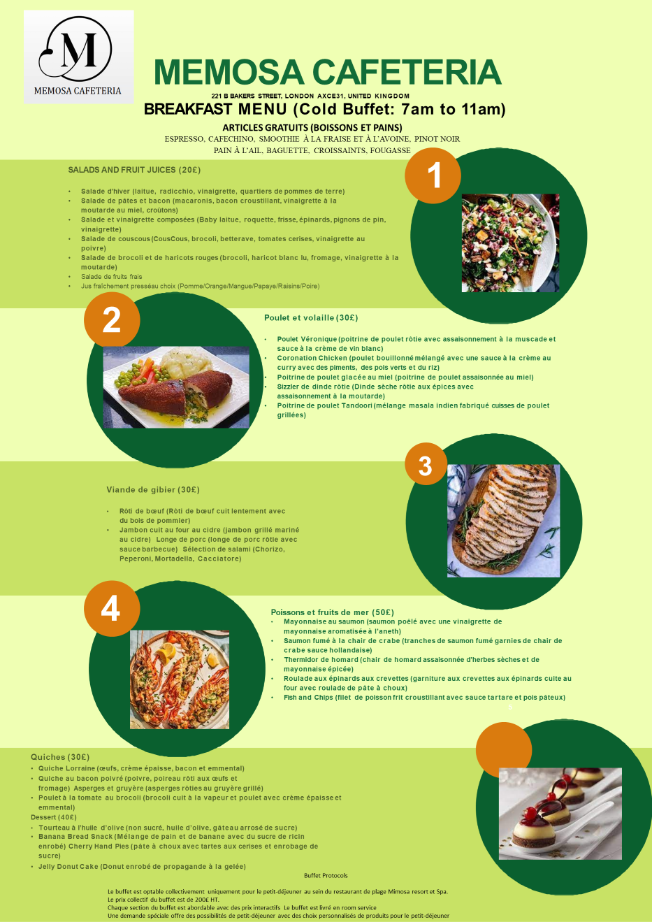

Slide 3


