Slide 1

BMGM5005: Professional Service
Emily Keane - 2409111
Lecturer – Jemma Smith
I confirm that I have not used any AI tools in the research and creation of this assignment. I confirm that I have not presented any AI generated materials as my own work. I confirm I have copies of my drafts, notes, and other resources I used, which I may be asked to provide in evidence.

Slide 2
Contents Page
Slide 3 - Title Page
Slide 4 – Introduction
Slide 5 – Key challenges
Slide 6 – 19 – PESTLE Analysis
Slide 20 – 21 – SWOT Analysis
Slide 22 – Business Impact
Slide 23 – 25 – Retention
Slide 26 – 27 – Industry Comparisons
Slide 28 – Retirement Tide
Slide 29 – Leadership Style
Slide 30 – Recommendations

Slide 3
Analyse the Impacts of Macro Environment on Human Resources Management and Personal Management of Nando's

Slide 4
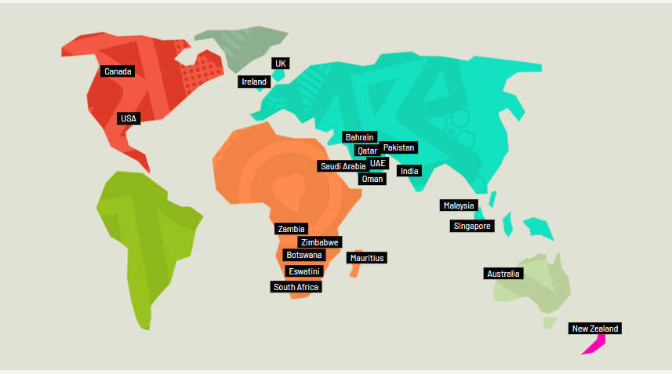
Introduction
Nando's is a well-established Portuguese style restaurant that specialises in Peri-Peri chicken, founded in 1987 (Vasileva, 2012). Whilst their largest market is currently in the UK, they have a strong presence across the world in Africa, Asia and America.
Nando's is currently facing the same issues as the rest of the hospitality industry, a lack of staff retention and increasing concerns surrounding the political state of the world.
(Nando's, 2026)

Slide 5

Key Challenges
Key elements of research conducted during this presentation include:
PESTLE factors
SWOT analysis
Retention rates
Leadership styles
Current trends within the hospitality industry
Additionally, recommendations will be made to combat the current challenges Nando's faces concerning employee recruitment and retention rates.
(WorkHarmony, 2019)

Slide 6
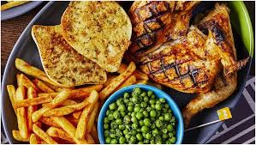
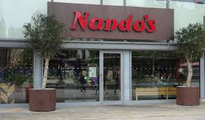
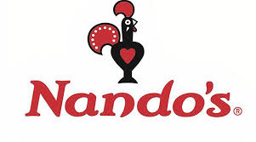
Nando's – PESTLE Analysis
(Nando's 2026), (QueensSquare, 2022), (The Caterer, 2023)

Slide 7
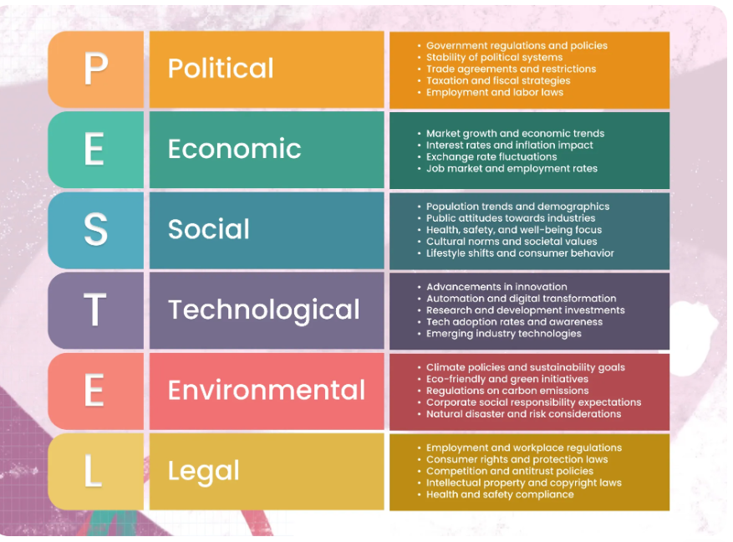
What is a PESTLE analysis?
A PESTLE analysis is a framework used to evaluate macro-environmental factors that impact organisations and industries (Oxford College Of Marketing, 2016).
(Mutomorro, 2024)

Slide 8

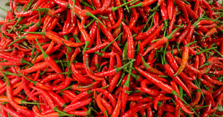
Political Considerations
Nando's has multiple establishments across the world, this means they must consider the political environments in each continent.
Brexit had a negative impact on Nando's, increasing the cost of importing food and causing the restaurant to temporarily close its doors in 2021 (Forrest, 2021).
Most notably, their peri-peri chillies are imported from South African countries : Mozambique, Zimbabwe and South Africa (Bannarasee, 2024).
For example, they operate in Malaysia, a country with strict regulations that requires food to be Halal.
(DtpAdmin, 2023), (Hollis, 2025)

Slide 9

Political Impacts
With the temporary closure of multiple locations, staff faced reduced hours which lead to job insecurity and caused staff to leave their jobs. This is a major factor that contributes to the increased staff turnover (Damir, 2022).
The long-lasting effect of Brexit caused difficulty in recruitments due to the lack individuals looking to work within hospitality (Sumption, 2019). With less hospitality workers looking for jobs this leads to increased pressure with those remaining in work.
With staff facing increased pressure at work there is a higher chance for them to burnout which will negatively affect their working performance.
(Turner, 2018)

Slide 10
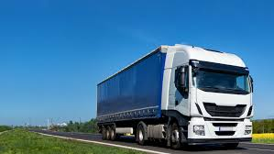

Economic
The economic decline during Covid-19 caused a loss of profits due to the lockdown.
The lockdown created a shortage of HGV lorry drivers (Wood, 2021).
Staff are paid minimum wage (Breakroom, 2026).
Inflation is causing potential customers to have less disposable income for dining out.
Inflation is also contributing to the rise in food and energy costs which in turn reduces profit margins for businesses such as Nando's.
(CORDIS , 2022), (GEOTAB, 2024)

Slide 11
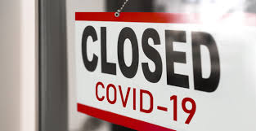
Economic Impact
With a shortage of lorry drivers, Nando's was unable to open their doors across the UK as they were short on stock which ultimately led to a decline in profits (LogisticsUK, 2025).
During the Covid-19 lockdown, Nando's joined many other businesses in taking part of the government's furlough scheme, which saw staff get paid up to 80% of their wages with subsidisation (Equifax, 2021).
With the cost of living rising many potential customers are finding themselves with less income to spend on dining out, this causes Nando's to lose profits as it is costing more to run the business whilst they are not welcoming as many customers as they once would have.
(Scorah, 2025)

Slide 12
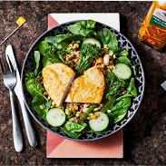
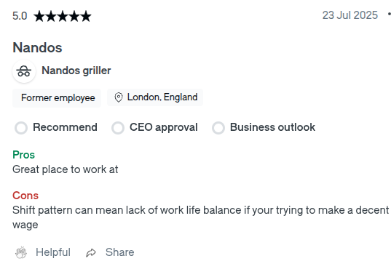
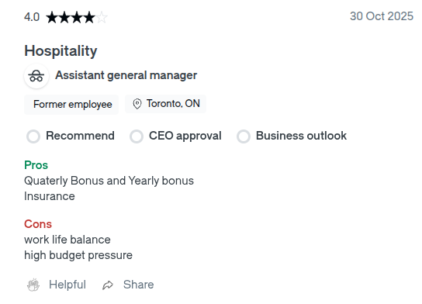
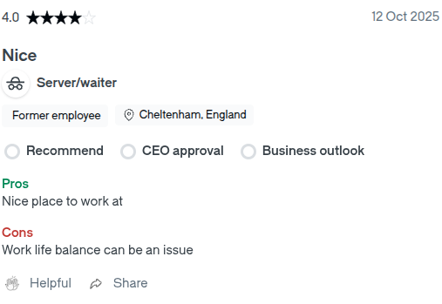
Socialisation
Nando's has made efforts to promote healthy eating by adding grilled skinless chicken to their menus.
There is evidence to suggest working at Nando's offers a poor work/life balance (Glassdoor 2026).
(Glassdoor 2026), (Jones, 2017)​

Slide 13
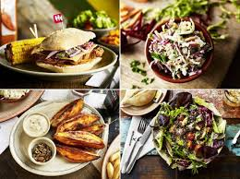

Social Impacts
As of May 2016, Nando's first began expanding their menu to include healthier options such a super-grain salad, skinless chicken and sweet potato fries (Mclean, 2016). This gave Nando's the chance to expand their customer base and include people looking to dine out whilst maintaining a healthier diet.
Grigoryan (2024) highlights that a poor work life balance for employees leads to additional stress and plays a large part in staff choosing to quit their jobs, increasing staff turnover within a business.
(Dyson, 2016), (Goorwich, 2015)

Slide 14

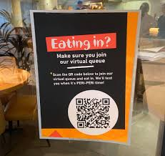
Technological
Nando's implemented QR codes on the tables for customers to order from.
Nando's branched out into using delivery apps such as Deliveroo in 2017 (GoodtoKnow, 2017).
(Deliveroo, 2021), (Facebook, 2026)

Slide 15

Technological Impacts
With the growing use of QR codes many restaurants find themselves with less need for large numbers of staff on shift (Koay and Ang, 2024).
Nando's first implemented QR codes when they reopened their restaurants after the lockdown in 2020. Since then, they have become the main form receiving orders with 85% of all orders being taken this way (Seymour, 2021).
Nando's first partnered with Deliveroo in 2017, before expanding their reach with the app in 2020. Since then, in 2025 they renewed their partnership with Deliveroo so they can continue to deliver to loyal customers (Deliveroo, 2025).
(PrimeView, 2023)

Slide 16
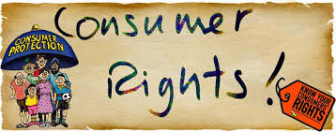
Legal
Nando's is complying with minimum wage requirements.
They adhere to consumer rights, prohibition of false advertising (Weir, 2023).
As of May 2021, Malaysia reformed their Employee Act, including changes to include better employee coverage, a 45-hour work week and flexible working arrangements (Fresh Fields, 226).
(Wade, 2026)

Slide 17

Legal Impacts
Due to the National Minimum Wage Act 1998 all workers must be paid the statutory wage or above otherwise they are breaking a law and face the risk of legal action being taken against them (GOV.UK, 2012).
This act is also in place to protect employees from exploitation and ensure equality amongst workers considering their pay.
Malaysia made changes to their employee act in 2021, this was done to improve working conditions for their employees across all working sectors.
(Schulte, 2023)

Slide 18
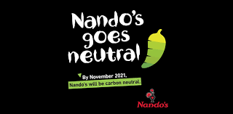
Environmental
There has been a call for Nando's to reduce the amount of plastic waste they produce.
They use 100% renewable electric in their UK sites (George Business Review, 2022).
In 2025, Nando's was accused of using a supplier the was contributing to pollution in the River Wye (Martin, 2025).
(Nando's, 2021),

Slide 19
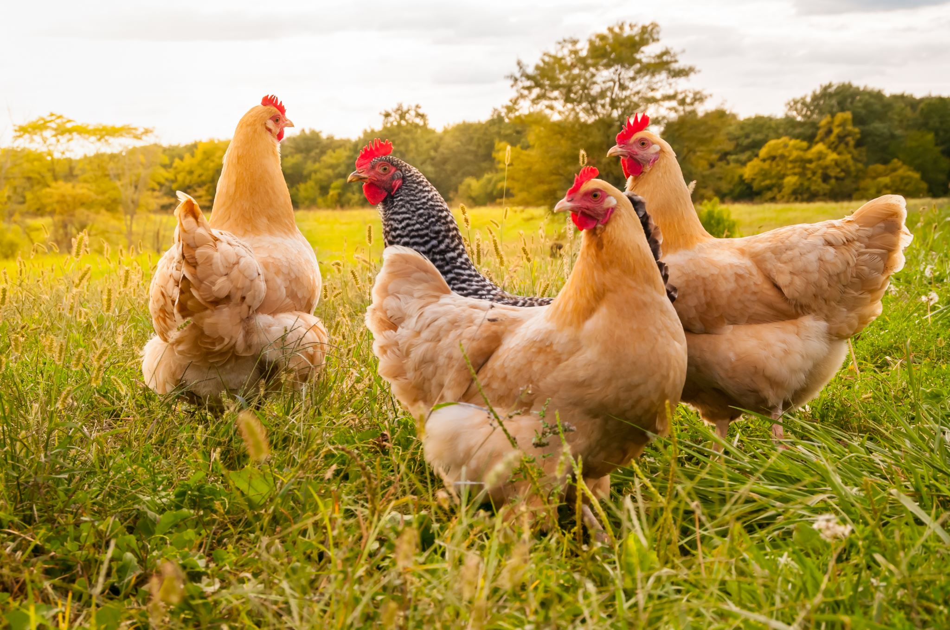
Environmental Impacts
Nando's are currently aligning their recycling targets to match with WRAP and their Plastic Pacts solution to excessive plastic waste and pollution.
So far WRAP have managed to connect with over 900 organisations in 19 countries to keep billions of plastic packaging items from ending up in the environment (WRAP, 2024).
Nando's uses the supplier Avara for their chicken, this supplier faced heavy criticism during 2025 as they were accused of disposing of their farm waste into the River Wye and subsequently aiding in the growing pollution problems the river faces.
Stock Image 2026)

Slide 20
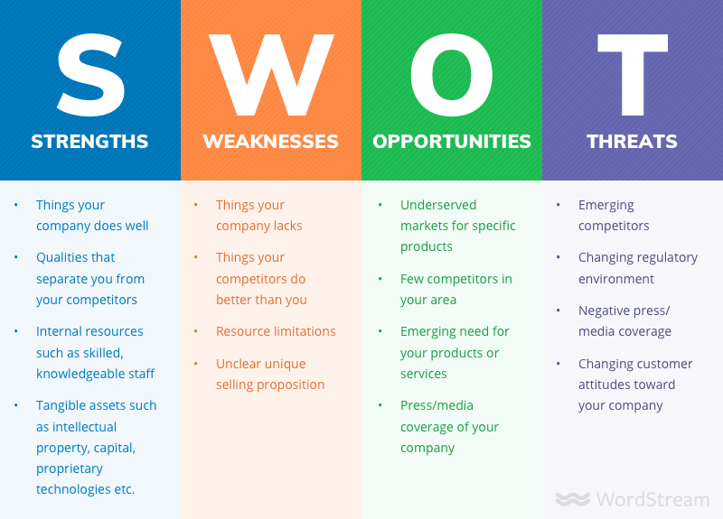
SWOT
A SWOT analysis is another useful framework organisations can use on their operations.
This framework is used to plan and evaluate a company's competitive position within the market, using a mix of internal and external factors.
(Shewan, 2025)

Slide 21
Strengths Strong brand presence Halal friendly (Nando's, 2020) Loyal customer base Unique signature flavours | Weaknesses Limited menu selection – lacking vegetarian options Expensive pricing Inconsistency across locations High staff turnover
Opportunities Increase vegetarian options. Expand online delivery options. Partnership with Yellow Ribbon to rehabilitate and employee ex-offenders in Singapore (Nando's, 2022). Female-first farming initiative in Marracuene. | Threats Strong competition from fast food chains Rising labour and food costs Fewer people eating out Vegetarian and veganism trending Labour shortages across hospitality

Slide 22
Business impact
Ameir et al. (2023) highlights that the information gained from both a PESTLE and SWOT analysis is vital for businesses to make informed decisions based on financial gain.
Gathering information both internally and externally will allow a restaurant such as Nando's to decide how best to move forward as a business (Abdel-Basset, Mohamed and Smarandache, 2018).
With a strong plan in place, Nando's can decide if it is truly beneficial to expand into new locations or decide if the competition is too strong or if PESTLE factors make the risk outweigh the reward.

Slide 23
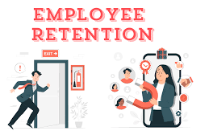
Retention
Employee retention refers to a business or organisation's ability to keep their employees engaged throughout the employee lifecycle an avoid staff quitting their jobs unnecessarily (Gelencsér et al., 2026).
This can be done by utilising different engagement methods or retention models that aspire to keep employees satisfied at work using methods such as rewad schemes, flexibility and career development (Noorulkhathija and Hussain, 2025).
Nando's current retention strategies are not working as they are still facing a highturnover with their staff. This could be due to the fact that many staff members arestudents who leave the business when they graduate or move away.
There is also evidence to suggest that the poor work life balance that many staff faceis another factor in why so many staff choose to leave the business after such ashort period of time working in Nando's.
(Kumar, 2024)

Slide 24
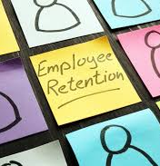
How Can Retention Be Improved
Retention within the workplace can be improved by using an employee engagement model, for example the Gallup Q12 model.
The Gallup model is designed to assess employee engagement and satisfaction within the workplace with the view of learning and understanding how to better retain staff (Khanna, 2020).
This is done by using 12 questions set across a 4-tired pyramid scheme focusing on staff's basic needs, individual contribution, teamwork and growth (Gallup, 2025).
This method would work well for Nando's as it would get to the root of why so many staff leave, help staff build a connection with the business and therefore improve the high turnover levels currently faced.
(Writer, 2022)

Slide 25
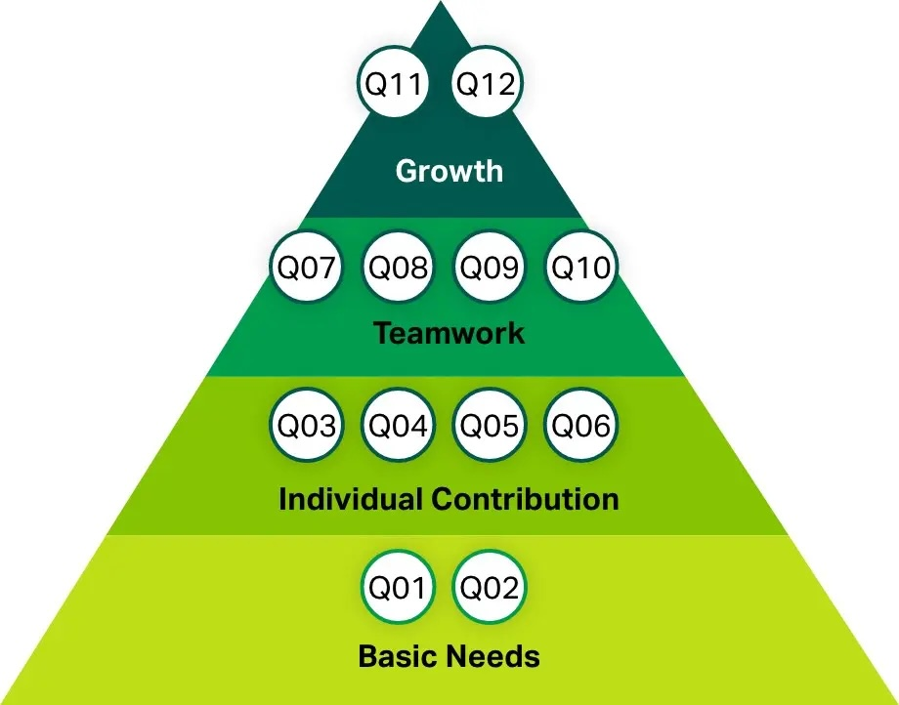
The Gallup Model
(Nagel, 2024)

Slide 26
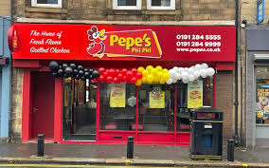
Industry examples and comparisons
There are many restaurants similar to Nando's that are dealing with the same trends within hospitality. For example, the growing us of AI within the hospitality sector and how this is forcing businesses to evolve the running of the restaurants.
However, there is a notable difference in how each restaurant chooses to tackle these trends and any potential issues that come along with them.
One such example is Pepe's Piri Piri, a British fast food chicken shop.
(Pepe's Piri Piri, 2023)

Slide 27

Pepe's Piri Piri VS Nando's
Seo (2023) notes that Nando's has been embracing the growing trend of AI and automation by trialling a FRYR210 fry line, designed to speed up the cooking of fries and improve consistency across the process.
Whereas Pepe's Piri Piri keeps their use of AI and automation to a minimum, mostly using it to improve their ordering and POS systems running smoothly.
(Stock Image 2026)

Slide 28

The Retirement Tide
Research conducted by Welsby (2023) shows that 16 – 24 year-olds make up 10% of the current working force, however, they make up 50% of the workforce in hospitality.
This evidence suggests that both Nando's and Pepes Piri Piri have staff forces made up of the younger generation and therefore have less issues surrounding the retirements tide. However, they would still face a high staff turnover with 60% of workers in this age bracket leaving their jobs after 2 years (CLH, 2024).
(Stock Image 2026)

Slide 29

Leadership Style
There are a range of different leadership styles that businesses can use to motivate and manage staff members. One such method is the Coaching Leadership Style, this is where leaders focus on developing their team members as individuals, highlighting their importance to the whole team (Personio, 2023).
This leadership style works well with the Gallup engagement model as it helps managers encourage staff to work their best at a personal level which then improves how they can work within a team, improving the overall work ethic of those in the business.
(Stock Image 2026)

Slide 30

Recommendations For The Future
Nando's has a chance to better improve their business image by continuing to develop more sustainable and ethical business methods such as expanding their plant-based food options.
They could also improve the customer experience by continuing to train staff and applying both a leadership style and employee engagement model, focusing on retaining more of the staff they already have instead of having to invest in hiring more staff as often as they do.
These methods can help Nando's continue increasing their customer base and loyalty whilst proving that they are evolving with fast paced hospitality industry.
(Pagefly, 2025)

Slide 31
References
Abdel-Basset, M., Mohamed, M. and Smarandache, F. (2018). An Extension of Neutrosophic AHP–SWOT Analysis for Strategic Planning and Decision-Making. Symmetry, 10(4), p.116. https://doi.org/10.3390/sym10040116 (Accessed 21 April 2026).
Ameir, O., Pawliczek, A., Kolumber, S., Belica, J. and Ocko, P. (2023). Strategic Management Combined with Behavioral Management. SGEM International Multidisciplinary Scientific GeoConference EXPO Proceedings, 23(5.1), pp.447–454. https://doi.org/10.5593/sgem2023/5.1/s21.60 (Accessed 21 April 26).
Bannarasee, R. (2024). Where Is Nando’s Food From? - Chef’s Resource.Chef’s Resource. https://www.chefsresource.com/where-is-nando%CA%BCs-food-from/?utm_source (Accessed 10 Feb. 2026).
Breakroom (2026). £12-13/hr Nando’s Nandoca Jobs (Now Hiring) Feb 2026. Breakroom.cc. https://www.breakroom.cc/en-gb/nandos-nandoca-jobs?_gl=1 (Accessed 10 Feb. 2026).
CLH (2024). Data Reveals Hospitality Employees Stay with a Company for Just Three Years. CLH News: Caterer, Licensee and Hotelier News. Available at: https://catererlicensee.com/data-reveals-hospitality-employees-stay-with-a-company-for-just-three-years/ (Accessed 05 May 26).
CORDIS (2022). CORDIS | European Commission. Europa.eu. https://cordis.europa.eu/article/id/435709-investigating-europe-s-life-saving-lockdown-policies (Accessed 10 February 2026).
Damir (2022). How Has Brexit and the Pandemic Impacted Staffing within Facilities Management? | Proxima. https://proximagroup.com/proxima-perspectives/how-has-brexit-and-the-pandemic (Accessed 08 May 2026).
Deliveroo (2021). Home. Roofoods Ltd. https://corporate.deliveroo.co.uk/ (Accessed 08 May 2026).
Deliveroo (2025). Nando’s, the UK’s Favourite flame-grilled PERi-PERi Chicken restaurant, and Deliveroo, the Delivery platform, Have Announced the Extension of Their Exclusive partnership. Deliveroo. https://deliveroo.co.uk/more/news-articles/nando-s-exclusivity-extension? (Accessed 28.04.26).
DtpAdmin (2023). Living with Brexit: Understanding the Experiences of People Living through the Brexit Period. South Coast DTP. https://southcoastdtp.ac.uk/living-with-brexit-understanding-the (Accessed 10 February 2026).
Dyson, M. (2016). 9 Signs You Have a Poor work-life Balance · PA Life. https://palife.co.uk/in-depth/9-signs-you-have-a-poor-work-life-balance/ (Accessed 27 April 2026).

Slide 32
Equifax (2021). What Furlough Means for You | Equifax UK. https://www.equifax.co.uk/resources/money-management (Accessed 08 May 2026).
Facebook (2026). Kennet Shopping. Facebook.com. https://www.facebook.com/KennetShopping/posts/nandos-are (Accessed 08 May 2026).
Forrest, A. (2021). Nando’s Closures ‘tip of Iceberg’ as More Restaurants Hit by Brexit Food Crisis. The Independent. https://www.independent.co.uk/news/uk/politics/nandos-brexit-food-shortage (Accessed 17 April 2026).
Fresh Fields (2026). Asia-Pacific Employment Law Bulletin Horizon-scanning People and Reward. https://www.freshfields.com/globalassets/our-thinking/campaigns/asia-employment (Accessed 22 April 2026).
Gallup (2025). Gallup’s Q12 Employee Engagement Survey - Gallup. Gallup.com. https://www.gallup.com/q12-employee-engagement-survey/ (Accessed 30 April 2026).
Gelencsér, M., Szabó-Szentgróti, G., Sándor Kőmüves, Z. and Hollósy-Vadász, G. (2026). The Holistic Model of Labour Retention: the Impact of Workplace Wellbeing Factors on Employee Retention.Proquest.com. https://www.proquest.com/docview/2819260258?accountid=130472&pq-origsite (Accessed 30 April 202626).
George Business Review (2022). External and Internal Environment Analysis of Nando’s. George Business Review. Available at: https://www.george-business-review.com/external-and-internal-environment-analysis(Accessed 10 Februrary 2026).
GEOTAB (2024). What Is a HGV? | Geotab. Geotab. https://www.geotab.com/uk/glossary/what-is-hgv/ (Accessed 10 February 2026).
Glassdoor (2026) Nando’s work-life balance reviews, Glassdoor UK, reviewed on Glassdoor.co.uk, 2026. https://www.glassdoor.co.uk/Reviews/Nando-s-work-life-balance-Reviews-EI_IE574195.0,7_KH8,25.htm (Accessed 10 February 2026).
GoodtoKnow (2017). Nando’s Have Launched Their Own UK Delivery Service (and it’s NOT Just in London!). GoodtoKnow. https://www.goodto.com/food/food-news/nandos-delivery-service-8931? (Accessed 28 April 2026).
GOV.UK (2012). The National Minimum Wage and Living Wage. GOV.UK. https://www.gov.uk/national-minimum-wage/worker-disputes-over-minimum-wage (Accessed 29 April 2026).
Grigoryan, K. (2024). Labor Shortages in the Hospitality Industry: The Effects of Work-Life Balance, Employee Compensation, Government Issued Unemployment Benefits and Job Insecurity on Employees’ Turnover Intentions. Westcliff International Journal of Applied Research , 8(1). https://doi.org/10.47670/wuwijar202481kg (Accessed 27 April 2026).

Slide 33
Hollis, L. (2025). 5 Common Chilli Pests and Diseases – PlantwisePlus Blog. PlantwisePlus Blog. https://blog.plantwise.org/2025/06/12/5-common-chilli-pests-and-diseases/ (Accessed 10 February 2026).
Jones, E. (2017). Nando’s calories: 17 of the Healthiest Things You Can Eat at Nando’s. Cosmopolitan. https://www.cosmopolitan.com/uk/lifestyle/food-and-drink/a49267/healthiest-things-eat-at-nandos (Accessed 08 May 2026).
Khanna, R. (2020). Re-Explore the Viability and Authenticity of the Gallup Workplace Audit in Private Universities. Business, Management and Education, 18(2), pp.344–362. https://doi.org/10.3846/bme.2020.11999 (Accessed 30 April 2026).
Koay, K.Y. and Ang, K. (2024). Understanding Consumers’ Intentions to Use QR Code Menus In the post-COVID-19 Pandemic. British Food Journal, 126(5), pp.2172–2186. https://doi.org/10.1108/bfj-10-2023-0880. (Accessed 06 April 2026)
Kumar, P. (2024). Driving Business Success in 2024 Through Employee Retention - Free Forever HRMS and Payroll For Unlimited Employees.Free Forever HRMS and Payroll for Unlimited Employees.https://kredily.com/effective-employee-retention-strategies-to-thrive-in-2024/ (Accessed 08 May 2026).
LogisticsUK (2025). HGV Drivers Kept the Economy Moving during Covid but Are Now ‘forgotten’, Says Shadow Cabinet Secretary | Logistics UK Logistics.org.uk. https://logistics.org.uk/media/press-releases/2025/september/hgv-drivers-kept-the-economy-moving-during-covid-b (Accessed 08 May 2026).
Martin, C. (2025). Celebs Accuse Nando’s of Contributing to River Wye Pollution. BBC News 15 Feb https://www.bbc.co.uk/news/articles/c70k26jjkklo (Accessed 22 April 2026).
Mclean, P. (2016). Nando’s Launch New healthy-eating Options. Wiltshire Times. https://www.wiltshiretimes.co.uk/news/14495886.nandos-launch-new-healthy-eating-options/ (Accessed 27 April 2026).
Mutomorro (2024). PESTLE Analysis: Template + Simple Walkthrough - Mutomorro. Mutomorro. https://mutomorro.com/tools/pestle-analysis/ (Accessed 21 April 2026)
Nagel, J. (2024). Understanding Gallup Q12: the Survey Framework for Effective Employee Engagement. Limesurvey.org. https://www.limesurvey.org/blog/knowledge/understanding-gallup-q12-the-survey-framework (Accessed 30 April 2026).
Nando's (2020). Is Nando’s Halal? Nandos.co.uk. https://www.nandos.co.uk/halal (Accessed 08 May 2026).
Nando's (2021). It’s Time to Turn down the heat. LinkedIn. https://www.linkedin.com/posts/nandos (Accessed 08 May 2026).
Nando's (2026). World. Nando’s. https://www.nandos.com/world/#world-view (Accessed 17 April 2026).
Nando's (2022). Opportunities for Change. Nando’s. https://www.nandos.com/people/opportunities-for-change/ (Accessed 29 April 2026).

Slide 34
Noorulkhathija, J. and Hussain, A. (2025). Strategic Employee Retention: Enhancing Workforce Stability through Effective HR Management. ICT Academy of Tamil Nadu; ICTACT Journal on Management Studies,11. https://doi.org/10.21917/ijms.2025.0314 (Accessed 30 April 2026).
Oxford College Of Marketing (2016). What Is a PESTEL analysis? Oxford College of Marketing Blog. https://blog.oxfordcollegeofmarketing.com/2016/06/30/pestel-analysis/ (Accessed 21 April 2026).
Pagefly (2025). 8 Product Recommendation Strategies to Leverage in 2022. PageFly. https://pagefly.io/blogs/shopify/product-recommendation (Accessed 08 May 2026).
Pepe's Piri Piri (2023). Pepe’s Newcastle Gosforth - Now Open!! - Pepe’s Piri Piri. Pepe’s Piri Piri. https://pepes.co.uk/pepes-news/pepes-newcastle-gosforth-now-open/ (Accessed 08 May 2026).
Personio (2023). Coaching Leadership Style Explained – Examples and Use Cases.https://www.personio.com/hr-lexicon/coaching-leadership-style/ (Accessed 05 May 2026).
PrimeView (2023). Technology’s Impact on Today’s World. PRIMEVIEW. https://primeview.co/technologys-impact-on-todays-world/ (Accessed 08 May 2026).
QueensSquare (2022). Restaurants Liverpool - Nando’s Queen Squar Queen Square. https://www.queensquare.co.uk/nandos-restaurant/ (Accessed 08 May 2026).
Schulte, A. (2023). The Legal Implications of Managing a Global Workforce: a Comprehensive Guide - Centuro Global. Centuro Global.https://www.centuroglobal.com/article/legal-implications-of (Accessed 08 May 2026).
Scorah, W. (2025). 5 Years later: How COVID Changed Health & Safety Forever - SAMS. SAMS. https://www.samsltd.co.uk/5-years-later-how-covid-changed-health-safety-forever/ (Accessed 03 May 2026).
Seo, J. (2023). Nando’s Trials Robot Fry Line to Cook Chips. The Caterer. https://www.thecaterer.com/news/nandos-trial-karakuri-robotic-automation-technology (Accessed 30 May 2026).
Seymour, A. (2021). Nando’s reveals 85% of orders are now placed digitally after integration of new system with kitchen operations. Foodservice Equipment Journal. https://www.foodserviceequipmentjournal.com/nandos-(Accessed 10 February 2026).
Shewan, D. (2025). How to Do a SWOT Analysis for Your Small Business. Wordstream. https://www.wordstream.com/blog/ws/2017/12/20/swot-analysis (Accessed 29 April 2026).

Slide 35
Siam Goorwich (2015). Calling All Nando’s fans: Four New Dishes Are about to Make Their Nando’s Debut. Metro. https://metro.co.uk/2015/03/26/calling-all-nandos-fans-four-new-dishes-are-about-to-make-their (Accessed 29 April 2026).
Sumption, M. (2019). Is Employer Sponsorship a Good Way to Manage Labour Migration? Implications for Post-Brexit Migration Policies. National Institute Economic Review, 248(1), pp.R28–R39. https://doi.org/10.1177/002795011924800111. (Accessed 08 April 2026)
The Caterer (2023). Nando’s announces new openings after... The Caterer. https://www.thecaterer.com/news/nandos-new-openings-returning-profit-pandemic (Accessed 08 April 2026).
Turner, A. (2018). Overworked Employees: Signs And Possible Consequences. Insperity. https://www.insperity.com/blog/overworked-employees/ (Accessed 08 April 2026).
Vasileva, V. (2012). The Nando’s Story. Nando’s 2010 Marketing Strategy & Advertising Campaign Research Project. https://nsms2010project.wordpress.com/the-nandos-story/ (Accessed 06 May 2026).
Weir, O., 2023. Assessment 1.2: PESTLE and SWOT Analysis of Nando’s. Business assignment, Notre Dame Catholic Sixth Form College. Available at: https://www.studocu.com/en-gb/document/notre-dame-catholic-sixth-form-college/business/assessment-12-pestle-and-swot-analysis-of-nandos/141352903 (Accessed 10 February 2026)
Wade, D.T. (2026). David T. Wade & Co — Affordable UK Law Firm in Goole & Nottingham. David T. Wade & Co. https://davidtwade.co.uk/services/consumer-law (Accessed 06 May 2026).
Welsby, M. (2023). The Occupations Most Dependent on Older and Younger Workers. Ons.gov.uk. https://cy.ons.gov.uk/employmentandlabourmarket/peopleinwork/employmentandemployeetypes/articles/theoccupationsmostdependentonolderandyoungerworkers/2023-05-31?utm_source=chatgpt.com (Accessed 05 April 2026).
Wood, Z. (2021). Nando’s forced to shut outlets through Covid-related shortages. The Guardian. https://www.theguardian.com/business/2021/aug/17/nandos-forced-to-shut-outlets-through-covid-related-shortages (Accessed 10 february 2026).
WorkHarmony (2019). The 7 Biggest Challenges Facing HR in 2019 - WorkHarmony. WorkHarmony. https://www.workharmony.com/the-7-biggest-challenges-facing-hr-in-2019/ (Accessed 06 May 2026).
WRAP (2024). Prevent Problem Packaging. WRAP - the Waste and Resources Action Programme. https://www.wrap.ngo/what-we-do/prevent-problem-packaging (Accessed 29 April 2026).
Writer, I.S. (2022). How to Improve Employee Retention. INTOO US. https://www.intoo.com/us/blog/how-to-improve-employee-retention/ (Accessed 06 May 2026).

