Slide 1
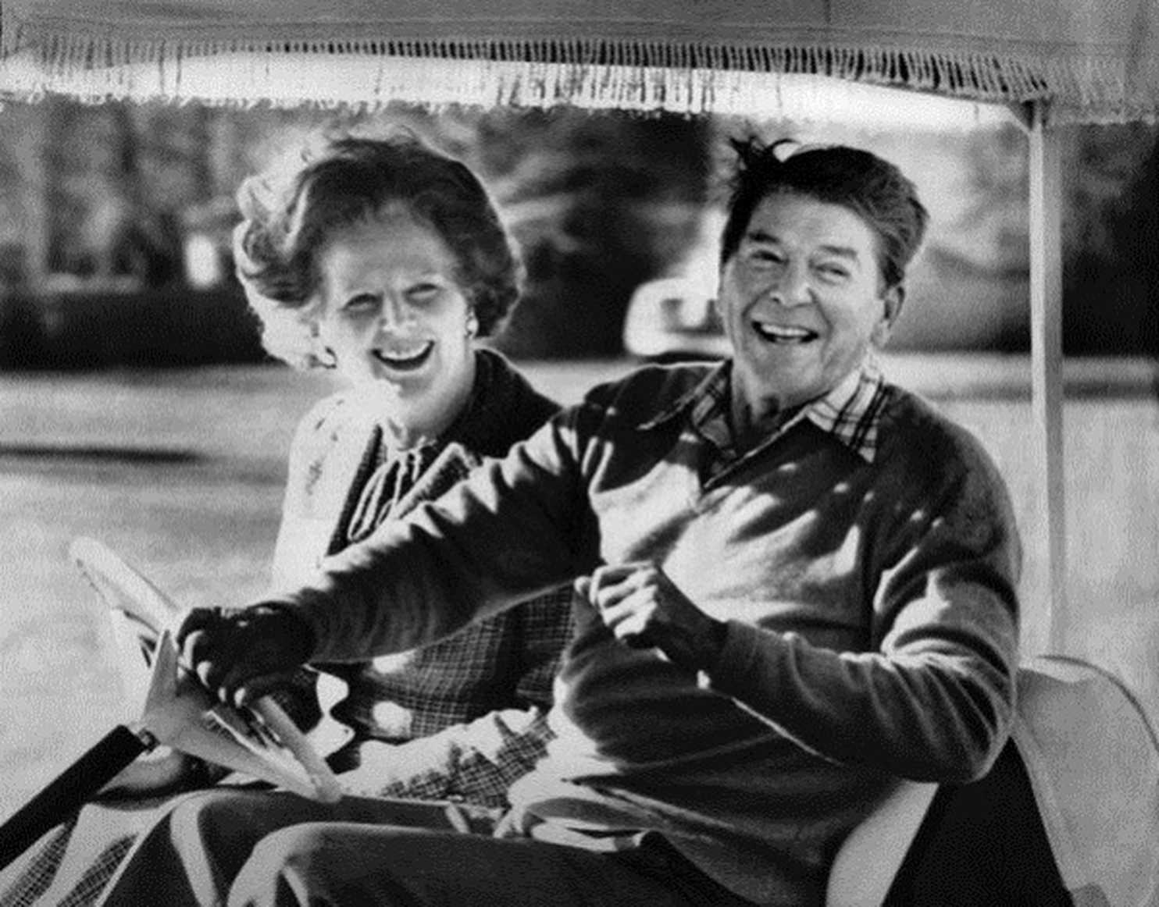
HPHI5005/6005
How
Soon
Is
Then?
Thatcher, Reagan and the Legacies of the 1980s
ESSAY GUIDANCE

Slide 2
ESSAY
Choose a topic relating to Margaret Thatcher’s premiership or Ronald Reagan’s presidency, and construct an essay using archival materials (such as those held by the Ronald Reagan Presidential Library and Museum and the Margaret Thatcher Foundation). The essay should address the following questions:
Level 5
What was Thatcher/Reagan’s attitude with regards to your chosen topic, and what might this reveal about her/his broader political project? How effective and impactful was the position taken by Thatcher/Reagan with regard on your chosen topic?
Level 6
What was Thatcher/Reagan’s attitude with regards to your chosen topic, and what might this reveal about her/his broader political project? How effective and impactful was the position taken by Thatcher/Reagan on your chosen topic, and what insights might this offer about how she/he transformed British/American politics?

Slide 3
What was Thatcher/Reagan’s attitude with regards to your chosen topic, and what might this reveal about her/his broader political project? How effective and impactful was the position taken by Thatcher/Reagan on your chosen topic, and what insights might this offer about how she/he transformed British/American politics?
Introduction
Outline your topic and your position on it
Affirm your thesis statement
Is there a good quote or piece of evidence that might be an eye-catching first sentence?

Slide 4
What was Thatcher/Reagan’s attitude with regards to your chosen topic, and what might this reveal about her/his broader political project? How effective and impactful was the position taken by Thatcher/Reagan on your chosen topic, and what insights might this offer about how she/he transformed British/American politics?
2. Specify what MT/RR’s attitude was with respect to your chosen topic
What was their position on the topic?
What experience did they have of the topic and related issues?
Did their position change or was it consistent?
What evidence have you got to support your assessment of your position; i.e. what archival sources can you use to illustrate your point?

Slide 5
What was Thatcher/Reagan’s attitude with regards to your chosen topic, and what might this reveal about her/his broader political project? How effective and impactful was the position taken by Thatcher/Reagan on your chosen topic, and what insights might this offer about how she/he transformed British/American politics?
3. Specify how your topic relates to broader policies
How important was your topic to MT/RR and why?
Did your topic shape broader policy decisions?
Might the position have impacted on other realms of government?
Does your topic seem inconsequential or singular? If so, why might it still be significant and illuminating irrespective of its singularity or relative lack of consequence?

Slide 6
What was Thatcher/Reagan’s attitude with regards to your chosen topic, and what might this reveal about her/his broader political project? How effective and impactful was the position taken by Thatcher/Reagan on your chosen topic, and what insights might this offer about how she/he transformed British/American politics?
4. Assess the impact
What key changes were brought about by MT/RR’s position on your topic?
Did MT/RR get what they wanted with respect to your chosen topic?
Were there obstructions to their principal goals with respect to your chosen topic?
What have other scholars written about your chosen topic, and to what extent do you agree with their verdict on it?

Slide 7
What was Thatcher/Reagan’s attitude with regards to your chosen topic, and what might this reveal about her/his broader political project? How effective and impactful was the position taken by Thatcher/Reagan on your chosen topic, and what insights might this offer about how she/he transformed British/American politics?
5. Assess the legacy
How different was UK/US politics before and after MT/RR?
To what extent did MT/RR engender a lasting set of changes with respect to your chosen topic?
How might your chosen topic illuminate their historical reputation?

Slide 8
What was Thatcher/Reagan’s attitude with regards to your chosen topic, and what might this reveal about her/his broader political project? How effective and impactful was the position taken by Thatcher/Reagan on your chosen topic, and what insights might this offer about how she/he transformed British/American politics?
6. Conclusion
Summarise and answer the question(s_)

Slide 9
Checklist
Answer the question
Include a thesis statement
Include, sustain and elaborate an argument
Include archival sources – and actively quote from them
Include secondary sources (books, articles) – and actively engage with existing scholarship
Footnotes and bibliography

