Slide 1
Systemic Failures in Quality Assurance and Patient Safety
A Critical Analysis of the Mid Staffordshire NHS Foundation Trust Scandal
Programme: MSc Public Health and Social Care in Practice
Module code: LCHS7006
Module: Quality Assurance and Service Improvements
Assignment Title: Component 1 Individual Presentation
Student ID:2529441
Lecturer: Dilhara Mampitiya
Christopher Mafuva

Slide 2

Introduction and Case Background
Mid Staffordshire NHS Foundation Trust (2005-2009) analyses significant patient care and patient governance failures.
The systemic weaknesses were exposed by the Francis Report (Francis, 2013).
It mainly focuses on quality assurance and service
improvement
This presentation seeks to provide a critical examination and analysis of root causes as well as policy failures and their effect on healthcare quality.
Notes:
The failures of Mid Staffordshire NHS Foundation Trust in patient care over the five years between 2005 and 2009 led to avoidable harm and high mortality rates. The Francis Report (2013) identified poor leadership, insufficient staffing, poor clinical governance and an organisation that emphasised financial goals above patient safety as some of the reasons for these failures. This presentation aims to critically consider the root causes of the issues, the theories that exist around quality management, the policy issues and their impact on service provision, while identifying lessons for sustainable quality improvement (Francis, 2013).

Slide 3
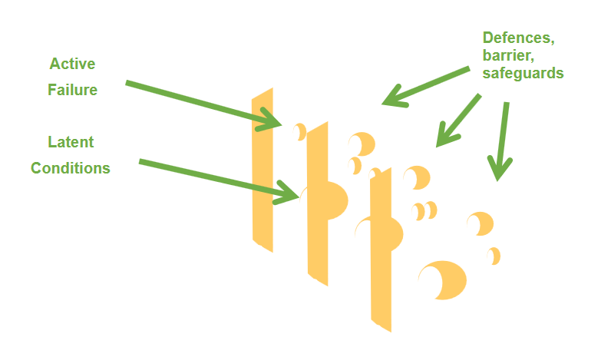
Identifying Root Causes – Systems-Based Safety Analysis (Swiss Cheese Model)
The Swiss cheese theory is a complex linear theory that seeks to explain the cause of accidents in different industries like aviation, engineering and health care, and it was developed by Professor James Reason (NHS, 2025).
There was a lack of proper clinical governance and good leadership, which led to low accountability and poor quality management (Francis, 2013).
Staffing problems and poor skills mix impacted the provision of quality and safe patient care.
Priorities within the organisation were about achieving financial and performance goals instead of focusing on patients’ needs.
Poor communication and reporting of incidents hindered organisational learning and risk management.
Inappropriate response to complaints from patients resulted in the existence of safety issues.
The Swiss Cheese Model explains that these systemic failures aligned across multiple organisational defence layers, enabling patient harm through cumulative weaknesses rather than isolated clinical errors.
Figure 1: The Swiss Cheese Model
(Source: NHS, 2025)
Notes:
The Swiss Cheese Model explains that adverse events occur when multiple organisational safety barriers fail simultaneously (Shabani et al. 2024). Poor leadership, inadequate staffing, ineffective clinical governance, failure to investigate complaints and poor communication led to gaps in patient safety in Mid Staffordshire. Despite recognising warning signs, the Trust prioritised financial performance and Foundation Trust status over quality care. These interlocking failures enabled unacceptable standards to continue for several years and the Francis Report showed that patient harm was caused by systemic organisational failures rather than by individual clinical incidents (Francis, 2013).

Slide 4
Benchmarking Against National Quality Standards
Benchmark Domain | National Quality Standard (NHS Expected Performance) | Mid Staffordshire NHS Foundation Trust (Actual Performance)
Patient-Centred Care | Deliver compassionate, dignified and patient-centred care (NHS, 2026a). | Patients experienced neglect, poor dignity and inadequate communication.
Safe Staffing | Maintain adequate staffing levels and an appropriate skill mix (NHS, 2018). | Nurse shortages and poor workforce planning compromised patient safety (Francis, 2013).
Clinical Governance | Ensure effective leadership, governance and quality monitoring (NHS, 2026a). | Weak leadership and governance prioritised targets over patient care (Francis, 2013).
Incident Reporting | Promote open reporting, investigation and organisational learning. | Complaints and safety incidents were ignored, limiting organisational learning.
Overall Performance | Continuously improve safe, effective and patient-focused care (NHS, 2026b). | Significant gaps in quality resulted in avoidable patient harm and loss of public trust (Francis, 2013).
Notes:
Benchmarking involves a comparison of the performance of the organisation with a nationally accepted healthcare standard. NHS quality frameworks include the importance of safe staffing, patient-centred care, effective clinical governance and transparency on reporting safety incidents (NHS, 2026a). Mid Staffordshire breached these core standards and the Francis Report attributed a lack of leadership and management, insufficient staffing, poor accountability & monitoring and ineffective controls as contributing to unsafe care. The experiences and complaints of the patients were disregarded as the performance indicators of the organisation was valued more than the quality of care that was provided. The benchmarking exercise clearly shows the large disparity that exists between the expected quality standards of the NHS and the actual performance of the Trust (Francis, 2013).

Slide 5
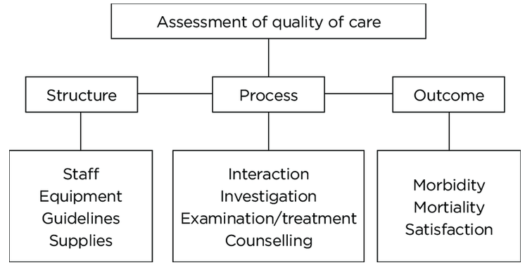
Root Cause Analysis Using Quality Improvement Models
Root Cause Analysis investigates the organisational, managerial and governance failures that cause negative healthcare incidents rather than solely the clinical failures (Tsamasiotis et al. 2024).
The Donabedian Model assesses the quality of healthcare delivery using three interrelated components of structure, process, and outcomes (Yang et al. 2025).
Weak organisational structures which include poor leadership, ineffective clinical governance, insufficient staffing and lack of organisational resources have a negative impact on healthcare processes.
Ineffective healthcare processes including poor communication, incident reporting, patient monitoring and decision-making, have led to unsafe patient care practices.
Consequently, these organisational failures lead to unnecessary patient harm, higher rates of mortality, lower levels of patient experience and loss of public trust as pointed out by the Francis Report (2013).
The Donabedian Model shows that the quality improvement of healthcare delivery is possible when both organisational structures and healthcare processes are improved (Singh, 2025).
Figure 2: Quality of care by Donabedian model
(Source: Singh, 2025)
Notes:
Root Cause Analysis (RCA) analyses the underlying organisational causes as opposed to the actual clinical incident (Tsamasiotis et al. 2024). In Mid Staffordshire, RCA uncovers leadership failures, understaffing, poor governance and organisational learning as key factors in the poor care. The Donabedian Model further elaborates how structural deficiencies including poor governance and limited resources, negatively affected clinical processes such as monitoring, communication and decision-making (Yang et al. 2025). These models present the need for organisational and clinical process improvement to sustain quality improvement.

Slide 6
Policy Issues Contributing to Organisational Failure
National governance focused on targets instead of patient-centred care (Francis, 2013).
Regulatory oversight did not detect increasing risks.
Local policies of staffing and incident reporting did not work.
Weak leadership accountability hampered organisational learning.
Poor policy implementation affected quality assurance and patient safety.
Notes:
In the Mid Staffordshire case study, organisational failure occurred due to poor implementation of policies as opposed to the lack of policies. The national governance systems including NHS Foundation Trust oversight and regulatory monitoring, concentrated on financial success and achievement of targets at the expense of patient outcomes (DOH, 2013). Regulators failed to detect warning signs despite increasing complaints and mortality indicators. Inadequate policies of staffing, incident reporting, risk management and leadership accountability also made it impossible to intervene in time. Thus, the governance structures became compliance-driven and ignored quality assurance. According to the Francis Report, patient safety requires the implementation of policies with transparent leadership and accountability (Francis, 2013).

Slide 7
Impact on Health and Social Care Service Provision
1. Quality
Poor safety and increased mortality.
Poor dignity and patient safety.
2. Efficiency
Legal costs, investigations and workforce losses.
Financial and operational inefficiencies.
3. Equity
Inequity in care provision for vulnerable patients.
Declining public trust (Francis, 2013).
Notes:
Organisational failures in Mid Staffordshire had serious negative impacts on the quality, efficiency and equity of health care services. The quality suffered due to the patients experiencing avoidable harm, dignity violations, neglect and poor safety. Efficiency declined as repeated investigations, workforce shortages, legal claims and reputational damage increased financial pressures and disrupted service delivery. Equity was compromised due to poor standards of care and lack of advocacy provided to vulnerable patients, such as older adults. This case shows that poor quality assurance has negative impacts beyond individual organisations. Therefore, the Francis Report confirms the need for good governance and quality improvement (Francis, 2013).

Slide 8
Service Improvement and Sustainable Future
Develop strong leadership and clinical governance.
Introduce a positive patient safety culture (Lu et al. 2022).
Enhance staff education (Yu et al. 2023).
Introduce electronic reporting and continuous audit process.
Involvement of patients for sustainable quality improvement (Bhaladhare and Rishipathak, 2025).
Notes:
The Francis Report identified many systemic changes required to avoid the same problem in the NHS. Strong leadership and robust clinical governance should be patient-centred and accountable. Creating a positive safety culture promotes an open environment, learning and reporting incidents (Kumah, 2025). Staff education, digital reporting of incidents and continuous clinical audit contribute to organisational learning and risk management. Moreover, patient and family engagement in evaluating the quality of services contributes to greater transparency and responsiveness. All these improvements help to sustain healthcare through quality assurance and continuous organisational learning.

Slide 9
Structure of Component 2 Report
Introduction & Background - The introduction section provides background information on the case of Mid Staffordshire NHS Foundation Trust, the importance of quality assurance and patient safety failures and the objectives of the report.
Literature Review & Theoretical Framework - This section provides a critical analysis of existing literature on the issue of quality management in healthcare. This section will be used to demonstrate how organizational failures resulted in adverse effects on patients through the application of the Swiss Cheese Model, Root Cause Analysis (RCA) and the Donabedian Model.
Analysis of Policy and Governance - This section analyses the governance framework, regulatory control, leadership responsibility and organisational policies contributing to organisational failures with the impact of such on quality of healthcare services.
Impact on Healthcare Services Provision - This section analyses the effect of organisational failures on quality, efficiency & equity of healthcare services and demonstrates how poor governance influenced patient outcomes.
Recommendation and Conclusion - This section provides evidence-based recommendations for enhancing leadership, clinical governance, patient safety culture and the continuous quality improvement process, followed by a conclusion.
Notes:
The report accompanying this presentation will provide a detailed critical analysis. It will start with an introduction and literature review, followed by a detailed analysis of root causes of failure based on the quality management theories. The next parts will discuss critically policy failures and their effects on the quality, efficiency and equity of health care services provided. Finally, evidence-based recommendations for sustainable quality improvement will be given.

Slide 10

Conclusion
Systemic root causes were responsible for the organisational failure.
Weaknesses in quality assurance reduced patient safety.
Failures in policy implementation increased risks.
Evidence-based changes help to develop sustainable patient-centred care.
Notes:
The Mid Staffordshire scandal proves that the patient suffering was caused by the interaction of leadership, governance, staff and culture issues. Poor quality assurance and policy implementation failures reduced the level of patient safety, service quality and trust in the service. Application of safety models and evidence-based approaches reveals the need for continuous organisational learning and patient-centred leadership to assure sustainable healthcare.

Slide 11
References
Bhaladhare, R. and Rishipathak, P., 2025. Strategies of quality improvement in healthcare organizations on sustainable healthcare system. Discover Social Science and Health, 5(1), p.74. https://doi.org/10.1007/s44155-025-00226-0
DOH, 2013. The regulation and oversight of NHS trusts and NHS foundation trusts. [Online]. Available at https://assets.publishing.service.gov.uk/media/5a7b94daed915d41476214f8/regulation-oversight-NHS-trusts.pdf [Accessed on 10.07.2026]
Francis. R., 2013. Report of the Mid Staffordshire NHS Foundation Trust Public Inquiry. [Online]. Available at Report of the Mid Staffordshire NHS Foundation Trust Public Inquiry: executive summary HC 947, Session 2012-2013 [Accessed on: 10.07.2026]
Kumah, A., 2025. Adverse event reporting and patient safety: the role of a just culture. Frontiers in Health Services, 5, p.1581516. https://doi.org/10.3389/frhs.2025.1581516
Lu, L., Ko, Y.M., Chen, H.Y., Chueh, J.W., Chen, P.Y. and Cooper, C.L., 2022. Patient safety and staff well-being: organizational culture as a resource. International Journal of Environmental Research and Public Health, 19(6), p.3722. https://doi.org/10.3390/ijerph19063722
NHS., 2018. Developing workforce safeguards. [Online]. Available at https://www.england.nhs.uk/wp-content/uploads/2021/04/Developing-workforce-safeguards.pdf [Accessed on 18.07.2026]
NHS., 2025. Reason’s Swiss Cheese Model. [Online]. Available at https://performanceandimprovement.nhs.wales/functions/quality-safety-and-improvement/improvement/improvement-cymru-academy/resource-library/academy-toolkit-guides/reasons-swiss-cheese-safety-model-toolkit/ [Accessed on 18.07.2026]
NHS., 2026a. Person-centred care. [Online]. Available at https://www.hee.nhs.uk/our-work/person-centred-care [Accessed on: 10.07.2026]
NHS., 2026b. The NHS Patient Safety Strategy. [Online]. Available at https://www.england.nhs.uk/patient-safety/the-nhs-patient-safety-strategy/ [Accessed on 18.07.2026]
Shabani, T., Jerie, S. and Shabani, T., 2024. A comprehensive review of the Swiss cheese model in risk management. Safety in extreme environments, 6(1), pp.43-57. https://link.springer.com/article/10.1007/s42797-023-00091-7
Singh. S., 2025. Donabedian Model: Structure, Process, and Outcome for Healthcare Quality Assessment. [Online]. Available at https://www.england.nhs.uk/wp-content/uploads/2021/04/Developing-workforce-safeguards.pdf [Accessed on 18.07.2026]
Tsamasiotis, C., Fiard, G., Bouzat, P., François, P., Fond, G., Boyer, L. and Boussat, B., 2024. From Reporting to Improving: How Root Cause Analysis in Teams Shape Patient Safety Culture. Risk Management and Healthcare Policy, pp.1847-1858. https://doi.org/10.2147/RMHP.S466852
Yang, J., Liu, F., Yang, C., Wei, J., Ma, Y., Xu, L., Xie, J. and Wang, J., 2025. Application of Donabedian Three‐Dimensional Model in Outpatient Care Quality: A Scoping Review. Journal of nursing management, 2025(1), p.6893336. https://doi.org/10.1155/jonm/6893336
Yu, C., Xian, Y., Jing, T., Bai, M., Li, X., Li, J., Liang, H., Yu, G. and Zhang, Z., 2023. More patient-centered care, better healthcare: the association between patient-centered care and healthcare outcomes in inpatients. Frontiers in Public Health, 11, p.1148277. https://doi.org/10.3389/fpubh.2023.1148277

Slide 12

Thank You

