Slide 1

The Impact Of Digital Health Technologies Compared With Traditional Care On Patient Outcomes And Patient Experience In Cancer Care: A Systematic Review
Student Name: Charlott Esi Jackson
Student ID: 2223874
Module: Practice Based Research
Module Code: LCHS7008
Assignment Title: Component 1 Poster Presentation
Programme: MSc Public Health and Social Care in Practice
Lecturer: Dr. Zeno Leung
Date: 15/6/2026

Slide 2
Content
 | Prevalence
 | Research Rationale
 | Why this Research
 | Research Question
 | Aim and Objectives Research type :Systematic Review Expected Impact DIGITAL TECHNOLOGIES CONCLUSION

Slide 3
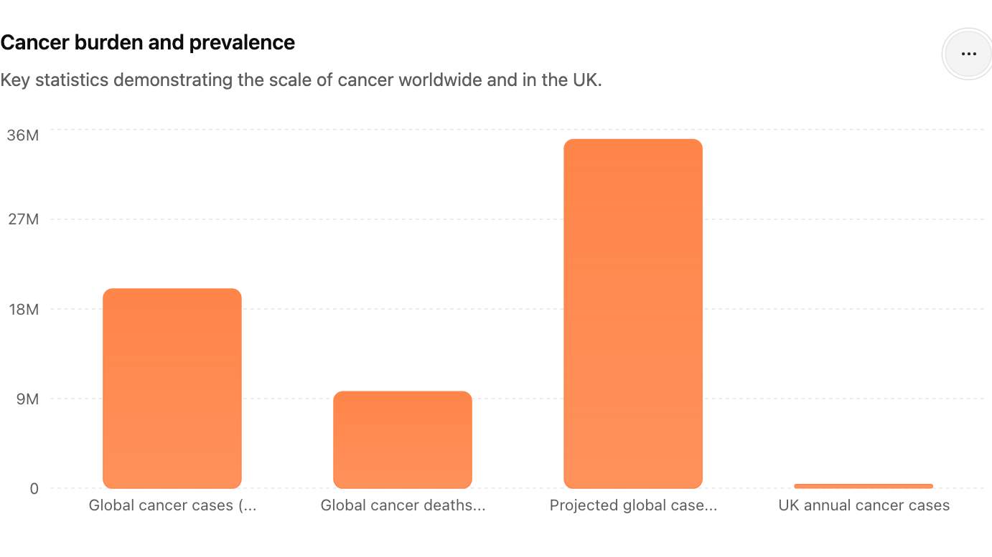
PREVALANCE OF THE PROBLEM
Cancer is a major global health challenge
In 2022, according to (WHO,2024) there were 20 million new cancer diagnoses globally, and 9.7 million deaths globally attributed to cancer. The worldwide incidence of cancer is anticipated to reach 35 million new cases per year by 2050, indicating a 77% increase (IARC, 2024).
In the United Kingdom, some 375,000 new cancer cases are identified annually (Cancer Research UK, 2025).
Approximately 50% of individuals in the UK will be diagnosed with cancer at some point in their lives (Cancer Research UK, 2025).
Figure 1. Author's illustration based on data from World Health Organization (2024), International Agency for Research on Cancer (2024) and Cancer Research UK (2025).

Slide 4


RESEARCH RATIONALE
Increasing cancer prevalence is placing significant pressure on healthcare services worldwide.
Digital health technologies (telehealth, mobile health apps and remote monitoring) are increasingly being integrated into cancer care (Shaffer et al., 2023).
Evidence suggests digital interventions may improve symptom management, patient engagement and access to care (Basch et al., 2017).
However, existing studies report mixed findings regarding their effectiveness and impact on patient experience (Lee et al., 2023).
Concerns remain regarding digital exclusion, accessibility and patient satisfaction (Lazarou et al., 2024).
A systematic review is needed to critically evaluate whether digital health technologies provide better patient outcomes and experiences than traditional cancer care.

Slide 5
WHY THIS RESEARCH
Rising cancer burden
Growth of digital health technologies
Unclear impact on outcomes and patient experience
Need for evidence-based cancer care

Slide 6
RESEARCH QUESTION AND AIM
How do digital health technologies contrast with traditional care in improving patient outcomes and patient experience among cancer patients?
AIM
To systematically review evidence regarding the impact of digital health technologies compared with traditional care on patient outcomes and patient experience in cancer care.

Slide 7

OBJECTIVES
1.Identify digital health technologies used in cancer care.
2. Evaluate the impact of digital health technologies on patient outcomes:
Quality of life
Symptom management
Treatment adherence
Survival outcomes
3. Examine the impact of digital health technologies on patient experience:
Satisfaction
Accessibility
Communication
Patient engagement

Slide 8

SYSTEMATIC REVIEW
Database Search
↓
Screening
↓
Eligibility Assessment
↓
Quality Appraisal
↓
Data Extraction
↓
Thematic Synthesis
↓
Findings & Recommendations

Slide 9

EXPECTED IMPACT
Patients
May enhance self-management and quality of life among cancer patients (Denis et al., 2019).
Can enhance communication around patients and healthcare professionals (Cox et al., 2017).
Healthcare Services
It supports more efficient coherent monitoring of patients undergoing cancer treatment (Wang et al., 2023;Daly et al.,2020).
May reduces uncritical hospital visits via remote care delivery (Heifetz et al., 2020).
Policy and Practice
Offers evidence to substantiate the adoption of digital oncology services (Geifman et al., 2023;Yab et al.,2020)
May educate or provide solutions for future strategies for equitable access to digital cancer care (Patel et al., 2023).

Slide 10

DIGITAL TECHNOLOGIES
(Telehealth, Apps, Remote Monitoring)
Improved Access
Better Patient Outcomes
Enhanced Patient Experience

Slide 11
CONCLUSION
Digital health technologies have the potential to improve patient engagement, accessibility, and outcomes in oncology care.(Shaffer et al., 2023).
Nevertheless, evidence about their effectiveness compared to traditional therapy remains inconsistent.(Lee et al., 2023).
A systematic review is critical to guide future cancer care practices and policies evaluations.

Slide 12
References
Basch, E., Deal, A.M., Dueck, A.C., Scher, H.I., Kris, M.G., Hudis, C. and Schrag, D., 2017. Overall survival results of a trial assessing patient-reported outcomes for symptom monitoring during routine cancer treatment. Jama, 318(2), pp.197-198.
Cancer Research UK (2025) Cancer Statistics for the UK. London: Cancer Research UK. Available at: https://www.cancerresearchuk.org/health-professional/cancer-statistics (Accessed: 10 June 2026).
Cox, A., Lucas, G., Marcu, A., Piano, M., Grosvenor, W., Mold, F., Maguire, R. and Ream, E., 2017. Cancer survivors’ experience with telehealth: a systematic review and thematic synthesis. Journal of medical Internet research, 19(1), p.e11.
Daly, B., Nicholas, K., Flynn, J., Silva, N., Panageas, K., Mao, J.J., Gazit, L., Gorenshteyn, D., Sokolowski, S., Newman, T. and Perry, C., 2022. Analysis of a remote monitoring program for symptoms among adults with cancer receiving antineoplastic therapy. JAMA Network Open, 5(3), p.e221078
Denis, F., Basch, E., Septans, A.L., Bennouna, J., Urban, T., Dueck, A.C. and Letellier, C., 2019. Two-year survival comparing web-based symptom monitoring vs routine surveillance following treatment for lung cancer. Jama, 321(3), pp.306-307.
Geifman, N., Armes, J. and Whetton, A.D., 2023. Identifying developments over a decade in the digital health and telemedicine landscape in the UK using quantitative text mining. Frontiers in Digital Health, 5, p.1092008.
. Heifetz, L.J., Koppel, A.B., Kaime, E.M., Palmer, D., Semrad, T.J., Lara, P. and Bold, R.J., 2020. Addressing rural disparities in cancer care via telehealth

Slide 13
Reference
International Agency for Research on Cancer (2024) Global Cancer Observatory: Cancer Today. Lyon: International Agency for Research on Cancer. Available at: https://gco.iarc.who.int/today (Accessed: 10 June 2026).
Lazarou, I., Krooupa, A.M., Nikolopoulos, S., Apostolidis, L., Sarris, N., Papadopoulos, S. and Kompatsiaris, I., 2024. Cancer patients’ perspectives and requirements of digital health technologies: A scoping literature review. Cancers, 16(13), p.2293.
Lee, K., Kim, S., Kim, S.H., Yoo, S.H., Sung, J.H., Oh, E.G., Kim, N. and Lee, J., 2023. Digital health interventions for adult patients with cancer evaluated in randomized controlled trials: scoping review. Journal of medical Internet research, 25, p.e38333.
Shaffer, K.M., Turner, K.L., Siwik, C., Gonzalez, B.D., Upasani, R., Glazer, J.V., Ferguson, R.J., Joshua, C. and Low, C.A., 2023. Digital health and telehealth in cancer care: a scoping review of reviews. The Lancet Digital Health, 5(5), pp.e316-e327.
Shaffer, K.M., Turner, K.L., Siwik, C., Gonzalez, B.D., Upasani, R., Glazer, J.V., Ferguson, R.J., Joshua, C. and Low, C.A., 2023. Digital health and telehealth in cancer care: a scoping review of reviews. The Lancet Digital Health, 5(5), pp.e316-e327.
Wang, T., Ho, M.H., Tong, M.C., Chow, J.C.H., Voss, J.G. and Lin, C.C., 2023, October. Effects of patient-reported outcome tracking and health information provision via remote patient monitoring software on patient outcomes in oncology care: a systematic review and meta-analysis. In Seminars in Oncology Nursing (Vol. 39, No. 5, p. 151473). WB Saunders.
World Health Organization (2024). Global Cancer Burden growing, Amidst Mounting Need for Services. [online] WHO. Available at: https://www.who.int/news/item/01-02-2024-global-cancer-burden-growing--amidst-mounting-need-for-services.
Yap, K., Ali, E.E. and Chew, L. eds., 2020. Design and Quality Considerations for Developing Mobile Apps for Medication Management: Emerging Research and Opportunities: Emerging Research and Opportunities.

