Slide 1

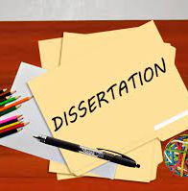

Methodology Workshop
Laura Knight

Slide 2

Learning Outcomes
Understand the term ‘Methodology’ & ‘Research methods’
List the 3 types of Data Collection
Describe the difference between ‘Quantitative & Qualitative data’, ‘Primary & Secondary data’, ‘Descriptive & Experimental Data’
List the different types of methods for data collection
List the 4 main methods of data analysis
How to structure your ‘methodology chapter’

Slide 3
A dissertation of 5 chapters
Chapter 1
Introduction
1200 words
Chapter 2
Literature Review
2500 words
Chapter 5
Conclusion
800 words
Chapter 3
Methodology
1500 words
Chapter 4
Findings
2000 words

Slide 4


Research
Output
Research topic
Research Proposal
Ethical Approval
An organised process of investigating a specific subject to advance current knowledge
Just like going on a journey, we need to know where we are heading before setting off
Collis and Hussey, (2013) and Saunders et al, (2009)

Slide 5
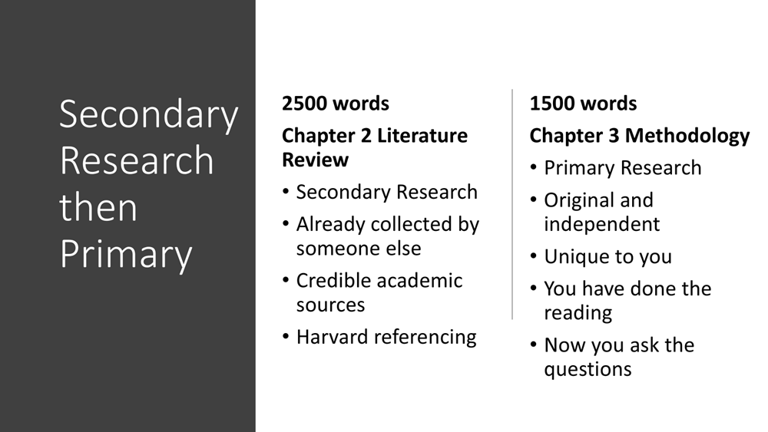

Slide 6

Filling gaps and adding value
My literature review shows that I have read very widely around my chosen topic. My independent research builds on that foundation
Research establishes an understanding of problems which need clarification.
Exploratory research aims to understand problems where there is an absence of existing research.
Additional investigation can provide a heightened level of knowledge and insight.
Collis and Hussey, (2013) and Saunders et al, (2009)

Slide 7
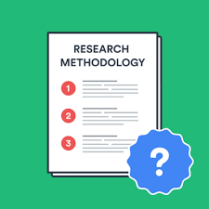
Methodology v Research methods
Research methods are:
‘ specific procedures for collecting and analysing data.
Integral part of research design’.
Methodology is:
‘ a set of systems, methods, procedures or rules that is used to conduct a structured research process for a dissertation’
‘the science of dealing with principles of procedure in research and study’
‘A system of ways of doing, teaching or studying something’
It explains what the exact activities and processes of your research is , through what methods you will be measuring the data and how you will interpret your results and outcome
Notes:
So lets begin by trying to define ‘methodology’ and ‘research methods’
Methodology is:
a set of systems, methods, procedures or rules that is used to conduct a structured research process for a dissertation’ or ( Dissertation-help.co.uk. 2022)
‘a system of ways of doing, teaching or studying something’ ( Cambridge English Dictionary online, 2022)
It explains what the exact activities and processes of your research is , through what methods you will be measuring the data and how you will interpret your results and outcome. ( dissertation.help.co.uk, 2022)
Research methods are:
‘ specific procedures for collecting and analysing data.
Integral part of research design ( Scribbr, 2022)

Slide 8
Methodology and Methods
Methodology – overarching strategy and rationale of your research project – a study of the methods, theories and principles
Methods – specific tools and procedures data use to collect and analyse

Slide 9
Planning your research methods
Step 1 - Deciding on how you will collect data
Methods will depend on the data required to answer your research question:
Qualitative v quantitative data
Primary v secondary data
Descriptive v experimental
Notes:
Research methods are specific procedures for collecting and analysing data. Developing your research methods is an integral part of your research design. When considering your methods around how you will plan your research , two key areas to consider:
Firstly - Step 1 - Deciding on how you will collect data
Methods will depend on the data required to answer your research question:
Qualitative v quantitative data – will your data take the form of words or numbers?
Primary v secondary data – will you collect original data yourself or data that has already been collected by someone else?
Descriptive v experimental – will you take measurements of something as it is or will you undertake an experiment
(scribbr, 2022)

Slide 10
Planning your research methods
Step 2 – how will you analyse the data
Quantitative data – you can use statistical analysis methods to test relationships between variable
Qualitative data – you can use methods such as thematic analysis to interpret patterns and meanings in the data
Notes:
Secondly - Step 2 – how will you analyse the data
Quantitative data – you can use statistical analysis methods to test relationships between variable
Qualitative data – you can use methods such as thematic analysis to interpret patterns and meanings in the data
(scribbr, 2022)

Slide 11

Methods for collecting data
Qualitative v Quantitative data
Primary v Secondary data
Descriptive v experimental data
Data is the information you collect for the purpose of answering your research question
Influenced by the aims of your research
Notes:
Data is the information you collect for the purpose of answering your research question
Keep referring back to your research question to make sure that what you are doing/your chosen methods will lead you to that answer
The type of data you need depends on the aims of your research
It could be any of the following:
1. Qualitative v quantitative data
2. Primary v secondary data
3. Descriptive v experimental data

Slide 12

Qualitative v Quantitative data
Qualitative data – deals with words
Quantitative – deals with numbers
Notes:
Your choice of qualitative or quantitative data collection depends on the type of knowledge you want to develop
What do we mean by ‘QUALITATIVE’ and ‘QUANTITATIVE’
In its simplest form:
Questions about ideas, experiences and meanings or to study something that can’t be described numerically, collect – QUALITATIVE data
If you want to develop a more systematic/automatic understanding of a subject, or your research involves hypothesis testing, collect – QUANTITATIVE data
So what are the pros and cons of each data method – take 5 mins to discuss with your colleague

Slide 13
Qualitative v Quantitative
 | Pros | Cons
Qualitative | Flexible – you can often adjust your methods as you go to develop new knowledge Can be conducted with small number of participants | Can’t be analysed statistically or generalised to broader populations Difficult to standardise research
Quantitative | Can be used to systematically describe large collections of things Generates reproducible knowledge | May require statistical training to analyse data Requires larger number of participants/sample
Notes:
Here are some others ( source Scribbr, 2022 online)

Slide 14

Primary v Secondary data
Primary data – any new or original information that you collect for the purposes of answering your research question
Secondary data – information that has already been collected by other researchers
Notes:
Question: What is the difference between PRIMARY and SECONDARY data?
PRIMARY is any original or new information that you collect for the purpose of answering your research question ( e.g. surveys, observations, experiments)
SECONDARY is information that is already out there, which has been collected by other research that has been done ( previous studies, Govt stats etc)
So what are the pros/cons of each?

Slide 15
Primary v Secondary Data
 | Pros | Cons
Primary | Can be collected to answer your specific question You have control over the sample methods Up to date data | May be expensive/time consuming to collect Need to know data collection methods
Secondary | Easier and quicker to access Can collect data over a longer timescale and bigger geographical area | No control over how data was generated Requires extra processing to make sure it works for your analysis Could be too old
Notes:
Content taken from Scribbr , 2022

Slide 16
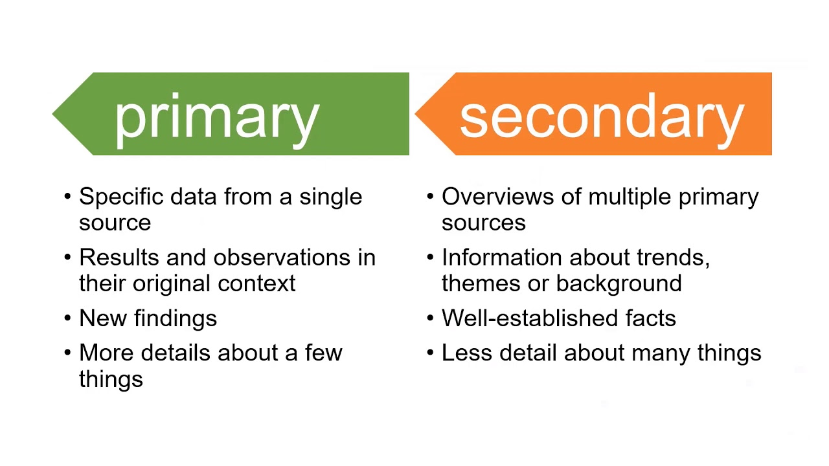
Primary v Secondary data…
Notes:
Source: QUT Library , Youtube 2020

Slide 17

Descriptive v Experimental Data
Descriptive research – you collect data about your study subject without interviewing. Validity depends on sampling method.
Experimental research – you systematically intervene in a process and measure the outcome. Validity depends on experimental design.

Slide 18
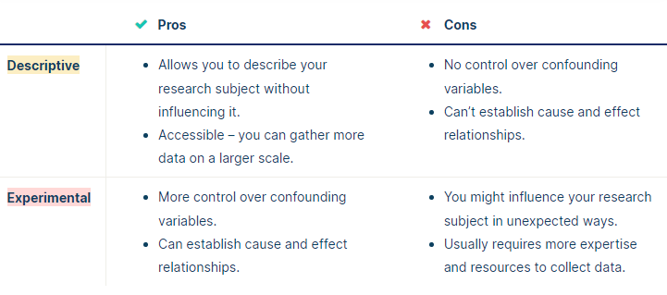
Descriptive v Experimental Data
Notes:
Source; Scribbr , online 2022

Slide 19
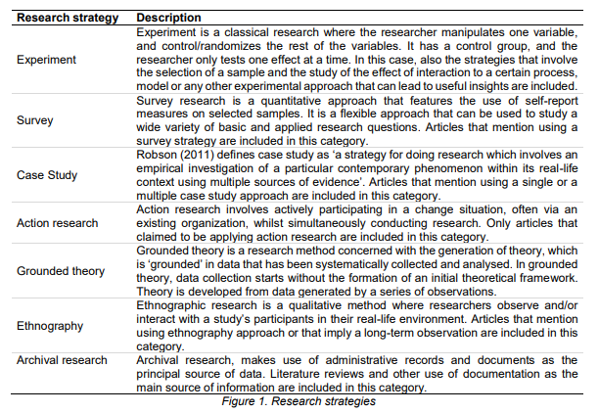
Strategies
Experiments
Surveys
Case studies
Action research
Grounded Theory
Ethnography
Archived research
Vizcarguenaga-Aguirre and López-Robles (2020)

Slide 20
Strategies
Survey
You ask people for their perspectives through questionnaires
You design a set of questions and ask people to respond
We would expect 100 or more
Experiments
Surveys
Case studies
Action research
Grounded Theory
Ethnography
Archived research
Interviews
You interview experts or professionals or people with direct experience in your area
A structured approach is essential
Far fewer respondents

Slide 21
Research methods for collecting data
Research method | Primary or secondary? | Qualitative or quantitative? | When to use
Experiment
Survey
Interview/focus group
Observation
Literature review
Case study

Slide 22
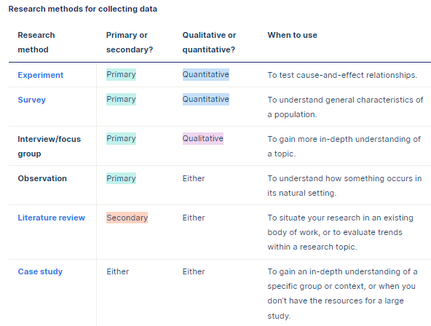
Research methods for collecting data

Slide 23

Methods for analysing data
Qualitative analysis methods – used to understand words, ideas and experiences.
  It relies upon the researcher’s judgement – reflect carefully on your choices and assumptions.
Quantitative analysis methods – uses numbers and statistics to understand frequencies, averages and connections
  As the data is collected and analysed statistically, the results are easily standardised and shared
Notes:
Your data analysis methods will depend on the type of data you collect and how you prepare it for analysis.
Qualitative analysis:
Data can be analysed both quantitatively and qualitatively. e,g survey responses could be analysed qualitatively by studying the meanings of responses or quantitatively by studying the frequency of responses to a question.
It relies upon the researchers judgements – so its good to reflect carefully on your choices and assumptions. It tends to be quite flexible.
Quantitative analysis:
Uses numbers and statistics to understand frequencies, averages in descriptive studies and correlations or cause and effect relationships in experiments

Slide 24
Methods for analysing data
Statistical analysis
Meta-analysis
Thematic analysis
Content analysis
Notes:
The 5 different methods for analysing data
How many have you heard of?
What do you think they mean?

Slide 25
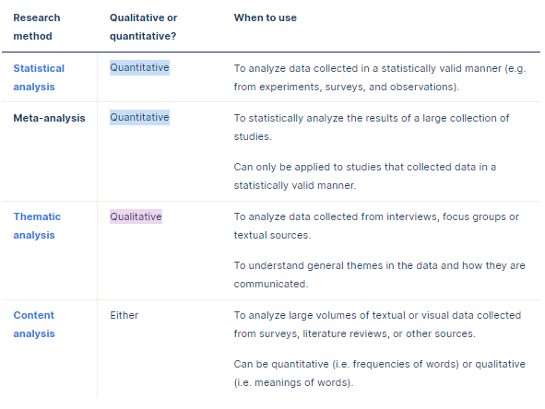
Methods for data analysis

Slide 26
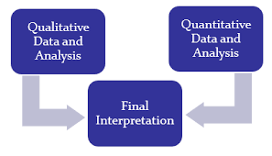
Mixed Methods Research
Mixed methods research is where you use both qualitative and quantitative data collection and analysis methods to answer your research question
Notes:
What about mixed methods approach to your research – what do you think that is ?

Slide 27
Writing your Methodology Chapter
All dissertation projects need to be clear on data collection
Include this chapter if undertaking – Primary/secondary/case study
It is the ….who, when, where, why…. of your research

Slide 28
What needs to be included
1.Introduction to the chapter
2. Research strategy
3. Data collection
4. Data Analysis
5. Limitations
Notes:
Lets look at what needs to be included in this chapter and how to structure it
5 areas to cover:
Introduction
Your research strategy
Data collection
Data analysis
Any limitations or problems that you encountered throughout your research

Slide 29


Introduction
Brief introduction to your subject area
Remind reader of your objectives
Explain why you are undertaking this research
  Reflection on literature review
  Gaps within the research
  New legislation
Notes:
Given the word count this subheading will not be very long
What do you think needs to be in your introduction?

Slide 30

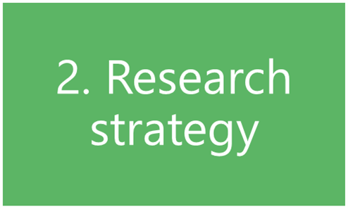
Research Strategy
What research methods have you used ( survey, questionnaire, case study etc)
Why did you choose that strategy/model?
How did you choose your sample ( size/participants)?
NB – don’t spend too much time writing about research methods in general
Notes:
Considering the next sub heading of the chapter – what would you consider writing here?

Slide 31

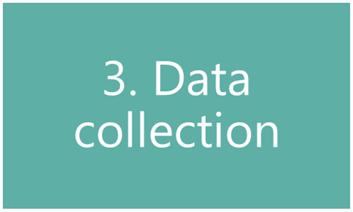
Data Collection
How will you analyse your findings?
  Quantitative = numbers
  Qualitative = focus on words
  Themes
NB – don’t talk about your findings yet!
Notes:
Next sub-heading – data collection – what do you think you need to write about here?

Slide 32

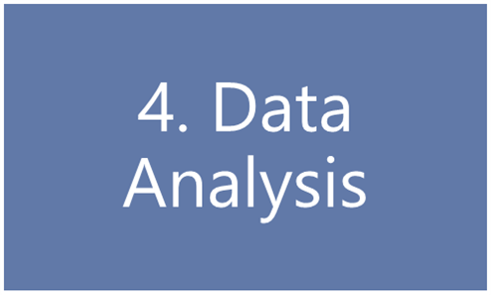
Data Analysis
How you prepared the data before analysis
Quantitative data:
  Any software used
  any statistical methods used
Qualitative data:
  Any coding or categorising of themes/ideas
Notes:
4th sub-heading – data analysis
What will you write here?

Slide 33

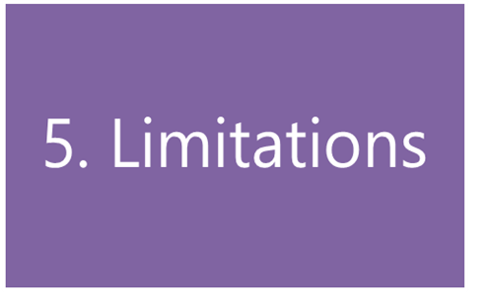
Limitations
Do you foresee any limitations or problems with undertaking your research?
Any limitations to your research strategy
  Access to participants
  Limited data collection
Notes:
Final sub-heading
What will you write here?
Remember that you are writing about limitations/problems in relation to your data gathering only – not general problems like time management
Questions to ask ( Biggam, 2015. p194)
What are the known criticisms of my chosen research strategy?
Is the approach to my data collection limited in any way? ( e.g. why use q’aires when interviews may give more meaningful info)
Is my sample population big enough – too big?
Is it valid? ( have I argued successfully that my methods are appropriate to achieving my objectives)
Is it free from bias and is it fair?
You must show how you have addressed any limitations that you highlight. Avoid just producing a list – not acceptable
Also – is time management a limitation?
Time limits is a common limitation expressed by students – especially when deadlines are fast approaching – these are more to do with a lackof time management and planning
Leave time for your empirical work and plan for any mishaps like people not available

Slide 34

Tips for writing a strong methodology
Don’t just describe – explain how and why you applied them and demonstrate how it was conducted
Focus on your objectives and research question- show why your methods suit your objectives. Keep relating your choices back to the purpose of your research
Cite relevant sources
Write for your audience – consider how much info you need to give. Clear – structured – argues your approach.
Don’t just list details and procedures
Discuss any difficulties you encountered and how you dealt with them – include how you minimised impact as a result or changed methods.
Notes:
And finally some tips for writing a strong methodology chapter:
Don’t just describe – explain how and why you applied them and demonstrate how it was conducted
Focus on your objectives and research question- show why your methods suit your objectives. Keep relating your choices back to the purpose of your research
Cite relevant sources
Write for your audience – consider how much info you need to give. Clear – structured – argues your approach.
Don’t just list details and procedures
Discuss any difficulties you encountered and how you dealt with them – include how you minimised impact as a result or changed methods.

Slide 35
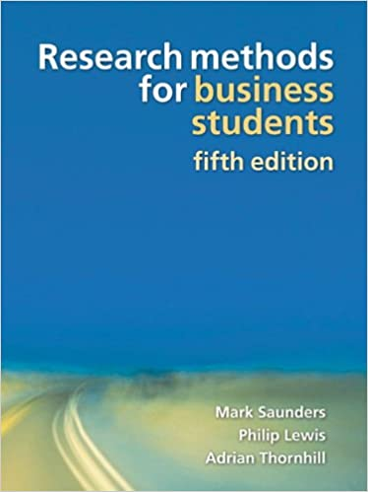
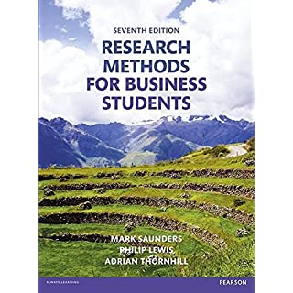
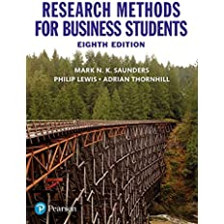
Saunders, Lewis & Thornhill – 'Research Onion'
Notes:
The ‘Research Onion’, is a model or framework that was developed by Mark Saunders, Philip Lewis and Adrian Thornhill and presented in their book 'Research Methods for Business Students' in 2007 and continues to be integral in all recent versions of the same publication.
Although primarily aimed at business students the model can be adopted by others.

Slide 36

Methodology
Aim
Introduce you to the ‘research onion’ (Saunders et al, 2007)
Explore Saunders et al’s 6 layers of research methodology
Provide you with useful resources to explore further
Notes:
The aim of this session is therefore to
Introduce you to the 'Research Onion'
Explore the 6 layers of research methodology described by Saunders et al (2007)
And finally provide you with some useful resources to explore further in your own time

Slide 37

The ‘Research Onion’
Saunders et al, 2007
Each layer will address choices you should consider for your methodology
Notes:
If you have been reading about research skills and methodologies you may have already come across the term ‘Research onion’
As mentioned earlier, this term was developed by Saunders et al in 2007 and is used to describe the different decisions that students should make or consider when developing a research methodology for a dissertation or other research project, and also highlights the issues that underly data collection techniques and analysis procedures.
The research onion encourages you to work your way through each layer ( think of how you peel an onion – layer by layer) and to address each layer in turn and the issues that you should consider for your methodology. In order that your research to gain credibility you must provide explanations and justification for each of your methodology decisions – the research onion provides you with the framework to do so.
Saunders suggests that whilst approaching your research methodology you will face a range of choices that will lead you from high level philosophical to tactical and practical issues towards the centre of your onion
You’ll come across some new language during this presentation – so make a note and research wider in your own time so that you become familiar with the terms and their meanings.

Slide 38
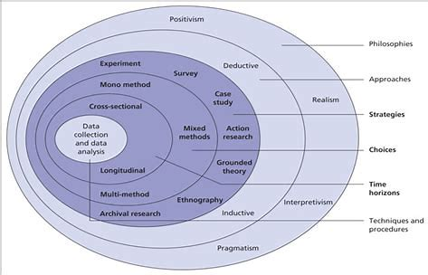
The Research Onion – Saunders et al
Notes:
Let's begin by looking at the 'research onion' diagram
When searching the internet you may come across different versions/colours etc. therefore your best source will be Saunders et al for referencing.
Take a few minutes to study the diagram.

Slide 39
The 6 layers of Saunders’ research Onion
Research philosophy
Research approach
Research strategy
Choices
Time horizon
Techniques & procedures
Notes:
Saunder's research onion consists of 6 layers – each layer is identified down the right hand side of the diagram as follows:
Research philosophy
Research approach
Research strategy
Choices
Time horizon
Techniques & procedures
The following slides will now look at each layer in turn.
Again you will come across some key terms/phrases that may be unfamiliar to you, so make a note and explore their meaning deeper so that you are able to put them into your own words for better understanding.

Slide 40

Layer 1 – Research Philosophy
The foundation of any study as it describes the set of beliefs the research is built upon:
  Ontological
  Epistemological
ONTOLOGY = the what and how of what we know
EPISTEMOLOGY = the ‘how’ of obtaining knowledge and understanding of things
Notes:
Layer 1 – is the Research Philosophy
What does it mean? Take a few minutes to think about it.
It is basically the foundation of any study as it describes the set of beliefs the research is built upon:
It can be described from two points of view:
Ontological
Epistemological
In simple terms ONTOLOGY = the what and how of what we know. It refers to the authenticity of the information and how it's existence can be understood.
EPISTEMOLOGY, on the other hand, is the how of obtaining knowledge and understanding of things. The valid information required for the research and how we can obtain it.
This is a really simplified explanation and I would suggest that if you want to explore further that you follow some of the links that I have added at the end to give you more information.

Slide 41
Research Philosophies
3 main research philosophies:
  Positivism
  Interpretivism
  Pragmatism
Positivism – knowledge exists outside of what’s being studied
Interpretivism – emphasises the influence that social and cultural factors can have on an individual.
Pragmatism – using the best tools possible to investigate phenomena
Notes:
There are a number of research philosophies that you will be able to research – Saunders however lists these 3 main research philosophies which are most commonly referred to
Have you heard of any of them?
Positivism – assumes that knowledge exists outside of what’s being studied in other words it is independent of the subject being studied.. What is being studied can therefore only be done objectively and it cannot include opinions or personal viewpoints – the researcher doesn’t interpret they just observe.
The positivist's view is that knowledge can only be obtained through empirical research ( experiments/observations etc) and is not reliant on human reasoning but is only gained from research. In their view knowledge can only be true, false or meaningless – ie. if something is not found to be true or false its dismissed.
Interpretivism – claims that individual observers have their own perception and understanding of reality. It considers the influence that social and cultural factors can have on an individual. It focuses on people’s thoughts and ideas – the researcher plays an active role in the study and its necessary to provide an overview of the participants and their actions and thoughts.
Positivists studies are often more scientific and result in testing phenomena, where Interpretivist studies are often qualitative in nature.
Pragmatism – is where the best tools possible are used to investigate phenomena. It allows for research to be approached from a practical point of view where knowledge is not fixed but is constantly questioned and interpreted. It involves an element of researcher involvement specifically when drawing conclusions to participants responses/decisions.

Slide 42
Layer 2 – Research Approach
The wider method you’ll use to research:
  Inductive
  Deductive
Inductive = generating theories from research
Deductive = beginning with a theory
Notes:
The ‘research approach’ is the wider method that you’ll use for researching your topic.
There are Two methods:
Inductive = where the researcher generates theories from research, rather than starting with a theory as a foundation. In other words the approach begins with observations that the researcher uses to create new theory.
Deductive = begins with a theory and builds on it or tests it through research. Another way to look at it is where a researcher starts with a specific hypothesis developed and based on the literature review and then gradually tries to test the hypothesis and checks to see if it holds itself in particular contexts.
Closely linked are quantitative and qualitative research data
Inductive approached normally use qualitative
Deductive approach normally use quantitative date
In choosing which approach ask yourself whether your research builds on something that exists or whether you will be investigating something new that’s not necessarily rooted in previous research

Slide 43
Layer 3 Research Strategy
Looks at how , based on the aims of your study, research can be conducted
Several approaches:
Experimental research
Action research
Case study research
Grounded theory
Ethnography
Archival research
Notes:
The next layer requires the student to compile or devise the strategy of the study being undertaken - in other words 'how your research will be conducted'.
There are a number of research strategies that can be utilised – the strategy chosen should however be based on the data required for the research and the purpose of the study/research.
The research Onion – highlights the following strategies:
Experimental research
Action research
Case study research
Grounded theory
Ethnography
Archival research
Take a few minutes to research each strategy so that you understand what is involved in each one.

Slide 44
Layer 4 - Choices
Data types:
Mono
Mixed
Multi-method
Mono = use of only 1 data type ( qualitative OR quantitative; primary/secondary)
Mixed = both qualitative and quantitative
Multi-method = wider approach in relation to data and analysis
Notes:
The 4th layer requires the researcher to decide upon the data types that will be use in their research and whether they will be qualitative or quantitative in nature:
The 3 data types highlighted in Saunder's Onion are:
Mono
Mixed
Multi-method.
Mono – refers to the use of only 1 data type ( qualitative OR quantitative)
Mixed – refers to the use of two or more methods and commonly refers to the use of both qualitative AND quantitative methods
And finally
Multi-method – refers to a wider approach or selection of methods

Slide 45

Layer 5 – Time Horizon
When you will collect your data – at which points in your time-line.
Notes:
Layer 5 refers to Time Horizons where the researcher needs to consider any practical constraints to their time –
In simple terms - how can you fit it in and when? What will you need to factor in?
Think back to when you compiled your dissertation proposals and the need to put a time-line into your proposal for completion of your dissertation. What did you have to consider? How has that changed as you have undertaken your research?

Slide 46

Layer 6 – Techniques and procedures
The centre of the ‘onion’
Practicalities of your research
  What data you’ll collect and the collection methods
  Sampling
  Data analysis
  Any resources/materials ( questionnaires etc)
Notes:
Layer 6 now brings you to the centre of the Research Onion where the researcher has to consider the techniques and procedures that will be used .
It is used to explain and describe the ways and purpose of the research being conducted.
Here the researcher will consider such decisions as
1. whether to use primary or secondary data
2. qualitative or quantitative data
As data is considered the central place in the research onion framework
In this section the researcher will aim to make the research design as clear as possible supporting with valid justification for each stage. For example : decisions regarding questionnaire content , the sample size to be used , how participants were selected, if using interviews – which types of questions will be used and why, and how the data will be analysed.
Don't forget that in this section it is also important to address any ethical issues that were considered or may even have been met as you have undertaken your research. This will demonstrate that you are aware of any regulations set by UWTSD and have addressed and complied with them throughout.

Slide 47

Real World Examples

Slide 48
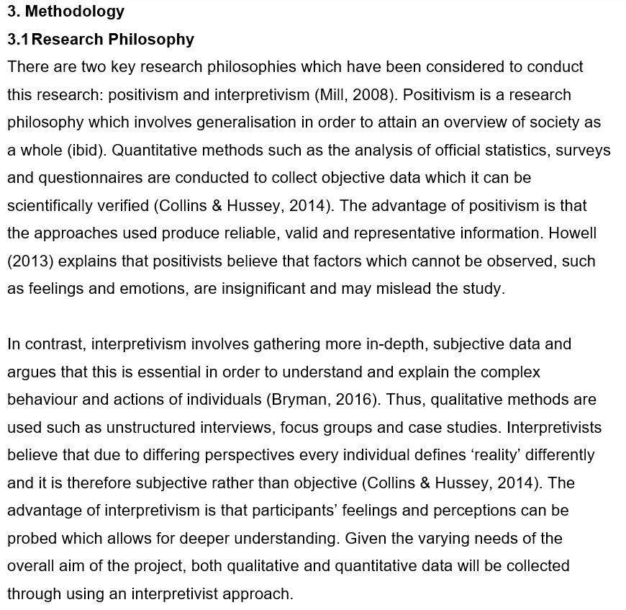

Slide 49
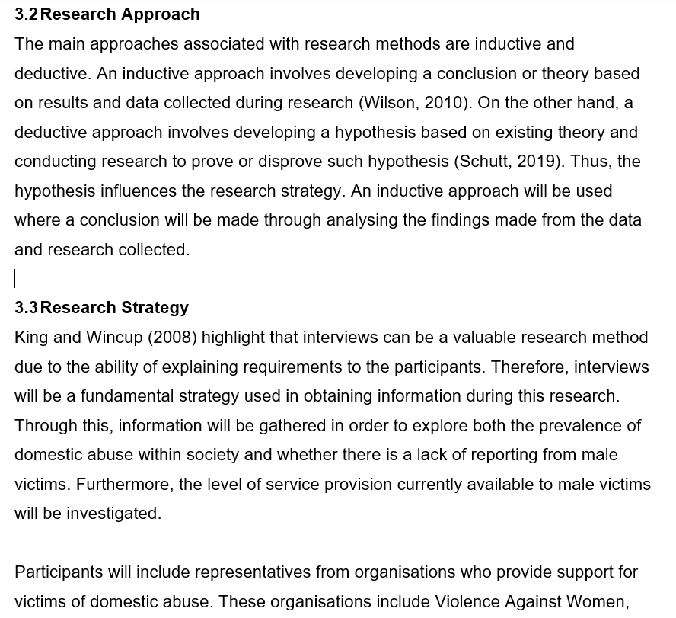

Slide 50
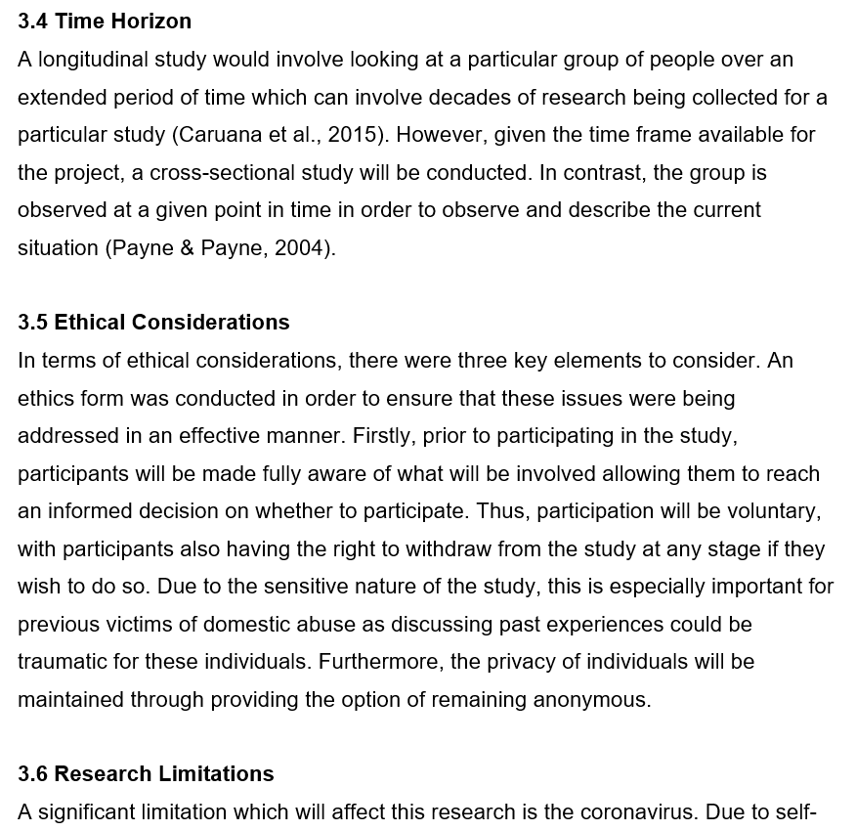

Slide 51
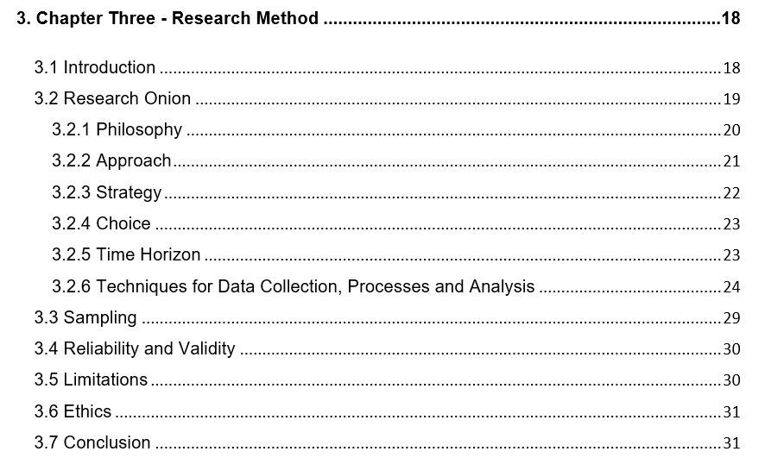

Slide 52
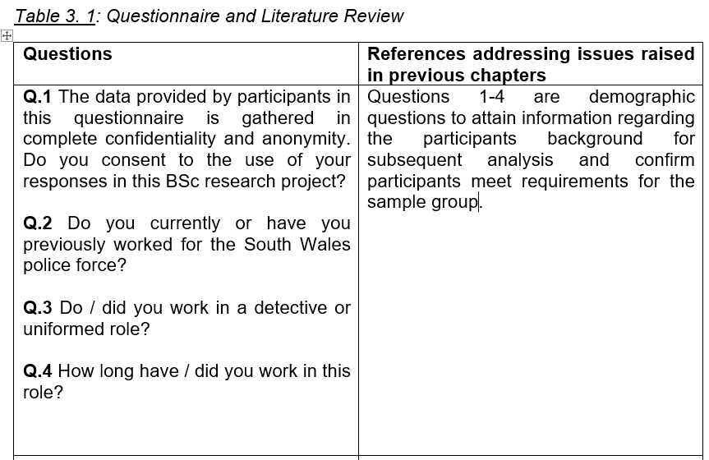

Slide 53
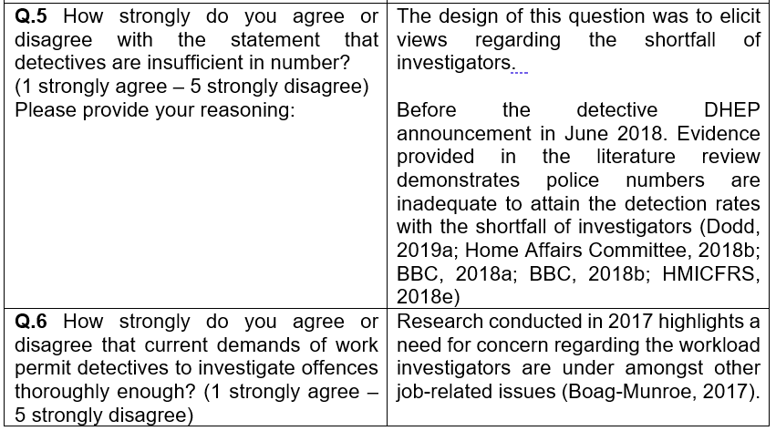

Slide 54
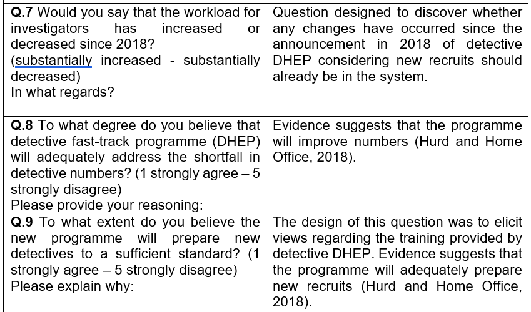

Slide 55
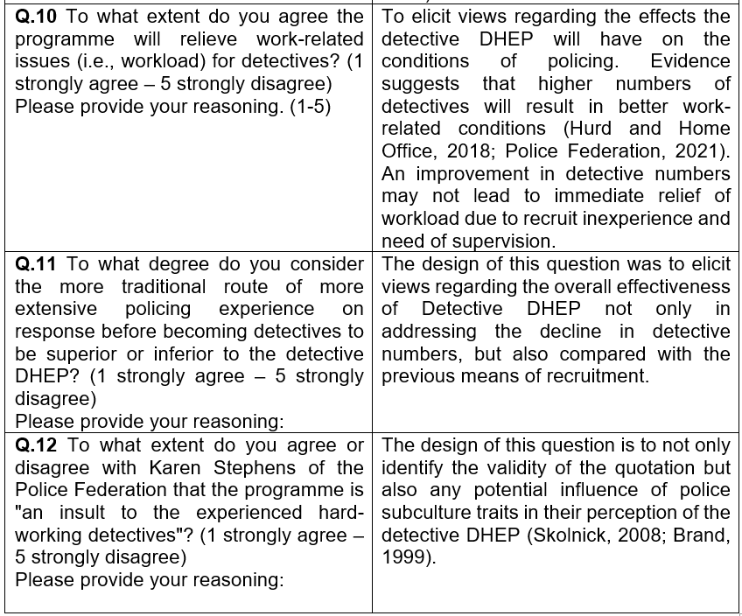

Slide 56
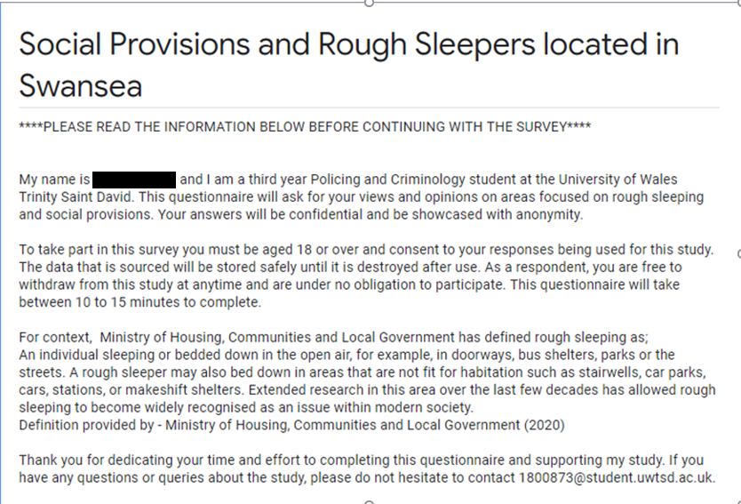

Slide 57
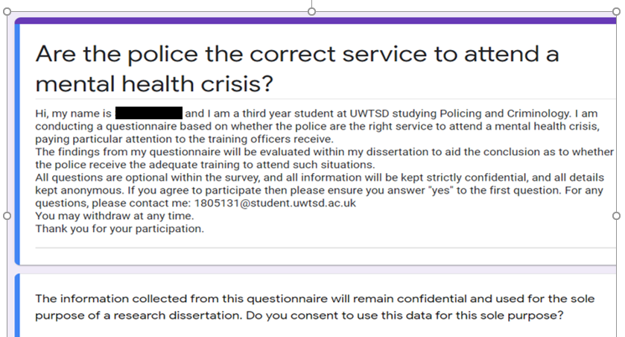

Slide 58
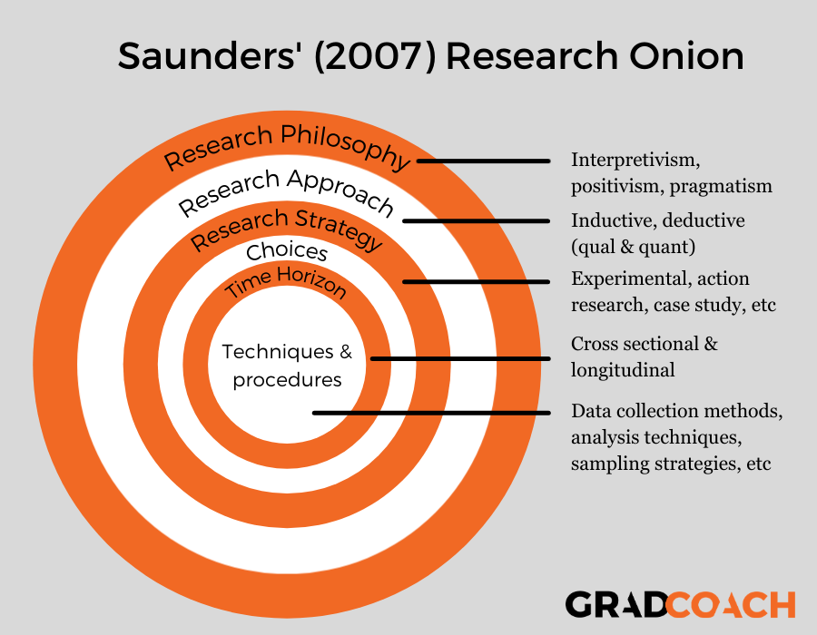
Recap
The research onion details the many interrelated choices you’ll need to make when you’re crafting your research methodology. These include:
Research philosophy – the set of beliefs your research is based on (positivism, interpretivism, pragmatism)
Research approaches – the broader method you’ll use (inductive, deductive, qualitative and quantitative)
Research strategies – how you’ll conduct the research (e.g., experimental, action, case study, etc.)
Choices – how many methods you’ll use (mono method, mixed-method or multi-method)
Time horizons – the number of points in time at which you’ll collect your data (cross-sectional or longitudinal)
Techniques and procedures (data collection methods, data analysis techniques, sampling strategies, etc.)
Notes:
Having now explored the 6 layers of the ‘research onion framework’ lets have a quick re-cap of the main points:
The research onion details the many interrelated choices you’ll need to make when you’re crafting your research methodology. There are 6 choices that you will address, these include:
Research philosophy – the set of beliefs your research is based on (positivism, interpretivism, pragmatism)
Research approaches – the broader method you’ll use (inductive, deductive, qualitative and quantitative)
Research strategies – how you’ll conduct the research (e.g., experimental, action, case study, etc.)
Choices – how many methods you’ll use (mono method, mixed-method or multi-method)
Time horizons – the number of points in time at which you’ll collect your data (cross-sectional or longitudinal)
Techniques and procedures (data collection methods, data analysis techniques, sampling strategies, etc.)
(source : Grad Coach)

Slide 59
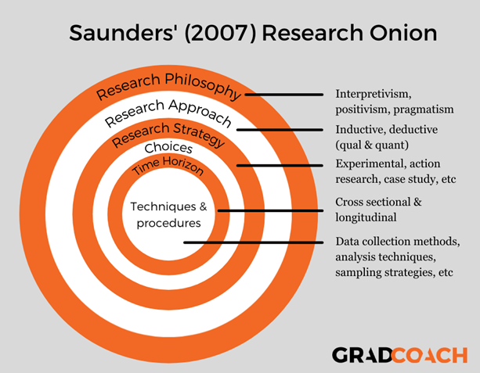
References & Useful resources
Saunders' Research Onion: Explained Simply (+ Examples) - Grad Coach
Understanding the Research Onion | Writing Guides | 15 Writers
The Research Onion Made EASY! Simple Research Methods Template For Your Methodology Chapter - Bing video
Saunders, Lewis, Thornhill (2007) Research Methods for Business Students 5th Ed. Essex, Prentice Hall.
Notes:
Here are some good resources that have been used to compile this powerpoint.

Slide 60

Questions?
Notes:
Take your time in exploring the 'Research Onion'.
You will see when viewing previously submitted dissertations by UWTSD students that the Research Onion is referred to by some and not by others. It is therefore a personal choice as to whether to include it in your dissertation.
If however, you are struggling to write your methodology section it will provide you with a simple framework in which to compile the chapter to ensure that you cover the main points of your methodology choices.
If you have any questions please get in touch.

Slide 61

Sources
Burnett, J. (2009) Doing Your Social Science Dissertation. London: SAGE Publications.
Denscombe, M. (2012) Research proposals a practical guide. Berkshire, McGraw Hill Open University Press.
Walliman, N. (2006) Social research methods. London: SAGE.
https://www.sagepub.com/sites/default/files/upm-binaries/18533_Chapter3.pdf
Notes:
Some useful sources for you – others will be added to Moodle over the next few weeks

