Slide 1
Working With Children in A Social Care Setting (7 – 11 years)
Student’s Name Ataa Sarpong
Student’s Number 2027066
Module:Psychology in Health and Social Care
Modul Code:(LCHS4006-BIRM)
Assignment Title Working with Children in a Social Care Setting (7-11 Years)

Slide 2

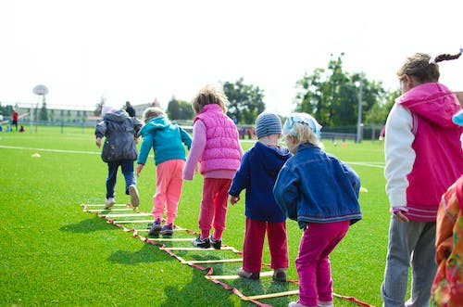
Introduction
From the minute they are born, children play.
They discover themselves and their surroundings through play.
It is how they learn and practice the bodily, mental, and social abilities necessary for life (Whitebread et al., 2012).
Children between 7 and 11 years have a solid understanding of details, patterns, shapes and colour and can use their mental capacity to relate things and be creative.

Slide 3
Cognitive Theory
The way that children's minds function and develop has a huge impact on educational theory. Their minds mature and become better able to comprehend the world around them (Gray and MacBlain, 2015).
They can't start doing some things unless they're psychologically ready to.
Their thinking does not necessarily evolve smoothly; rather, there are specific moments when "it takes off" and completely enters new domains.
The two main concepts of Piaget are assimilation and accommodation (Gray and MacBlain, 2015).
a) Assimilation: It is the process by which a person absorbs information from the world into their mind, which may entail modifying the data from their senses to fit.
b) Accommodation: The modification that the assimilation process makes to one's thoughts or notions.

Slide 4
Stages of Cognitive Development
Pre-operational (2-7 years): A child picks up linguistic skills and learns how to describe objects using words and pictures. Thinking is still egotistical and has trouble understanding other people's perspectives. It categorizes items based on a particular characteristic, such as colour or shape.
Concrete operational (7-11 years): Able to reason coherently about things and happenings. classifies items based on a variety of characteristics and has the ability to arrange them in a series along a particular dimension, such as size and colour (Ghazi et al., 2016).
Formal operational (11 years and up): Able to logically consider abstract claims and conduct systematic hypothesis testing. becomes preoccupied with theoretical, prospective, and ideological issues.

Slide 5
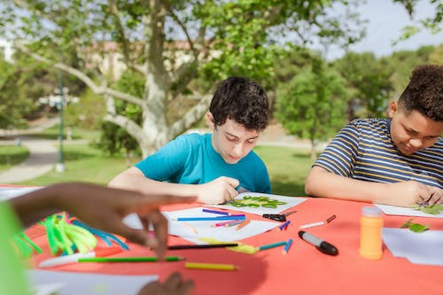
Activity One: Art and craft
7–11-year-olds are able to come up with new techniques to build things (Amy Morin & Appleton, 2022).
They don't use pre-made components.
They might build wings out of waste paper and leaves or draw and cut out wings for a handmade butterfly.
Younger students may still require assistance to get going.

Slide 6
Ideas for Creative Art and Craft Activities
Get the children to build and decorate a castle out of natural material such as sticks of cardboard.
Paint using textured paint such as adding sawdust or dirt to paint and use to make paintings.
Use cardboards and see what the children can come up with, it could be a puppet theatre, plane or robot costume.
Combine digital media with clay making, painting or drawing. The children can make clay models and take photographs and use then to create different stories.
Use software apps or programs to create digital artwork.

Slide 7
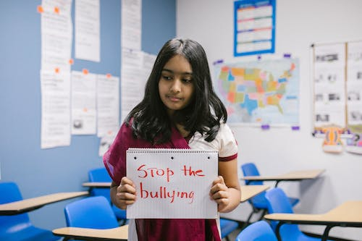
Activity Two: Drama
7–11-year-olds frequently make up their own stories to act out using easy props.
They occasionally recreate scenes from everyday life, movies, and tv shows.
Children get the opportunity to solve real-life issues, such as what to do when a person or a pet is ill or when someone is furious, through these dramatic exercises (Tandy et al., 2009).
They also educate children to consider other people's perspectives, which fosters empathy.

Slide 8
Ideas for Drama
Create easy puppets, then perform a puppet show.
Alternate telling stories. Start with a straightforward scenario and take turns describing what occurs next. The tale can be more creative the longer the game lasts.
A play or performance on video. The children could create the outfits and compose the script before using a camera or smartphone to record themselves. Using applications or software, they can modify and apply special effects.
Play guessing and acting games, such as pictionary and charades.

Slide 9

Conclusion
7-11 year old learn and grow through artistic pursuits like drama and craft.
Children in this age groups should be given time and space to express their creativity.
For children with a range of abilities, the creative activities can be modified to suit their needs

Slide 10
References
Amy Morin, L.C.S.W. and Appleton, N. (2022) 11-year-old child development milestones, Verywell Family. Verywell Family. Available at: https://www.verywellfamily.com/11-year-old-developmental-milestones-4171925 (Accessed: February 13, 2023).
Ghazi, S.R., Ullah, K. and Jan, F.A. (2016) “CONCRETE OPERATIONAL STAGE OF PIAGET’S COGNITIVE DEVELOPMENT THEORY: AN IMPLICATION IN LEARNING MATHEMATICS,” Gomal University Journal of Research, 32(1).
Gray, C. and MacBlain, S. (2012) Learning theories in childhood. London: SAGE.
Tandy, M., Roberts, B. and Howell, J. (2009) Creating drama with 7-11 year olds: Lesson ideas to integrate drama into the primary curriculum. Routledge.
Whitebread, D. et al. (2017) The importance of play report, Toy Industries of Europe. Available at: https://cdn.toyindustries.eu/wp-content/uploads/2012/11/Dr-David-Whitebread-The-importance-of-play-final.pdf (Accessed: February 13, 2023).

